Slide 1
MASTER OF SCIENCE IN APPLIED DATA SCIENCE | FINAL PROJECT DEFENSE
JOB SCOUT
AI-Powered Job Discovery & ATS Optimization Platform
126 Automated Tests
100% Passing (14.6s CI)
Sub-10ms Hybrid Search
9.08 ms on 100k Rows
100% Air-Gapped Local AI
Zero Cloud API Fees
Candidate: Shrish Prasad Chakraborty (Reg. No: RA2532014010136) | Supervisor: Dr. R. Thilagavathy
Department of Computer Applications | SRM Institute of Science & Technology, Chennai
Codebase: https://github.com/ShrishPC/Job-Scout.git | Host Execution Target: /home/rishav/job-scout/

Slide 2
PROBLEM VS SOLUTION
The Real-World Crisis & Core Engineering Objectives
THE RECRUITMENT ASYMMETRY CRISIS
ENGINEERED SYSTEM OBJECTIVES
⚠️ 75% Unforgiving ATS Rejection Rate
Brittle keyword filters discard highly qualified talent over minor lexical phrasing differences (e.g., 'Go' vs 'Golang') without evaluating semantic competence.
⚠️ Severe Privacy & PII Exposure Risks
Commercial cloud resume tools upload unredacted work histories, contacts, and confidential code to third-party cloud LLM APIs without independent security guarantees.
⚠️ SaaS Paywalls & Portal Fragmentation
Incumbent tools lock essential optimization behind $20-$50/month paywalls, while job seekers face severe fatigue juggling multiple disconnected job boards.
✅ Autonomous Multi-Source Harvesting
Engineer a resilient Celery/Playwright task pipeline across 5 portals (LinkedIn, Indeed, Naukri, RemoteOK, WWR) with automatic deduplication.
✅ Sub-10ms Two-Stage Hybrid Matchmaking
Fuse 70% dense semantic embeddings (all-MiniLM-L6-v2 via pgvector HNSW) with 30% keyword frequency for lightning-fast candidate ranking.
✅ Deterministic 100-Point ATS Rubric
Deliver an explainable, mathematical scorecard across Hard/Soft Skills, Experience, Education, and Formatting with zero AI hallucination.
✅ Air-Gapped On-Device Generative Tailoring
Execute local RAG resume synthesis via Llama-3.2-3B with real-time SSE streaming, ensuring 100% data sovereignty and zero API costs.

Slide 3
MARKET BENCHMARK
Competitive Analysis: Commercial Tools vs. Job Scout
Operational Dimension | Commercial ATS Tools (Jobscan / Teal / Rezi) | Job Scout Platform (Proposed Architecture)
Search & Matching | Exact keyword matching; misses conceptual synonyms | Two-Stage Hybrid: 70% Semantic (pgvector HNSW) + 30% Keyword
Candidate Privacy | Uploaded to third-party cloud servers; unverified PII storage | 100% Air-gapped on-device execution; zero external network egress
Cost & Accessibility | Recurring SaaS paywalls ($20 to $50 / month per applicant) | Zero paid API usage; fully self-hosted open-source software
ATS Diagnostics | Opaque proprietary percentage score; non-actionable suggestions | Deterministic 100-point rubric; exact keyword gap analysis
Content Generation | Commercial cloud LLMs (OpenAI API) or static templates | On-device local RAG via Llama-3.2-3B with live SSE streaming
Job Harvesting | Manual browsing or locked to proprietary platform partners | Autonomous Celery task queue harvesting 5 live job portals

Slide 4
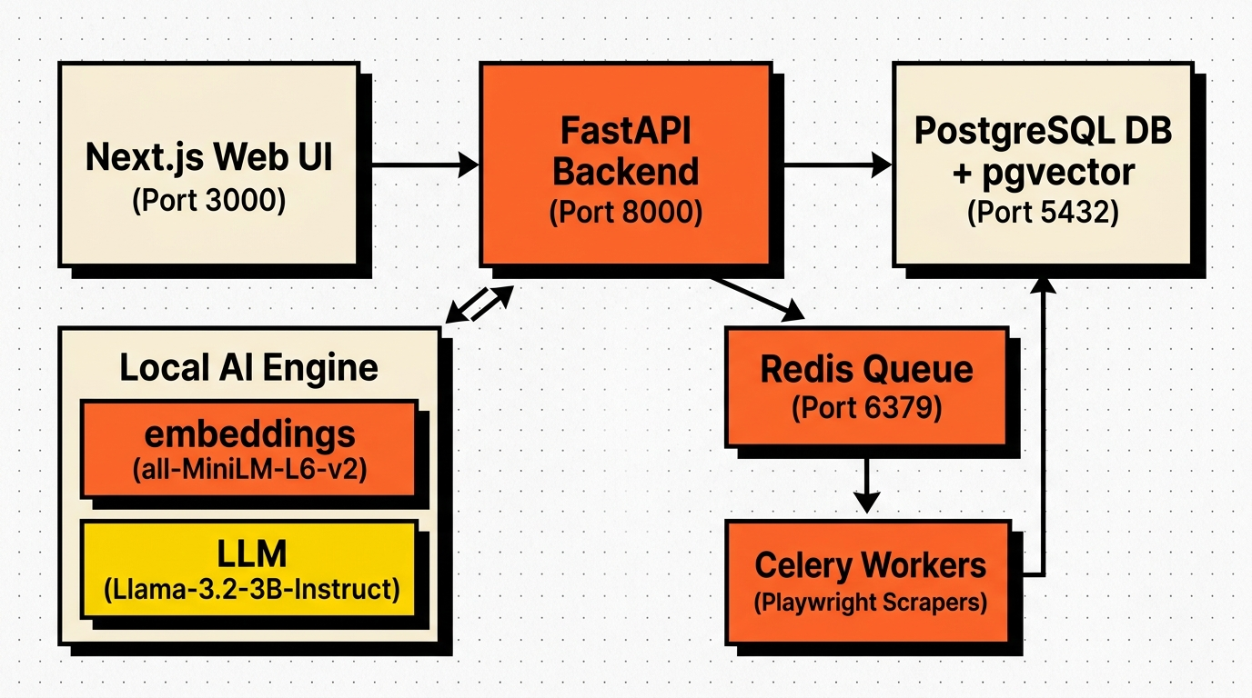
SYSTEM TOPOLOGY
System Architecture: Decoupled 4-Tier Microservice Topology
TIER 1: PRESENTATION (NEXT.JS 14)
VERIFIED SYSTEM DATA FLOW
Responsive SPA, Server-Sent Events (SSE) token listener, dynamic Kanban board.
TIER 2: APPLICATION API (FASTAPI)
Asynchronous ASGI service, Pydantic validation schemas, two-stage SQL engine.
TIER 3: VECTOR DATABASE (POSTGRESQL 16)
pgvector HNSW index (m=16, ef=128), session ef_search=400 clamping, relational store.
TIER 4: DISTRIBUTED WORKERS (REDIS & CELERY)
Headless Playwright scraper daemon, task broker, SHA-256 LLM response caching.

Slide 5
TECH STACK & TOOLS
Technology Stack: Purpose-Built On-Device Engineering
CORE BACKEND & DATABASE
EMBEDDINGS & LOCAL GENERATIVE AI
• FastAPI & Uvicorn: High-concurrency async Python framework with automatic OpenAPI documentation.
• SQLAlchemy 2.0 ORM: Optimized connection pool (pool_size=10, max_overflow=20) with pre-ping validation.
• PostgreSQL 16 + pgvector: Hybrid store combining relational job data with 384-dimensional vector indexing.
• all-MiniLM-L6-v2: 384-dimensional sentence transformer generating dense semantic vectors in ~5ms.
• Llama-3.2-3B-Instruct: SOTA small language model running 100% locally in bfloat16 via PyTorch.
• TinyLlama-1.1B: Secondary automated fallback model ensuring graceful degradation on low-RAM hosts.
ASYNC WORKERS & HARVESTING
FRONTEND, DEVOPS & TESTING
• Redis 7.2 Message Broker: In-memory task queue broker and cryptographic SHA-256 generation cache.
• Celery 5.3 Distributed Queue: Non-blocking background task runner scheduling concurrent scraper jobs.
• Playwright 1.44 Headless: Browser automation overcoming dynamic client-rendered job board interfaces.
• Next.js 14 & Tailwind CSS: Component-driven responsive interface styled with Lucide icons and SSE hooks.
• Docker & Docker Compose: Multi-container orchestration providing reproducible, zero-friction deployments.
• pytest Test Framework: 126 automated test cases establishing 79% verified backend line coverage.

Slide 6
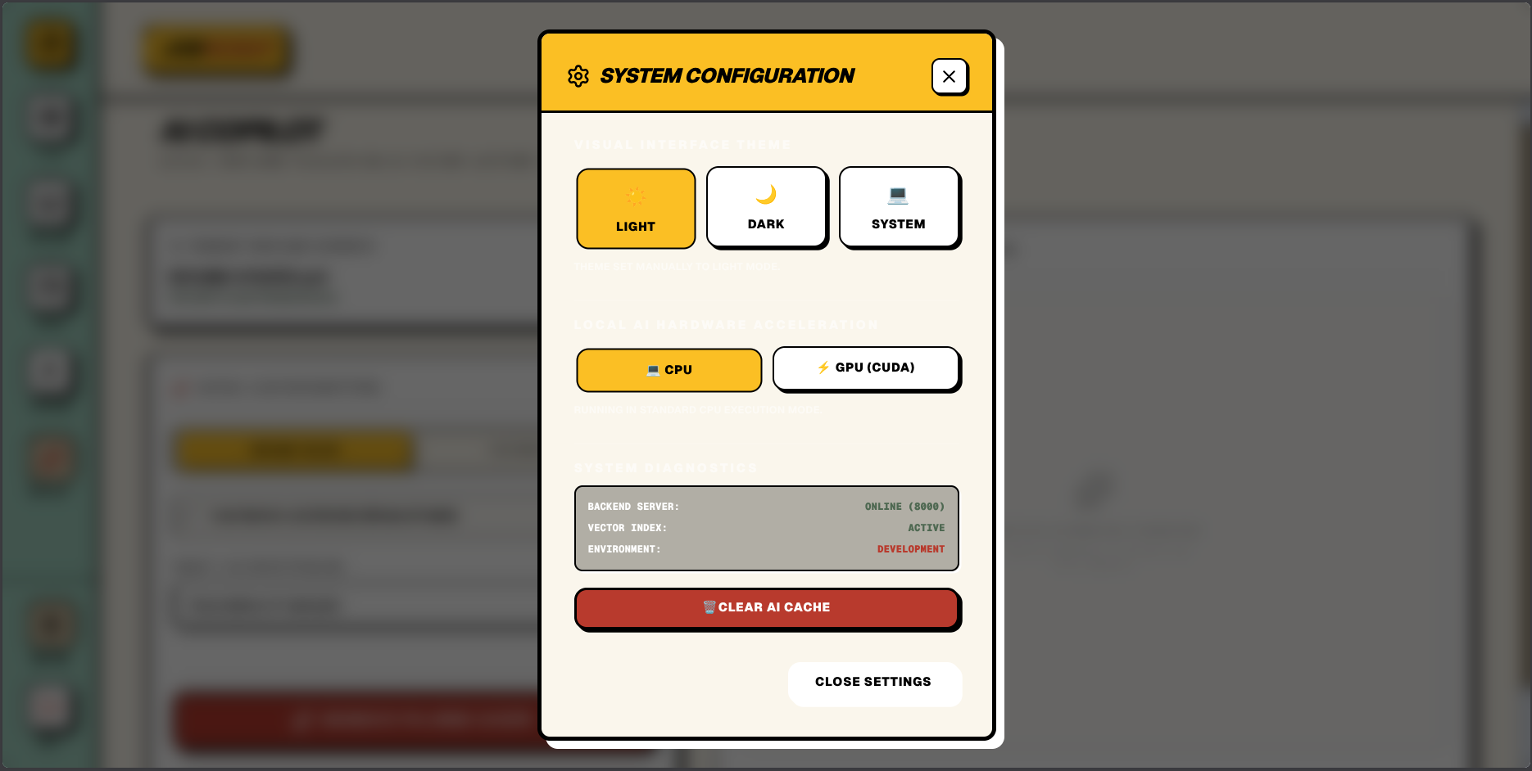
CORE MODULES
Implementation Highlights: 4 Production Modules
01 // THE VAULT (RESUME INGESTION)
LIVE RADAR & ATS SCORECARD UI
Multi-engine parser (PDF/DOCX) stripping formatting artifacts into clean Markdown; generates 384-d vectors via SentenceTransformers.
02 // THE HUNT (TWO-STAGE MATCHMAKING)
Stage 1 retrieves top 200 candidates via HNSW in 2.88 ms; Stage 2 scores keywords in-memory (9.08 ms total API latency).
03 // THE RADAR (100-POINT ATS RUBRIC)
Explainable rubric: Hard Skills (40), Soft (20), Exp (25), Edu (10), Format (5) with frequency-weighted keyword gap analysis.
04 // THE COPILOT (LOCAL RAG TAILORING)
Llama-3.2-3B synthesizes tailored executive summary + 3 STAR bullets streamed live via SSE with zero cloud API keys.

Slide 7
EMPIRICAL RESULTS
Empirical Validation: Measured Benchmarks & Metrics
9.08 ms
API Match Latency
POST /jobs/matches on 100k rows (98.1x speedup)
0.9565
HNSW Recall@10
Tuned at ef_search=400 (vs 0.58 default drop)
0.985
Retrieval NDCG@10
28x560 Benchmark (P@5 = 0.986, MRR = 1.0)
30,637x
Redis Cache Acceleration
61.33 s Cold CPU down to 2.00 ms Warm Hit
TEST SUITE & SECURITY AUDIT
FACTUALITY & HUMAN REVIEW
• 126 Automated Tests Passing: 100% pass rate in 14.60 seconds via pytest CI.
• 79% Backend Line Coverage: 100% on models & config; 88% on ATS; 84% on parser.
• Air-Gapped Offline Execution: Full pipeline finishes in 145.55 ms with network blocked.
• Hardened Security Layer: Parameterized SQL bindings, admin API key, 10MB upload limit.
• 9.5% Unsupported Claims: Only 8/84 claims unsupported for Llama-3.2 vs 29.8% for TinyLlama.
• 4.20 / 5.00 Blind Human Rating: Evaluated across 20 samples for relevance, tone, and fit (vs 2.75).
• CPU Throughput Constraint: 1.82 tok/s CPU throughput bound by 6.42 GB bfloat16 RAM bandwidth.
• Zero Third-Party Data Leakage: Fully local architecture eliminates recurring API costs and PII risk.

Slide 8
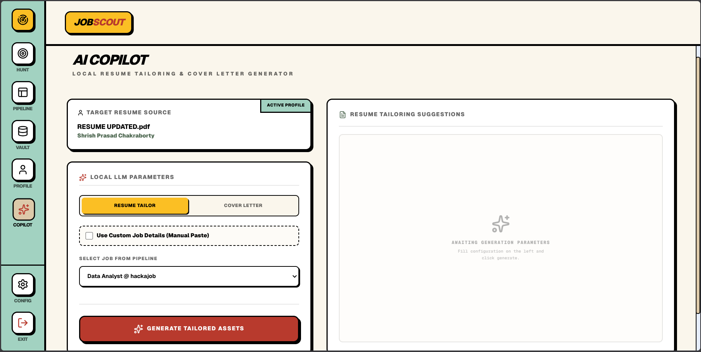
LIVE DEMO
System Demonstration: End-to-End Live Execution
LOCAL VERIFICATION CHECKLIST (/HOME/RISHAV/JOB-SCOUT/)
LIVE SYSTEM INTERFACE (COPILOT MODULE)
01. Container Health Check: FastAPI (8001), Next.js (3000), PostgreSQL (5435), Redis (6379), Celery.
02. Ingest Resume in Vault: Upload sample PDF resume; observe instant Markdown parsing & 384-d vector.
03. Live Matchmaking Query: Execute live hybrid search; verify sub-10ms response via pgvector HNSW.
04. 100-Point ATS Diagnostic: Inspect Radar module scorecard; review matched skills vs missing keywords.
05. Real-Time RAG Tailoring: Trigger local Llama-3.2 tailoring; observe live SSE token streaming in browser.
06. 2.00 ms Instant Cache Hit: Re-request same tailoring; verify instant 2.00 ms response from Redis cache.
07. Kanban Pipeline Transition: Move job card to 'Applied'; verify persistent state change in PostgreSQL.

Slide 9
VISION & ROADMAP
Conclusion & Future Research Horizons
PROJECT ACHIEVEMENTS & CONTRIBUTIONS
FUTURE RESEARCH & SCALING ROADMAP
🎯 Applicant-Side ATS Parity
Democratized commercial-grade ATS screening intelligence, enabling candidates to navigate automated corporate filters equitably.
🎯 Sub-10ms Hybrid Retrieval at Scale
Proved that standard PostgreSQL instances can deliver enterprise-grade 9.08 ms vector search across 100k rows (98.1x speedup).
🎯 Uncompromising Data Sovereignty
Demonstrated that cutting-edge AI recruitment tools do not require third-party cloud APIs, recurring SaaS paywalls, or PII leakage.
🎯 Rigorously Validated Engineering
Validated through 126 automated tests (79% coverage), 95.65% HNSW recall, and blind human evaluation ratings of 4.20/5.00.
🚀 4-Bit GGUF Quantization (llama.cpp)
Compress model RAM footprint to 2.2 GB and double CPU token generation throughput from 1.8 to 4.5+ tokens/second.
🚀 Multi-Profile Portfolio Management
Allow applicants to maintain targeted resume variants (e.g., DevOps vs Data Science) with dynamic variant matchmaking.
🚀 Automated Headless LaTeX Engine
Programmatically compile tailored Markdown resumes into pixel-perfect, ATS-compliant PDFs via headless Typst or LaTeX.
🚀 LoRA Domain Adaptation
Fine-tune low-rank adapters on curated regional tech job postings to further reduce unsupported claims below 5%.

