Slide 1

JOB SCOUT
A Self-Hosted AI Platform for Job Discovery & ATS Optimization
By Shrish Prasad Chakraborty
Reg. No.: RA2532014010136
Guide: DR. R. THILAGAVATHY, Ph.D., Assistant Professor

Slide 2
Abstract
Job Scout is a self-hosted platform that helps users find job vacancies suited to their
resumes, review each match, and prepare application materials.
The project addresses two practical issues. Keyword-based filters can miss relevant
experience when candidates describe the same skill in different words. In addition, online
resume tools may process personal documents on provider-operated systems, depending
on the service and its settings. Job Scout collects listings from five job portals using
Playwright and Celery. It converts resumes and job descriptions into embeddings with all-
MiniLM-L6-v2 and stores and searches those vectors in PostgreSQL using pgvector and
HNSW. The ranking combines semantic similarity (70%) with keyword matching (30%).
An ATS diagnostic highlights missing keywords, and a locally hosted Llama-3.2-3B-
Instruct model uses retrieval-augmented generation (RAG) to help draft resume bullet
points and cover letters. FastAPI, Next.js, Redis, and Docker Compose connect the API,
interface, background tasks, and deployment.
In the recorded CPU-only tests, raw vector queries over 100,000 postings averaged
2.88 ms, while the two-stage hybrid query averaged 9.08 ms through the API; its 95th-
percentile latency was 11.13 ms. The automated suite passed 126 tests, with 79% backend
code coverage. On the synthetic retrieval benchmark, hybrid ranking reached an
NDCG@10 score of 0.985, compared with 0.896 for keyword-only ranking. The
evaluation also found that 9.5% of bullets generated by Llama-3.2-3B-Instruct mentioned
a technology absent from the resume. Because the retrieval labels were synthetic rather
than human-labelled examples from real job searches, these measurements should be
treated as an initial evaluation. The tests show that the main workflow can run locally;
retrieval quality on real job data and the factual accuracy of generated content need further
evaluation.
Keywords: Retrieval-Augmented Generation, Resume Parsing, Artificial Intelligence,
Job Matching, Vector Search.

Slide 3

Problem & Motivation
Candidates navigate disconnected portals, duplicate work and opaque ATS rules.
01 Multiple portals fragment discovery and tracking
02 Keyword-only screening misses semantic fit
03 ATS optimization is difficult to validate
04 Tailoring each application creates repetitive manual work
05 External AI processing raises privacy and control concerns
MOTIVATION
Private, self-hosted assistance that keeps the user in control.

Slide 4
Objectives
Define a private, review-first workflow for job discovery and ATS optimization.
• Parse resumes into structured information
• Retrieve relevant roles across five portals
• Combine semantic and keyword evidence
• Generate assistance locally, with human approval
• Track applications in one workspace

Slide 5
A different class of job-search tool
TRADITIONAL ATS TOOLS
JOB SCOUT
— Keyword-first retrieval
+ 70 / 30 semantic-keyword ranking
— Cloud-dependent generation
+ Local RAG with fallback model
— Siloed application records
+ Five-portal discovery + tracking
— Limited user transparency
+ Mandatory human review
THE RESEARCH GAP

Slide 6
Research Gap
Existing tools often separate discovery, screening, generation, and tracking.
• Keyword-only retrieval misses semantic fit
• Cloud-dependent generation weakens privacy
• Application records remain fragmented
• Validation and user transparency are limited

Slide 7
Six stages. One private loop.
PARSE
EMBED
HYBRID MATCH
LOCAL RAG
TRACK
REVIEW
FastAPI + Celery orchestration
PostgreSQL · pgvector · HNSW
Local Llama + fallback
Next.js · Redis · Playwright · Docker Compose

Slide 8
Built as modular infrastructure
API
DATA
EMBED
FastAPI
PostgreSQL + pgvector
all-MiniLM-L6-v2
126 tests · 79% coverage
HNSW graph index
384-dimensional vectors
UI
GEN
OPS
Next.js
Local Llama 3.2 3B
Redis · Celery · Playwright
Review-first workflow
TinyLlama fallback
Docker Compose

Slide 9
Resume Parsing & Embedding
Resume → structured profile → embedding → searchable index
• Resume parsing creates usable candidate signals
• all-MiniLM-L6-v2 produces 384-dimensional vectors
• PostgreSQL + pgvector stores the representations
• HNSW supports efficient similarity search

Slide 10

Hybrid search is fast—and precise
70%
30%
SEMANTIC
KEYWORD
0.9565
Recall@10 · ef_search=400
61.33 s cold CPU → 2.00 ms cached
OFFLINE AUDIT PASSED

Slide 11
Local RAG & Generation
Retrieved jobs and resume evidence ground the response.
• Local Llama 3.2 3B handles generation
• TinyLlama provides fallback support
• Human approval is required before generated content is used
• Unsupported-tech rate: Llama 9.5% vs TinyLlama 29.8%

Slide 12

Job Discovery & Application Tracking
1 Upload resume
2 Parse + embed
3 Discover across 5 portals
4 Generate with local RAG
5 Review, apply + track
Human approval is required before generated content is used.

Slide 13
Testing & Evaluation
01
02
03
04
05
Synthetic labels
Benchmark sets
Retrieval metrics
Latency profile
Offline audit
126
79%
Scope: single-user prototype · English technical roles · GPU timings not measured
AUTOMATED TESTS
LINE COVERAGE

Slide 14
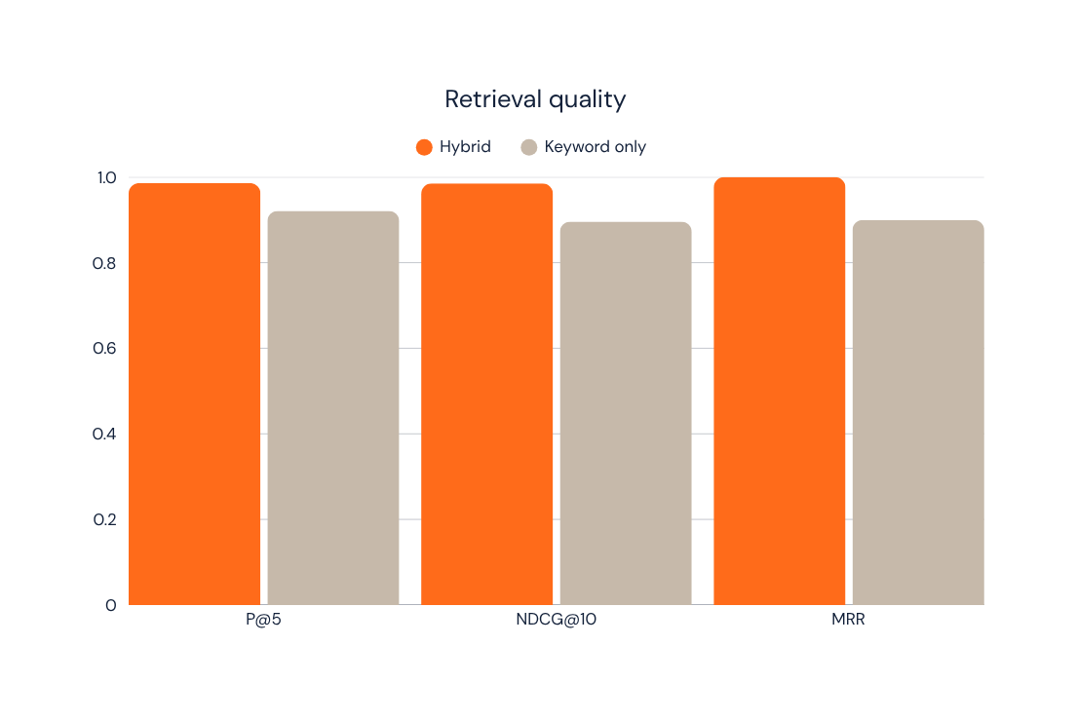
Results & Performance
LIMITATIONS
Prototype scope
Human review required
No GPU generation timing
NEXT
Multi-user support
Broader languages & roles
GPU acceleration
Explainable RAG
UNSUPPORTED TECH IN GENERATION
Llama 9.5% vs TinyLlama 29.8%

Slide 15
Limitations, Future Scope & Conclusion
HYBRID WINS
LOCAL CAN SCALE
Semantic + keyword retrieval outperforms the baseline.
HNSW keeps discovery responsive at 100k rows.
PRIVACY BY DESIGN
HUMANS STAY IN LOOP
Self-hosting preserves user data and control.
Review remains essential for application quality.

Slide 16
Thank you.
By Shrish Prasad Chakraborty
Reg. No.: RA2532014010136

