Slide 1
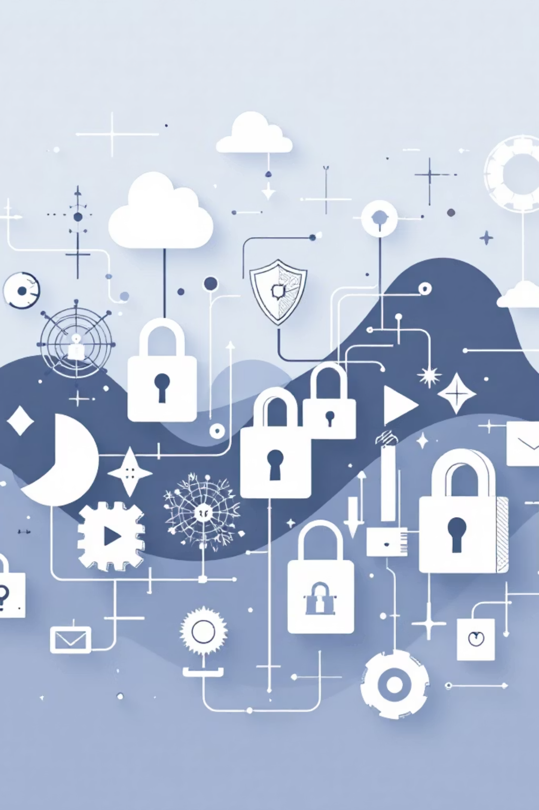
OWASP Top 10 Vulnerabilities
Case Studies
Real-World Data Breaches & Business Impact (2021–2026)
Case study examining how the most critical web application security risks have fueled devastating data breaches — and what they cost the companies that failed to act.

Slide 2

CHAPTER 1
FOUNDATION
Introduction: Why OWASP Top 10 Matters
The Open Web Application Security Project (OWASP) Top 10 is the most authoritative reference for the critical security risks facing modern web applications. Updated periodically through rigorous analysis, this list captures the vulnerabilities that attackers exploit most frequently and most destructively in the wild.
Over the past five years, these vulnerabilities have been directly responsible for breaches affecting billions of records, costing organizations hundreds of millions of dollars in fines, settlements, and remediation. Understanding these risks through the lens of real-world incidents reveals the true business impact — from regulatory penalties and litigation to irreparable brand damage and customer trust erosion.
$4.5M
277
Avg. Breach Cost
Days to Identify
Global average cost per data breach in 2023 (IBM)
Average time to detect and contain a breach
This presentation walks through OWASP categories A01 through A10, mapping each to documented breaches, quantifying their financial toll, and distilling the lessons every security team must internalize.
83%
Repeat Breaches
Organizations breached more than once

Slide 3
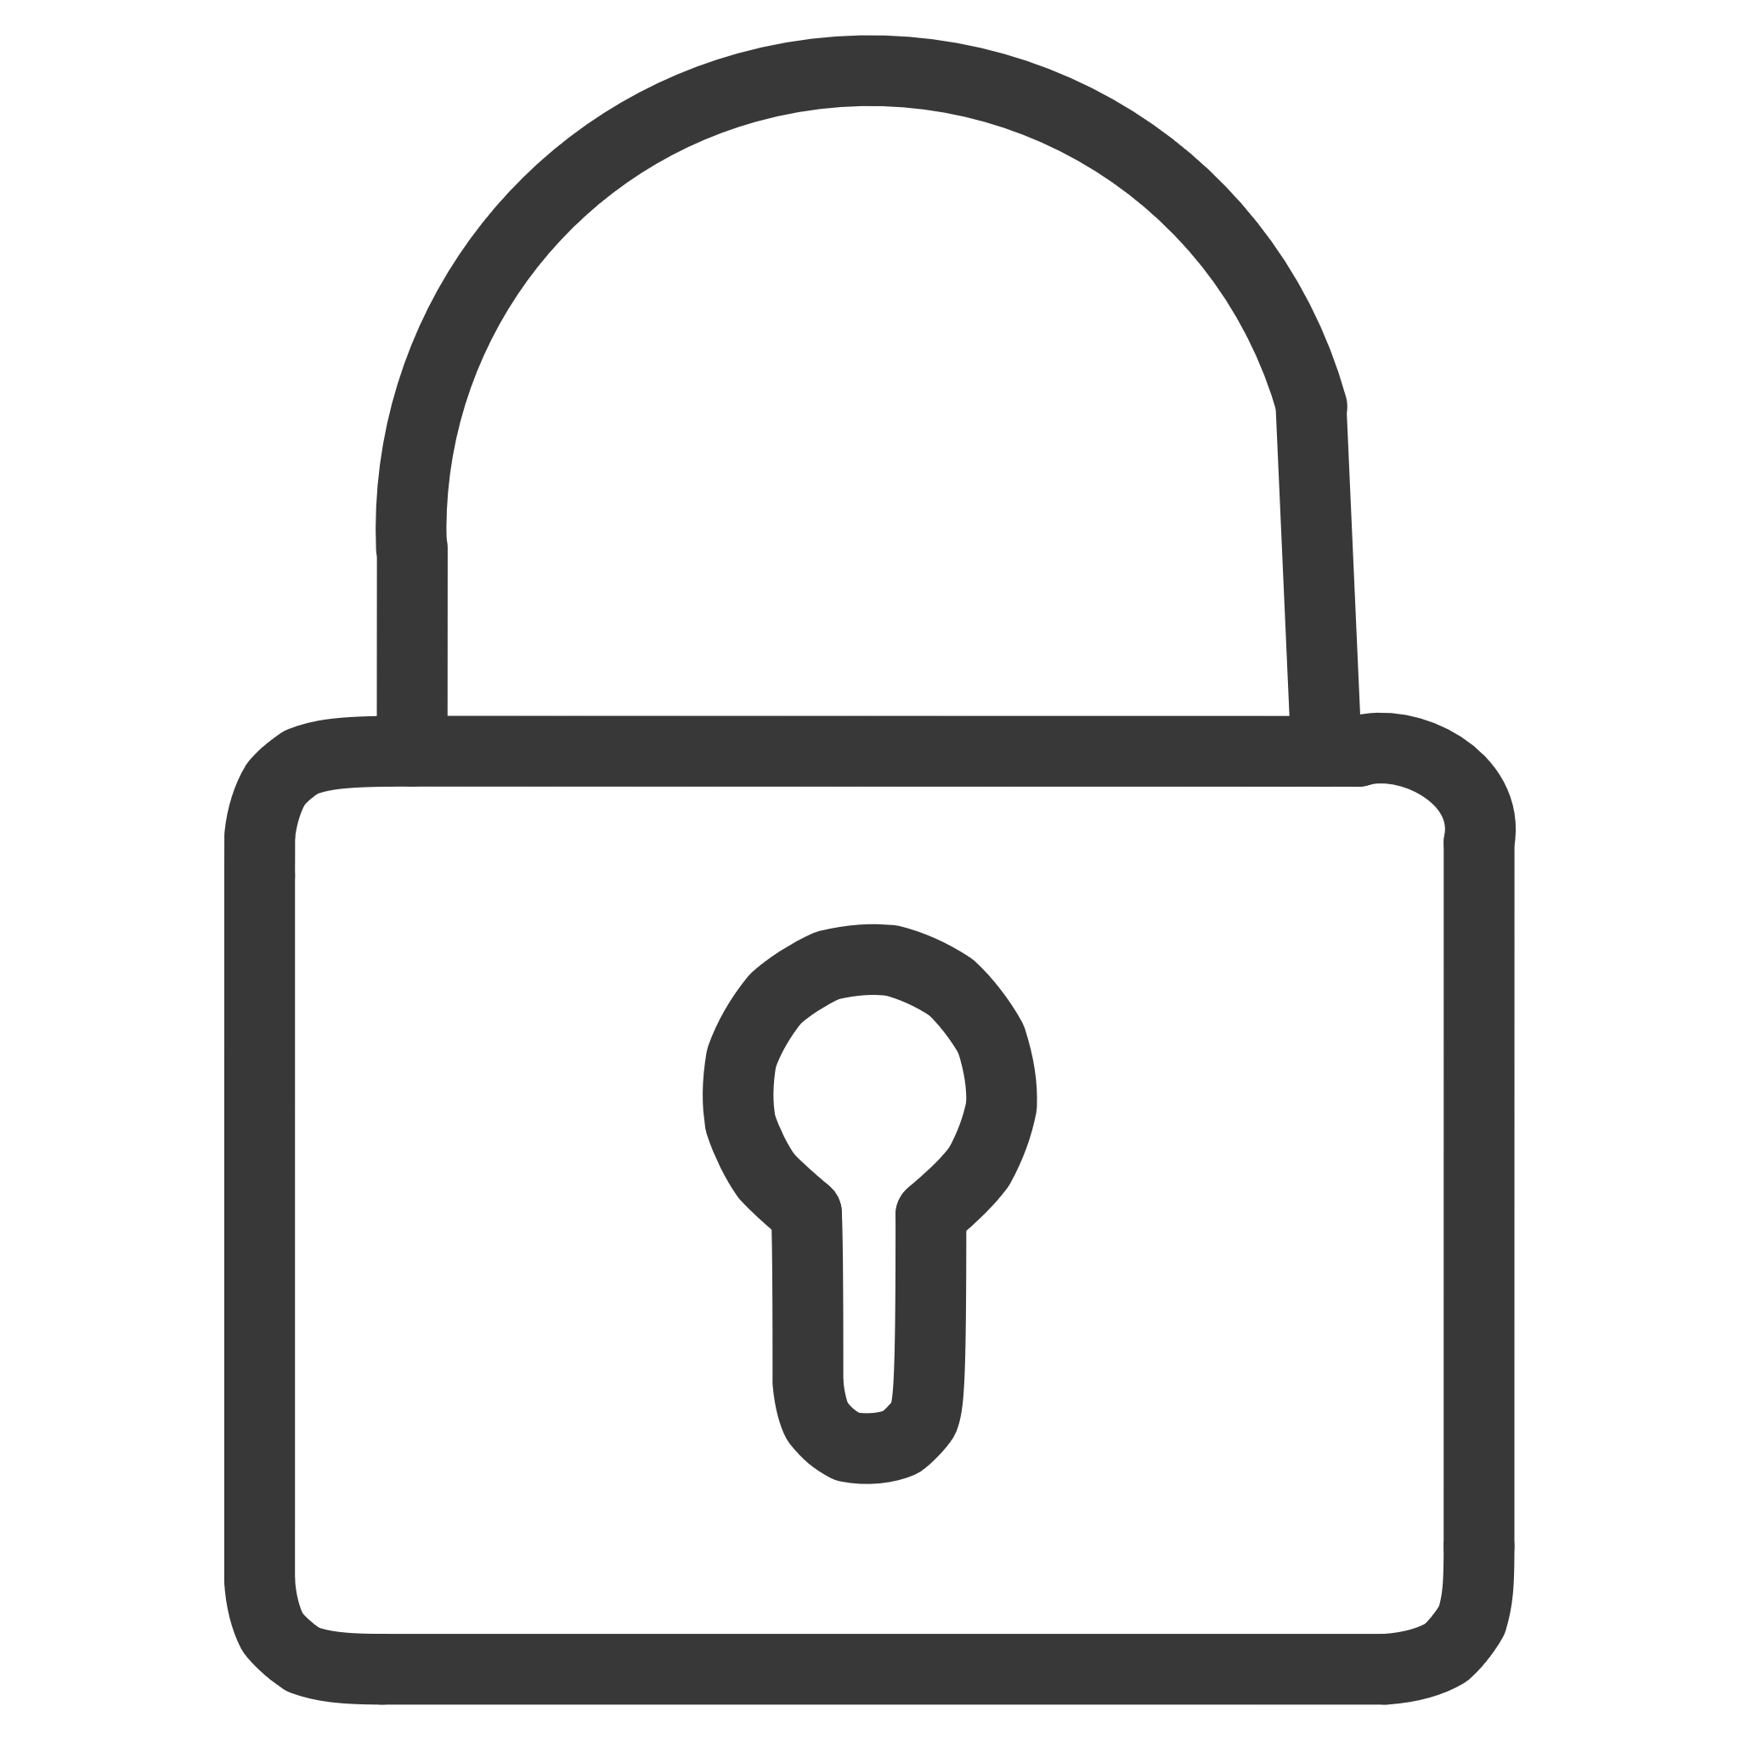
A01
BROKEN ACCESS CONTROL
Broken Access Control — Facebook Leak, 2021
The Incident
🔑 Key Lesson
In April 2021, personal data from 533 million Facebook users across 106 countries surfaced on a hacking forum. The root cause was an API flaw in the platform's contact importer feature, which allowed attackers to scrape user profiles at scale — harvesting phone numbers, email addresses, full names, locations, and biographical information.
Enforce strict server-side authorization checks on every API endpoint. Implement rate limiting, access control lists, and automated anomaly detection to prevent unauthorized bulk data extraction. Never rely solely on client-side controls.
Impact & Financial Loss
The breach triggered intense regulatory scrutiny worldwide, including a €265 million GDPR fine from Ireland's Data Protection Commission. Beyond fines, Meta faced sustained brand erosion, congressional inquiries, and a measurable decline in user trust. Remediation costs included engineering overhauls, legal defense, and public relations campaigns spanning years.
Records Exposed
533,000,000
Regulatory Fine
€265M

Slide 4


A02
CRYPTOGRAPHIC FAILURES
Cryptographic Failures — Equifax Aftermath (Ongoing)
While the original Equifax breach occurred in 2017, its ramifications have dominated the cybersecurity landscape throughout the past five years. Weak encryption practices, poor key management, and failure to patch a known Apache Struts vulnerability collectively exposed 147 million consumer records — including Social Security numbers, birth dates, and addresses.
Breach Scope
Long-Term Damage
147 million records containing the most sensitive personal identifiers — Social Security numbers, driver's license numbers, and credit card details for 209,000 consumers.
CEO resignation, congressional hearings, permanent reputational harm, and the breach became the benchmark case study for cryptographic negligence in enterprise security.
Financial Toll
Over $700 million in settlements with the FTC, CFPB, and all 50 U.S. states. Additional hundreds of millions spent on security upgrades, credit monitoring, and legal fees.
Lesson: Use strong, regularly updated cryptographic standards (AES-256, TLS 1.3). Protect encryption keys with hardware security modules (HSMs) and rotate them on schedule. Audit all data-at-rest and data-in-transit encryption rigorously.

Slide 5
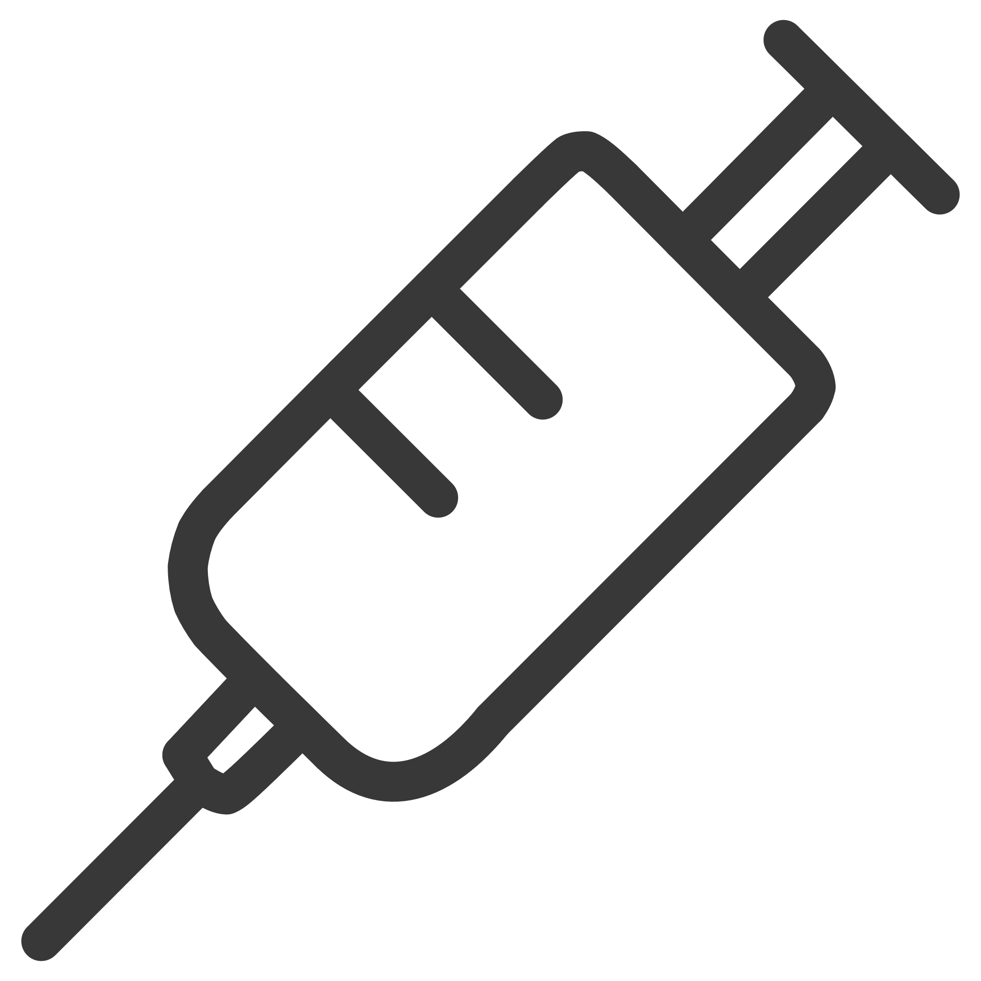

A03
INJECTION ATTACKS
Injection Attacks — SQL Injection in Healthcare, 2023
Attack Vector
Impact & Business Fallout
Attackers exploited a SQL injection vulnerability in a patient-facing web portal to bypass authentication and extract complete patient record databases from a major U.S. hospital network.
The breach constituted a severe HIPAA violation, triggering federal investigations by the HHS Office for Civil Rights. The hospital system faced multi-million dollar regulatory fines, class-action lawsuits from affected patients, and significant operational disruption as systems were taken offline for forensic analysis and remediation.
Data Compromised
Beyond direct costs, the organization experienced a measurable decline in patient enrollment, staff attrition in IT security roles, and lasting damage to community trust — a devastating outcome for a healthcare provider.
Protected health information (PHI)
Patient names, diagnoses, treatment histories
Insurance and billing records
Social Security numbers
Lesson: Always use parameterized queries and prepared statements. Implement strict input validation, deploy web application firewalls (WAFs), and conduct regular penetration testing on all patient-facing applications.

Slide 6

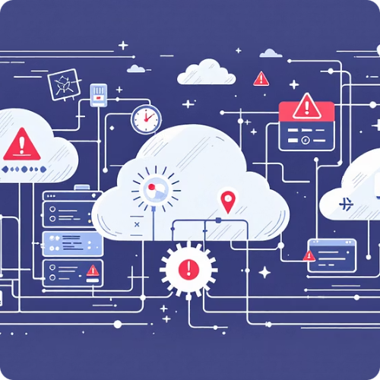

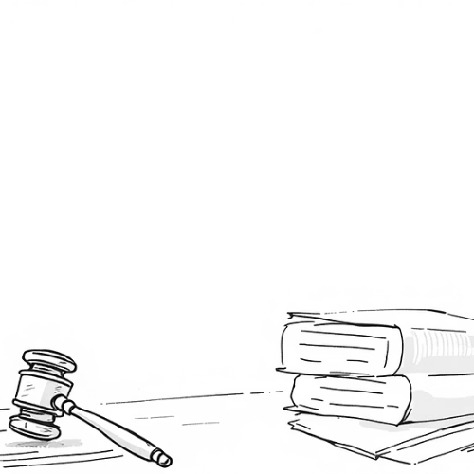

A04 & A05
INSECURE DESIGN & MISCONFIGURATION
Insecure Design & Security Misconfiguration — Capital One Cloud Breach
In one of the most high-profile cloud security failures, a misconfigured AWS Web Application Firewall allowed an attacker to exploit a Server Side Request Forgery (SSRF) vulnerability and access Capital One's cloud storage. The breach exposed 100 million credit applications containing names, addresses, credit scores, and Social Security numbers.
Misconfigured Firewall
100M Records Stolen
$80M Fine & Beyond
An overly permissive IAM role on an AWS EC2 instance allowed the attacker to query the metadata service and extract temporary credentials, pivoting into S3 buckets containing sensitive data.
Credit scores, bank account numbers, and 140,000 Social Security numbers were exfiltrated. The data spanned applications from 2005–2019, amplifying the breach's scope dramatically.
The OCC levied an $80 million penalty. Total costs including remediation, legal settlements, and security overhaul exceeded $300 million. The CISO departed and the incident reshaped cloud security policy industry-wide.
Lesson: Embed security into cloud architecture from day one. Audit IAM policies, enforce the principle of least privilege, disable SSRF-vulnerable metadata endpoints, and use infrastructure-as-code scanning to catch misconfigurations before deployment.

Slide 7
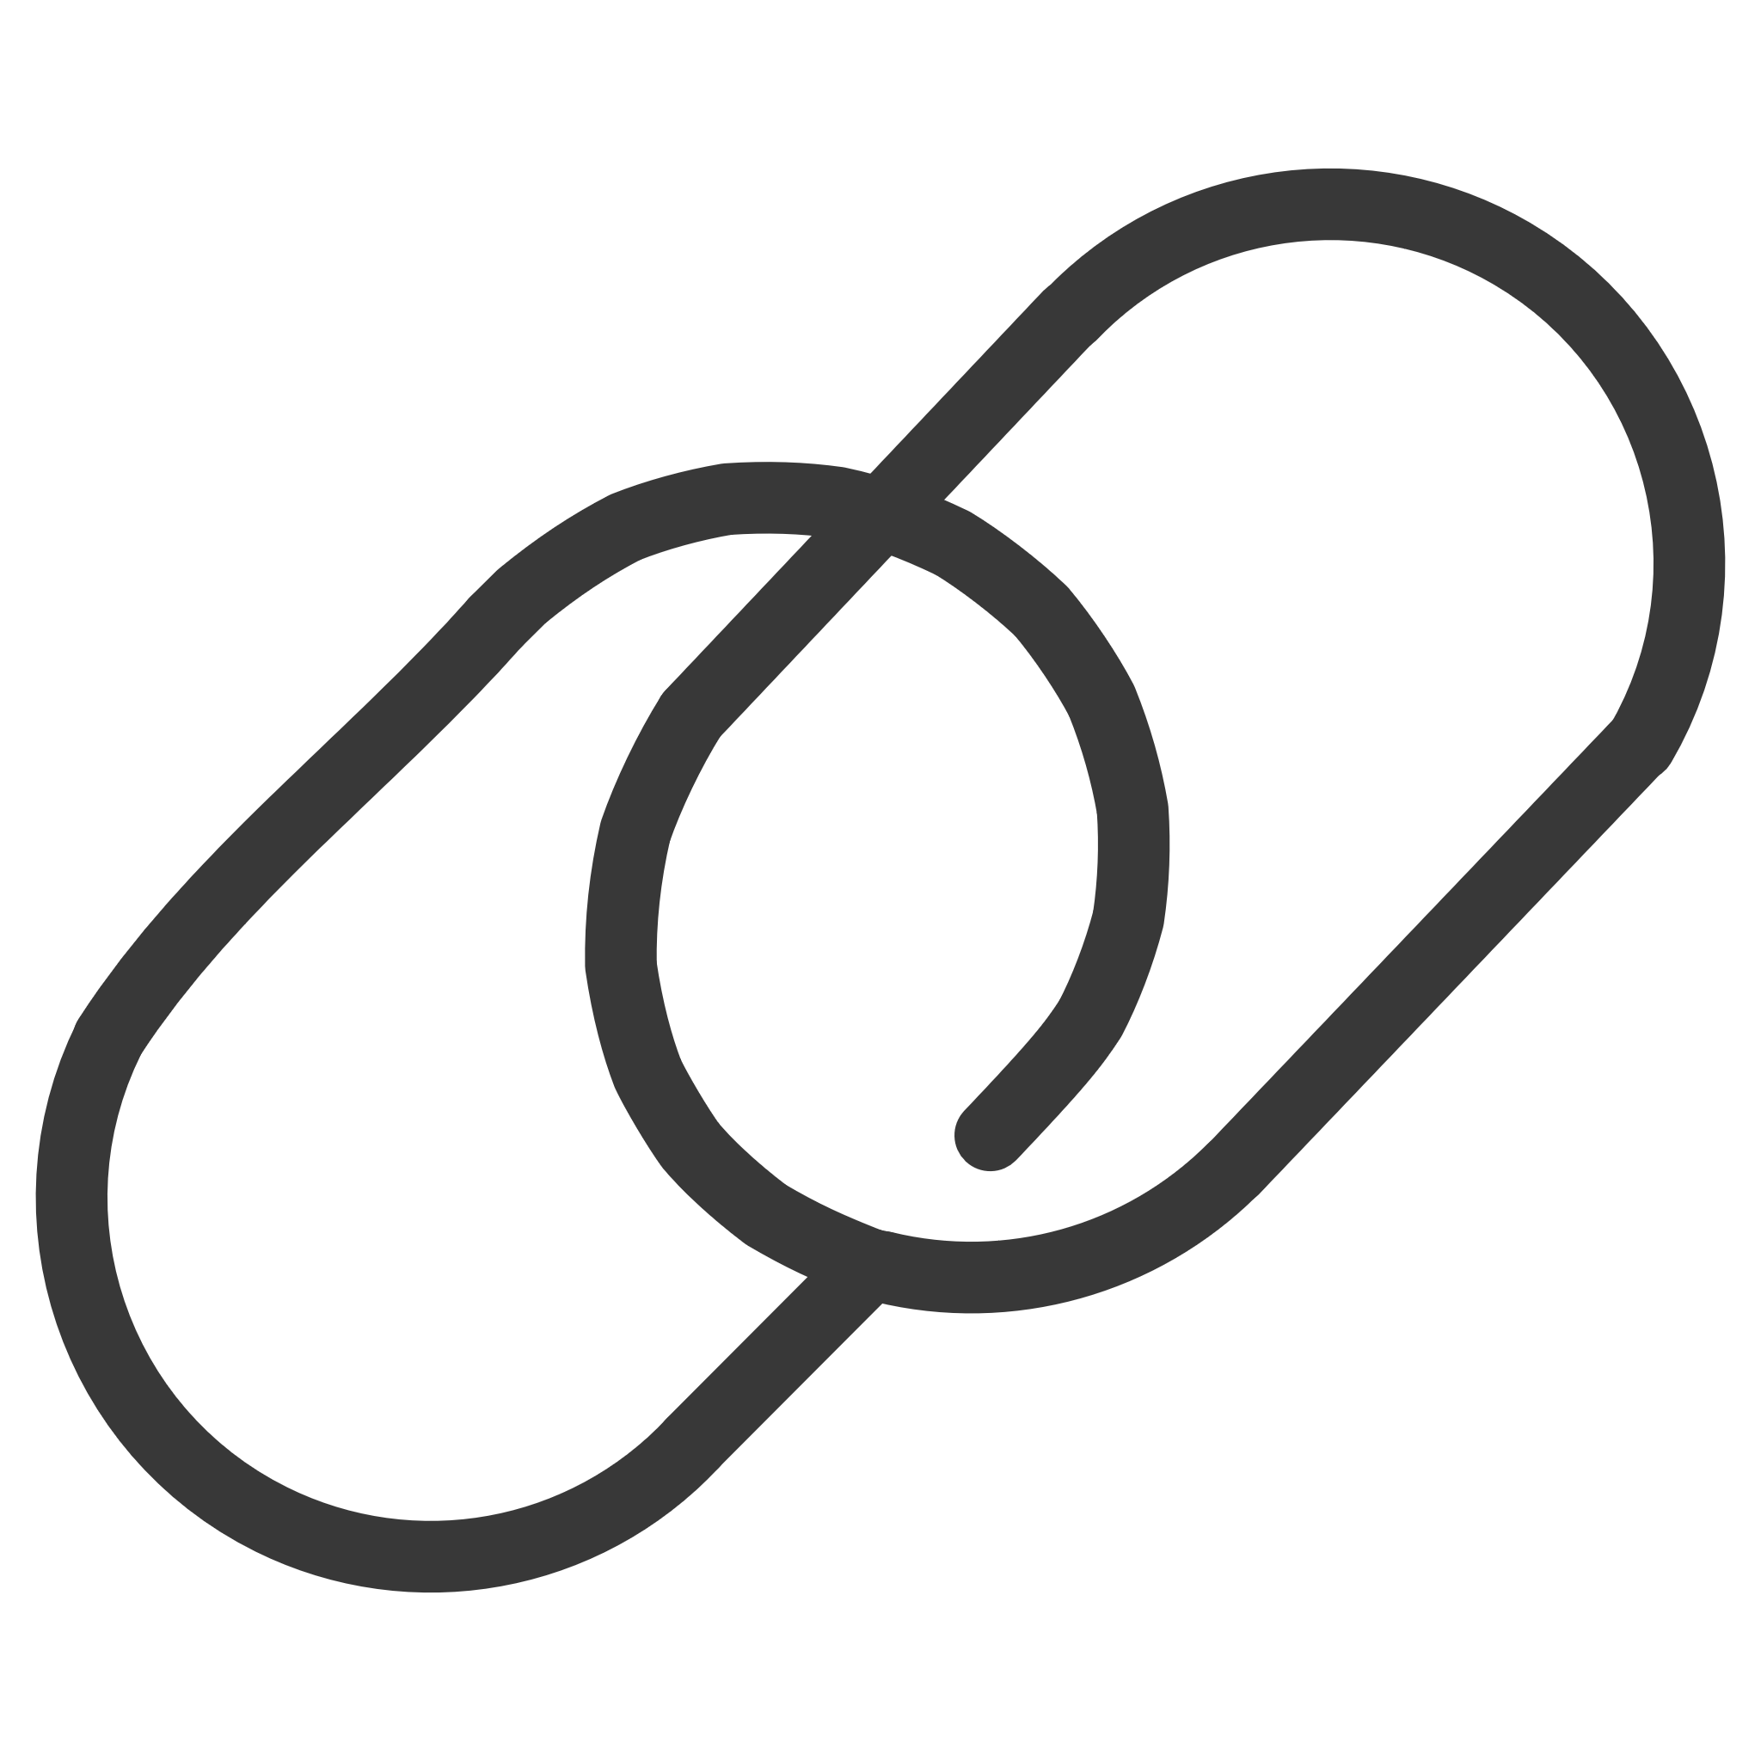
A06
VULNERABLE COMPONENTS
Vulnerable & Outdated Components — SolarWinds Supply Chain Attack
The SolarWinds attack, discovered in late 2020, remains the defining supply chain compromise of the decade. Attackers injected malicious code into SolarWinds' Orion software updates, which were then distributed to approximately 18,000 organizations — including U.S. federal agencies, Fortune 500 companies, and critical infrastructure operators.
Sep 2019
Dec 2020
Attackers gain initial access to SolarWinds' build environment and begin testing code injection techniques.
FireEye detects the compromise during investigation of their own breach. Public disclosure triggers global incident response.
1
2
3
4
Mar 2020
2021–2025
Trojanized Orion updates (SUNBURST malware) begin shipping to customers worldwide through legitimate update channels.
Billions spent on remediation. New regulations (e.g., SBOM mandates) reshape software supply chain security practices.
Impact
Lesson
Widespread espionage targeting government agencies (Treasury, Commerce, DHS), data theft across enterprises, and compromised national security intelligence.
Continuously monitor and update all third-party dependencies. Implement Software Bill of Materials (SBOM), verify build integrity, and adopt zero-trust architectures to limit lateral movement.

Slide 8

A07
AUTHENTICATION FAILURES
Identification & Authentication Failures — Twitter Account Takeover, 2023
In 2023, a series of high-profile Twitter/X account hijackings exposed critical weaknesses in the platform's authentication infrastructure. Attackers leveraged credential stuffing — using billions of leaked username-password pairs from previous breaches — combined with SIM swapping techniques to bypass weak multi-factor authentication protections.
Attack Methods
Credential stuffing with leaked databases
SIM swapping to intercept SMS codes
Social engineering of support staff
The Cascading Impact
Compromised accounts belonging to public figures and verified organizations were used to launch sophisticated phishing campaigns and cryptocurrency scams, defrauding followers of millions of dollars. User data including email addresses, phone numbers, and direct messages were also exposed during several incidents.
Business Consequences
Advertiser trust collapse
FTC regulatory escalation
User compensation payouts
The platform faced regulatory attention from the FTC (already under a consent decree), brand trust collapsed among advertisers, and user compensation costs mounted. The incidents accelerated advertiser exodus and contributed to significant revenue decline.
🔑 Key Lesson
Enforce phishing-resistant MFA (FIDO2/WebAuthn), monitor login anomalies with behavioral analytics, and eliminate SMS-based verification for high-value accounts.

Slide 9




A08–A10
EMERGING RISKS
Emerging Risks & Lesser-Known Impacts
While the first seven OWASP categories dominate headlines, vulnerabilities A08 through A10 represent insidious risks that amplify breach severity and complicate response. These often serve as force multipliers — turning manageable incidents into catastrophic failures.
A09: Logging & Monitoring Failures
A08: Software & Data Integrity Failures
A10: Server-Side Request Forgery
Without adequate logging and real-time alerting, breaches go undetected for months. The average detection time of 277 days means attackers have free rein to exfiltrate data, establish persistence, and cover their tracks.
Tampered code updates, unsigned packages, and insecure CI/CD pipelines enable attackers to inject backdoors directly into production. The SolarWinds attack exemplifies this risk — trusted updates became the attack vector.
SSRF vulnerabilities allow attackers to make requests from the server to internal resources, bypassing firewalls. Unhandled errors can also expose system internals — stack traces, database schemas, and API keys — giving attackers a detailed roadmap.
Business Impact: These vulnerabilities collectively increase breach dwell time, forensic investigation costs, compliance penalties, and system downtime — often doubling the total cost of an incident.

Slide 10




CONCLUSION
Protecting Data Protects Business
The OWASP Top 10 vulnerabilities remain the root cause of the most costly breaches in the modern threat landscape. From Facebook's 533 million exposed records to SolarWinds' billions in damages, these case studies prove that security failures carry existential business risk.
Secure by Design
Monitor Continuously
Respond Rapidly
Embed security into architecture, code, and cloud configurations from inception — not as an afterthought.
Deploy real-time logging, behavioral analytics, and automated alerting to detect threats before they escalate.
Maintain tested incident response plans, invest in forensic capabilities, and practice breach simulations regularly.
Call to Action: Prioritize OWASP Top 10 mitigation in your security strategy today. The cost of prevention is always a fraction of the cost of a breach. Invest in secure development, continuous monitoring, and a culture of security — because protecting data isn't just an IT issue, it's a business imperative.

Slide 11
A09:2021 – Security Logging and Monitoring Failures
What it means?
The system does not properly log security events or fails to monitor them. If an attack happens, the organization may not detect it quickly — or at all.
Examples of Logging and Monitoring Failures
No logging of failed login attempts
No alerts for suspicious activity
Logs exist but are never reviewed
Logs can be deleted or modified by attackers

Slide 12
Realtime Incident:
In the Equifax (2017 data breach), attackers accessed systems for weeks before being detected. Monitoring systems failed to properly identify suspicious activity.
Impact:
Delayed detection of attacks
Long-term unauthorized access
Larger data breaches
Regulatory penalties
Financial Loss:
$700+ million
The Equifax breach cost approximately $700+ million in settlements, fines, and remediation.
Lesson:
01
02
03
Log all important security events
Monitor logs in real time
Use SIEM tools
04
05
Generate alerts for suspicious behavior
Protect logs from tampering

Slide 13
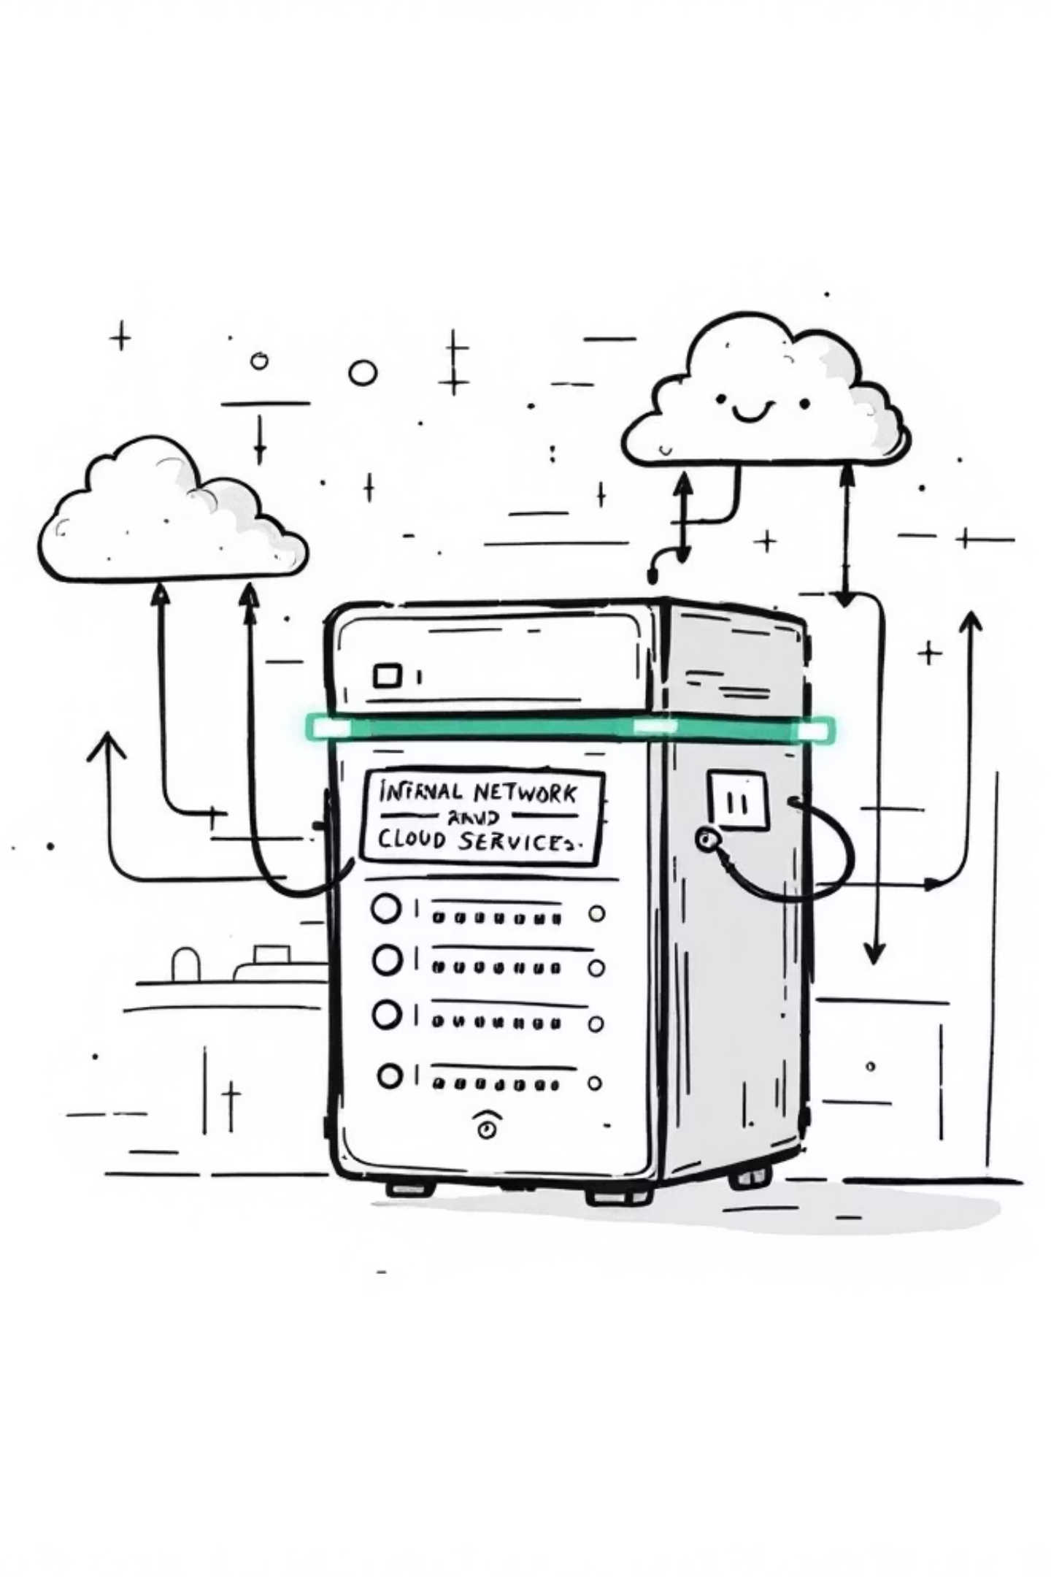
A10:2021 – Server-Side Request Forgery (SSRF)
What it means?
SSRF happens when a web application fetches a remote resource based on user input — without validating the URL.
An attacker tricks the server into making requests to:
Internal systems
Cloud metadata services
Localhost
Other internal APIs

Slide 14



Realtime Incident:
In 2019, Capital One suffered a breach where an SSRF vulnerability exposed sensitive data stored in AWS.
Impact:
Access to internal servers
Cloud credential theft
Data exfiltration
Full infrastructure compromise
Financial Loss:
Capital One paid approximately $80 million in regulatory fines, plus additional costs for lawsuits and security improvements.
Lesson:
Validate and whitelist URLs
Block internal IP ranges
Disable access to cloud metadata endpoints
Use network segmentation
Apply strict firewall rules

