Slide 1
Axiom
AI-Powered Competitive Intelligence for Life Sciences
MVP Prototype Presentation
Life Sciences | Cloud | AI-Assisted Development

Slide 2
Use Case / Problem Statement
Life sciences teams need fast competitive landscape views, but data is scattered across multiple public sources.
Researchers manually search ClinicalTrials.gov, openFDA, and PubMed - often exporting spreadsheets
Competitive intelligence takes hours and becomes stale quickly
Strategy and BD teams need answers like: Who is running trials? Which mechanisms are crowded? Where is white-space?
Generic AI chatbots are risky - they can invent trial counts and drug statistics
There is no single workspace that fetches live public data, visualizes it, and explains it safely
Selected use case: Competitive pharmaceutical intelligence powered by live public APIs + AI agent.

Slide 3
Approach
Build an MVP web app that accepts plain-English research questions
Use an AI agent with tool calling - the LLM decides which data tools to run
Fetch live data at query time from ClinicalTrials.gov, openFDA, and PubMed
Compute metrics in Python (momentum scores, white-space signals) - not in the LLM
Generate dynamic dashboards, follow-up chat, executive briefings, and bull/bear debate
Package everything in Docker; deploy on GCP VM with nginx and a free dpdns domain
Vibe-code rapidly with Cursor while keeping architecture and guardrails human-designed

Slide 4
Architecture Overview
Frontend: Next.js + React
Backend: FastAPI (Python)
Database: PostgreSQL
AI: OpenRouter + DeepSeek V4 Flash
Data: ClinicalTrials.gov, openFDA, PubMed
Deploy: Docker, GCP VM, nginx
Flow:
User question -> Agent -> Tools -> Live APIs
-> Dashboard + AI explanation
Browser / Next.js
FastAPI Agent + Tools
PostgreSQL
Public APIs + DeepSeek V4 Flash

Slide 5
Key Features
Live investigation - fresh trial, FDA, and PubMed data per query
AI agent with 8+ tools (search trials, landscape, momentum, white-space, safety, publications)
Dynamic dashboard - charts adapt to question intent
Server-computed momentum rankings and white-space opportunity detection
Explain these signals - AI narrates dashboard data with citations
Follow-up chat on the same investigation
Executive briefing export and bull vs bear investment debate
Session library, portfolio view, auth, and admin token limits

Slide 6
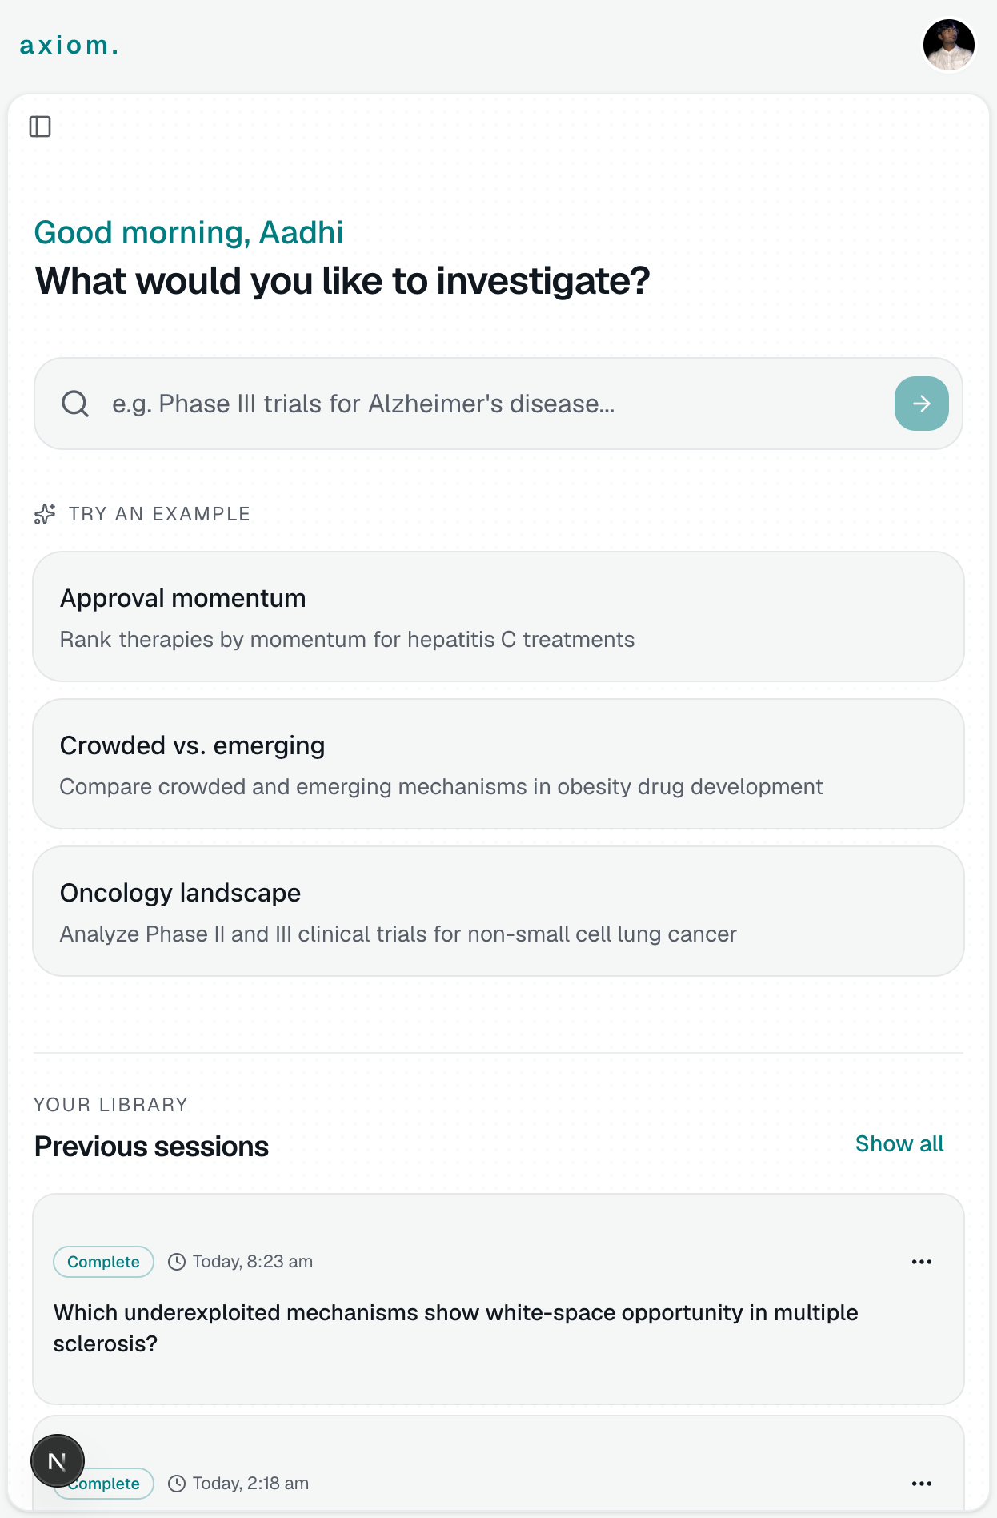
Solution Demonstration
Step 1 - Ask a research question
User enters a plain-English question or picks an example prompt from the command center.

Slide 7
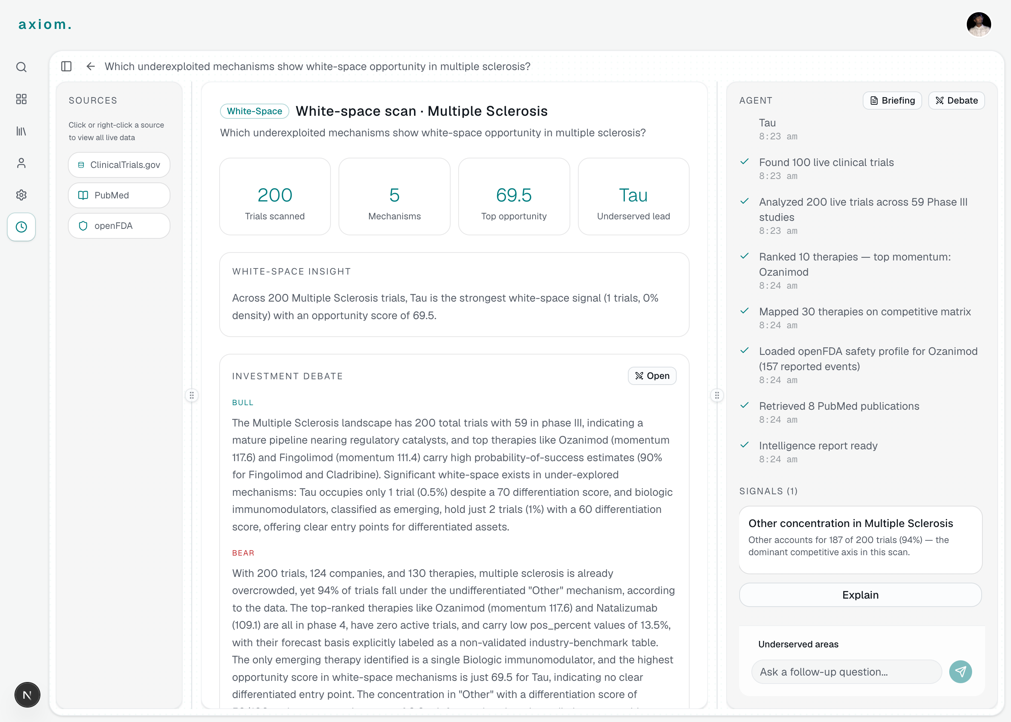
Solution Demonstration
Step 2 - Live dashboard and AI agent
Agent fetches live data, builds KPIs/charts, runs bull/bear debate, and supports follow-up questions.

Slide 8
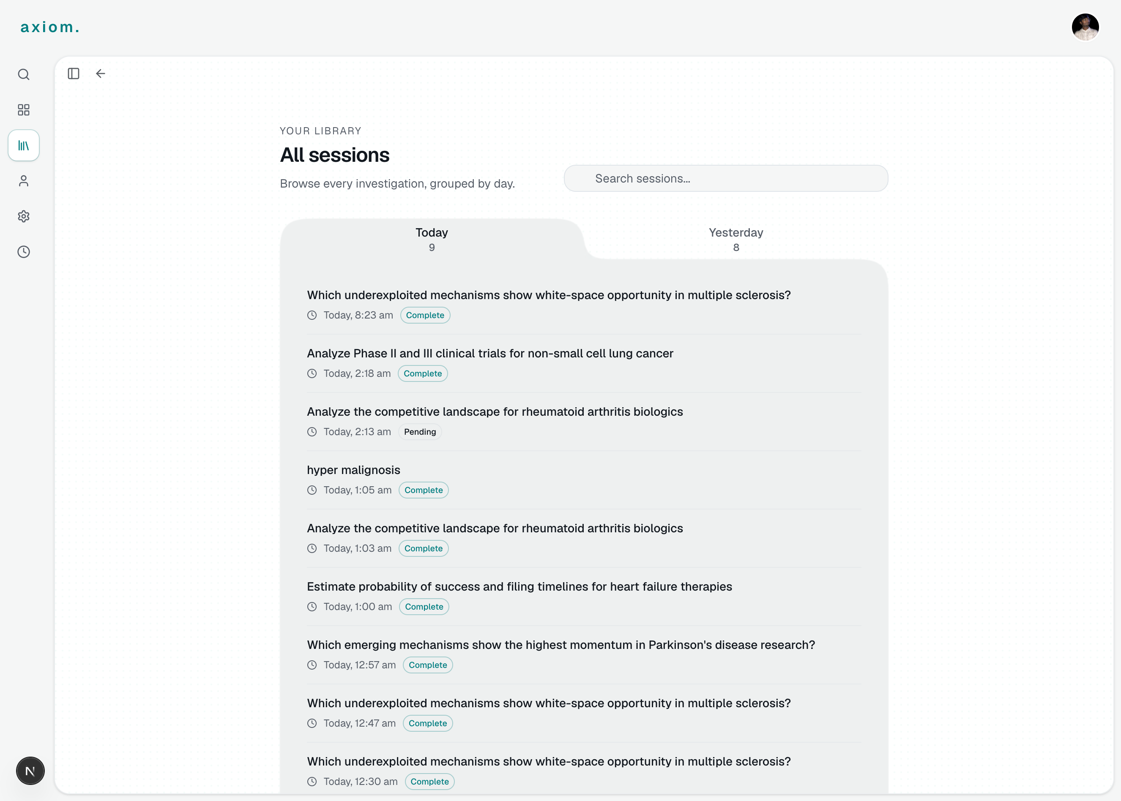
Solution Demonstration
Step 3 - Saved investigations
Users revisit past investigations from the library and portfolio views.

Slide 9
How the Prototype Solves the Problem
One question replaces hours of manual searching across multiple websites
Data is live - fetched at investigation time, not from a stale demo dataset
Visual dashboard makes competitive landscape easy to scan
AI explains results but numbers come from code and APIs - reducing hallucination risk
Briefings and debate views support real strategy conversations
Cloud-ready Docker deployment proves the app can run in production-like hosting

Slide 10
Key Learnings & Challenges
Challenge: LLMs want to answer from memory - solved with tool-first agent design and strict prompts
Challenge: Live API calls are slow (30-60s) - addressed with streaming UI and agent trace visibility
Challenge: Dashboard must match question intent - built intent classification for dynamic sections
Challenge: Deploying full stack on a VM - solved with Docker Compose + nginx reverse proxy
Learning: Server-computed metrics are more trustworthy than LLM-generated scores
Learning: MVP scope matters - public APIs first, enterprise features later
Learning: Vibe coding is fast, but testing real data flows is still essential

Slide 11
AI-Assisted Development
This MVP was vibe-coded - built rapidly with AI coding tools while keeping human ownership of architecture and product decisions.
Cursor - AI pair programmer for frontend, backend, Docker, and debugging
DeepSeek V4 Flash (open-source via OpenRouter) - agent reasoning, tool selection, summaries, briefings, debate
OpenRouter - one API for model access, easy swapping, optional web search plugins
AI helped write boilerplate UI, API routes, and agent orchestration code
Human decisions: data sources, tool schemas, prompts, guardrails, deployment, and UX flow
Validation: real NCT IDs, matching chart data, health checks, and end-to-end investigation tests

Slide 12
Next Steps / Roadmap
Phase 1 (Done): MVP with live public data, agent, dashboard, briefing, GCP VM deploy
Phase 2: Caching, monitoring, CI/CD, more data sources, mobile polish
Phase 3: Enterprise - private data connectors, alerts, SSO, audit logs, multi-tenant GCP
Future: RAG on internal documents, regulatory-ready exports, forecasting module

Slide 13
Thank You
Questions & Demo

