Slide 1
Smart Procurement &
Purchase Order Management System
Project Presentation
Infosys Internship Project
Professional Procurement • Supplier • Order • Payment Management

Slide 2
1. Project Overview
Smart Procurement
Business Need
Core Objective
Key Users
Centralize procurement operations in one platform.
Reduce manual coordination between administrators and suppliers.
Improve visibility of purchase orders, deliveries and payments.
Create a role-based system for managing products, suppliers and purchase orders.
Track the complete order lifecycle from creation to delivery.
Provide payment and performance visibility.
Admin: manages products, suppliers and procurement activities.
Supplier: views assigned orders, payments and rating.
System: maintains status, payment and reporting data.
End-to-end digital procurement workflow
Role-specific dashboards and actions
Payment history with summaries and monthly trend
Supplier rating and performance visibility

Slide 3
2. Major Features
Functional Scope
Product Management
Supplier Management
Purchase Orders
Add and maintain products
Product availability and details
Supplier onboarding and profiles
Supplier dashboard and rating
Create and assign POs
Track order lifecycle and status
Payment Management
Dashboards
Role-based Access
Record successful/pending payments
Payment history, exports and trend
KPIs for orders and payments
Recent orders and status overview
Admin and supplier experiences
Restricted actions based on role

Slide 4
3. Technology Stack
Implementation
Frontend
Angular
Responsive web UI, routing, forms, dashboards
Backend
Spring Boot
REST APIs, business logic and service layer
Database
MySQL
Persistent storage for users, products, suppliers, POs and payments
API / Integration
REST APIs
Communication between frontend and backend
Charts
Chart.js
Monthly payment and dashboard visualizations
UI Components
Angular Material
Buttons, icons, snackbars and enterprise UI components
Build / Runtime
Node.js + Maven
Angular tooling and Spring Boot dependency/build management

Slide 5
4. System Architecture
High-Level Design
Angular
Frontend
Spring Boot
REST API
Service / Business
Layer
MySQL
Database
Authentication /
Role Control
Payment &
Reporting
Frontend sends HTTP requests to REST endpoints.
Backend validates requests, applies business rules and persists data.
Role-specific views expose only relevant procurement actions.
Dashboards aggregate operational data for quick decisions.

Slide 6
5. End-to-End Procurement Flow
Process
1. Login
User authentication
2. Product
Select / manage product
3. Supplier
Supplier assigned
4. PO
Purchase order created
5. Fulfilment
Accept → Pack → Dispatch → Deliver
6. Payment
Payment recorded
7. Dashboard
Status & reports
The PO status changes as the supplier progresses through fulfilment.
A successful payment contributes to the supplier's received-payment summary.
Supplier dashboards surface order counts, payment status and rating.

Slide 7
Role-Based Procurement Workflow
Three roles work together across the complete procurement lifecycle
USER / EMPLOYEE
SUPPLIER
ADMIN
• Browse products
• Create purchase requests
• Track order status
• View personal orders
• View assigned POs
• Accept / process orders
• Update delivery status
• Track payments & ratings
• Manage products
• Manage users & suppliers
• Create / manage POs
• Monitor payments & ratings
Employee Request → Admin / PO Processing → Supplier Fulfilment → Delivery → Payment & Rating

Slide 8
7. Purchase Order Lifecycle
Order Tracking
CREATED
ACCEPTED
PACKED
DISPATCHED
OUT FOR DELIVERY
DELIVERED
Supplier View
Operational Visibility
Completion
Assigned PO appears in the supplier dashboard with product, quantity, amount and current status.
Counts are calculated by status so users can quickly identify pending and delivered orders.
Delivered orders provide the completed procurement context for payment and reporting.

Slide 9
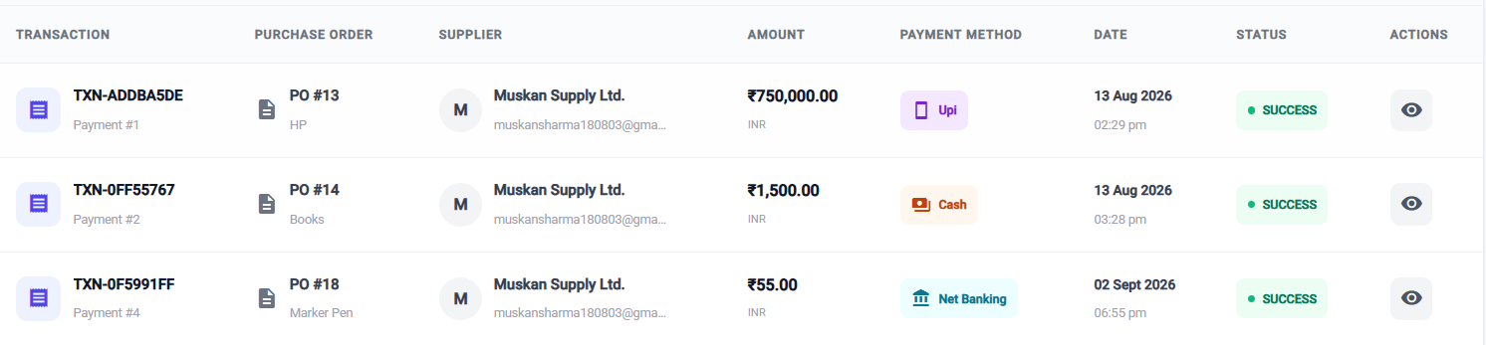
8. Payment Management & History
Financial Tracking
Payment Records
Supplier Summary
Reporting
Payment ID and purchase order
Amount, date and method
Transaction ID and status
Total payment received
Completed vs pending payments
Average successful payment
Monthly successful-payment trend
Search and status filtering
Excel / PDF export endpoints
Payment Transactions

Slide 10
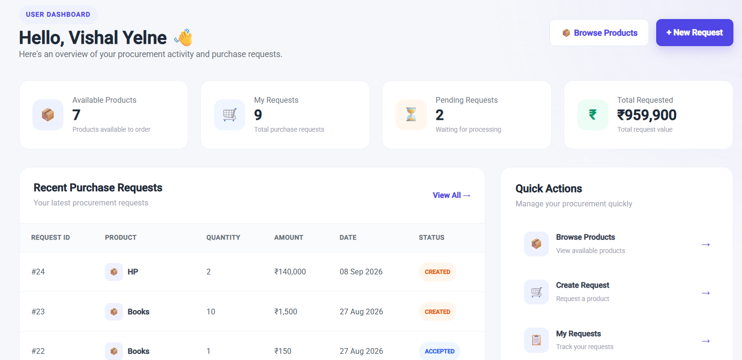
9. User Dashboard
UI Preview
User Portal — Dashboard
Dashboard highlights orders, pending/delivered counts, received payments, rating and recent purchase orders.

Slide 11
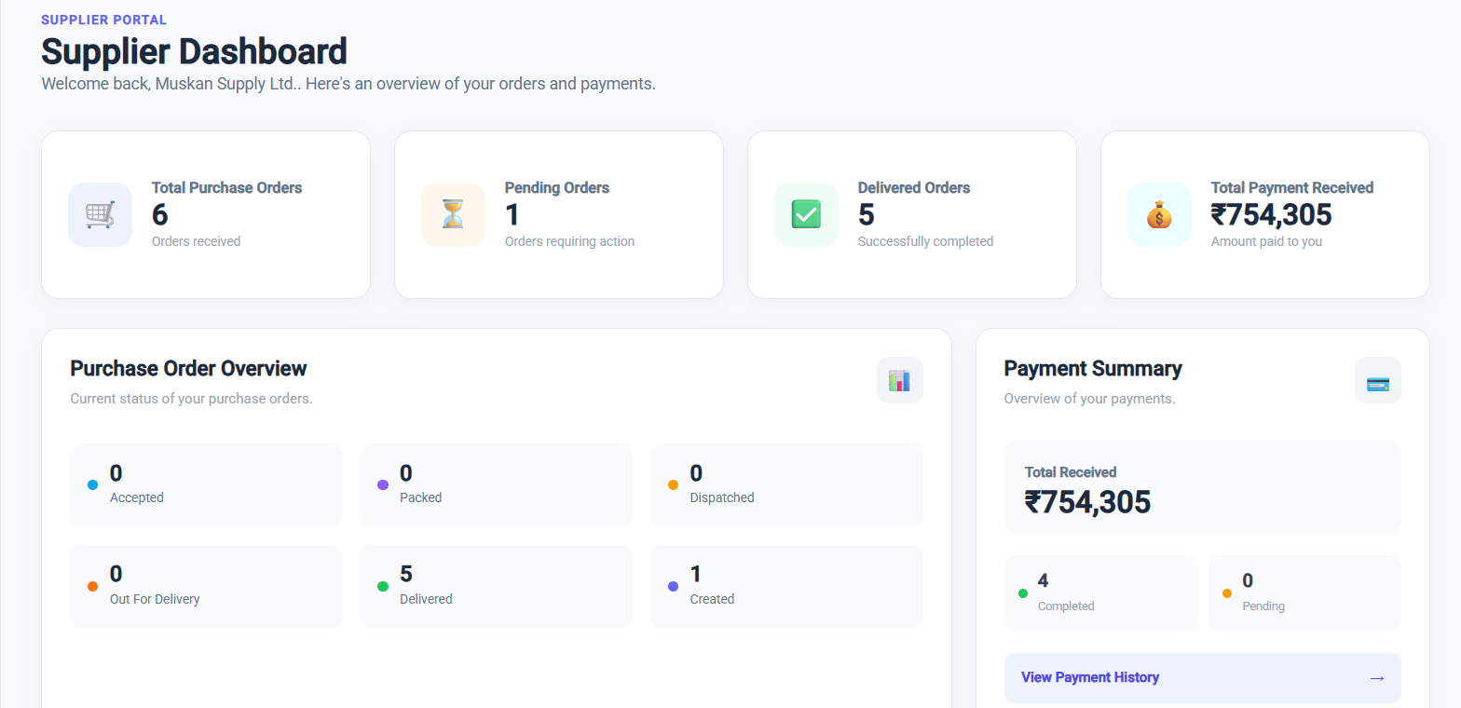
9. Supplier Dashboard
UI Preview
Supplier Portal — Dashboard
Dashboard highlights orders, pending/delivered counts, received payments, rating and recent purchase orders.

Slide 12
11. Data Model
Core Entities
User / Role
Product
Supplier
userId, name, email, role
productId, name, price, stock/details
supplierId, name, contact/details
Purchase Order
Payment
Rating
purchaseOrderId, supplier, product, quantity, totalAmount, status, orderDate
paymentId, purchaseOrder, amount, paymentDate, method, transactionId, status
supplier rating, review count / feedback

Slide 13
12. Benefits & Future Enhancements
Outcome
Project Benefits
Possible Enhancements
Centralized procurement information
Clear purchase-order lifecycle tracking
Role-based supplier and admin experiences
Payment transparency and searchable history
Dashboard-driven operational visibility
Structured data storage and reporting
Email / notification alerts for PO status changes
Advanced procurement analytics and filters
Invoice and document management
Approval workflows and audit logs
Cloud deployment and production monitoring
More granular permissions and access policies

Slide 14
Thank You
Smart Procurement & Purchase Order Management System
Infosys Internship Project

