Slide 1
SALES PERFORMANCE ANALYSIS
(CAPSTONE PROJECT)
-SHRISTI BHARDWAJ

Slide 2
BUSINESS PROBLEM AND OBJECTIVE
Business Problem
Global Superstore operates across multiple markets and sells a wide range of products. However, management lacks clear insights into:
Sales performance across different regions and markets
Product categories generating the highest revenue
Profitability across products and customers
Shipping performance and Customer purchasing behavior
Objective
Develop an end-to-end analytics solution to:
Clean and prepare raw sales data
Analyze business performance using SQL
Build an interactive Power BI dashboard and Generate business insights to support decision-making

Slide 3
PROJECT WORKFLOW
RAW DATA
PYTHON
DATA CLEANING
FEATURE ENGINEERING
REMOVING DUPLICATES
MYSQL
SQL QUERIES
POWER BI
DASHBOARD
UNCLEANED DATA
BUSSINESS INSIGHTS
KPI'S AND VISUALS

Slide 4

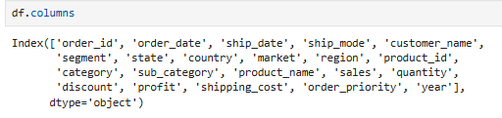
DATASET OVERVIEW
Data Source
Kaggle
Shape
51290 x 21 (before cleaning)
51290 x 24 (after cleaning)
Key Features
Customer Information
Product Information
Sales & Profit
Shipping Details
Geographic Information
Order Details

Slide 5
Python Data Cleaning & Feature Engineering
Data Cleaning
Checked missing values and duplicate records
Converted date columns
Verified data types
Feature Engineering
Columns Created:
Processing Days
Order Month
Quarter
RAW DATA
DATA CLEANING
FEATURE ENGINEERING
CLEANED DATA

Slide 6
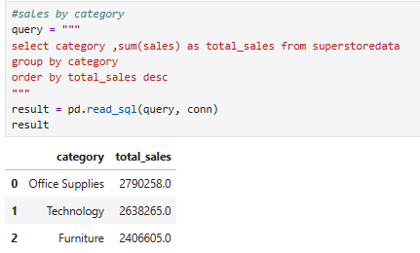
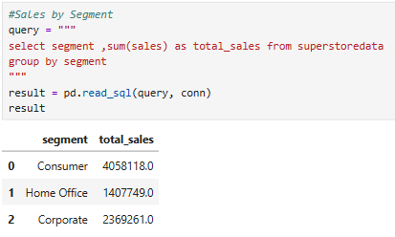
SQL ANALYSIS
Total Sales , Profit and Orders
Sales by Category
Sales by Region
Profit by Category
Profit by Market
Top Products and Customers
Average Shipping Cost and Days
Order by Priority

Slide 7
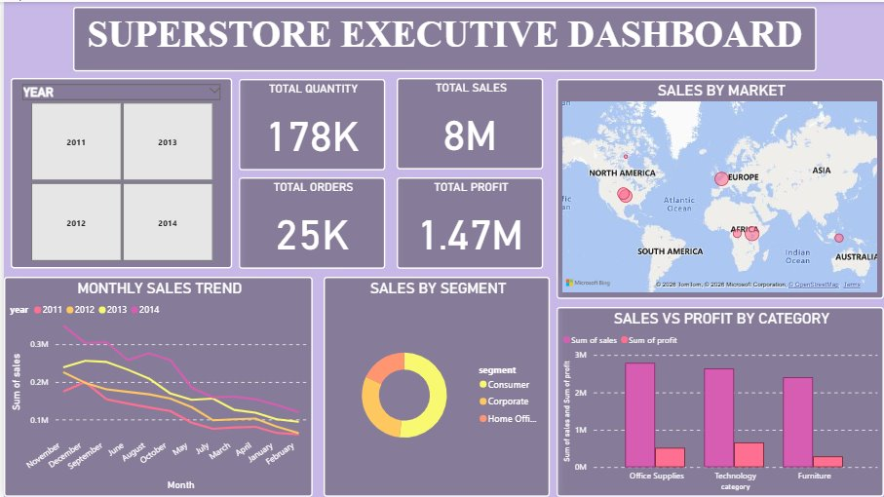
EXECUTIVE DASHBOARD
Dashboard Overview
Slicer - Year
KPI's - Total Sales, Total Profit ,etc.
Charts:
1. Monthly Sales Trend
2. Sales by Segment
3. Sales by market
4. Sales vs Profit by Category
Key Insights​
Consumer segment generated the highest overall sales.
Technology category delivered the highest overall profit.
Furniture showed the largest gap between sales and profit, indicating comparatively lower profitability.
2014 recorded the highest sales and profit across the four-year period.
2011 recorded the lowest sales and profit, reflecting the initial stage of business growth.

Slide 8
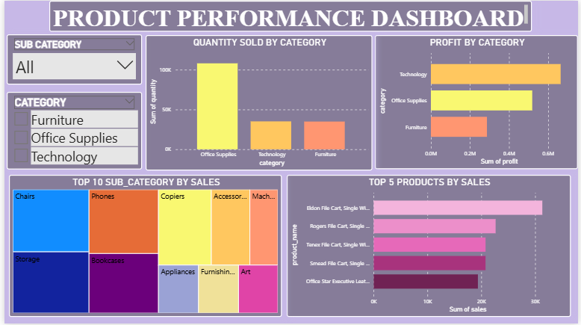
PRODUCT PERFORMANCE DASHBOARD
Dashboard Overview
Slicer – Category, Sub-category
Charts:
1. Top Sub-Category by Sales
2. Quantity by Category
3. Profit by Category
4. Top Products by Sales
Key Insights​
Chairs emerged as the highest revenue-generating sub-category.
Technology was the most profitable product category.
Office Supplies recorded the highest quantity sold, indicating strong customer demand.
Eldon File Cart, Single Width generated the highest product sales.

Slide 9
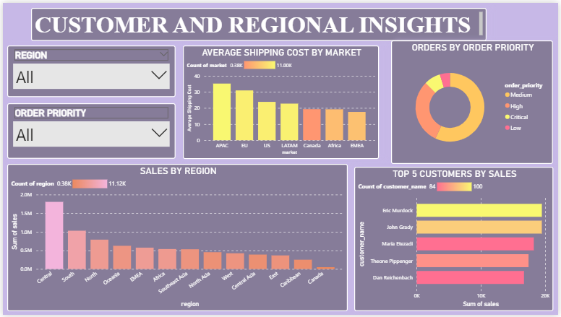
CUSTOMER AND REGIONAL INSIGHTS
Dashboard Overview
Slicer – Region, Order-Priority
Charts:
1. Avg shipping cost by Market
2. Sales by Region
3. Order by Order priority
4. Sales by Region
Key Insights​
Central region generated the highest sales, while Canada recorded the lowest sales among the regions.
APAC market had the highest average shipping cost.
Medium-priority orders accounted for the largest share of total orders.
Eric Murdoch was the highest revenue-generating customer.
Sales performance varied significantly across regions.

Slide 10
BUSINESS INSIGHTS
Optimize Discount Strategy
Focus on High-Performing Product Categories
Strengthen Regional Sales Strategy
Improve Shipping Cost Efficiency
Strengthen Customer Relationship Management
Improve Product Portfolio Management
Increase inventory levels for high-demand products

Slide 11
THANK YOU

