Slide 1


Medical Report Summarizer using Transformer
An AI-powered solution for generating concise summaries of complex medical reports using custom Transformer architecture
Project Team:
Roma Rajbhar (22000921),
Shristi Mishra (22000793),
Janvi Patel (22000877),
Ahad Shaikh (22000762),
Vraj Shah (22000776)
Notes:
1

Slide 2
The Challenge: Information Overload in Healthcare
The Problem
Medical reports are lengthy and complex, making them time-consuming for healthcare professionals to interpret. Critical information is often buried in dense technical language, delaying decision-making and patient care.
Our solution leverages artificial intelligence to automatically generate concise, accurate summaries that preserve essential details like diagnosis and treatment recommendations.
Time-Consuming
Complex Language
Critical Details
Hours spent reading lengthy reports
Dense medical terminology
Key information hard to locate
Notes:
2

Slide 3




Our Approach: Custom Transformer Architecture
We developed an abstractive summarization system using Transformer architecture built from scratch in PyTorch. This educational approach demonstrates core understanding of attention mechanisms and sequence-to-sequence modeling.
Data Preprocessing
Model Training
Cleaning and formatting medical text from mtsamples dataset
Fine-tuning on ~5000 medical samples
Summary Generation
Evaluation
Producing concise, accurate summaries
Measuring quality with ROUGE scores
Notes:
3

Slide 4
Dataset and Preprocessing Pipeline
01
Data Preparation
Load Data
Import mtsamples.csv dataset
We utilized the mtsamples.csv dataset containing approximately 5,000 medical transcription samples. Each sample includes a full transcription as input and a concise description as the target summary.
02
Clean Text
Remove NA values and format columns
Key preprocessing steps:
03
Load CSV and rename columns to 'text' and 'summary'
Tokenize
Remove NA values to ensure data quality
Train custom WordPiece tokenizer with 30,000 vocab size
Custom WordPiece tokenizer (30K vocab)
Tokenize, truncate, and pad sequences
04
Split into 80% training and 20% validation sets
Encode
Truncate to 512 input, 128 target length
05
Split
80% train, 20% validation
Notes:
4

Slide 5




Custom Transformer Architecture
Built entirely from scratch in PyTorch to demonstrate fundamental understanding of attention mechanisms and sequence-to-sequence modeling. The architecture is optimized for Google Colab GPU constraints.
Embedding Layer
Positional Encoding
Converts vocabulary tokens to 256-dimensional vectors, providing semantic representation of medical terms
Sinusoidal encoding to capture sequence order information in medical narratives
Encoder/Decoder
Output Layer
3 layers each with 8 attention heads and 1024 feedforward dimensions for processing
Linear projection to vocabulary size for generating summary tokens
Notes:
5

Slide 6
Training Process and Configuration
Training Setup
We trained the model for 10 epochs using Adam optimizer with a learning rate of 0.0001. Cross-entropy loss was used as the objective function, with mixed precision training via GradScaler to optimize GPU memory usage.
Configuration details:
Batch size: 4 (optimized for Colab GPU)
Optimizer: Adam (lr=0.0001)
Loss function: Cross-Entropy
Mixed precision training enabled
Shuffle enabled for training data
10
4
5K
Training Epochs
Batch Size
Dataset Size
Complete training cycles through dataset
Samples processed simultaneously
Medical transcription samples
Notes:
6

Slide 7
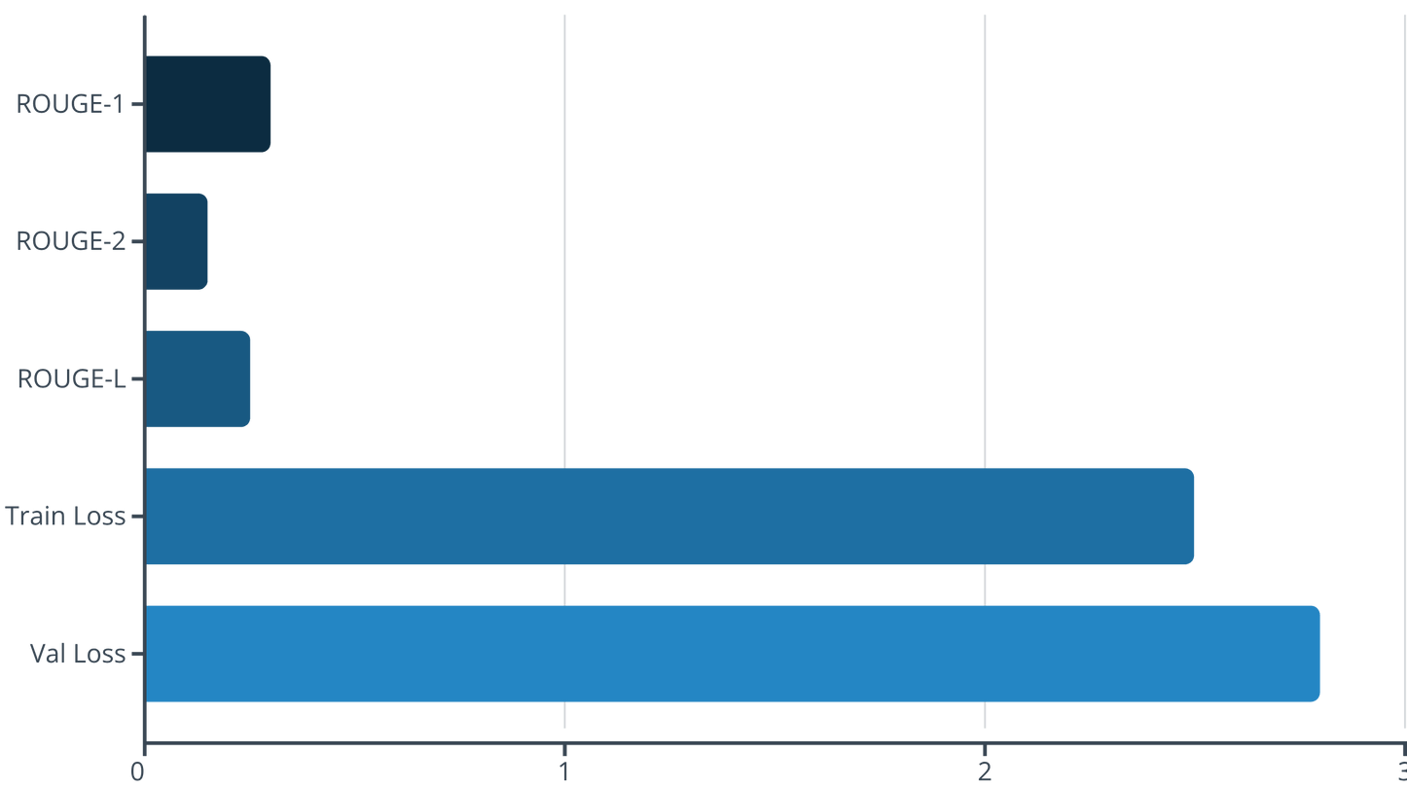
Evaluation Metrics and Results
Model performance was assessed using ROUGE (Recall-Oriented Understudy for Gisting Evaluation) metrics, which measure the overlap between generated summaries and reference summaries. Results reflect the challenges of training from scratch on a small dataset without pre-training.
ROUGE-1 measures unigram overlap, ROUGE-2 measures bigram overlap, and ROUGE-L measures longest common subsequence. Scores of 0.25-0.35 are expected for models trained from scratch on limited medical data without pre-training on large corpora.
Notes:
7

Slide 8
Inference System and User Interface
1
Load Model
Retrieve trained model and tokenizer from Google Drive storage
2
Input Text
User enters medical transcript via Colab form interface
3
Generate
Greedy decoding produces summary token-by-token up to 128 length
4
Display Output
Concise summary appears in 10-20 seconds
The inference system uses greedy decoding for generation, selecting the most probable token at each step. Users interact through a simple Colab form with a text area for input, a generate button, and an output display area. Processing time averages 10-20 seconds per summary.
Notes:
8

Slide 9
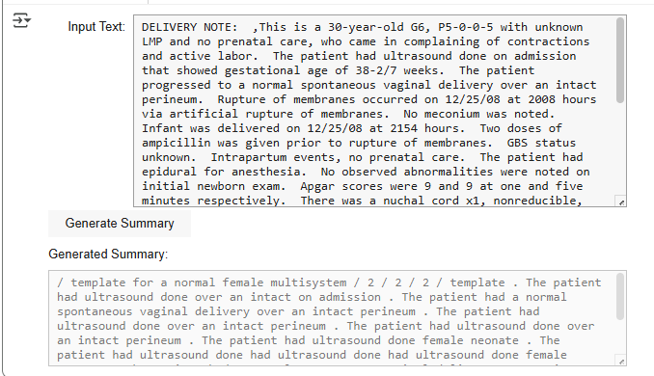
Challenges and Solutions
GPU Memory Constraints
Challenge: Limited GPU memory in Google Colab environment restricted model size and batch processing.
Solution: Designed compact model with 256 dimensions and 3 layers; used batch size of 4 with mixed precision training.
Small Dataset Limitations
Challenge: Only ~5,000 samples without pre-training led to moderate ROUGE scores.
Solution: Focused on educational demonstration; suggested future work with larger datasets and pre-trained models.
Slow Inference Speed
Challenge: Token-by-token generation resulted in 10-20 second processing times.
Solution: Implemented greedy decoding; recommended beam search for future improvements.
Key Learning: Building a Transformer from scratch provided deep insights into attention mechanisms and sequence modeling, despite performance trade-offs compared to pre-trained models like T5.
Notes:
9

Slide 10



Future Directions and Impact
Enhanced Model Performance
Additional Metrics
Production Deployment
Implement beam search decoding, increase training epochs, and expand dataset size. Consider leveraging pre-trained models like T5 for improved ROUGE scores.
Incorporate BLEU scores alongside ROUGE for comprehensive evaluation. Add human evaluation studies with healthcare professionals.
Develop user-friendly web application using Streamlit or Flask for broader accessibility in clinical settings.
Project Impact
This project successfully demonstrates the application of custom Transformer architecture for medical text summarization. By reducing the time required to interpret lengthy medical reports, our solution has potential to improve healthcare efficiency and support clinical decision-making.
Key Achievements: Built and trained a complete Transformer model from scratch, gained deep understanding of attention mechanisms and NLP challenges in the medical domain, and created a functional prototype for automated medical report summarization.
Notes:
10

Slide 11
Thank You!
Notes:
10

