Slide 1
Online Course Demand & Strategy Recommendations
Data-Driven Insights for Company Decision Making

Slide 2
Objective
• Identify most in-demand courses
• Understand student preferences
• Recommend strategy for course launches

Slide 3
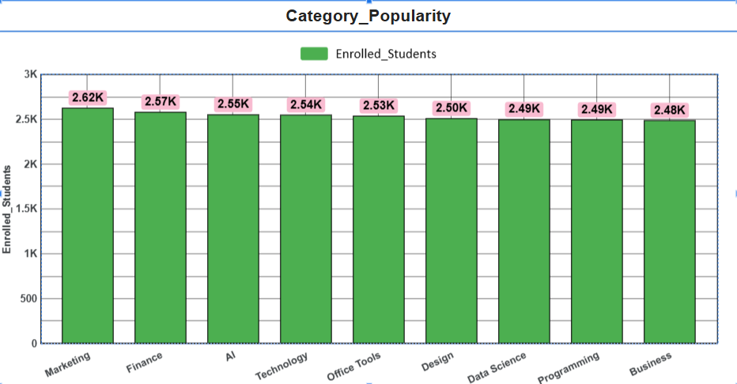
Market Insights
• Bar chart: Top 10 most demanded skills or course categories
• Insight: Business & analytics courses dominate demand, followed by technical skills.

Slide 4
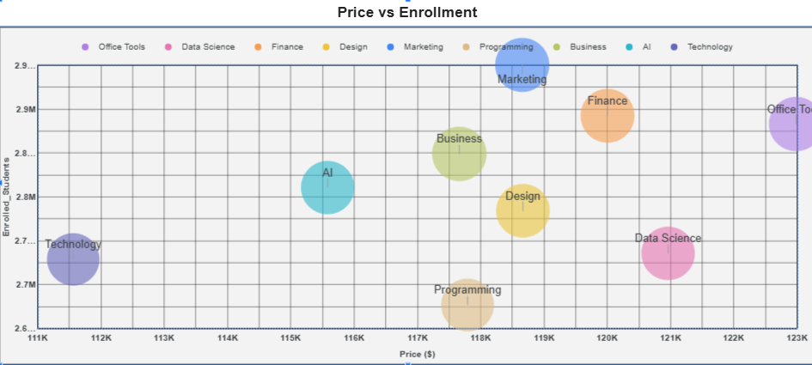
Student Behavior
• Scatter chart: Price vs Enrollments
• Insight: Courses priced between ₹9,800–₹10,000 show highest enrollments.

Slide 5
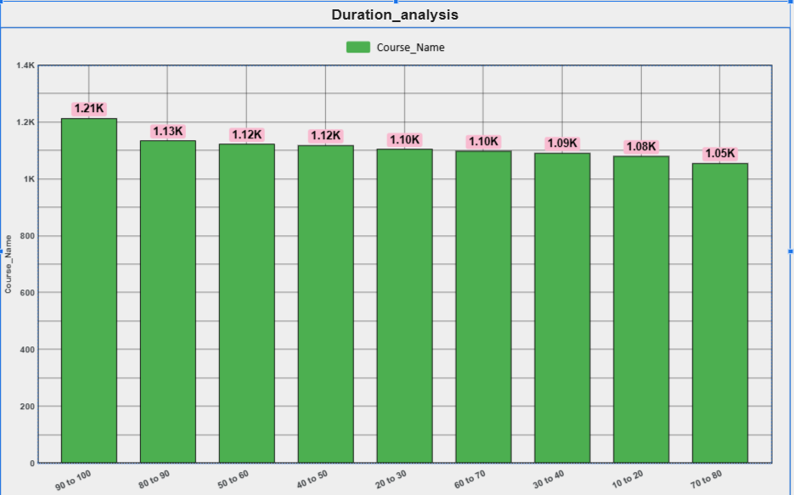
Engagement & Completion
• Bar chart: Course duration vs completion rates
• Insight: Short-duration (under 90 hrs-100 hrs) courses see fast completion compared to long ones.

Slide 6
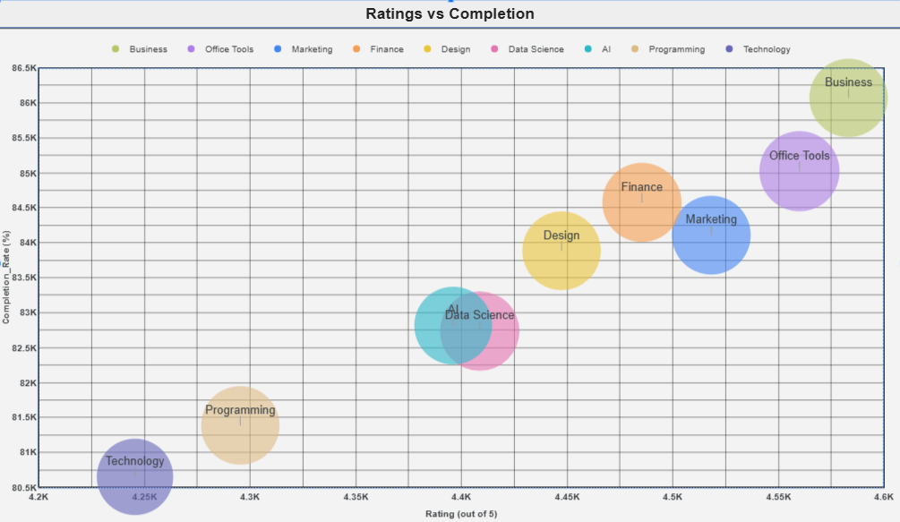
Ratings Performance
• Scatter chart: Completions & Ratings by platform
• Insight: Courses having high rating having high completion rate as courses should be introduced which have high rating in job market.

Slide 7
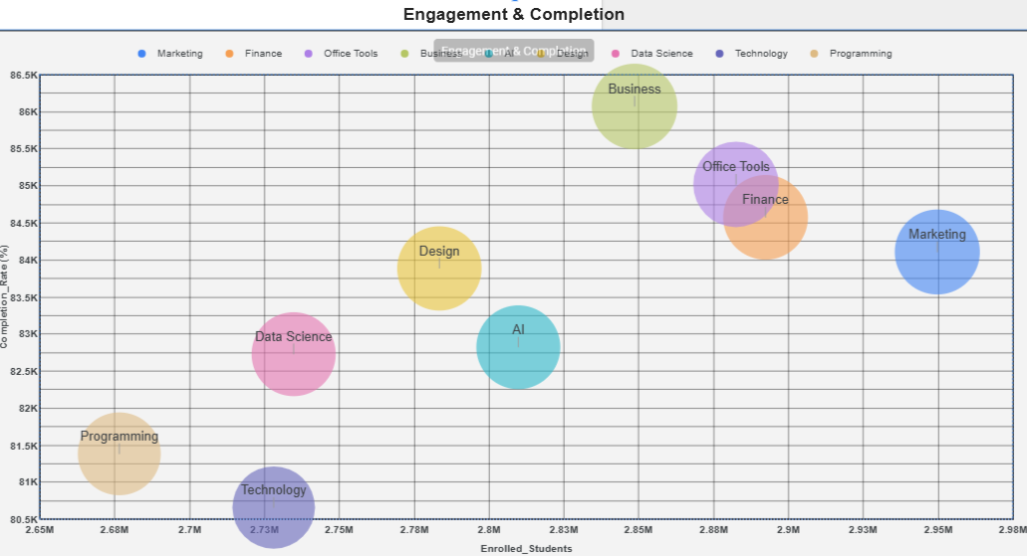
Enrollment Insights
• Scatter chart: Enrollment v/s Completion
• Insight:Longer course durations do not negatively impact completion rates.

Slide 8
Recommendations
✅ Launch short, affordable, high-demand tech & business courses
✅ Price range: ₹9,800 – ₹10,000
✅ Keep duration under 90 hrs-10 hrs for higher completion
✅ Partner with platforms that balance enrollments & ratings

Slide 9
Conclusion & Next Steps
• Pilot launch 2–3 courses in top-demand categories
• Track enrollments, completion, and student feedback
• Expand into other categories after testing response

