Slide 1

Job Recommendation System
Project by
Shrita Shirish Gaonkar
Facilitator
Uzair Ahmed

Slide 2
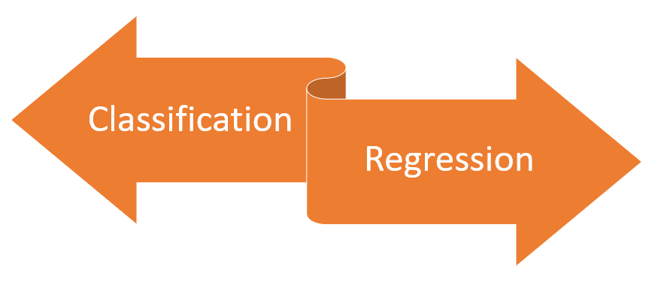
Approach

Slide 3
Content
Career Recommendation system
Data pre-processing
Model architecture
Algorithm performance
Admission Prediction
EDA
Data pre-processing
Model architecture
Algorithm performance

Slide 4
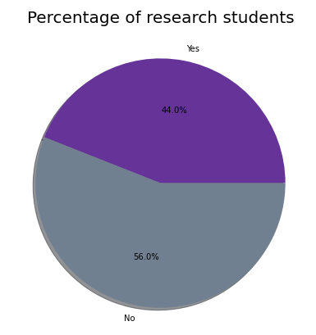
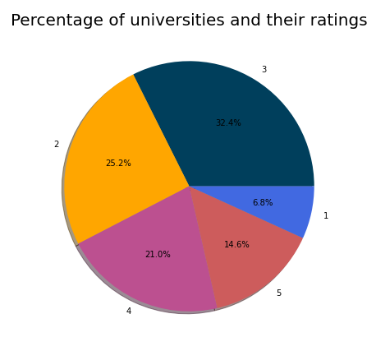
Admission Prediction Data Analysis(EDA)

Slide 5
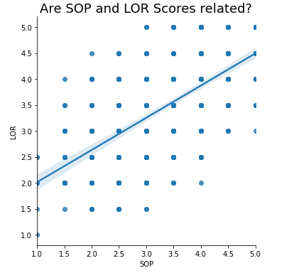
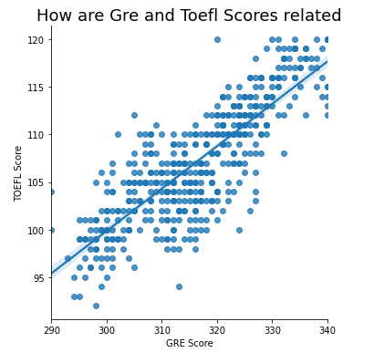
Admission Prediction Data Analysis(EDA)

Slide 6
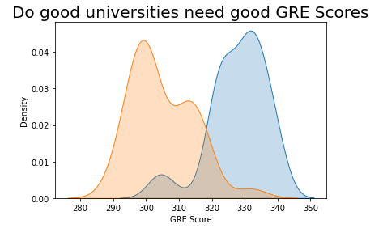
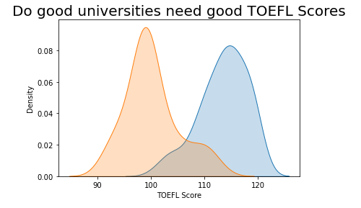
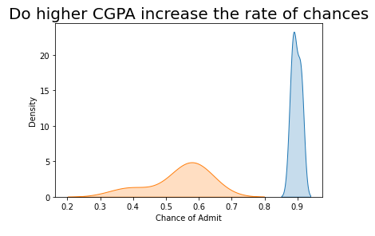
Admission Prediction Data Analysis(EDA)

Slide 7
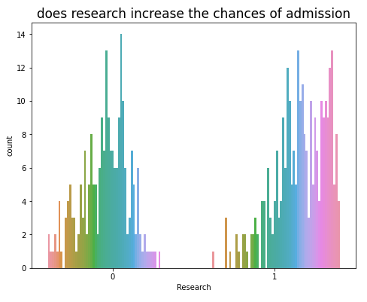
Admission Prediction Data Analysis(EDA)
GRE scores, GPAs, quality of undergrad school, admission essays, and personal statements are all important to the admission process to get into graduate school.
however, research is a unique and important way to distinguish you as a qualified candidate to admissions committees.
In fact, some universities even require that you have prior research experience before graduate school.

Slide 8




Data Pre-processing
Drop unnecessary columns
Null values -> Dropping
Label Encoding
Standard Scaling

Slide 9
Job Recommendation
Job recommendation Data
Dropping Unnecessary columns and rows
Building custom tokenizer to process text
Train-Test Split
Modelling
Gaussian Naïve bayes
Logistic Regression
Random Forest Classifier
Over-fitting
Hyper-parameter Tuning
Modelling with new parameters
ACCURACY
Plotting results

Slide 10
Admission Prediction
Admission Prediction Data
Data Analysis
Dropping Unnecessary columns
Train-Test Split
Modelling
SVR
Random Forest Regression
Linear Regression
ACCURACY
ACCURACY
ACCURACY
Plotting results
Plotting results
Plotting results
Prediction

Slide 11
Algorithm Performance(Admission Prediction)
English Grades | Mean Absolute Error | Root Mean Absolute Error | R2_Score
Linear Regression | 0.0032409296 | 0.056929 | 0.8413731
SVR | 0.006107 | 0. 07815 | 0.70105008
Random Forest Regression | 0.00391 | 0.062564 | 0.808413

Slide 12
Algorithm Performance(Job Recommendation)
Models | Accuracy before hyper-parameter tuning | Accuracy after hyper-parameter tuning
Logistic Regression | 0.7991071 | 0.834821428
Random Forest Classifier | 0.352678 | 0.419642
Gaussian Naïve Bayes | 0.7008928 | There are no hyperparameters to tune!

Slide 13

Questions ?

