Slide 1


ARTIFICIAL INTELLIGENCE ALGORITHMS
Artificial Intelligence Design and Implementation
TEST 1
YOUR NAME: Shrita Gaonkar
COLLEGE_ID: 100799307

Slide 2
ARTIFICIAL INTELLIGENCE ALGORITHMS
Artificial Intelligence Design and Implementation
Read the question and USE X , in all boxes that are correct in your perspective.

Slide 3
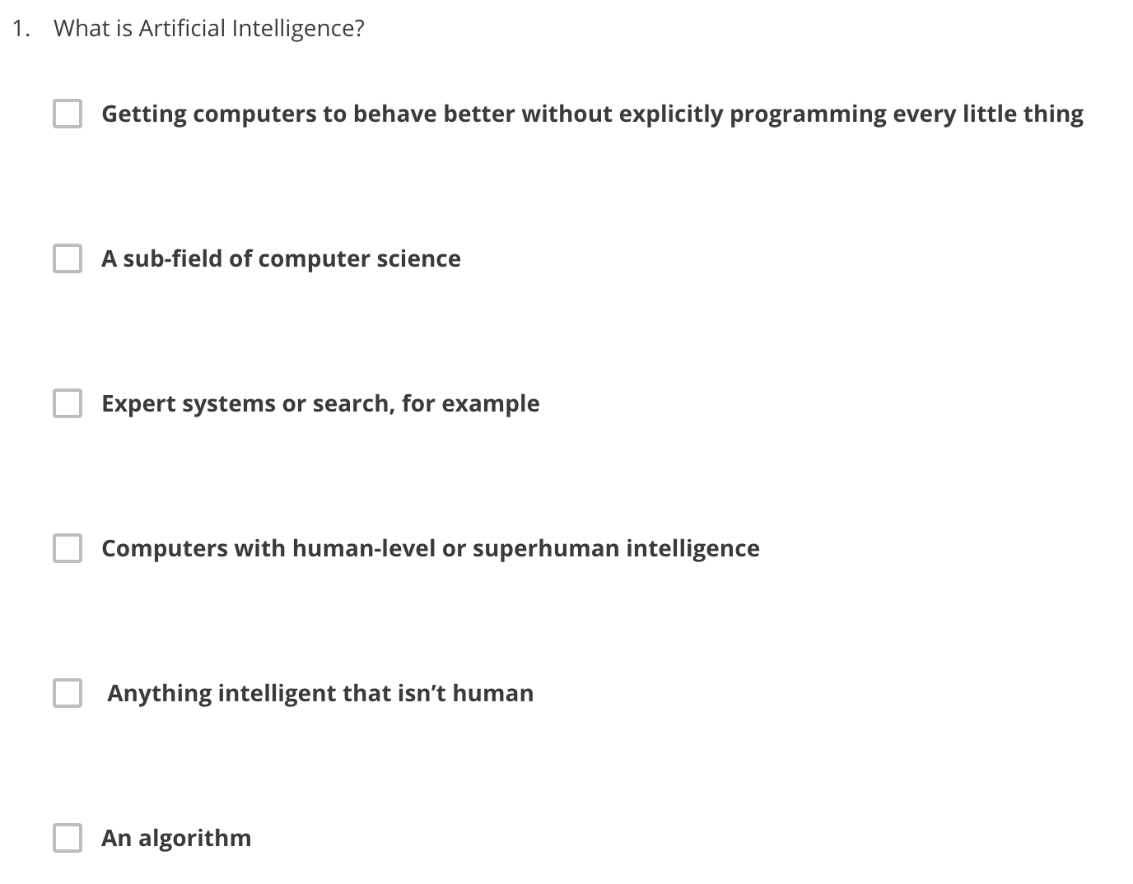
1
X
X

Slide 4
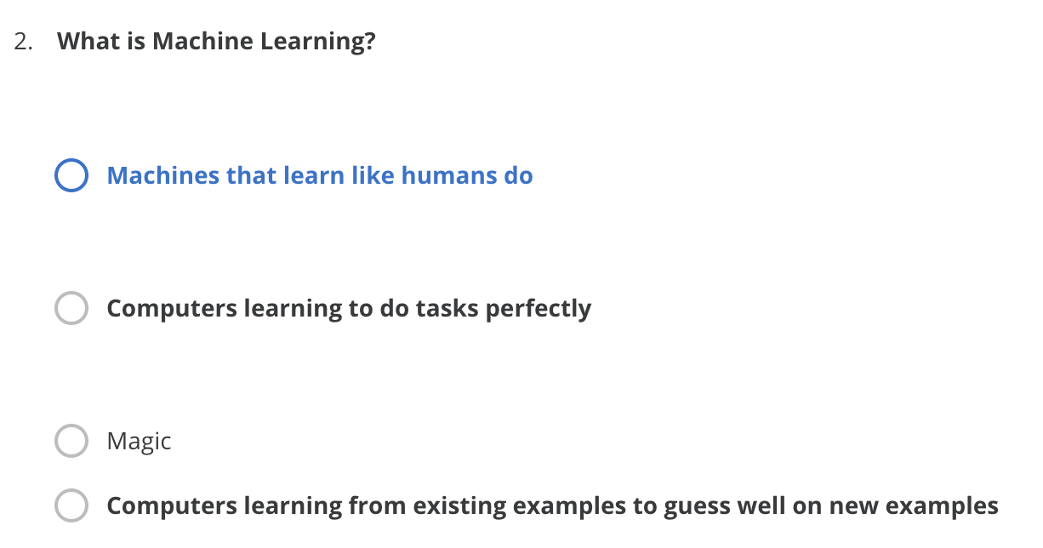
2
X

Slide 5
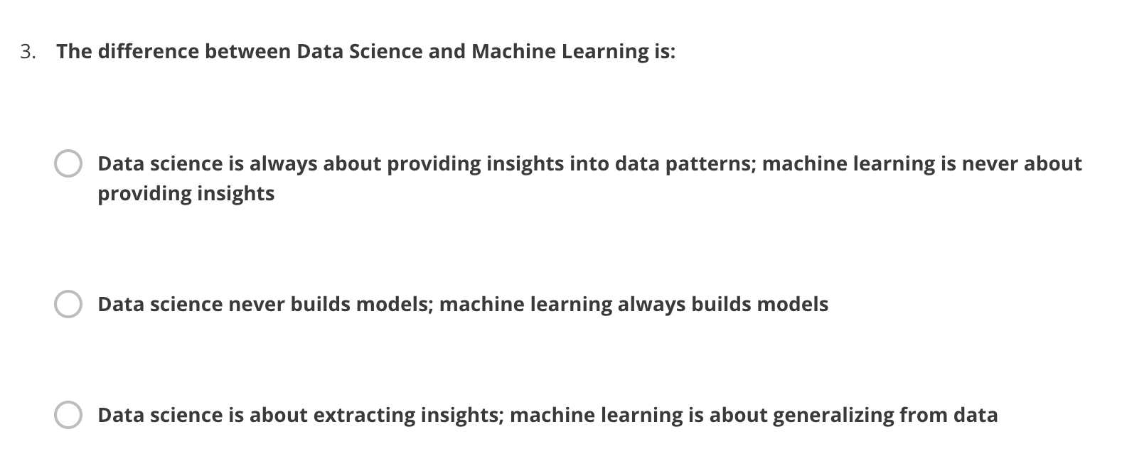
3
X

Slide 6
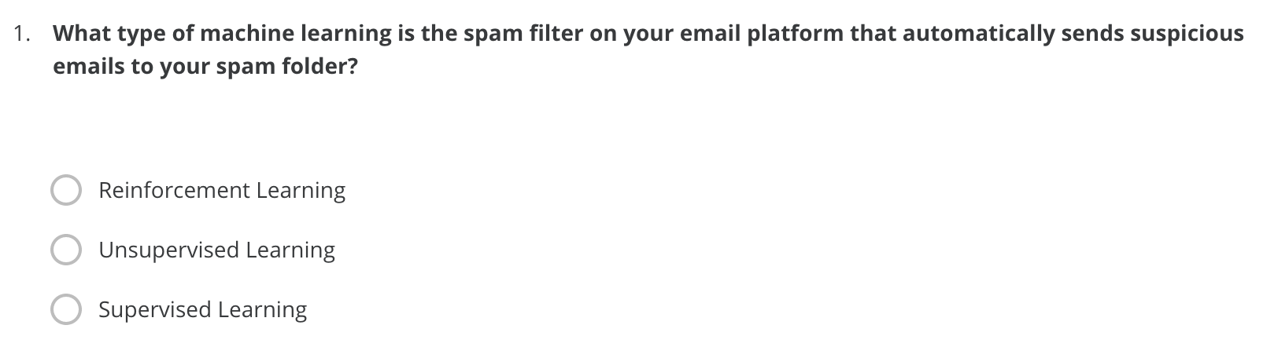
4
X

Slide 7
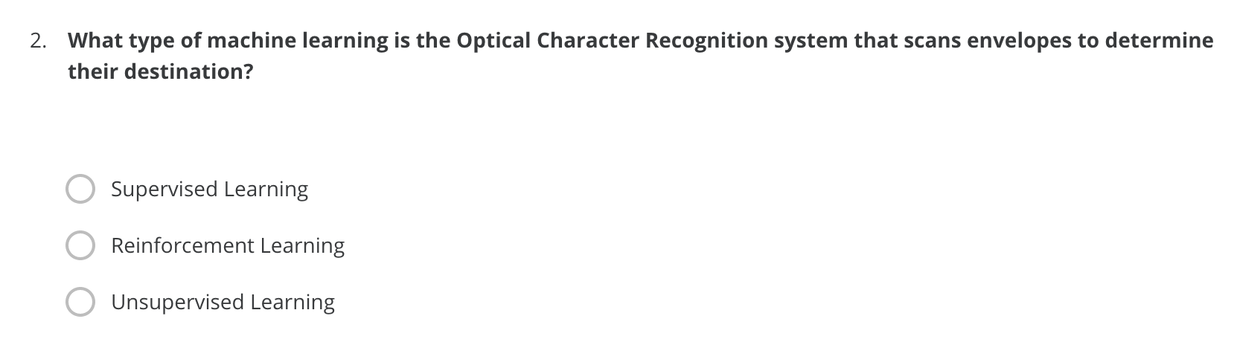
5
X

Slide 8
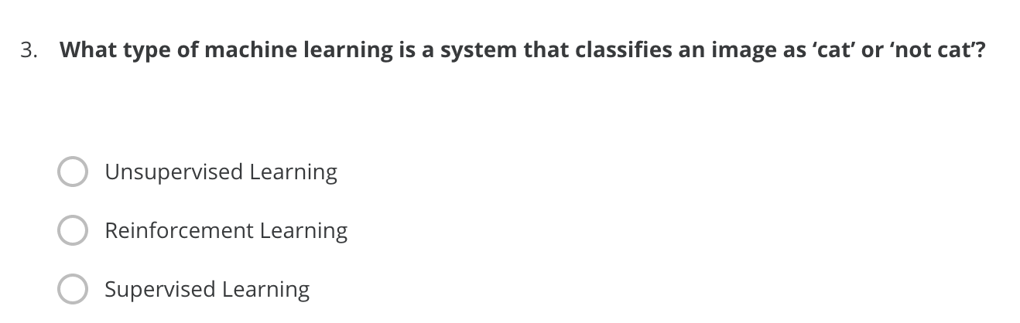
6
X

Slide 9
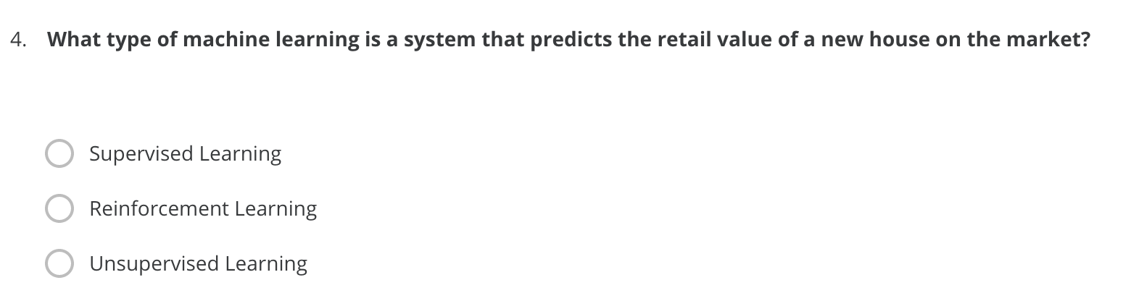
7
X

Slide 10
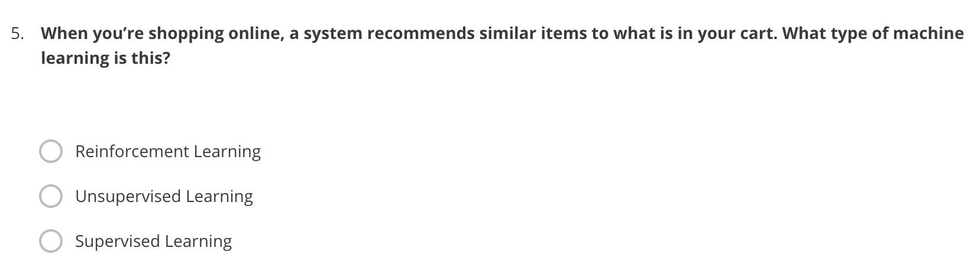
8
X

Slide 11
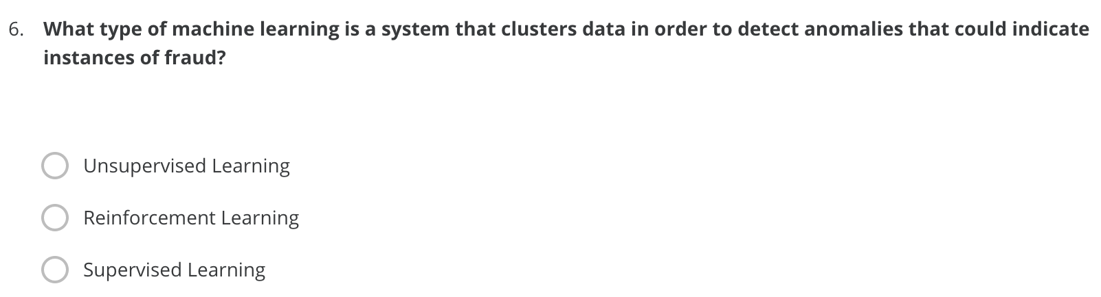
9
X

Slide 12
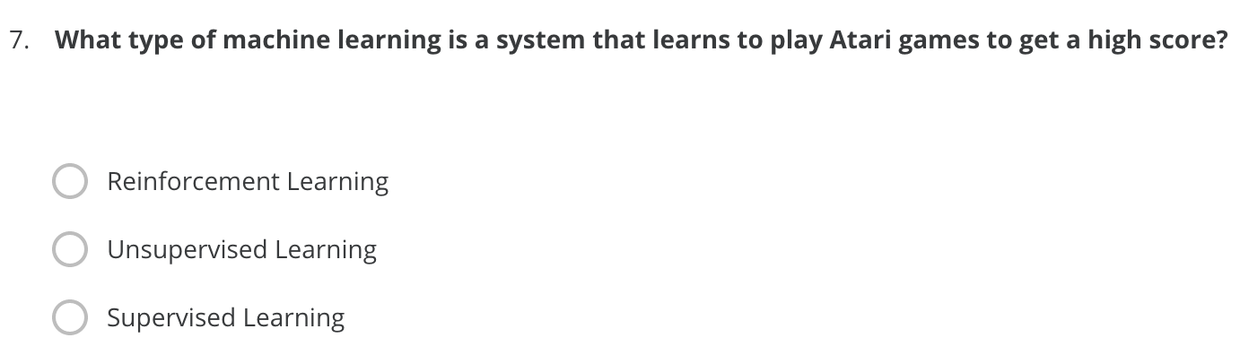
10
X

Slide 13
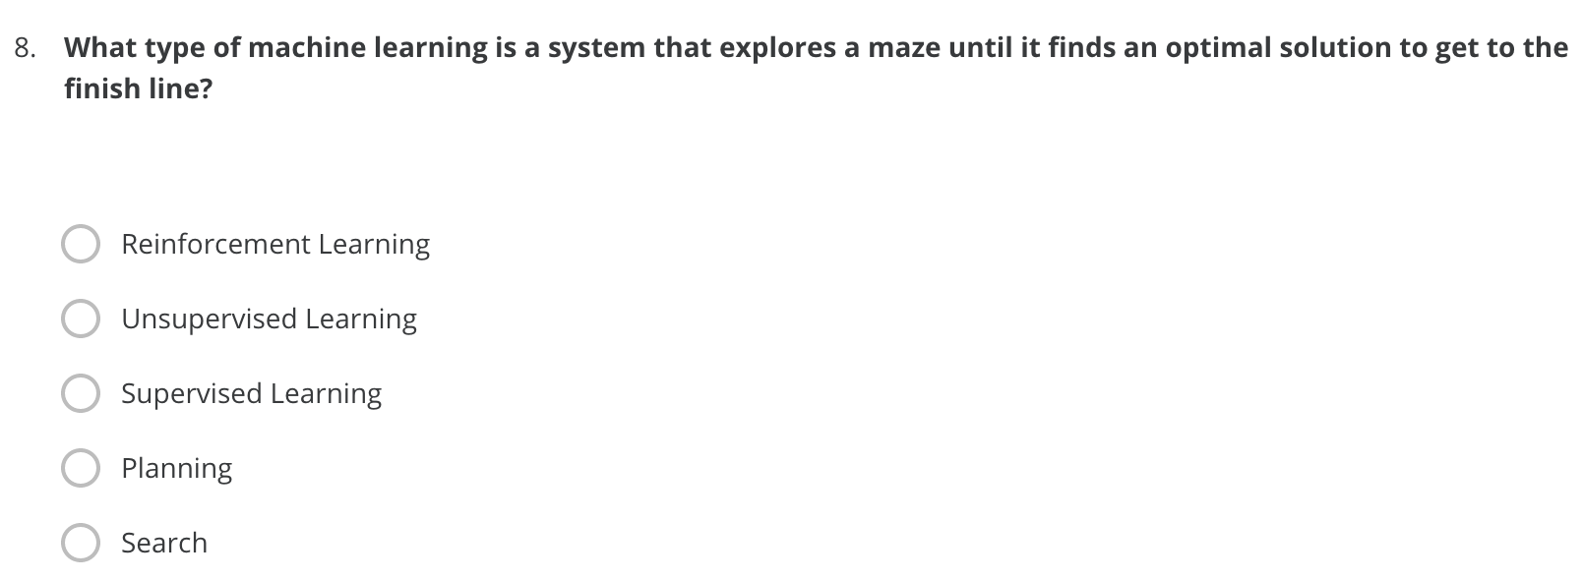
11
X

Slide 14
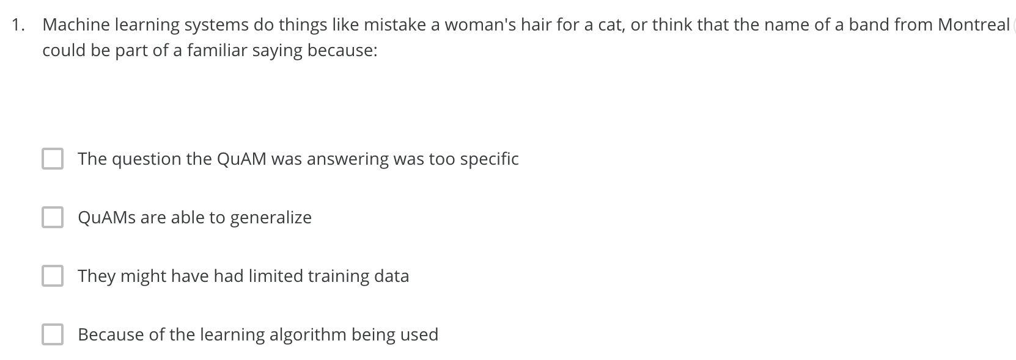
QuAM = Machine Learning Model.
12
X
X

Slide 15
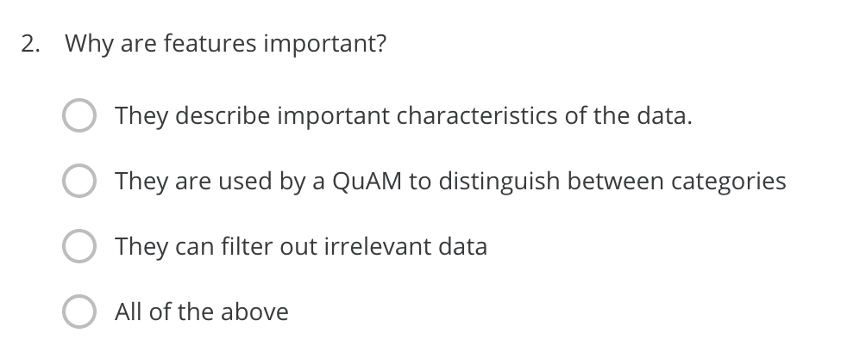
QuAM = Machine Learning Model.
13
X

Slide 16
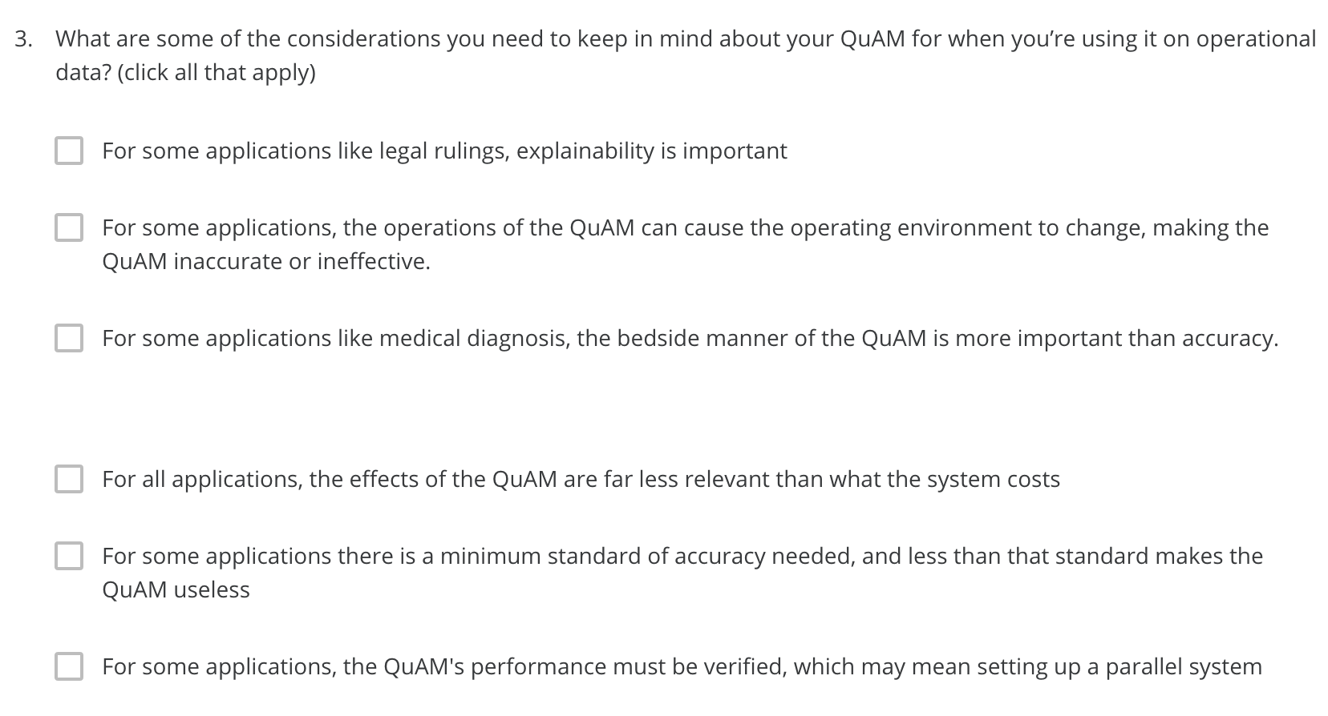
QuAM = Machine Learning Model.
14
X
X
X

Slide 17
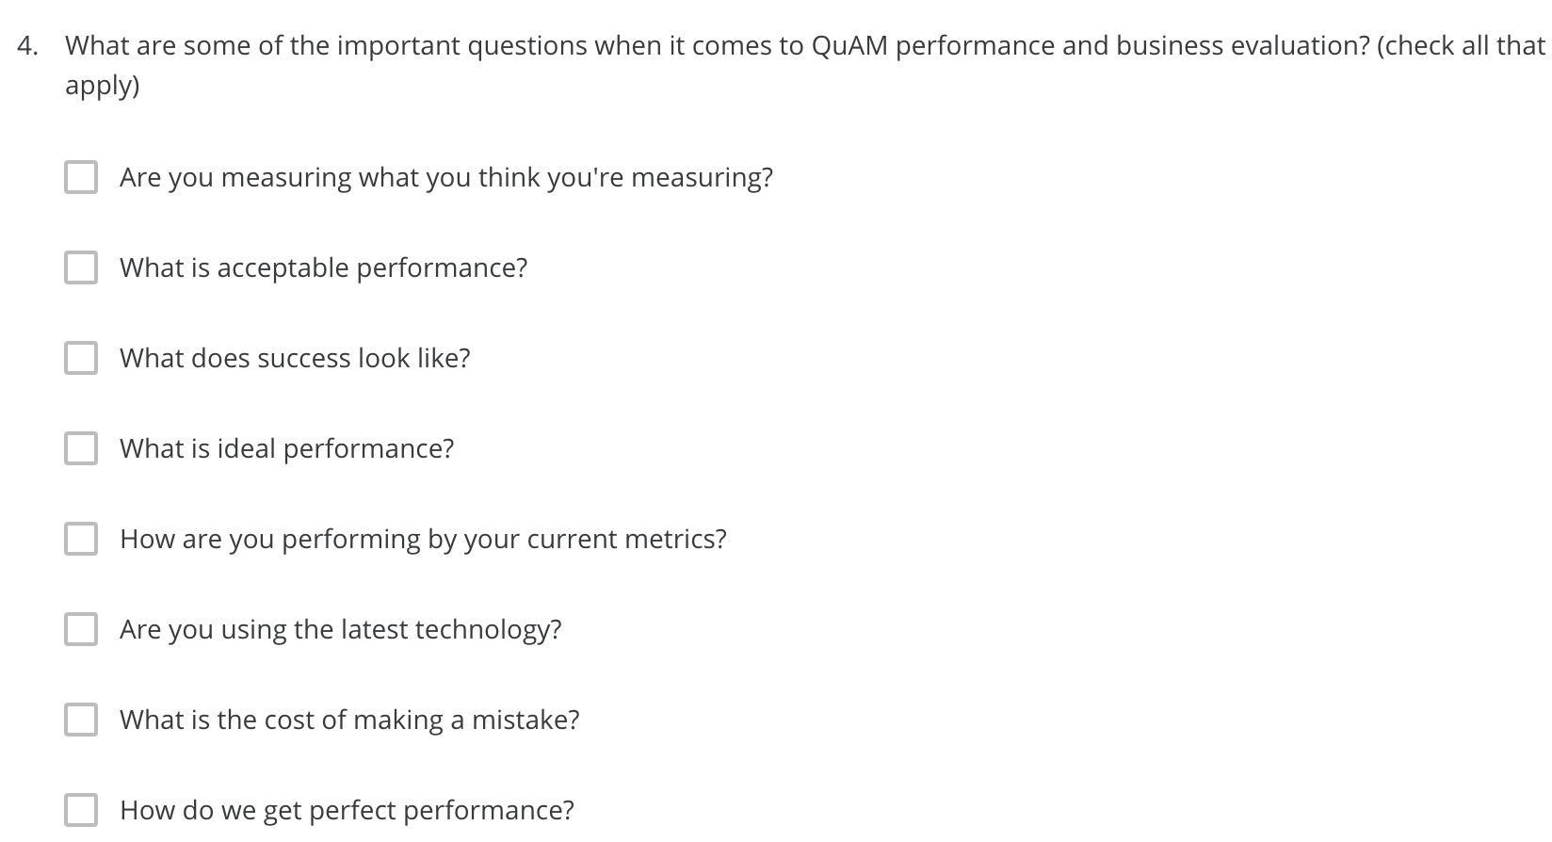
QuAM = Machine Learning Model.
15
X
X
X
X
X
X
X

Slide 18
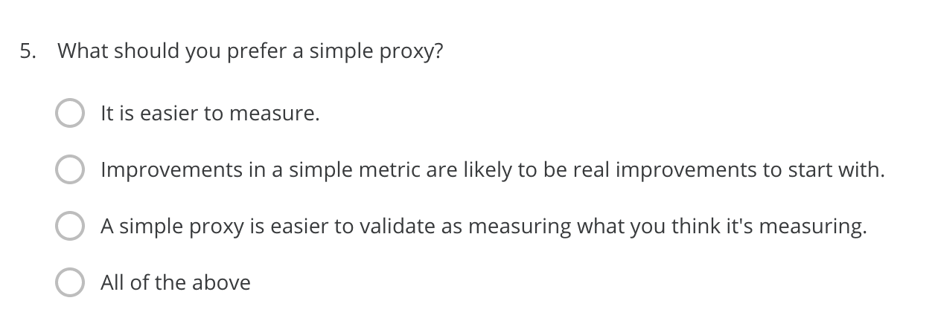
16
X

Slide 19
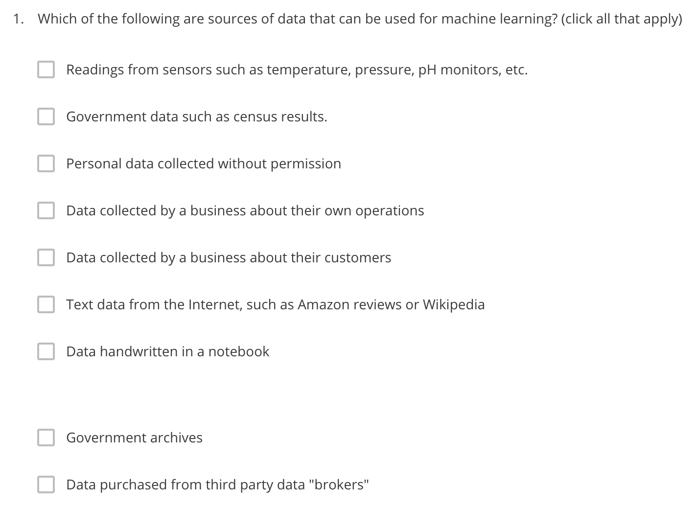
17
X
X
X
X
X
X
X

Slide 20
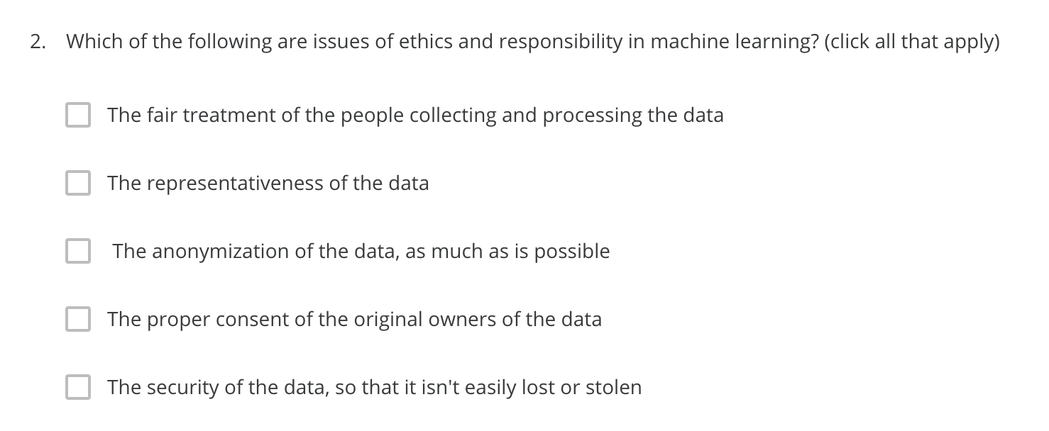
18
X
X
X
X
X

Slide 21
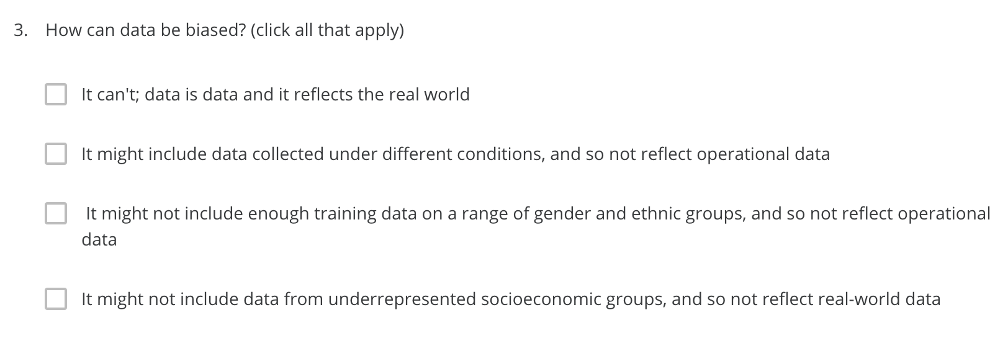
19
X
X
X

Slide 22
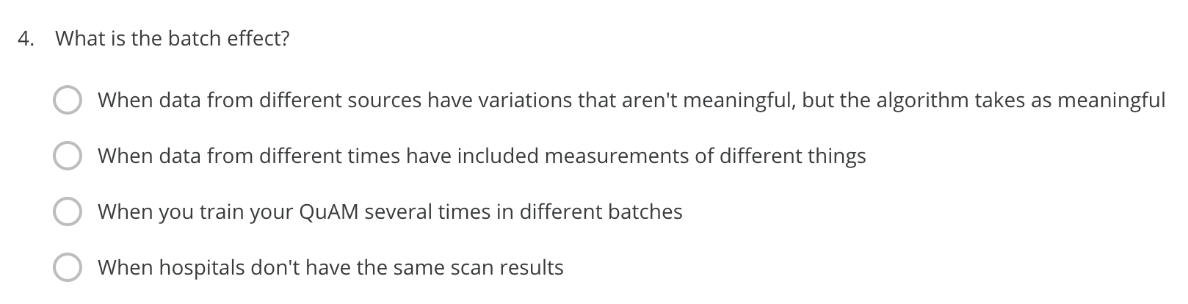
QuAM = Machine Learning Model.
20
X

Slide 23
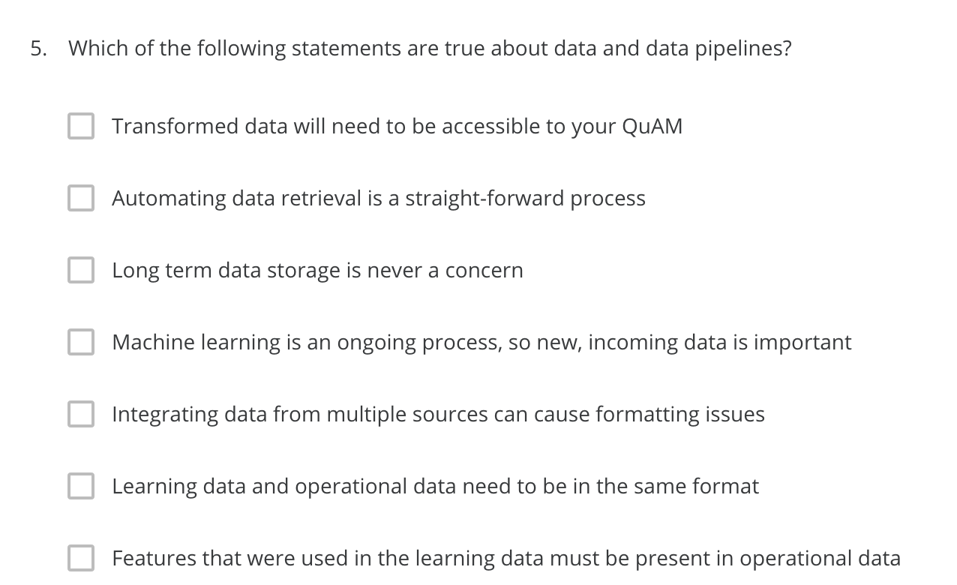
QuAM = Machine Learning Model.
21
X
X
X
X
X

Slide 24
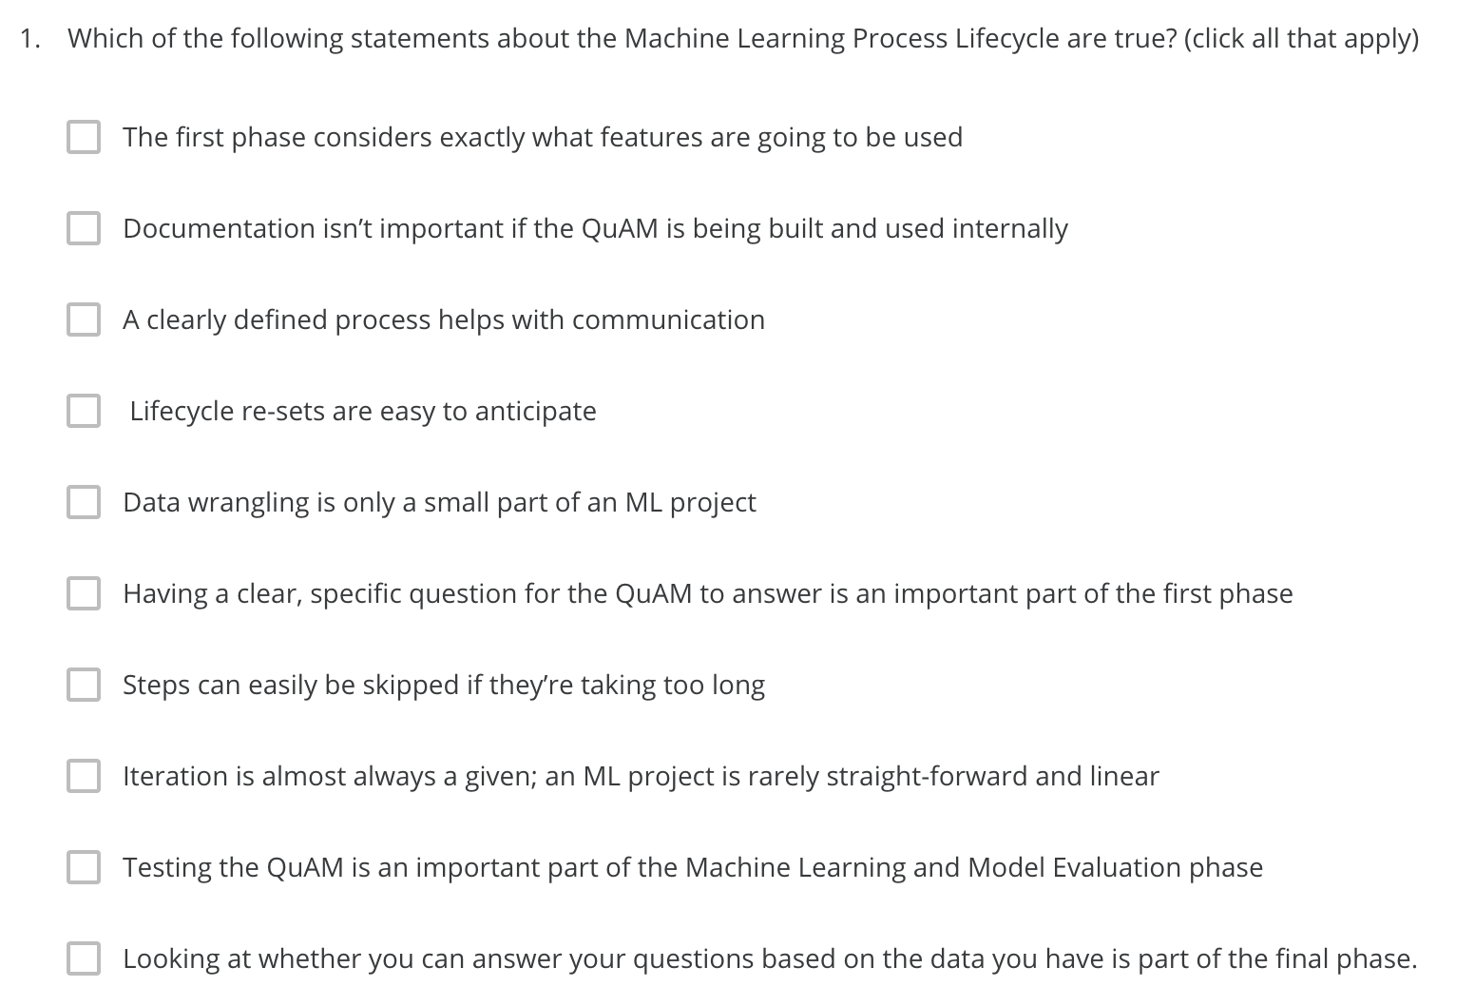
QuAM = Machine Learning Model.
22
X
X
X
X
X
X

Slide 25
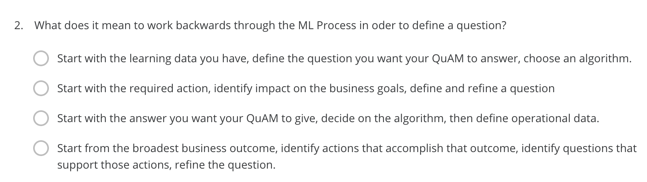
QuAM = Machine Learning Model.
23
X

Slide 26
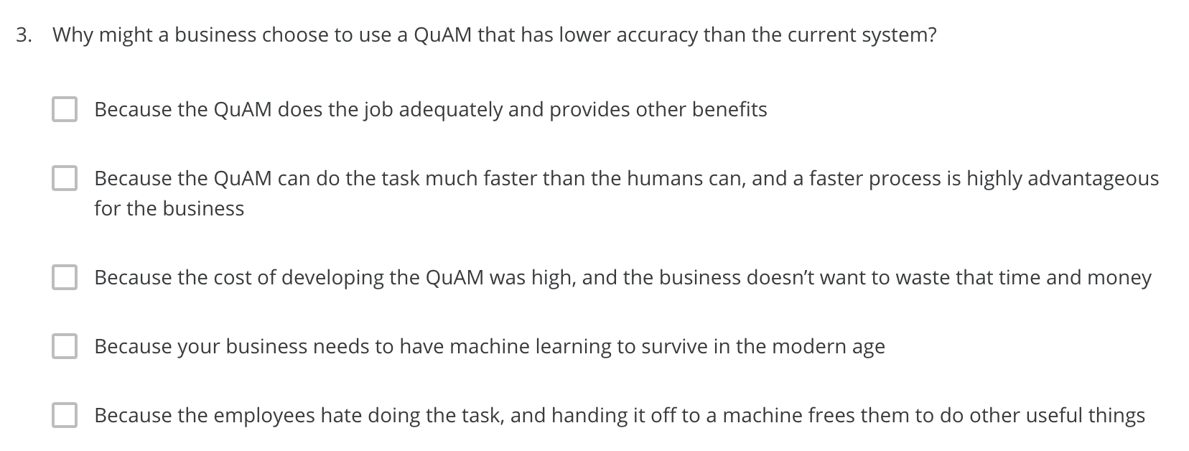
QuAM = Machine Learning Model.
24
X
X
X

Slide 27
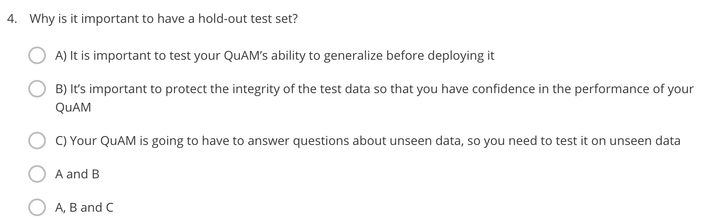
QuAM = Machine Learning Model.
25
X

Slide 28
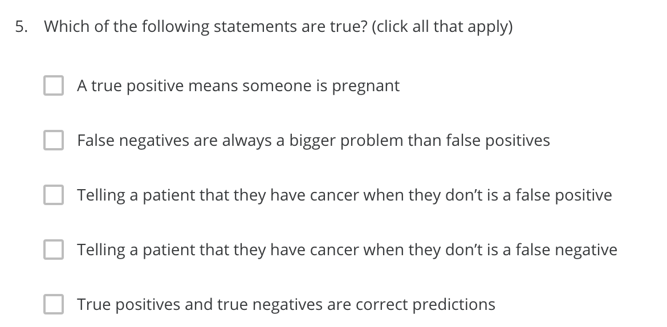
26
X
X
X
X

