Slide 1
Data analysis for student grade prediction
Shrita Gaonkar (100799307)

Slide 2
Welcome All!
Good Afternoon! We are gathered here to study the various factors impact the student’s grade in Portugal
We will begin by studying the population, literacy, youth percentages of Portugal(This is important to know because that is how Jobs and other features are changed)
Next, We will study all the individual features of the two available datasets(student-mat and student-por)
After this is done, we answer a few questions about the correlation of the features with each other
Lastly, We will learn the correlation of dependent(G1,G2,G3) and independent features

Slide 3
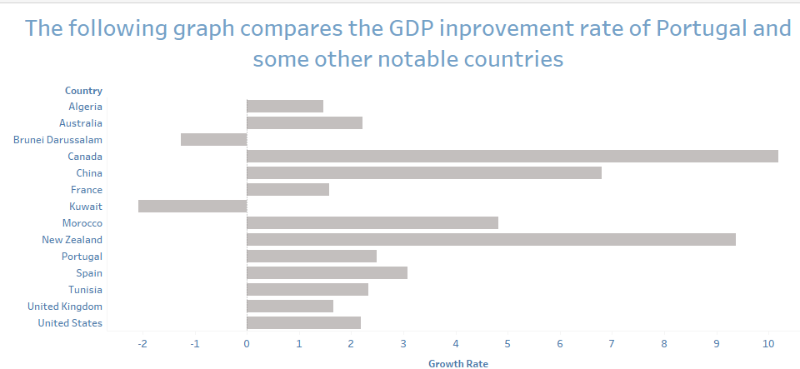
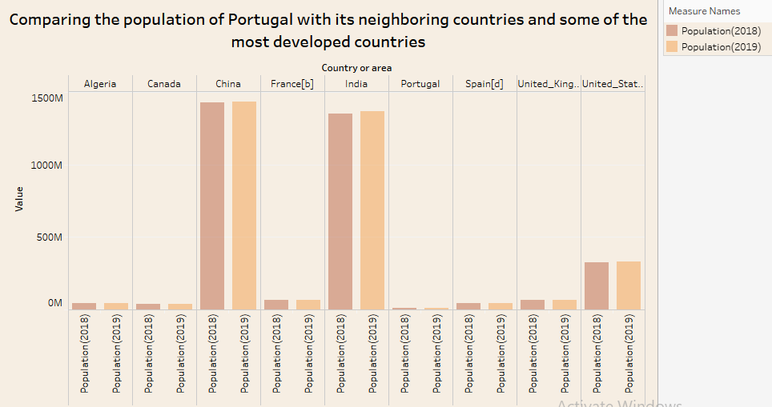
Introduction to general information about portugal
Graph A : Population of Portugal compared to its neighboring countries and some developed countries
Graph B : Comparing GDP development rate of Portugal with its neighboring countries and some developed countries

Slide 4
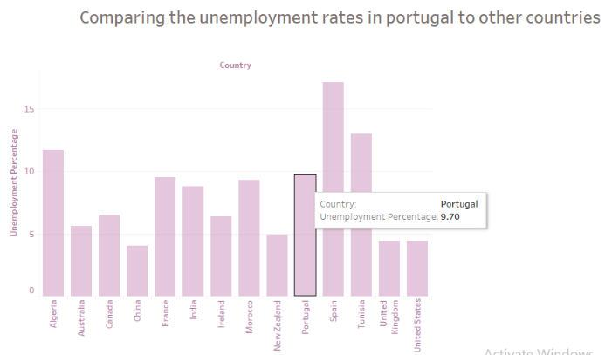
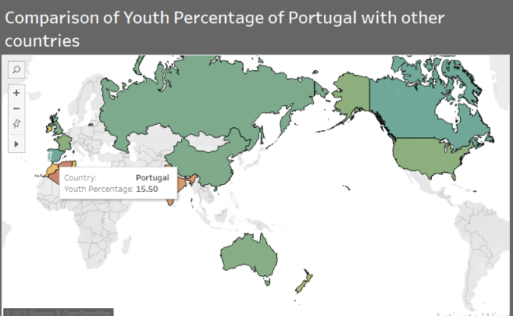
Youth Percentage of Portugal compared to its neighboring countries and some developed countries
Youth percentage of Portugal is very less compared to other countries
Comparing the unemployment rates of Portugal compared to its neighboring countries and some developed countries
Youth percentage of Portugal is nine percent!

Slide 5
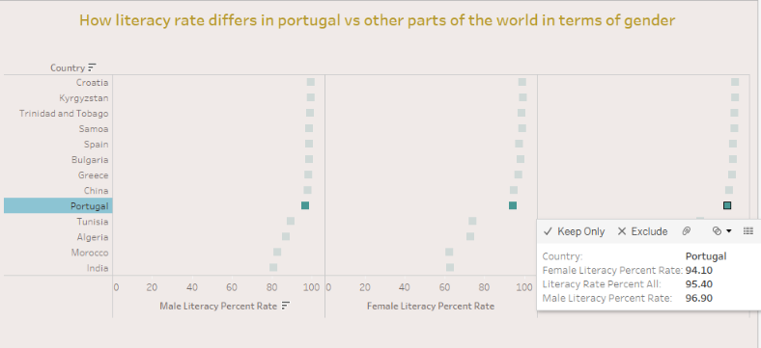
Literacy rate of Portugal is good and is equally provided to both the genders!
Portugal is a very literate country with equal number of opportunities for both males and females.
It has an overall literacy rate of 96.9%
The female and male literacy is 94% and 95% respectively.

Slide 6
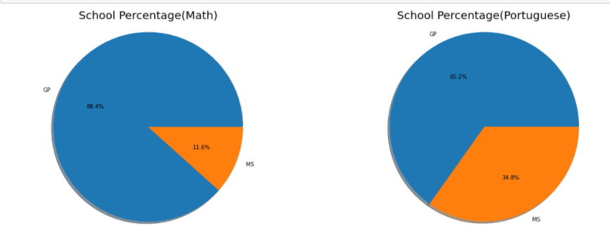
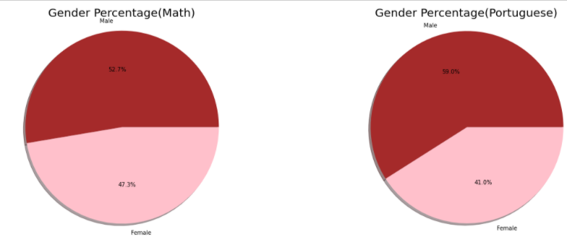
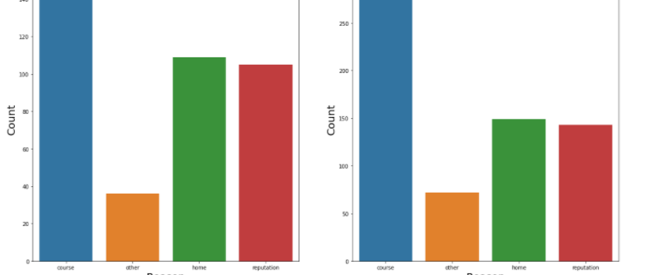
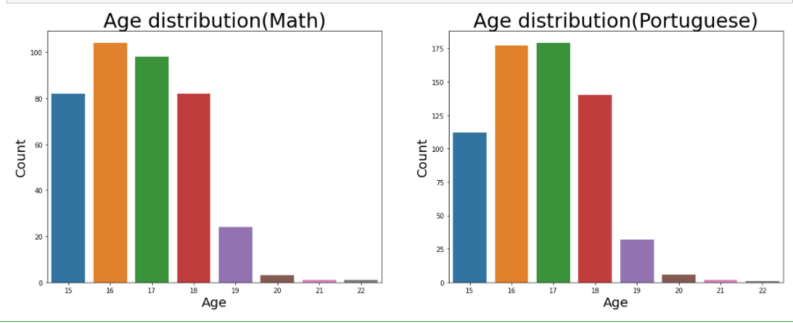
Now, Let’s compare the count of some features
As both the datasets, did not have a primary key, I have not combined the datasets. We will study them separately.
In the math dataset, there are 88.4% students from GP and 11.6% students from MS
In the math dataset, 52.7% students are male. In the port dataset, 41% students are female
In Both the datasets the distribution of age seems very similar with ages 17 and 18 at peak and lesser number of 20+ years old
In both the datasets, The reason for students to choose their schools was because of the course and because the school was closer to home

Slide 7
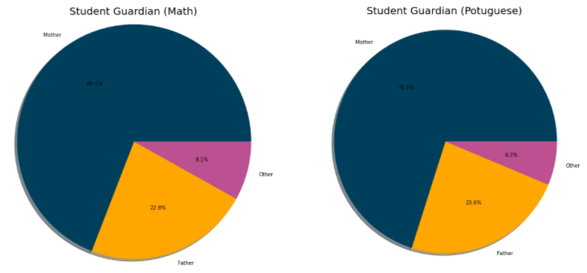
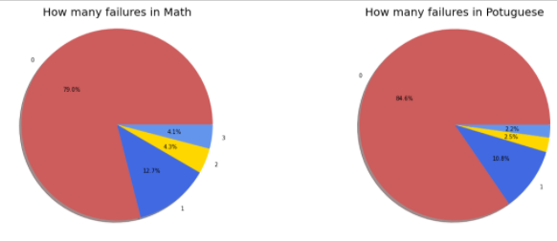
Almost all the students in both the datasets have mothers as their guardians
Both the datasets saw that there were zero failures associated with most students
The failures were more in Math dataset
For more information on features kindly look at the Jupyter notebook provided

Slide 8
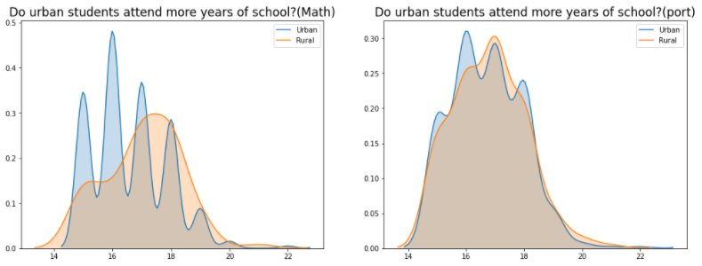
Do students living in Urban area attend more years of school?
We can not draw this conclusion firmly. But there is a small rise at the end because of which we can say that to students living in Rural areas attend school more school compared to students living in Urban areas

Slide 9
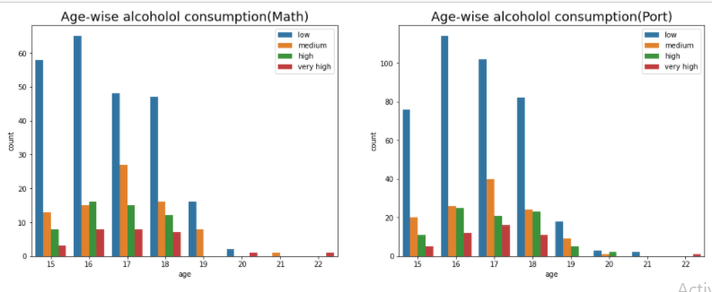
Age-wise alcohol consumption
Looks like 16-18 year olds had more weekly alcohol consumption than the other age classes.
Overall, The alcohol consumption in students is very less in both the datasets

Slide 10
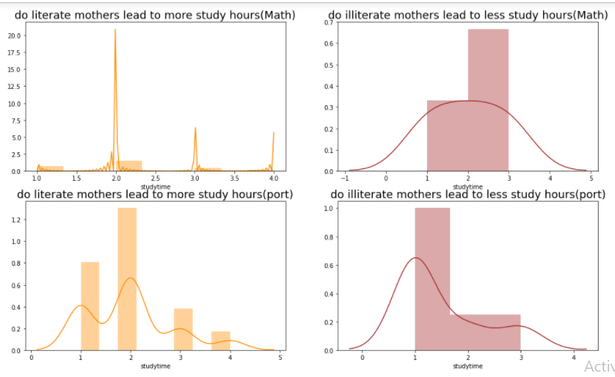
do illiterate mothers lead to less study hours?
Literacy of mothers had no affect on number of hours a student studied

Slide 11
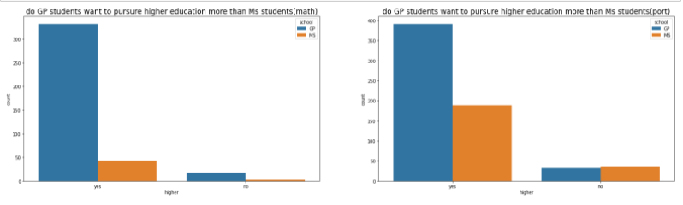
do GP students want to pursue higher education more than Ms students?
In port data, we can see that the students don’t want to take higher education
But other than that in math dataset Both schools want to pursue higher education

Slide 12
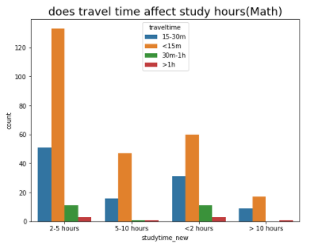
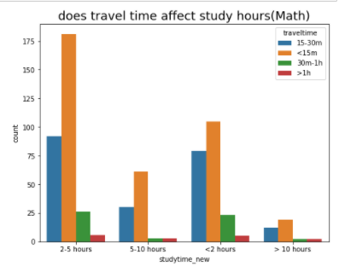
does travel time affect study hours
In math dataset, Most of the students who had a travel time of less than 15 mins were able to study for more than 10 hours This means that less travel time leads to more study hours
In port dataset, Most of the students who had a travel time of less than 15 mins were able to for more than 10 hours which is .This means that less travel time leads to more study hours

Slide 13
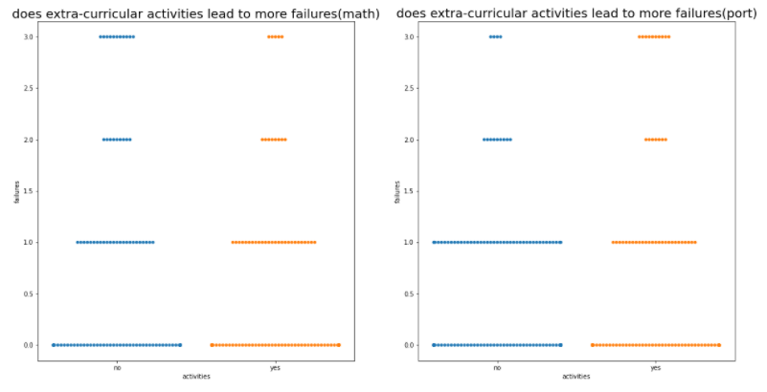
does extra-curricular activities lead to more failures
The graph clearly shows that involving in extra-curricular activities does not affect grades or lead to more failures

Slide 14
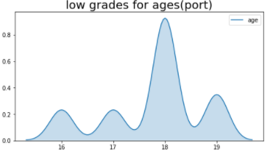
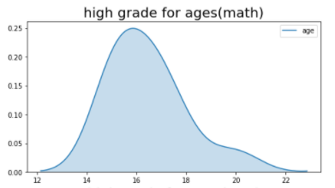
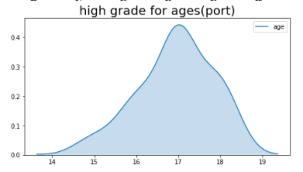
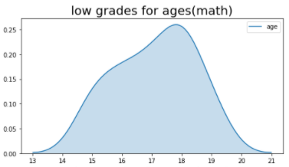
High grade and low grade vs age?
Age groups 12-16 had more higher grades and ages 19 and above had lower grades in Math dataset
Age groups 17-19 had more higher grades and ages 19 and 18 year olds had lowest scores

Slide 15
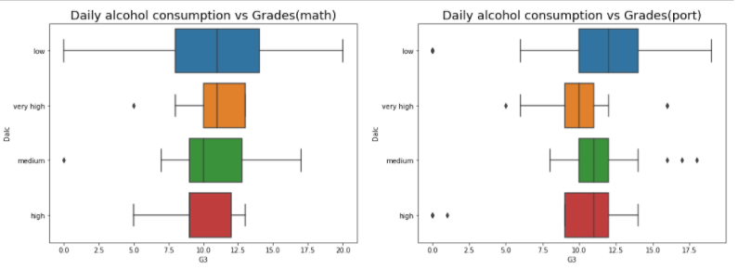
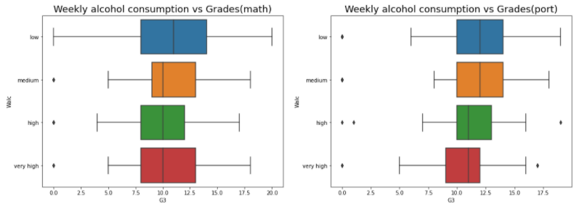
Weekly and daily alcohol consumption vs Grades(math)
In terms of number, students who consumed less alcohol did better. Their graph also looks evenly distributed
In terms of number, students who consumed less alcohol did better. Their graph also looks evenly distributed
In both the datasets students who have high alcohol content performed poorly

Slide 16
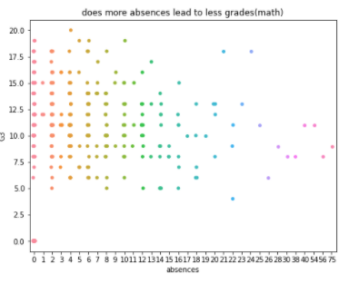
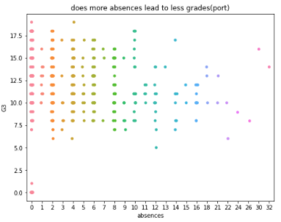
does more absences lead to less grades?
Absence has a higher impact on grades. The more the absences the lesser the grade

Slide 17
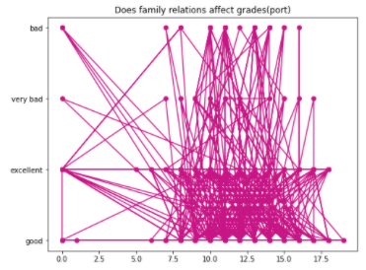
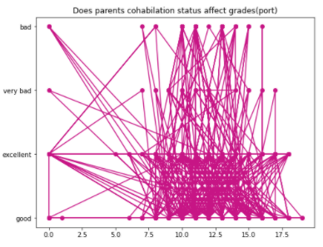
Does family relations affect grades?
Students whose good or excellent family relations performed better?

Slide 18
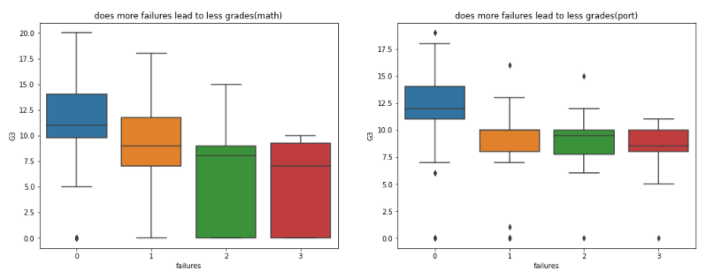
does more failures lead to less grades?
Students who had zero failures tend to perform better in terms of grades.

Slide 19
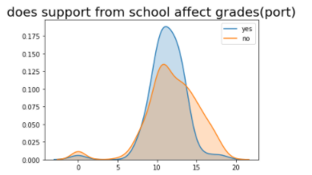
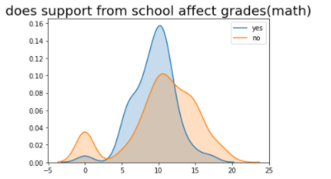
does support from school affect grades?
Students who had support from school tend to perform better with higher grades in both the datasets with a greater margin.

Slide 20
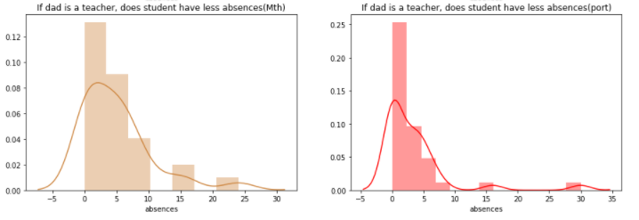
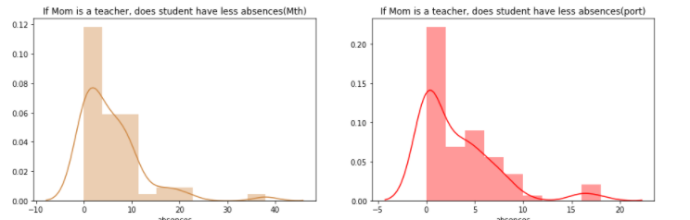
If mom is a teacher, does that mean less absences?
From the graph, it looks like if the students had parent teacher or father they had less absences in general than students whose parents were in other occupations.

Slide 21
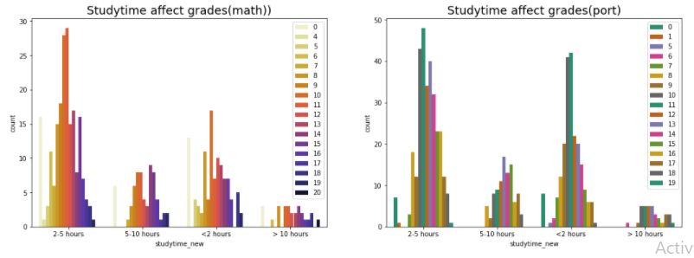
DOES STUDYING FOR MORE HOURS LEAD TO BETTER grades?
More study time leads to higher grades is clear from the graph.

Slide 22
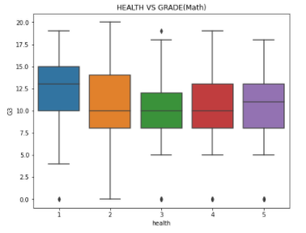
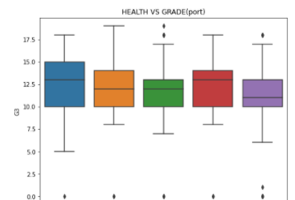
Does good or bad health have impact on grades?
Health had a very high correlation with grade. But we can see that health does not directly change the grades.

Slide 23
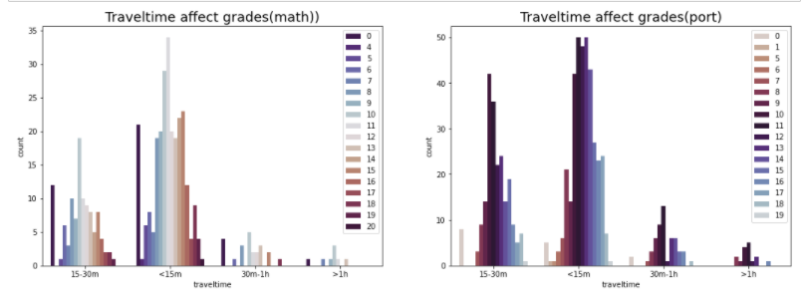
Does more travel time lead to less grades?
Surprisingly, in math dataset students who travelled lesser had lower scores
In port dataset, travel time has no affect over grades

Slide 24
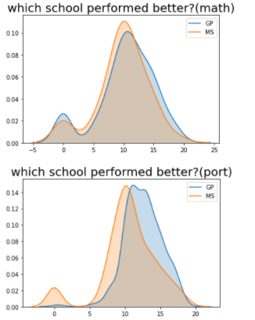
Which school has better grades?
In math dataset, MS students had performed better than GP students
But in port data the higher grades are equal for both the school

Slide 25
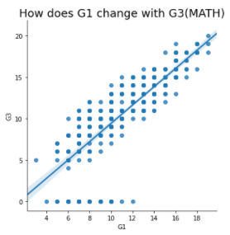
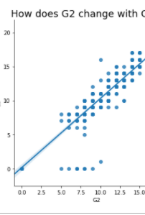
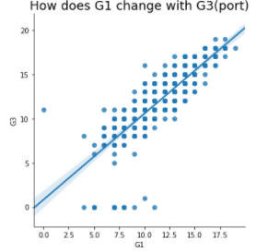
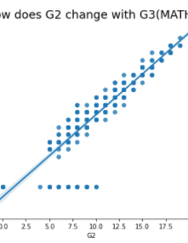
How will G1 and G2 change G3?
G1 and G2, if change will change G3 entirely
That is why we can say that G1 and G2 are highly correlated with G3

Slide 26
Conclusion
To conclude, all the variables had high correlation with each other
These features are needed to predict accurately the future grades of students
The major indicators for the math and port datasets were Health, School and age

