Slide 1
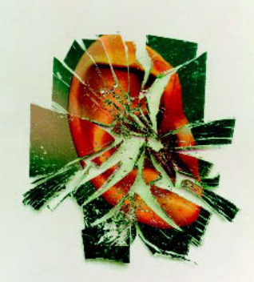
Prevalence of Hearing Loss in the United States by Industry
Shrita Shirish Gaonkar
100799307

Slide 2
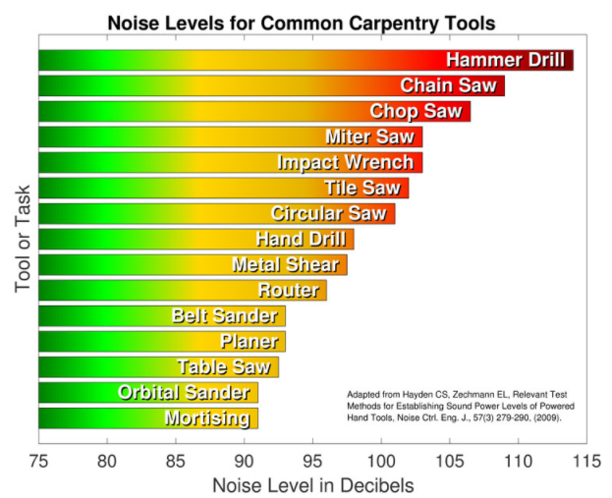

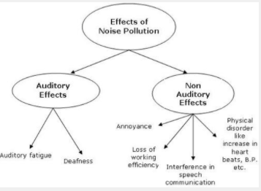
Why is it important to change the current system to prevent noise pollution
Noise pollution is displeasing human, animal or machine created sound that disrupts the activity or balance of living organisms
Common effects of hearing loss:
Hearing loss
Stress
Sleep disturbance
High blood pressure
Recommendations
The equipment used to smash stuff can be coated with rubber.
It is possible to store machines that make a lot of noise in a sound-proof environment.
Staff working in a noisy environment will work with ear muffs that cancel noise.
The use of alternative equipment or secure operating systems should be considered.

Slide 3
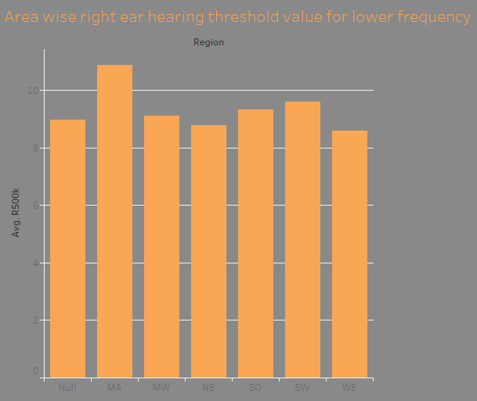
Data Analysis and assumptions
I am keeping in mind that there was no data manipulation before.
I have enough data to conduct analysis.
I am assuming that all columns are necessary, and all independent variables are correlated with the dependent variable and not changing any variable name.
The dataset would be easily understandable to all the developers.

Slide 4
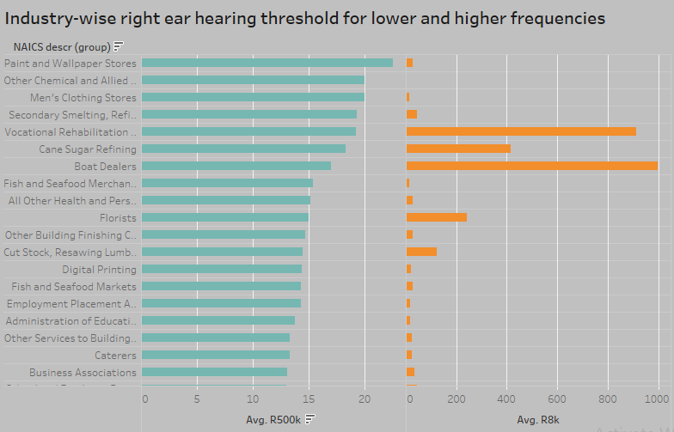

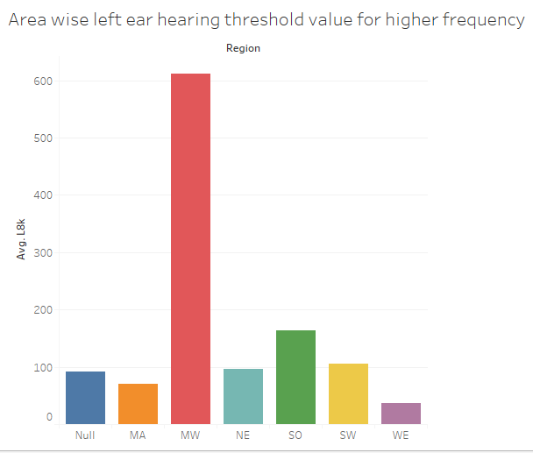
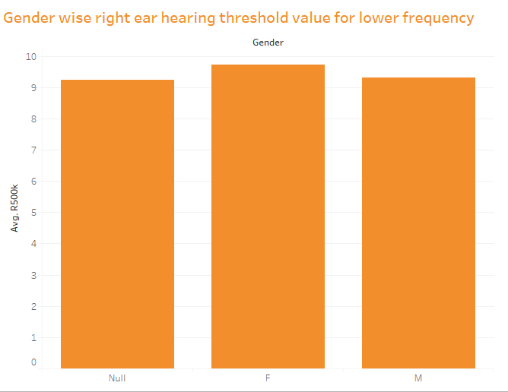
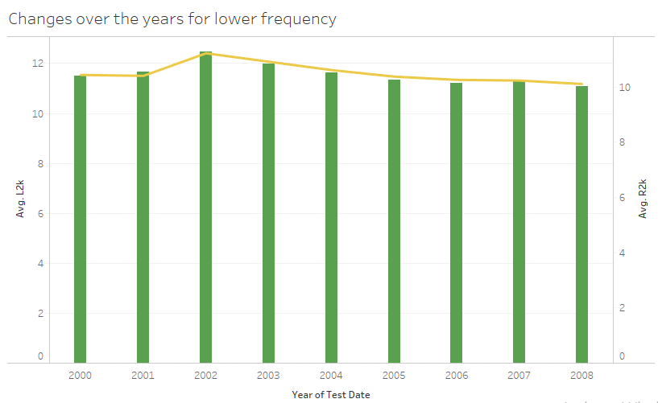

Data analysis and assumption ctd

Slide 5


My personal views on the subject

Slide 6
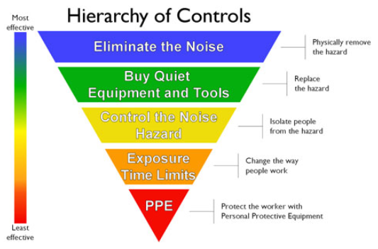
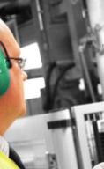
Conclusion

