Slide 1

Text-AI
TECH LEAD – JACK LEMERE
DEVELOPER 1: HEET SONI
DEVELOPER 2 : SHRITA GAONKAR

Slide 2
TEAM MEMBERS
JACK LEMERE (TECH LEAD)
Student ID: 100591906
Email Id: jack.lemere@dcmail.ca
SHRITA GAONKAR
Student ID: 100799307
Email Id: shritashirish.gaonkar@dcmail.ca
HEET SONI
Student ID: 100768241
Email Id: heetbalkrishna.soni@dcmail.ca

Slide 3
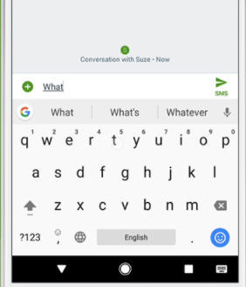
PROBLEM STATEMENT
The role of Next word predictor, or what is often called language modelling, is to predict what word comes next.
You can type faster and make less errors with the next word predictor model.

Slide 4
USER BENEFITS
To provide a wide range of variety for the user, the model will have three suggestions for the users.
The selection and the rejection of these words will be stored in a database.
This process will make sure that the words are curated according to the user.
Number of times a word was used is also used to measure the efficiency of the software.

Slide 5
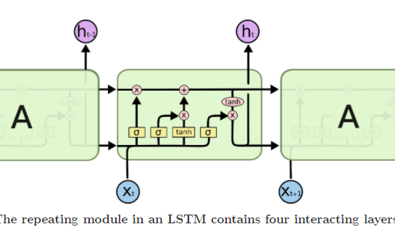
CORE TECHNOLOGY BEHIND TEXT-AI
LONG SHORT-TERM MEMORY:
LSTM networks – usually just called “LSTMs” – are a special kind of RNN, capable of learning long-term dependencies.
The key to LSTMs is the cell state, the horizontal line running through the top of the diagram.
The LSTM does have the ability to remove or add information to the cell state, carefully regulated by structures called gates.

Slide 6
PROJECT ARCHITECTURE
Data Preprocessing
Removing spatial characters,
symbols
standardization
Dataset Collection:
a) Books
b) Articles
EDA, Data Analysis
MVP VERSION 1
Model selection: Deep learning or Machine learning model selection(3-4 alternatives)
Model evaluation: Comparing the accuracy and performance of the Deep learning and Machine Learning models
Model selection: Deep learning or Machine learning model selection(3-4 alternatives)
MVP VERSION 2
Cloud Deployment options:
Azure
AWS
MVP VERSION 3
GUI:
Creating GUI for the ML app
Project presentation

Slide 7
DIFFERENT USE-CASES
USER USE CASES:
The users will interact with the application interface to check all the possible word or sentence out comes.
The users will try to create some meaningful full sentences using Text AI.
TESTING USE CASES:
The tester will check spellings for all the suggestions and will test whether the generated sentences are grammatically correct or not.
The tester will check the consistency of storing all the output in a separate data sheet for further analysis.

Slide 8
GITHUB LINK FOR THE PROJECT
https://github.com/Shrita10/Text-AI.git

Slide 9
Citations
https://machinelearningmastery.com/gentle-introduction-long-short-term-memory-networks-experts/
https://towardsdatascience.com/building-a-next-word-predictor-in-tensorflow-e7e681d4f03f#:~:text=Next%20Word%20Prediction%20or%20what,or%20emails%20without%20realizing%20it.
https://towardsdatascience.com/exploring-the-next-word-predictor-5e22aeb85d8f
https://colah.github.io/posts/2015-08-Understanding-LSTMs/

