Slide 1
2023 UTA BUSINESS ANALYTICS STUDENT COMPETITION: DETAILS
March 2023

Slide 2
AGENDA
Problem Statement
Summary of the Data
Data Example
Submission Guideline
Q&A

Slide 3


PROBLEM STATEMENT: BACKGROUND
Kelly works in the marketing team for Super Server Company. To support a new branding initiative, the team is planning for the upcoming campaigns reaching the target audience by ads through different digital channels (e.g., paid search, social). Given the fixed budget, they would like to maximize the campaign return measured by audience responses and costs.
As a data scientist, Kelly is asked to assist the team to identify the optimal budget plan for each digital channel and each audience type. She has the access to the historical campaign data on the ads displayed in different digital channels, ad costs, reached audience, and their responses.
(This problem resembles the real-world problem and data that our data scientists in the marketing team are typically asked to solve.)

Slide 4
PROBLEM STATEMENT: QUESTIONS
*See the term definition and solution examples in the Glossary & Reference slide.
**The data we provide mainly focus on the digital engagement instead of the revenue to simplify the problem.
Marketing Campaign Budget Allocation Optimization
Problem: Given a marketing budget of $1 Million, how do you optimally allocate this budget across three digital channels (search, programmatic, social) and five audience types to maximize campaign returns? Following are the business constraints that need to be accounted for.
Spend allocation on each channel and audience type should not be more than 50% of budget and no less than 2% of the budget.
Students are strongly encouraged to develop their own metrics and methods. In the meantime, below are some useful hints.
How can the campaign return be measured (e.g., click-through rate*, pay per click*) given the data we have**?
What factors drive the campaign return? And what are their impacts?
Given the impacts of digital drivers and audience types, how do you allocate the budget to maximize the campaign return?

Slide 5
DATA SUMMARY
Variables
Timestamp (1): Day
Metrics (10):
Ad Spend
Audience Reach
Audience Response
Independent Variables (10):
Campaign
Ad
Audience
Records
379,139

Slide 6
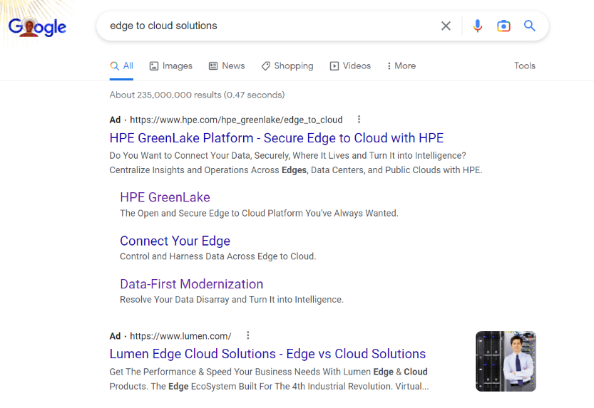
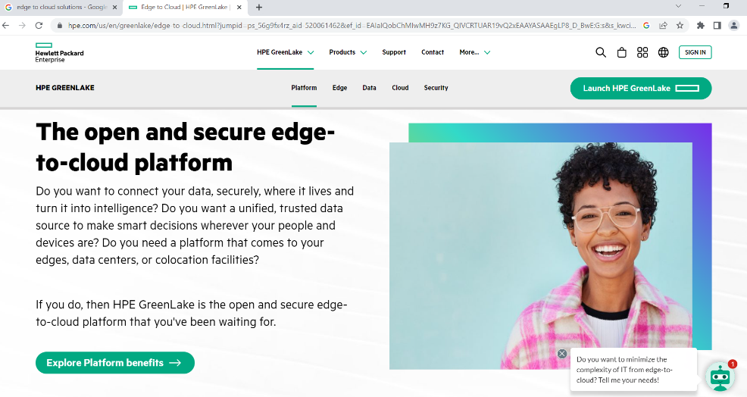
DATA EXAMPLE
In a search engine (Google, Bing, etc.), the audience searches certain keywords, for example, “edge to cloud solutions”
The ad is displayed in the search result. This is collected as one impression in the backend data.
When the audience clicks on the ad, the page is directed to the company website. This is collected as one click in the backend data.
When the audience lands on the company website, this is collected as one web visit in the backend data.
On the company website, the audience’s actions are collected in the backend data, for example, collateral view.
search
Ad display
Digital Driver: Search
Page direct
Company web visit

Slide 7
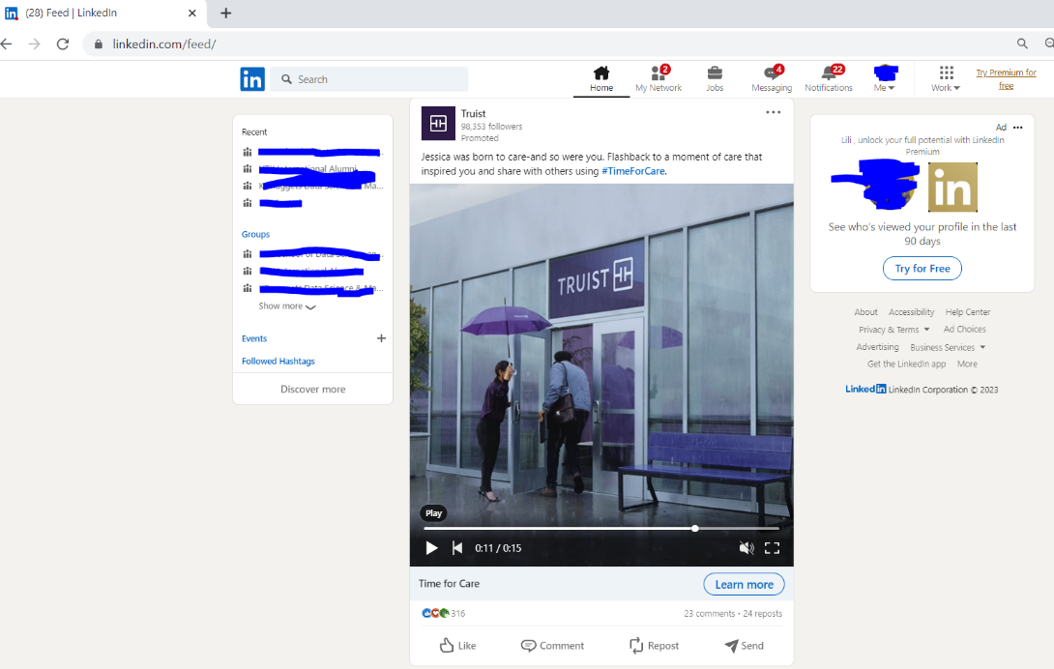
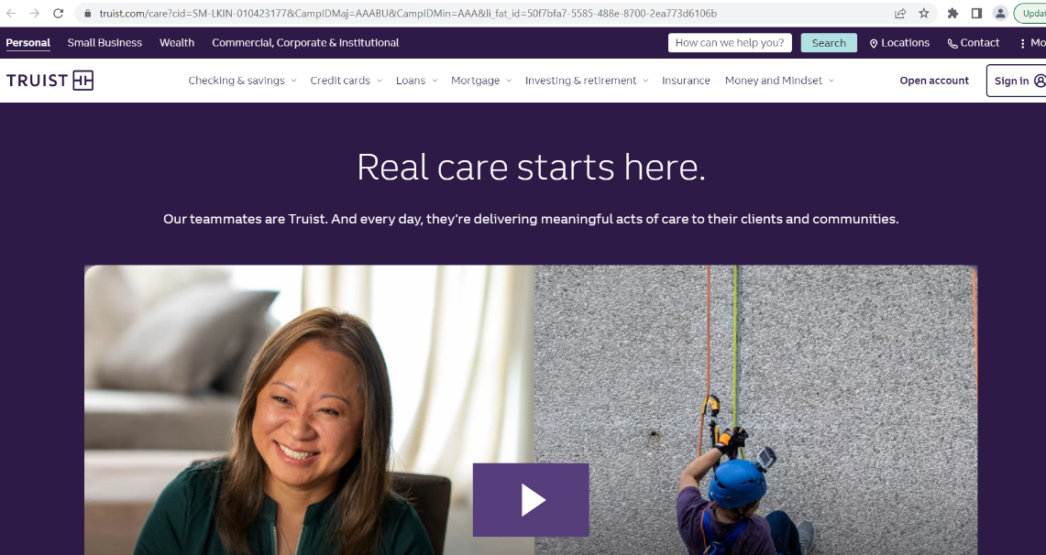
DATA EXAMPLE
The audience logs in the social platform (LinkedIn, etc.).
The ad is displayed on the home page or other pages the audience browse. This is collected as one impression in the backend web data.
If the audience views the whole video, this is collected as “video complete” in the backend data.
The audience can “Like” or “Repost” the ad. This is collected as “social like” or “social share” in the backend data.
When the audience clicks on the ad, the page is directed to the company website. This is collected as one click in the backend data.
When the audience lands on the company website, this is collected as one web visit in the backend data.
On the company website, the audience’s actions are collected in the backend data, for example, video view.
Log in
Ad display
Video complete
Digital Driver: Social
Social like/share
Page direct
Company web visit

Slide 8
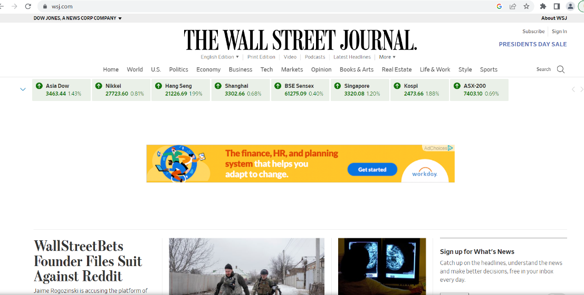
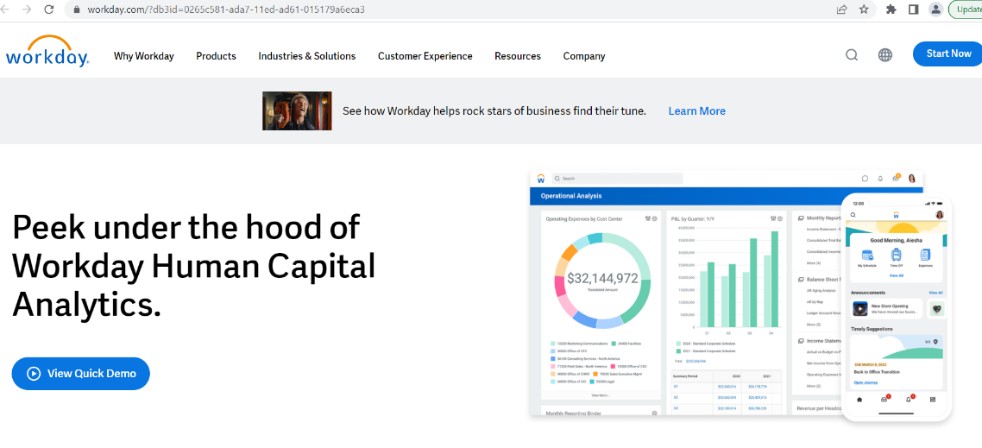
DATA EXAMPLE
The audience views a third-party website, for example, the Wall Street Journal.
The ad is displayed on the home page or other pages the audience browse if the ad wins the bid over other ads. This is collected as one impression in the backend web data.
When the audience clicks on the ad, the page is directed to the company website. This is collected as one click in the backend data.
When the audience lands on the company website, this is collected as one web visit in the backend data.
On the company website, the audience’s actions are collected in the backend data, for example, product demo view.
Third-party Website visit
Ad display
Digital Driver: Programmatic
Page direct
Company web visit

Slide 9
REPORT PRESENTATION FORMAT
Abstract
1 sentence explaining the purpose and importance of the work
1-2 sentences describing the methods
2-3 sentences describing the results and conclusions
Introduction
State the purpose and explain the importance of the work
Solutions
Describe the solution formulation
Describe the solution implementation
Provide the model evaluation metrics if the statistics or math models are used
Results (Answers to the Asked Questions)
Describe the optimal budget plan for each digital driver and audience type
Justify the optimal budget plan
Conclusions
Summarize the results
Discuss the limitations
Discuss the recommendations for the next step
(Template is provided.)
Template Format:
Font: Times New Roman
Font size:
Paper title: 16
Section title: 14
Body: 11
Margin:
Top: 1’’
Bottom: 1’’
Left: 1’’
Right: 1’’
Page Maximum Limit: 3

Slide 10
LOGISTICS
Participants will receive a link via email to access the problem statement and the data on the google drive. The following files can be found.
0_UTA_Student_Contest_DetailsforDiscussion.pptx
1_data_dictionary.xlsx
2_data.csv
3_report_template.docx
Downloading Link: https://drive.google.com/drive/folders/1_EcrR0sEX1GLj4G1PBqFhOjcY0mQMfyA?usp=sharing
Participants will submit the final report presentation with results to utacontest2023@gmail.com for evaluation.
Report in word document or ppt
(For questions, please do not hesitate to send emails to utacontest2023@gmail.com or Dr. Zainab Jamal by zainab.jamal@hpe.com.)

Slide 11
EVALUATION MEASUREMENTS
Solution Formulation
Business and mathematical justification
Clarity
Originality
Data understanding
Solution Implementation
Model-specific metrics
Regression: mean squared error
Classification: Area under ROC curve
Optimization: convergence

Slide 12


HONOR CODE
I pledge, on my honor, to uphold UT Arlington's tradition of academic integrity, a tradition that values hard work and honest effort in the pursuit of academic excellence.
I promise that I will submit only work that I personally create or that I contribute to group collaborations, and I will appropriately reference any work from other sources. I will follow the highest standards of integrity and uphold the spirit of the Honor Code.
(Reference: https://catalog.uta.edu/academicregulations/dishonesty/)

Slide 13
GLOSSARY & REFERENCE
click-through rate: https://en.wikipedia.org/wiki/Click-through_rate
Pay per click: https://en.wikipedia.org/wiki/Pay-per-click
Solution Reference:
Example 1: https://www.latentview.com/marketing-mix-modeling/
Example 2: https://pubsonline.informs.org/doi/10.1287/ijoc.2020.1023
Example 3: https://dl.acm.org/doi/10.1145/2983323.2983347

