Slide 1


Kate Nelson, M.Ed., Sarah Miller, M.Ed.
Career Center

Slide 2

Social media is here to stay

Slide 3
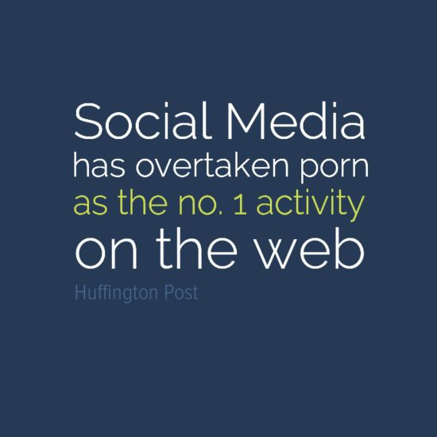
Fun fact….
Two new
members
sign up on
LinkedIn
every second
-Source: TechCrunch

Slide 4
objectives
What is LinkedIn?
How to build a strong profile
How to build a strong network
How to use LinkedIn as a job search tool

Slide 5
3 guiding rules – John Hill
Build your network before you need it
Build a quality relational network not a quantity relational network
Think Aspirational – BIG

Slide 6

Why should you use it?

Slide 7
Who else is using Linkedin?
313,000,000 users worldwide
100,000,000+ alone in the U.S.
30,000,000 students and recent grads
35% of users check daily
42% are updating their profiles on a regular basis
56% of users are male; 44%female
There are 2.7 million business pages
There are 1.5 million groups to join
A 2013 study conducted by The Society For Human Resources Management shows that 77% of hiring professionals are using social media in their search process
Of that group, 94% are using LinkedIn
http://www.washingtonpost.com/business/capitalbusiness/linkedin-has-changed-the-way-businesses-hunt-talent/2013/08/04/3470860e-e269-11e2-aef3-339619eab080_story.html

Slide 8
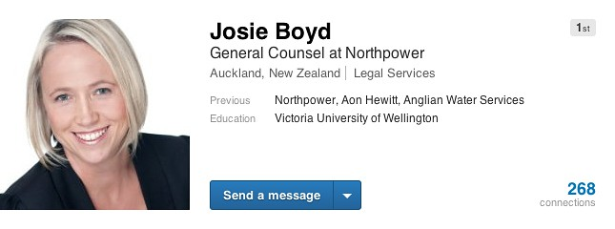
Did you know?
You are 11 times more likely to have your profile viewed if there is a photo

Slide 9
Let’s get started!
BUILD A PROFILE
BUILD A NETWORK
BUILD A BRAND

Slide 10
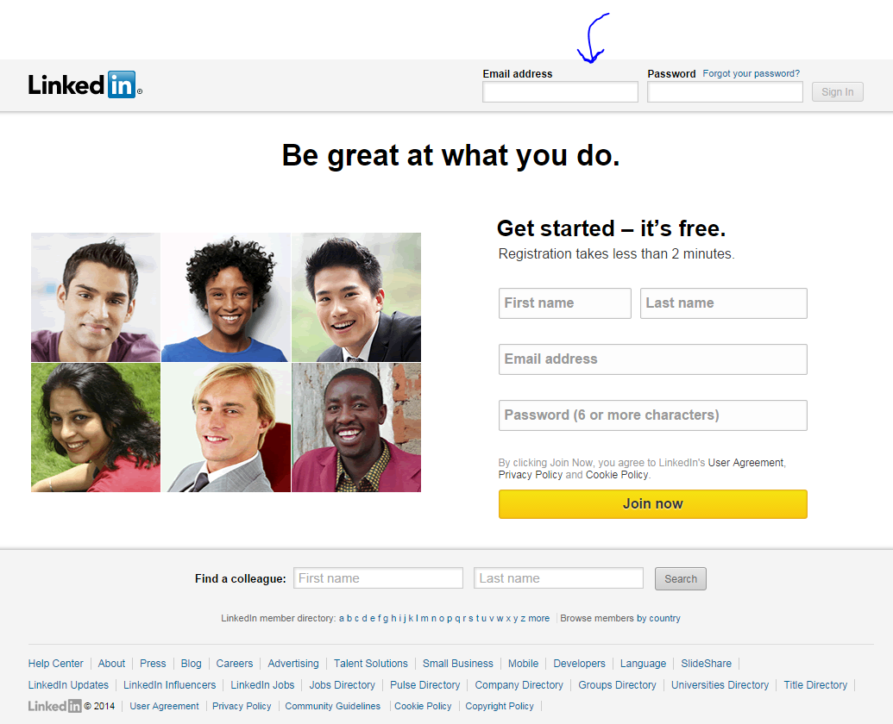
www.linkedin.com

Slide 11
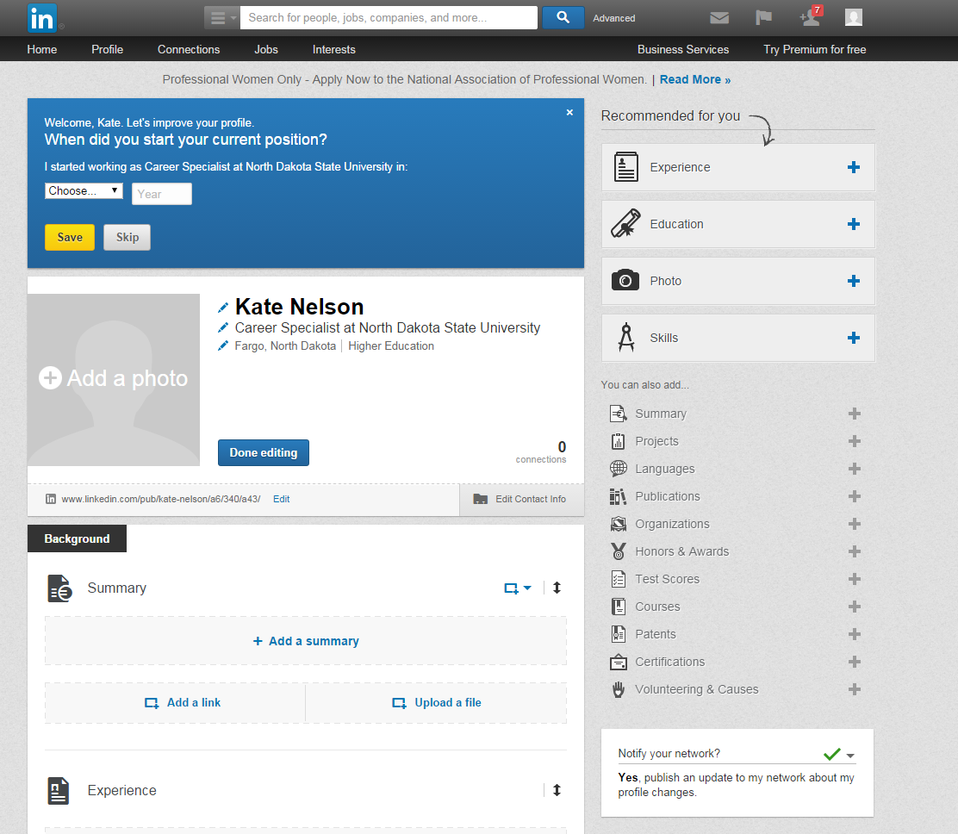

Slide 12

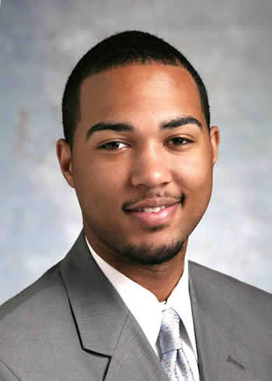
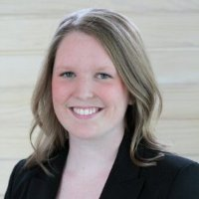
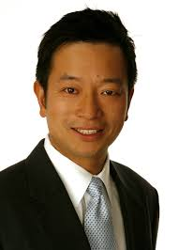

Step 1: Photo

Slide 13



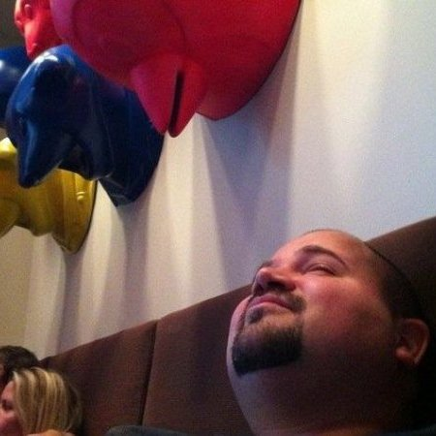
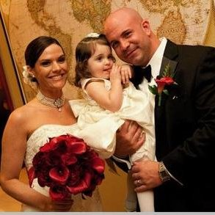
Bad examples

Slide 14
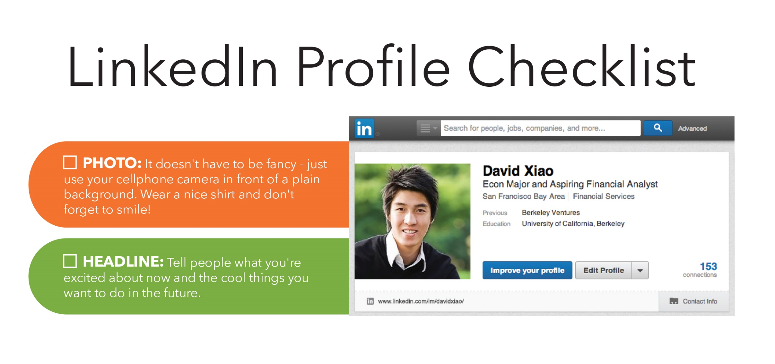
Step 2: Your headline

Slide 15
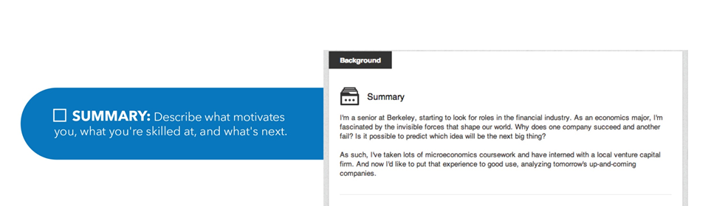
Step 3: Writing your summary

Slide 16
What is a summary?

Slide 17
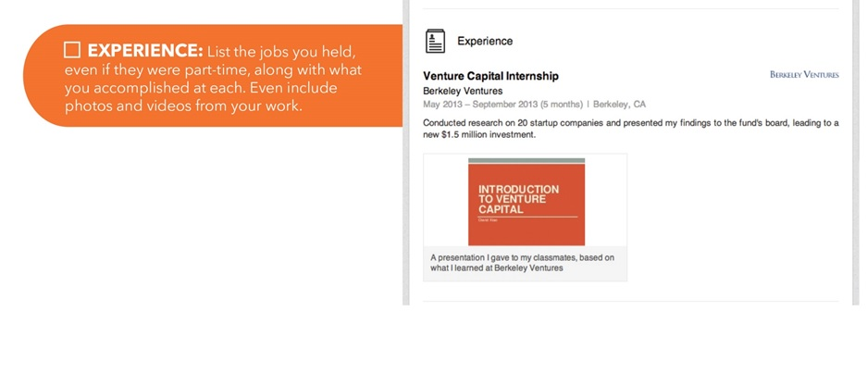
Step 4: Experience

Slide 18
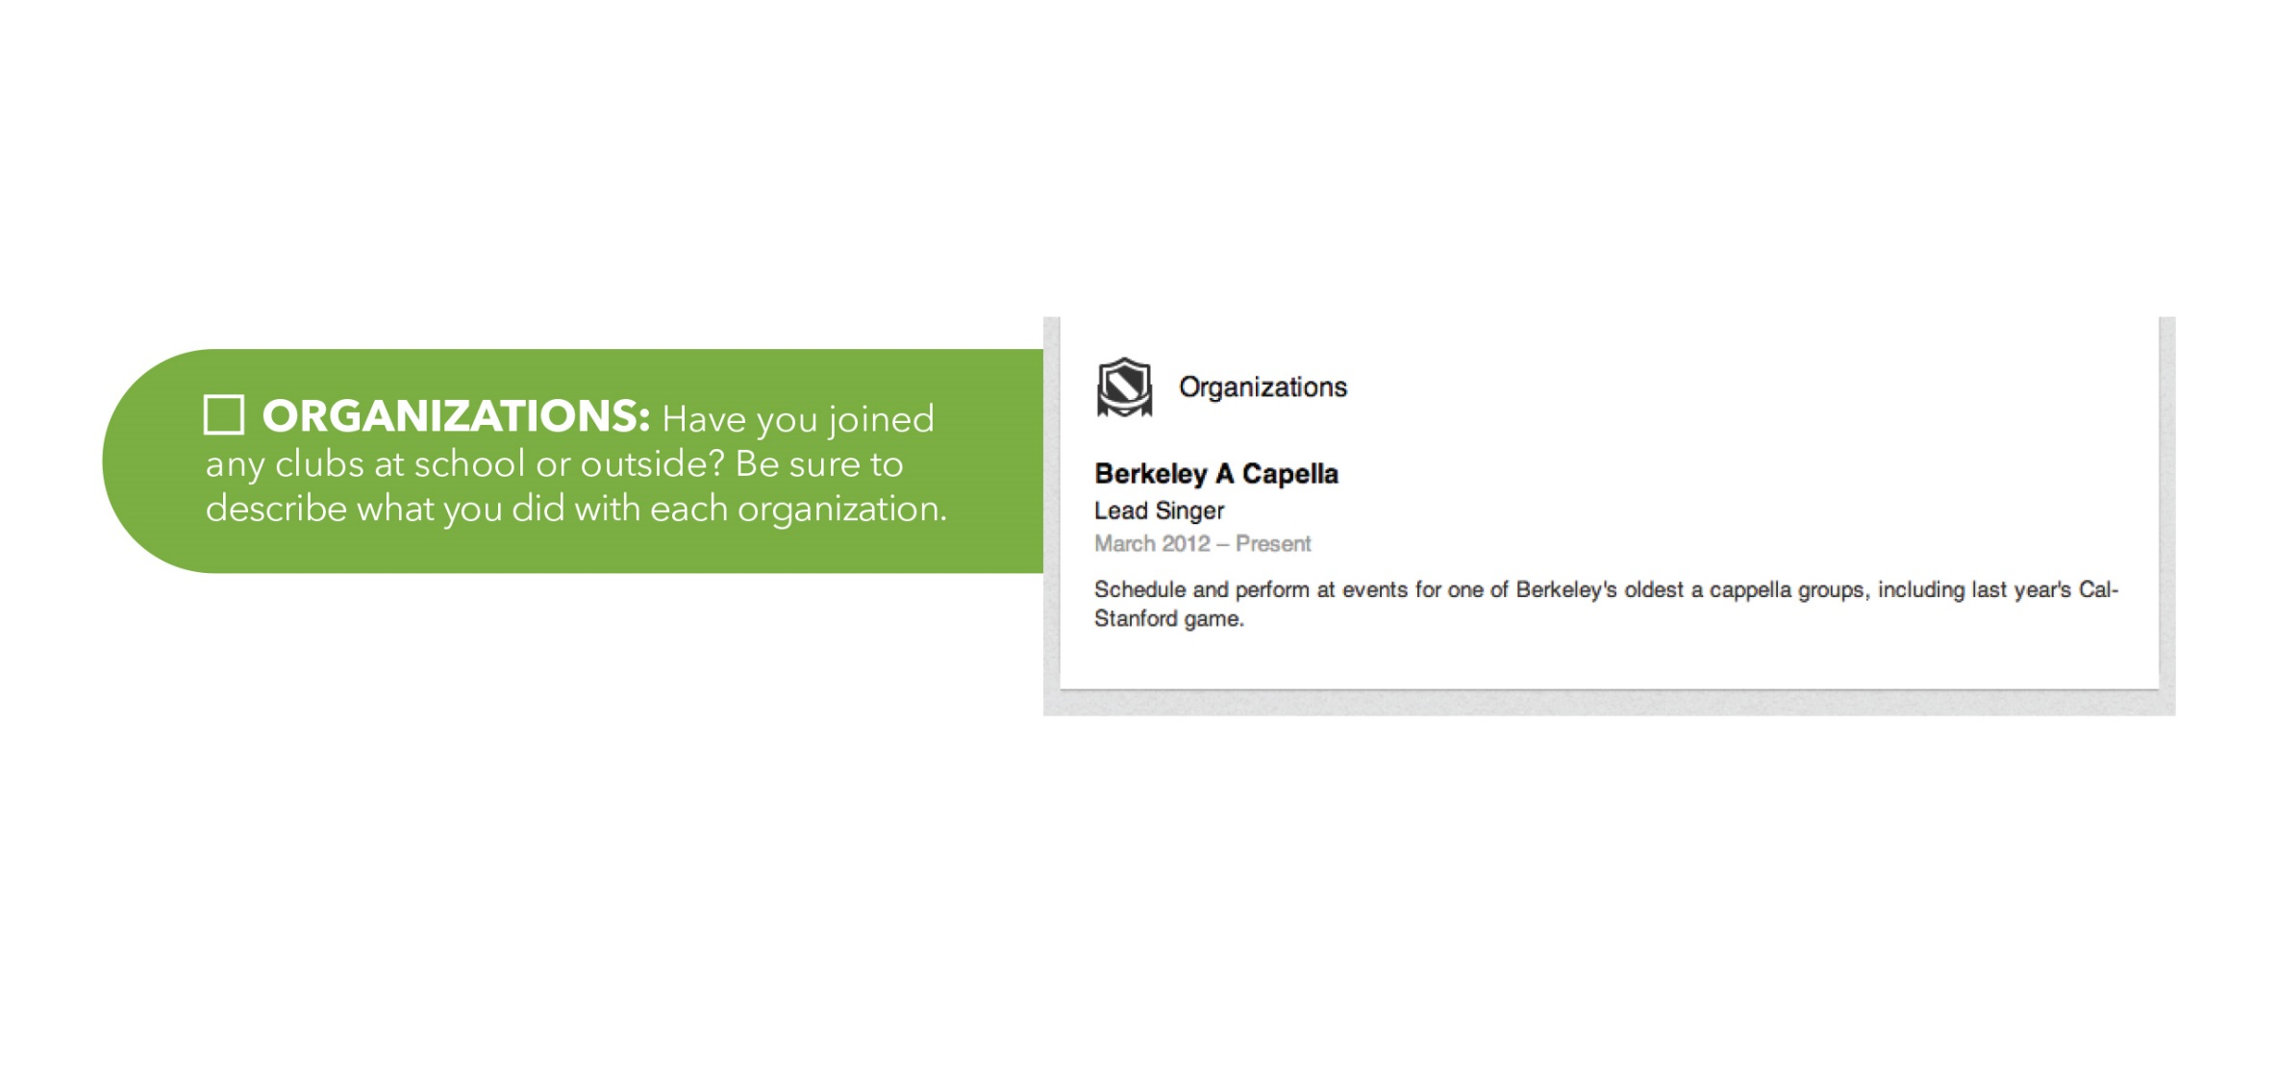

Slide 19
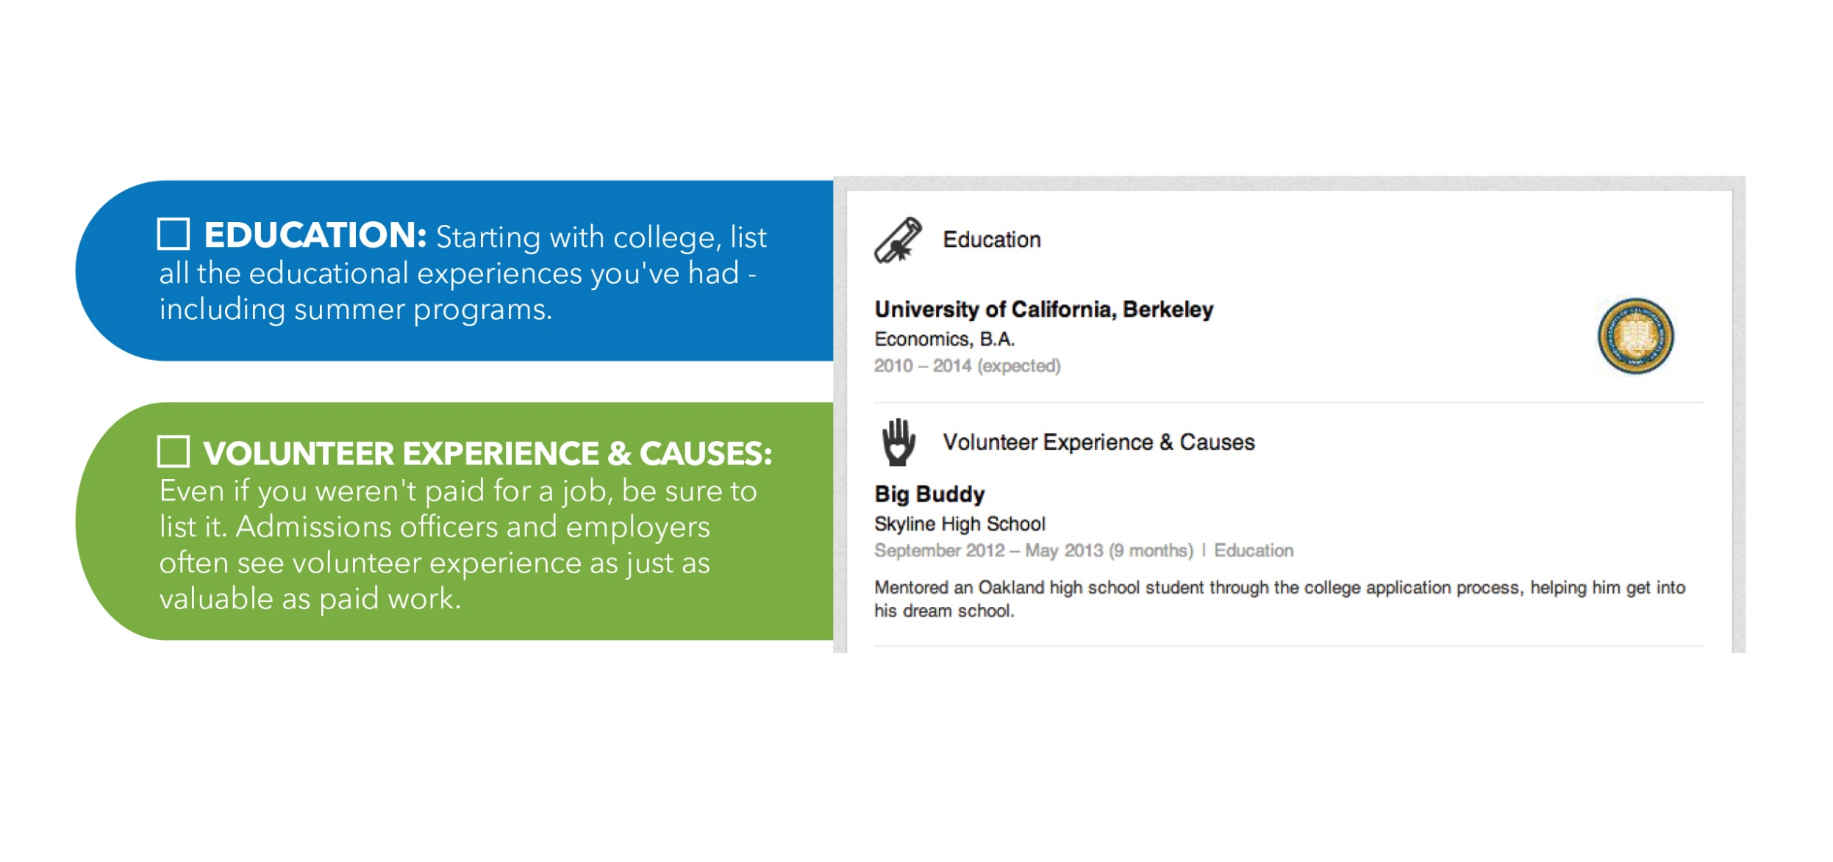

Slide 20
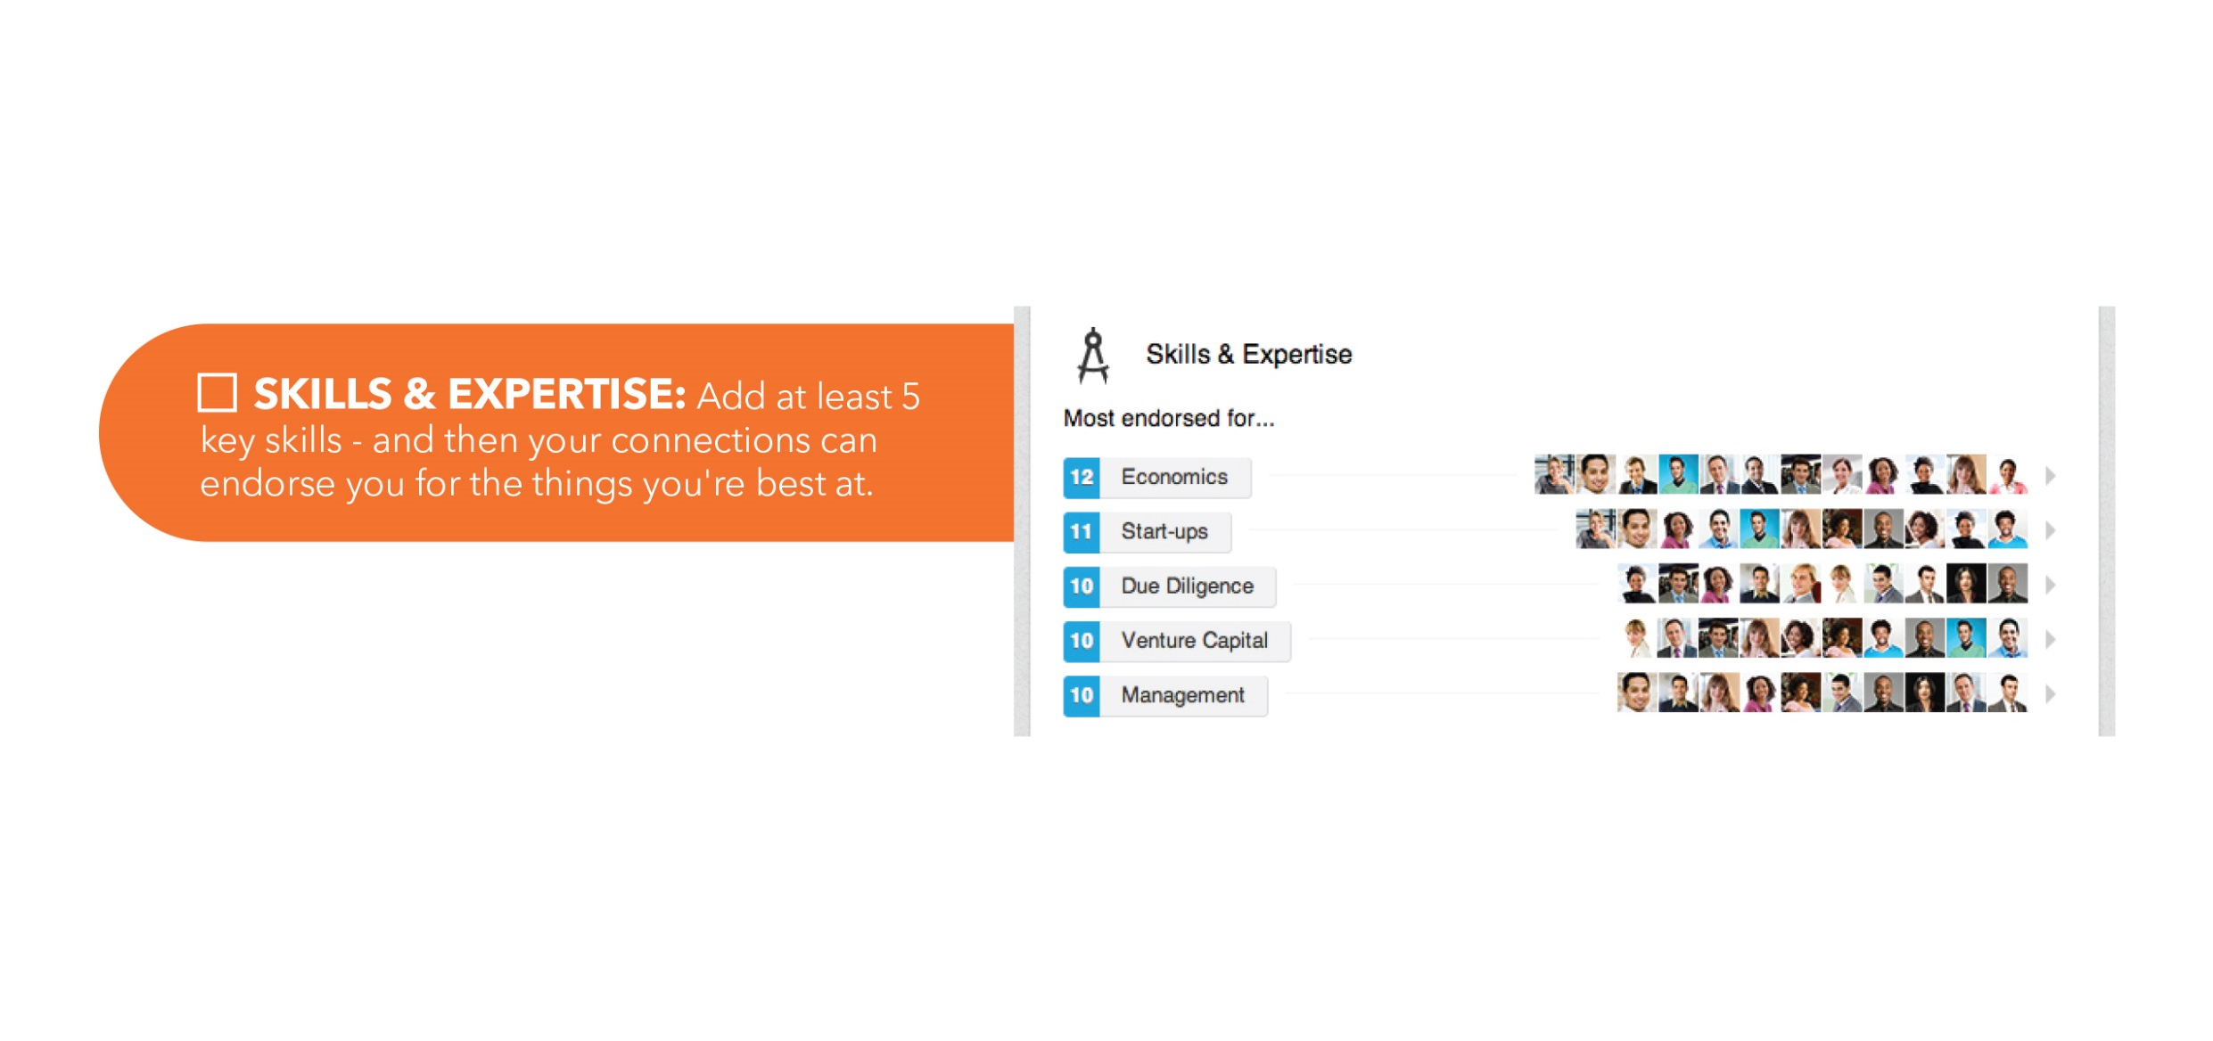

Slide 21
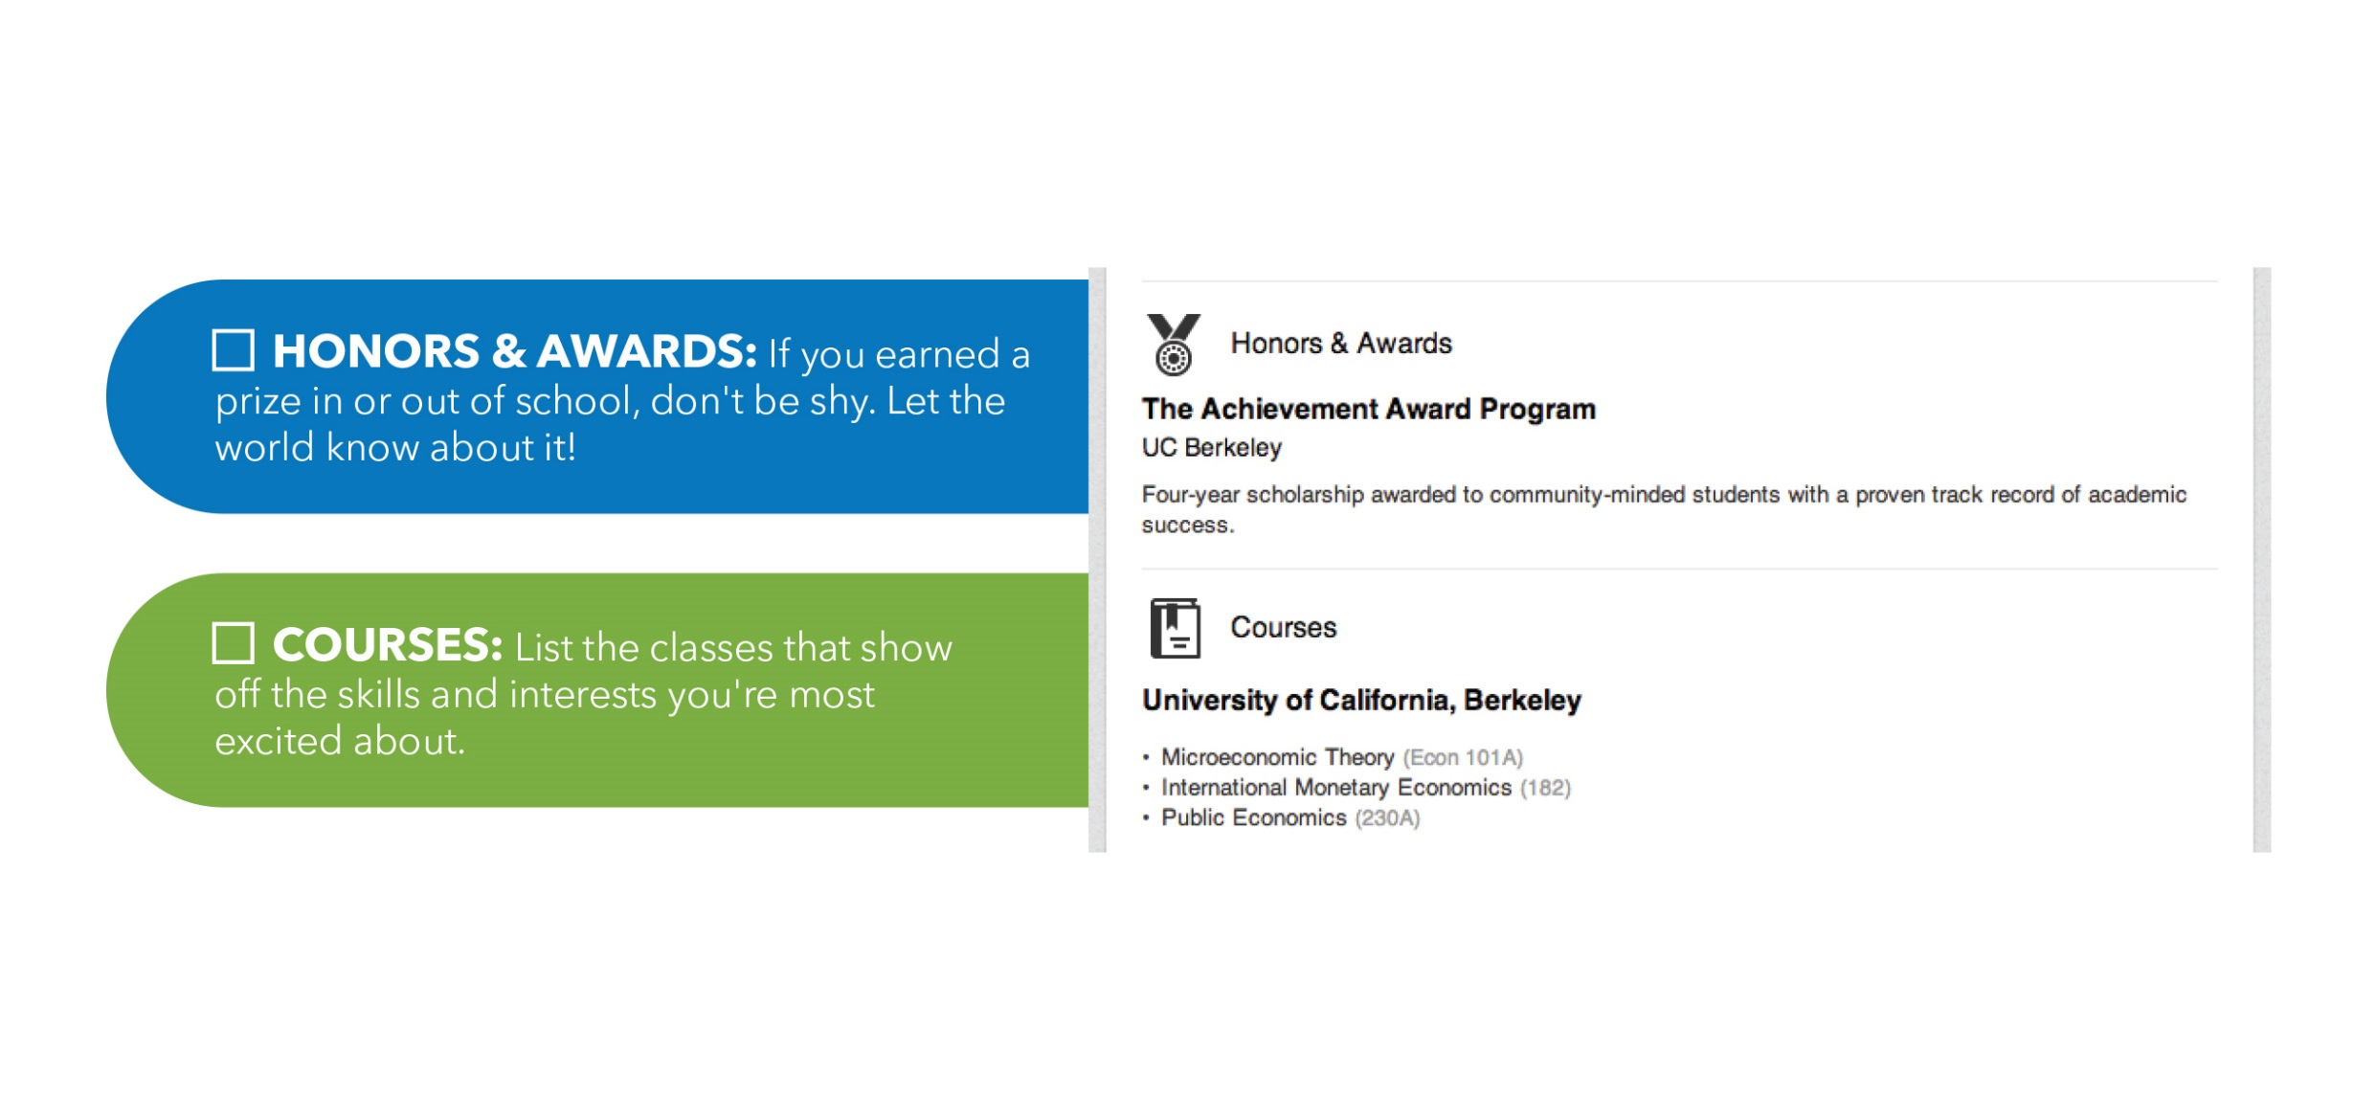

Slide 22
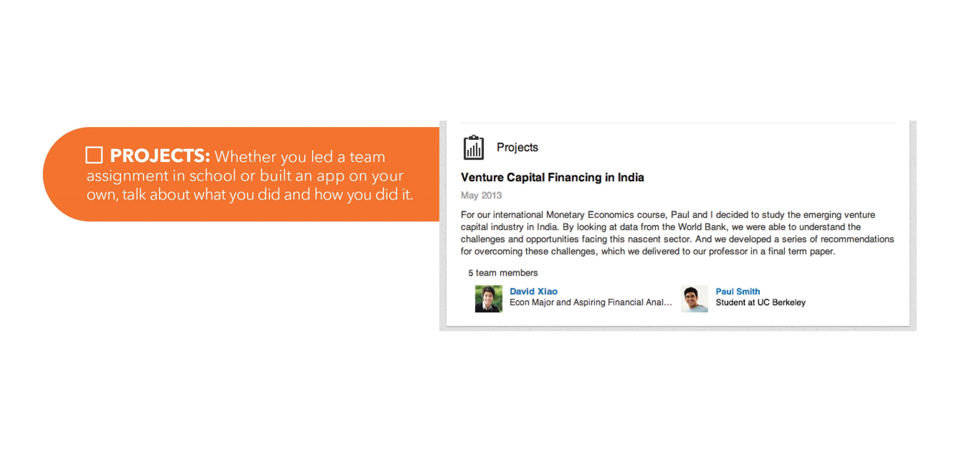

Slide 23
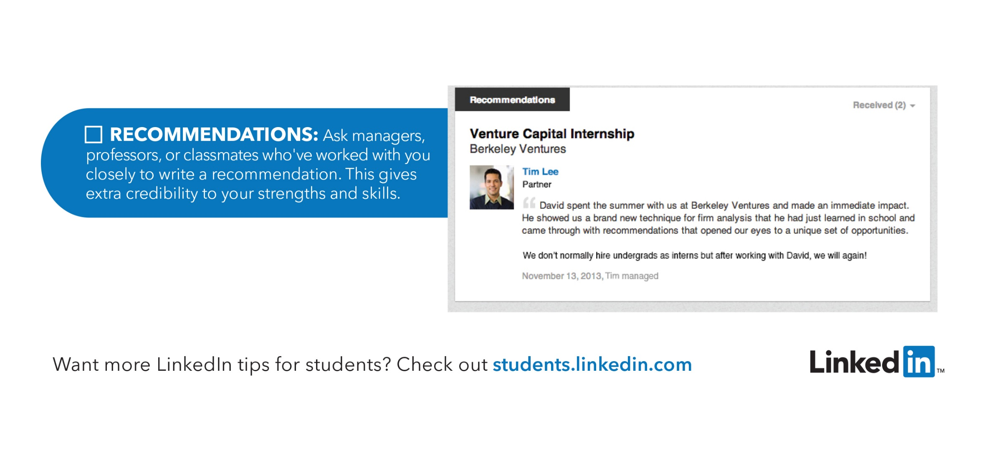

Slide 24
Essentials
Claim your unique URL
Participate in groups
Use the alumni tool
Actively update your profile
Complete your profile

Slide 25
Questions?
LinkedIn

Slide 26
Additional Resources:
https://www.themuse.com/advice/what-you-should-be-doing-on-linkedin-every-month-week-and-day?utm_source=Sailthru&utm_medium=email&utm_term=Daily%20Email%20List&utm_campaign=How%20You%20Should%20Be%20Using%20LinkedIn%20Every%20Day%2C%20Week%2C%20and%20Month
http://www.washingtonpost.com/business/capitalbusiness/linkedin-has-changed-the-way-businesses-hunt-talent/2013/08/04/3470860e-e269-11e2-aef3-339619eab080_story.html
https://www.linkedin.com/studentjobs
http://students.linkedin.com/

Slide 27
Career Center
www.ndsu.edu/career
701-231-7111
Kate Nelson
Katherine.nelson.1@ndsu.edu
Sarah Miller
Sarah.ann.miller@ndsu.edu
Please provide us with feedback on today’s workshop: http://studentvoice.com/ndsu/paf14kate

