Slide 1


LinkedIn How to market yourself, build connections, and get a job
2015
Notes:
Polls to pass the time.
Which social networking sites do you currently use? (Facebook, LinkedIn, Google+, Twitter, Other)
After results: That’s why we’re here today, to better understand the differences between these sites and how to be successful using LinkedIn.

Slide 2
Agenda
LinkedIn Overview
Profiles Review & Critique
How Recruiters Find You
Targeting Companies and People
Making Connections
Creating Your Action Plan
Notes:
WORKSHOP: QUICK OVERVIEW & REVIEW OF ONLINE – 10 MINS

Slide 3

LinkedIn:Overview
Professional networking site used by 313 Million People
How it should be used:
Not used for making new friends, connecting with strangers, viewing photos, or posting personal information
Connect with individuals, research companies, build an online presence, apply to jobs
Recruiters & Hiring Managers use LinkedIn to find talent
How do you use LinkedIn?
Notes:
SKIP FOR WORKSHOP - SO HIDE SLIDE FOR PRESENTATION
http://press.linkedin.com/about
LinkedIn is a professional networking site with over 175 million users. It is a widely used resource in the U.S. with a global presence. We’ve had job seekers get connected to U.S. employers through contacts from their home countries. Your connections abroad can help you get connected in the U.S. for your job search!
Individuals use the site to exchange information, ideas, and opportunities
LinkedIn is a platform where you can stay informed about your contacts and industry; find the people & knowledge you need to achieve your goals; control your professional identity online.
Additionally, LinkedIn is both a job search tool and career development tool.
Like social networking sites, LinkedIn lets you connect to individuals online. However, etiquette and use of LinkedIn is very different from social networking sites. You should not use LinkedIn to make new friends, view photos, or post personal information. You should always make sure that you let strangers on LinkedIn know why you are requesting to connect– DO NOT CONNECT WITH STRANGERS WITHOUT A STATED PURPOSE. If you message a stranger in your field, however, it is appropriate to explain that you are looking to rebuild your career in the field and would like to connect with them for networking.
Importantly, recruiters are increasingly using LinkedIn to find talent to fill hiring needs. Corporate recruiters and headhunters use LinkedIn as the first place they go to when looking to fill a professional level job. This means that they are looking on LinkedIn before they look anywhere else. Recruiters often use it to find passive candidates (those who are not actively in their job search) as well.

Slide 4
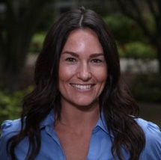

Profile Review
Picture
Headline
Good: PMP Project Manager - Known for successfully leading multi-million dollar projects in developing countries
Needs Improvement: Job Seeker in Project Management
Summary
Engaging & Original
Written in the 1st person
Audience Specific - write like you’re having a conversation with someone
Has a call to action/next steps
Tips & Examples: http://muse.cm/1nYPEhO
Who Will Volunteer to Have Their Profile Critiqued by the Group?
Notes:
Here you can see an example of a completed LinkedIn Profile. Diego is an UpGlo alumnus.
As you see, his “Professional Headline” shows his current job. For current job seekers, this will show the job that you are looking to get. Before Diego got a job, he had written “Civil Engineer” as his professional title. He also lists his location and industry specialization, which is civil engineering.
Next, you see Diego’s current positions, which includes his membership roles in associations. You should include any memberships you have in associations here as well.
Then, you will see his past experience. This is where uploading your resume saves you a lot of time, and ensures that you have your accomplishments clearly stated.
Education is the next section on LinkedIn. Here, you should list your education degrees from your home country. You should also include coursework that you may be currently doing to update your skills. For example, Diego has listed his continuing education courses at community colleges in the Chicago area.
The next section is Recommendations, which as we will review, is a great way to become more visible online.

Slide 5
How Do Recruiters Find You?
Keywords/Boolean Searches
Boolean - A type of search that allows users to combine keywords with operators such as AND, NOT and OR to get more relevant results
http://linkd.in/1qnB5T0 - Basic boolean search tips from LinkedIn
https://bit.ly/Search-LI - Google driven LinkedIn profile search
http://recruitin.net/ - Helps you create boolean searches
Filters
Groups (Diversity!)
Degree of Connections
Years of Experience, Last LinkedIn Activity, etc.
Companies you’re following
Profile Visibility/Security Settings
Marketing Consistency (email, name, picture, etc.)
Notes:
WORKSHOP – EXPAND ON DEMO AND NEXT STEPS
ENGAGE CLASS (THIS MAY BECOME TOO TIME CONSUMING, YOU MAY WANT TO CHOOSE A JS IN ADVANCE WHO HAS SIGNED UP FOR CLASS)
Expand your network:
First, search for and invite past colleagues, alumni connections, fellow job seekers, and professionals in your network
Second, try to import your webmail contacts to expand your network. Be careful when doing this, as this function will send non-personalized invitations to your address book in your email.
Recommendations are an important part of completing your profile. You should have at least 3 recommendations from individuals who have worked with you and can provide you with a positive recommendation. Note that it is expected that you will write your recommender a positive recommendation in return. So keep in mind that proper online etiquette is that you will provide your recommender with a positive recommendation back as well. Also, your recommender must have a LinkedIn account in order to provide you with an online recommendation. We will review how to ask for a recommendation in a few minutes.
Affinity groups:
With affinity groups, try to find the 5+ most relevant affinity groups, you don’t need to join every one. Participation is more important. Quality over quantity!
Also target diversity groups you can join.
Companies:
Following companies can help you connect with employees in the company and can also provide you with the latest information on new trends within the company. This also allows you to easily search for jobs in the company.
Participation:
When you participate in discussions, make sure that you pay attention to grammar (try your best, use spell/grammar check). Also try to make insightful comments that show positively on your industry knowledge. Staying active in discussions helps you get noticed by recruiters and other LinkedIn users.

Slide 6
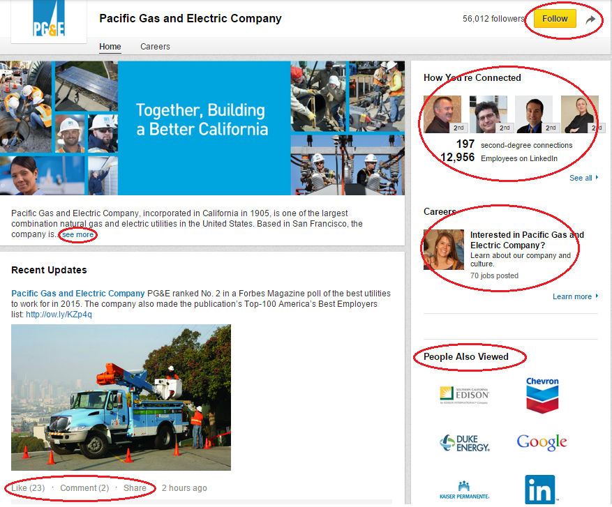
Targeting Companies
You want to work at PG&E. How do you use LinkedIn?
Following can help you show up in recruiter searches
See what connections you have for referrals or informational interviews (visible for companies, jobs, groups, etc.)
Discover keywords
Find Jobs
Find new companies
Engage. It will help recruiters find you
Notes:
Joining groups is an important way to expand your network, get involved in discussions, and create your online presence. Online groups are very similar to professional associations, which can also be found on LinkedIn. As a reminder, professional associations are groups where individuals in a specific field gather to exchange resources, mingle, and learn about upcoming trends in the field. Professional associations often host networking events and seminars. You can often gain access to these associations for FREE by joining their LinkedIn group. Groups rarely verify if you are already a member and many use LinkedIn groups as a way to attract new members to join.
You can search for groups in a variety of ways. Here, you see two engineering groups that are organized by ethnicity (Society of Hispanic Professional Engineers) as well as gender (Society of Women Engineers). Now, let’s go through an example of how to search for a group in Public Accounting.
Switch to screen view for demo (takes a second to show on screens, slow)
Click on “groups” tab
Search “public accounting” in search menu under “groups”
Look through search results, paying careful attention to number of members in the group and recent activity for jobs and discussions. Remember that you want to find groups that are active and have many members for you to network with.
Select the group and click “Join Group”
Remember that you don’t want to join every group that you find! You want to be an active participant of the groups you join, so keep in mind that quality is more important than quantity. Also, it is helpful to target bi-lingual and diversity groups, since many recruiters are searching for diversity and bi-lingual candidates.

Slide 7
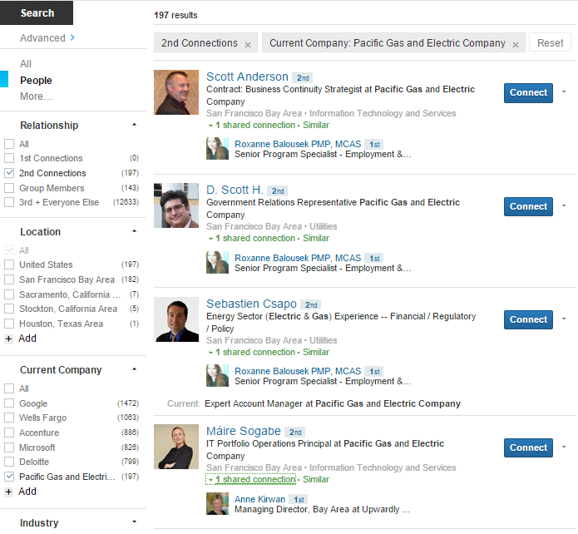
Targeting People
Use filters to save time and improve searches
Evaluate targets by the strength of the connection you have
Find similar types of people to expand your search to other companies
Notes:
WORKSHOP ONLY – ENGAGE
BRAINSHARK: - SEE IF THEY CAN SUBMIT QUESTIONS TO ASK UPGLO!

Slide 8
Making Connections
Remember, not everyone wants to network
Only connect to people you know, who you’ve met in person, or to connections of people in your network
Yes: UpGlo volunteers, staff, friends, family, former colleagues
No (mostly): Hiring Managers who you are currently interviewing with, Strangers you don’t have a connection to
Always send a personalized note
Let them know how you found them and why you want to connect
Before asking for job referrals you must build a relationship (accepting your connection ≠ relationship)
Notes:
WORKSHOP – EXPAND – JUIA, DO YOU HAVE SOME TECHNIQUES? TIPS? STORIES FROM JS? MUSE ATICLES?
You can use LinkedIn to target your job search online. One benefit of using LinkedIn is that you are able to see who you are already connected with that might work at a company that posts a job opening. You can use the job tab at the top of your screen or search within groups for jobs. Let’s go through an example together. In this example, let’s search for a bilingual administrative job.
BRAINSHARK:
Switch to screen view for demo
Click on “Jobs” tab
Type “Administrative Assistant + Spanish” in the search bar
Show results and scroll through to point out how you can see your connections for the positions
Click on “X people in your network at X Company” to show how job seekers can see connections to company
Click on “X members shared this job” to show how job seekers can figure out who to message about the job (or ask for more information from person)
Also show on left side panel how you can narrow your search for location
*STAY ON WEBSITE
If you are first degree contacts with an employee at the company, you might feel comfortable asking your contact to help in your job application by giving an employee referral. This can increase your chances of being reviewed for the position. If you are a second degree contact with an employee at the company, you can ask your mutual connection to link you together so you can expand your network. This might give you a valuable opportunity to ask questions about the company, interviewing process, or methods to be more competitive in the application process for the position. We will review how to ask for an introduction from a mutual connection in a few minutes.
In summary, you can use the “Jobs” tab in groups to look at job opportunities through your new online network!

Slide 9
Plan Your LinkedIn Activities
Create daily, weekly, monthly goals
Update your profile, and let your Job Coach review
Join the Global Talent Idaho group
https://www.linkedin.com/groups/8364320
Follow your Action Plan
Notes:
Part 2 – Taking it to the next level (thinking this is where you’d focus the bulk of class, with some review from previous part)
Profiles – Taken to the next level
Key words
Making your profile found and marketable?
Why recommendations and contacts are important? (slide 13)
Recruiters & What makes you found on Linkedin:
Complete profile
Keywords
Connections
Recommendations/Endorsements
Groups
Active comments / information sharing – keeps you on the radar…
Make Recruiters find and want you?
Expanding your connections beyond your contacts – how?
Good and Bad Messaging – what might get you a response?
Job Search –
Tips from LinkedIn & The Muse Articles
Next Steps

Slide 10
Helpful Links
Research Breaks Down the Perfect Profile Photo: http://bit.ly/1dqullp
5 Ways to Get the Most Out of LinkedIn Groups: http://muse.cm/1ORSm4i
4 Key Elements of a LinkedIn Summary: http://muse.cm/1nYPEhO
Updating Your LinkedIn Headline: http://muse.cm/1fqTXtX
9 Email Templates for Your Job Search: http://muse.cm/1ORYMQG
LinkedIn Premium vs. Free Accounts: http://bit.ly/1gUWQ8U
10 Message Templates for LinkedIn Requests: http://muse.cm/1HeoObG

