Slide 1


Step 1
Creating a Compelling and Effective LinkedIn Profile
Career Services – LinkedIn Learning Module 1

Slide 2


LinkedIn is an online network for business professionals (that includes students, too! It's different than other social networking sites because it's designed specifically for professional networking -- finding a job, discovering sales leads, connecting with potential business partners.
93% of recruiters are using LinkedIn to find their future employees
Almost 100% use to initially screen applicants
Career Services | 487-2313 | www.mtu.edu/career

Slide 3
Why should college students be “on” LinkedIn?
First and foremost: To get a job!
And, it’s your job is to make it easy for your reader to hire you, and to do that, you need to tell them how you can do the work they need you to do, and that you have the characteristics of their ideal employee.
Second: You’ll also grow your professional network and maintain a positive online presence that may help you in your future work or job search.
Career Services | 487-2313 | www.mtu.edu/career

Slide 4

Your Profile is your online “first impression”
Priorities:
1. Top Fold
2. Summary
3. Experience
Career Services | 487-2313 | www.mtu.edu/career

Slide 5
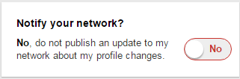
As You Start Creating or Editing your Profile
Please turn off your notifications or for your edits until you’re ready to launch…or your connections will be notified about every little change you make and that gets annoying! The box is located on the right side of the page next to your summary.
(Come next time to learn
when to turn it back on)
Career Services | 487-2313 | www.mtu.edu/career

Slide 6
Start Your Great First Impression with a professional photo
Photos are a must for a LinkedIn Profile!
Research shows that profiles with pictures are 7x more likely to be viewed by potential connections than those with no picture.
The image you present in your photo can communicate the credibility of the rest of your profile.
Use a professional headshot, if possible.
Notes:
If you don’t have the opportunity for a professional photo, best practice is for you to stand up against a white or very light covered wall. You are encouraged to smile, wear professional clothing, and the photo should be from the bottom of your shoulders, up.

Slide 7
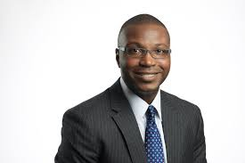
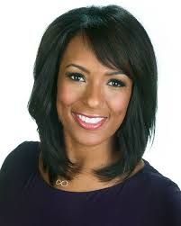
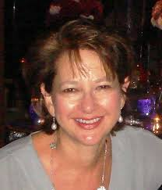
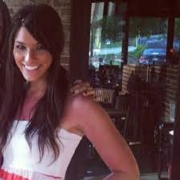
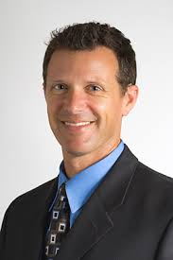
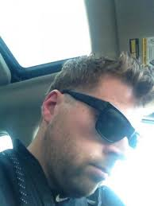

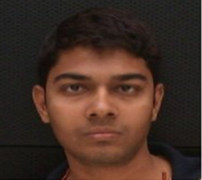
Professional Photo
VS.
Up close, smiling,
and a light background are key elements for your LinkedIn profile pic!

Slide 8
Your Headline
Showcase Your Specialty!
Jane Student
BS Mechanical Engineering | Michigan Tech | Manufacturing | New Product Design | Mechatronics
John Student
Dining Services Supervisor at Michigan Technological University
(really an ME-EM student)
VS.
A detailed LinkedIn headline is critical in increasing your “findability”, creating your professional credibility, and motivating your audience to keep reading the rest of your profile.
In editing mode, simply hover over your current headline, click on the pencil, and update accordingly utilizing entire space.
Use key words that effectively identify your expertise, focus, experience.
Career Services | 487-2313 | www.mtu.edu/career

Slide 9
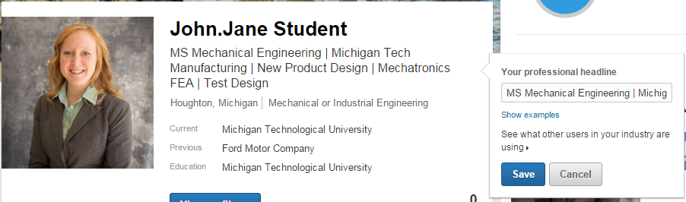
Headline - Showcase Your Specialty
In editing mode, click on the pencil that pops up next to your headline. Then, change your headline, save, and check to see how it looks in each line.

Slide 10
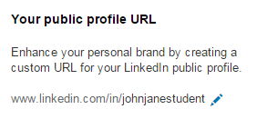
Customize Your URL Make your profile look more professional, and easier to share and be found by claiming your vanity URL.
On your profile page, click on the blue flower to update your profile settings
Then, in the upper right hand corner, select the editing pen to take off the numbers from your URL. It will then look nice and clean and less confusing.

Slide 11

A Compelling Summary
The summary is really your virtual handshake and personal introduction that you might have in a face-to-face networking opportunity. You want to use the same genuine, conversational voice that you would use if you were meeting someone over coffee – personal and descriptive – just tell your reader what you do…and maybe a little bit of why.
No selling – just telling!
Career Services | 487-2313 | www.mtu.edu/career
Notes:
When you read the sentences back to yourself, are those words that you would use in a conversation over coffee. Even though people think they are being genuine in conversational voice, you might not say out loud what you would think to write. Most people write more formally than they speak.

Slide 12
A Compelling Summary
First Paragraph – short summary, including that you’re looking for a job, and how to contact you.
“I am a second year chemical engineering student at Michigan Tech seeking a summer 2016 internship. Please contact me at jjstudent@mtu.edu
or 906-123-4567”
Career Services | 487-2313 | www.mtu.edu/career
Notes:
After first paragraph, explain that the area to explain how to contact you is so far down towards the bottom of your profile page that you don’t want to make it hard to find your information. Consider a video resume or introduction

Slide 13
A Compelling Summary
Second Paragraph - provides more detail about you…
You might want to start with the background of why you do what you do – why you are passionate about what you are studying (without saying “I’m passionate”). A story about your “Aha!” moment will immediately grab attention.
Career Services | 487-2313 | www.mtu.edu/career
Notes:
Not a story about your childhood.

Slide 14
A Compelling Summary
Third Paragraph – follows up with what you’re doing to follow your “passion.”
Describe and highlight the hands-on experiences that relates to your industry, whether that be an internship/co-op, enterprise, or course work projects. Ensure you talk about what you worked on, the problem you were trying to solve, or the goal you were trying to achieve. Include the scope, challenges, and results.
Career Services | 487-2313 | www.mtu.edu/career
Notes:
Not a story about your childhood.

Slide 15
A Compelling Summary
Fourth Paragraph – icing on the cake
Tell about your co-curricular involvement, on campus or within the community. Highlight any teamwork you’ve been involved with or leadership positions you’ve held. These experiences have helped you develop strong interpersonal, communication, organizational, and collaborative skills.
Career Services | 487-2313 | www.mtu.edu/career

Slide 16
A Compelling Summary
Optional Fifth Paragraph
If there is room at the bottom, you can create a list of keywords relevant to your field of study/industry
keyword | keyword | keyword | keyword
Career Services | 487-2313 | www.mtu.edu/career

Slide 17
Additional Summary Tips
Write in first person
Apply keywords … carefully – Keywords are effective but they need to be placed within the context of your story as it outlines your experience.
Use numerous paragraphs that are conversational bullets. This allows the reader to segment a lot of information about you. This always seems more readable than a large group of text.
Again, just tell – no need to sell. Avoid words and phrases like - extensive experience, organized, good communication skills, results driven, responsible, effective. Your great summary of your experience shows that and your respect your reader to deduce your fit for their needs because of all the evidence you’ve provided.
Keep revising
Career Services | 487-2313 | www.mtu.edu/career

Slide 18
Add your resume and rich media in your summary section!
Most readers can’t spend the time reading your full profile initially. Once they’re intrigued by your resume, they may want to download your resume before returning to read more of your profile. You want to make it easy for them to find it.

Slide 19
Summary Examples
I am a Mechanical Engineering student, graduating in May 2015, looking for Full-Time Employment. Please contact me at aebrecht@mtu.edu or 906-123-4567.
A FARM GIRL BECOMES AN ENGINEER
I grew up on a 120-acre fruit and vegetable farm in Grand Rapids, MI, and am no stranger to hard work. I worked long hours operating machinery to plant, harvest, sort and clean produce and sold all our crops in my family's store – just some of the work I did as the daughter of a self-employed farmer. I had to work just as hard at Michigan Tech, as it’s got a reputation for a demanding and hands-on curriculum, and I’m really proud of my 3.70 GPA. I also added internship experience and campus leadership experience that has helped me develop strong teamwork, project management, communication and leadership skills, that I believe have prepared me to make a valuable contribution to your company. I’m really ready to work hard and exceed your expectations!
In the summer of 2014, I worked at Ford Motor Company as a Design engineering intern where I created an original design for the console mats for the newly designed 2017 Escape. I also worked at John Deere as a manufacturing (operations) engineering intern in the summer of 2013 where I developed a logistics procedure to outsource paint stripping in the seeding factory and coordinated off-site training for 550 employees.
One of the most rewarding experiences I’ve had at MTU has been my 3 years as a member of the Aerospace Enterprise Engineering Program, where I got work on a satellite funded by the US Air Force that will actually be launched into space in 2016.
An accomplishment I’m really proud of is that I founded an official student org called Silver Wings (SW). “SW is a national, professional organization dedicated to creating proactive, knowledgeable, and effective civic leaders through community service and education about national defense.” I’m now president of a 20 member group, working toward national recognition.

Slide 20
Summary Examples
Electrical Engineer with experience in Communication Systems, Signal Processing, RF, low-level C, and assembly programming, looking for entry level job. 123-456-7890 | aszajna@mtu.edu.
I've spent my life making stuff: computers, my 76 Mustang, or performing and creating music. I was good at math, so I was drawn to engineering, but I don't think math is enough. I believe that, for a designer, human perception has to drive technology - because it’s worthless without people wanting to use it. “Begin with the End in Mind,” is a line I've intentionally tried to straddle by doing so many different things. I'm not just an engineer - I’m also a musician, a camper, hiker, fisherman, and gear head. So, while I’ll proudly wear the label “geek,” these other things define me in so many other ways, and they get me out of the lab and from behind my computer, keep me real, and I think, a better engineer.
I just graduated from Michigan Tech with a BS in Electrical Engineering and was fortunate to get a lot of hands-on experience:
In the summer of 2013, I interned at Motorola Solutions working in both the RF and power supply groups to develop a commercial, rack-mounted, radio repeater.
In the summer of 2014, I went to the University of Connecticut to work on implementing a localization algorithm utilizing PCs and underwater acoustic communications. I also developed a procedure for comparing acoustic modem performance – published in IEEE MASS 2014.
In my senior year at Michigan Tech, I did research in the Wireless Positioning Lab, where I developed and executed a procedure for taking near-ground wireless channel measurements and comparing them with analytic models – accepted to IEEE VTC Fall 2015.
Making stuff with lots of other really smart and excited people helped me develop all those “soft” skills that drive the implementation of my technical skills.
While I’ve had opportunities to work in the Midwest, the West Coast is where I belong, so my search is there, and I’m ready to go.

Slide 21
Summary Examples
I am currently pursuing my MS in Mechanical Engineering at Michigan Technological University, with a specialization in Engines, Hybrid Vehicles, and Powertrains. I am looking for a full-time job in Mechanical Engineering, starting from May 2016. You can contact me at rmkalurk@mtu.edu or 906-123-4567. I have completed 2 semesters at MTU with a GPA of 3.81/4.0, and I have 1 more semester to graduate (expected, May 2016). I completed my Bachelors in Mechanical Engineering from University of Pune, India, securing a GPA of 3.68/4.0.
I am currently doing my co-op (8 months) at Kohler Engines, WI., where I am working as an Application Engineer. Before coming to the U.S. to pursue my MS degree, I worked as a full-time Design Engineer at Tata Technologies, Pune, India, where I designed the front suspensions of vehicles. I have completed two manufacturing internships, in Toyota Motors, Bangalore, India and Rivolta Auto Industries, Pune, India, respectively, during my undergrad. These industry helped me hone my understanding and knowledge in automotive manufacturing processes and trained me well in practicing quality control and waste control. At MTU, I am working on a graduate research project on designing, installation, and experimental analysis of an Auxiliary Power Unit (generator-set) on a big-rig truck for HVAC applications to be used during driver off-duty conditions. In my undergrad senior year, my team mates and I designed and fabricated a prototype Briquetting Machine using a 2hp motor, to make small pellets for eco-friendly combustion purposes. I am well-versed with the following design softwares - CAD, Pro-E, Catia V5, MatLAB, Simulink and have basic knowledge of Ansys. I am a Career Ambassador with Michigan Tech’s Career Services. Strengths: 1) Customer Relations 2) Strong Communication Skills 3) Ability to work in extreme environments 4) Hands-on work in Engines

Slide 22
Experience – relevant FIRST!
Company Name:
Internship or Co-op company
Michigan Tech University for your project work…enterprise…research…classroom projects
Independent projects
Description:
Make sure that you highlight your experiences that relate to industry needs, first.
Cut and paste from your resume or your resume addendum. You will no doubt have more room on your LinkedIn profile than on your resume to give lengthy, detailed descriptions of your hands-on experience.
Add relevant rich media:
Technical reports, images of posters, video, etc…
Notes:
LinkedIn tries to force to follow their template. But, because of so many complaints that one size does not fit all, they have loosened their editing capabilities so that you have a lot more power in how you appear.
Story about student who was identified as a dining services employee rather than an MS ME student.
Doesn’t matter if it’s paid or not, how long it is, an official project or an independent project

Slide 23
Education
Michigan Technological University
Your degree
Your expected graduation year
Field of Study – your minor or concentration
Grade – class status
Add co-curricular involvement, including leadership
Description – this can include your GPA & field/industry related coursework

Slide 24
The Rest
Fill in the fields that are not directly relevant to your field, but that describe more about you. Tell about your volunteer passions, causes, and organizations you belong to. These might be commonalities between you and a potential employer and a great way to make your initial connection (you can mention it in your personal invitation to connect).
Move each section to location of your prioritization (again, think of importance to your reader). Many of these categories you should have already covered much higher in your profile, but because every reader chooses a different place to start, repetition is good!
Other sections to consider:
Volunteering Opportunities Organizations | Honors and Awards Test Scores | Publications Patents
Notes:
These are non-academic co-curricular involvement

Slide 25
Remember Your Profile Priorities!
Topfold
Ensure your headline describes exactly who you are, including your specialties, and that you have a professional photo
Summary
The first line should tell your reader who you are, what you want, and how they can contact you. After that, make sure your summary is more of a story that answers, “Tell me about yourself?” “Why do you do what you do?” and “Why do you love it?” Tell about your “Aha!” moment. Remember to describe the accomplishments you are most proud of.
Experience
Make this functional - not chronological. Include relevant work and projects that describe your hands-on experience and makes them know you can do the work.

Slide 26

Next Lunch-n-Learn… How to How to use LinkedIn in Your Job Search
Schedule your appointment on…
We invite you to visit Career Services for help with LinkedIn or any of your job search needs!
220 Administration Building
career@mtu.edu
906.487.2313
www.mtu.edu/career

