Slide 1
Bluestock Mutual Fund Analytics Capstone Project
Prepared By:
Shriti Sharma
Technology Stack:
Python | SQLite | Jupyter Notebook | Power BI | GitHub

Slide 2
Problem Statement &Objectives
Problem Statement
--Analyze mutual fund performance , investor behavior, portfolio risk, and SIP trends using data analytics and business intelligence techniques.
Objectives
-Build an ETL pipeline
-Perform Exploratory Data Analytics(EDA)
-Calculate performance metrics
-Analyze risk metrics
-Study investor behavior
-Develop interactive Power BI dashboards
-Generate actionable business insights

Slide 3
Data Source
Datasets Used
Fund Master → Scheme Information Nav History → Return Analysis Investor History → Investor Analytics
Portfolio Holding Dataset → HHI Analysis
Benchmark Indices Dataset → Alpha/Beta Calculation

Slide 4
Project Architecture / ETL Flow
Project Architecture
Raw Data
Data Ingestion
Validation
SQLite dataBase
Analytics
Power BI Dashboard
ETL pipeline ensures clean , consistent, and analysis-ready data.

Slide 5
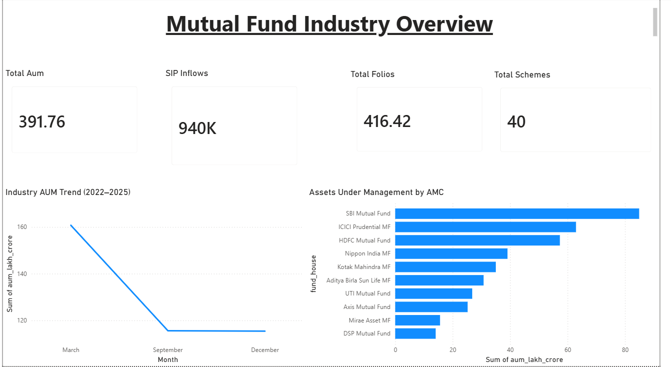
EDA Highlights(Fund Analysis)
Key Observations
1.Mutual funds are distributes across multiple categories.
2.Ceratin funds houses manage a larger number of schemes.
3.Category distribution indicates preferences for specific fund types.

Slide 6
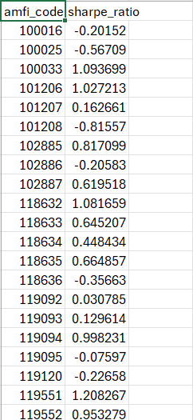
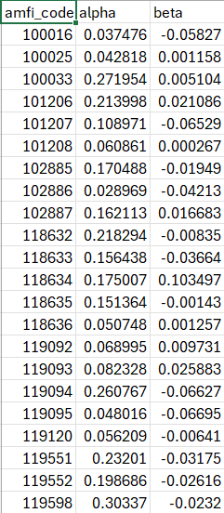
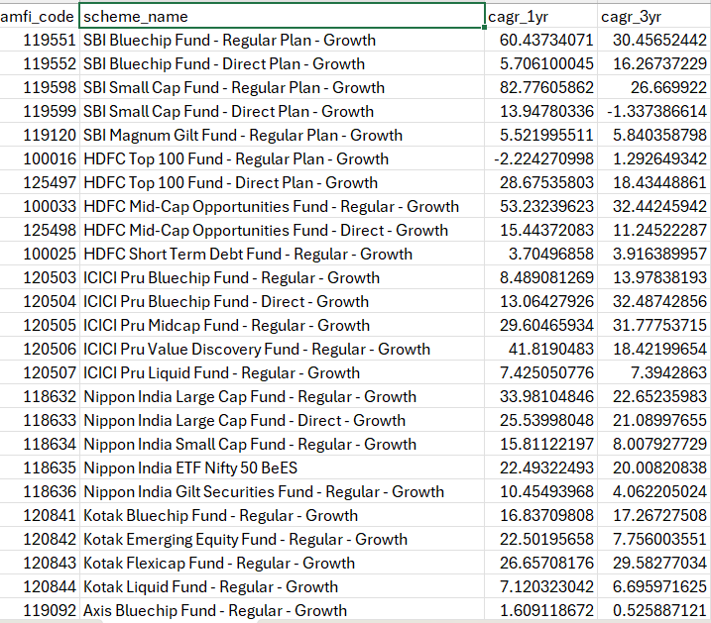
Performance Metrics
Key Observations
-- Performance varies significantly across mutual fund schemes.
-- Sharpe Ratio helps identify superior risk-adjusted returns.
-- Alpha and Beta provide benchmark comparison insights.

Slide 7
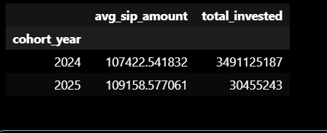
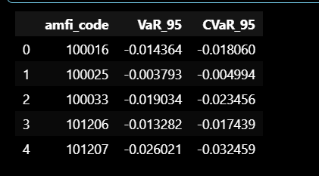
Risk Metrics & Advances Analytics
Value at Risk(VaR)
Conditional Value at Risk(CVaR)
Advanced Analytics
Investor Cohort Analysis
SIP Continuity Analysis
Portfolio Concentration(HHI) Fund Recommendation Engine

Slide 8
Industry Overview Dashboard
Observations
--Provides category –level and industry –level insights.
--Highlights fund distribution and market trends.
--Enables quick comparison across fund categories.

Slide 9
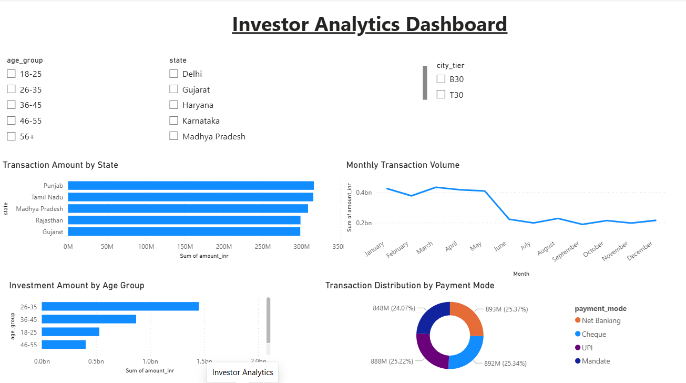
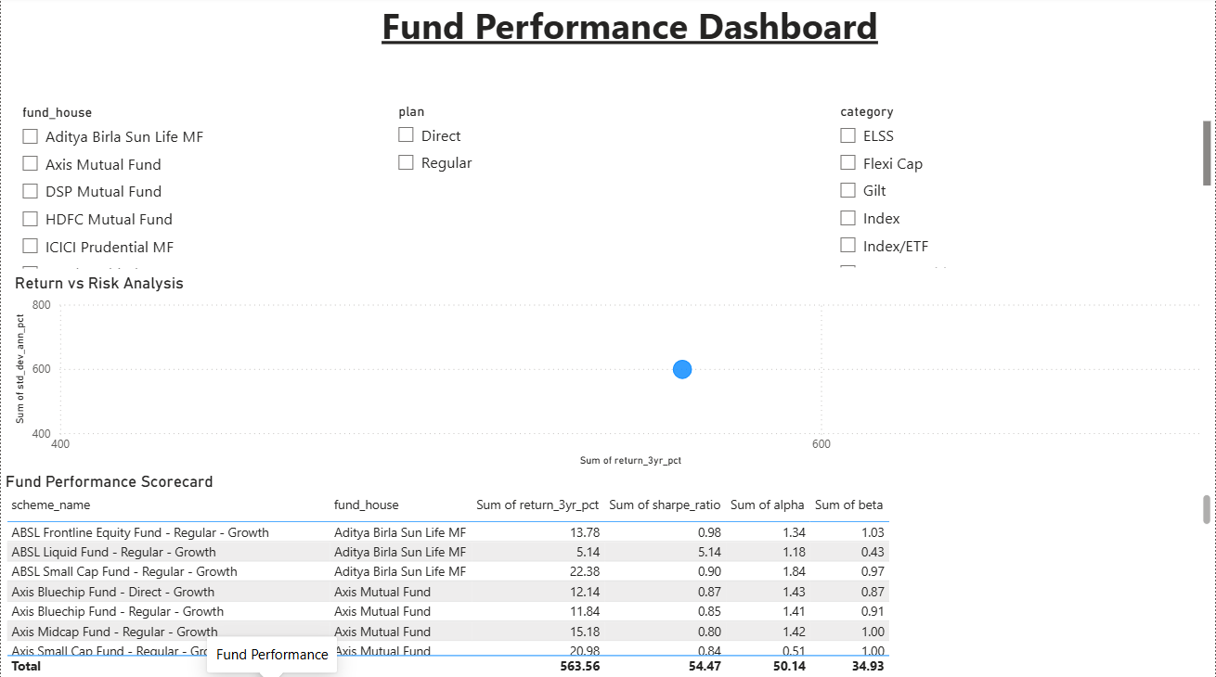
Fund Performance & Investor Analytics Dashboard
Observations
Investor demographics influence investment behavior.
Risk –adjusted performance differs across schemes.
Geographic analysis highlights key investor regions.

Slide 10
Key Findings & Recommendations
Key Findings
Investors aged 26-35 contribute the highest investment volume.
The 2024 cohort invested the most.
Low-risk liquid funds achieved strong Sharpe Ratio.
Portfolio concentration varies significantly across funds.
Recommendation
Introduce real –time market data integration.
Enhance investor segmentation.
Implement SIP retention monitoring.
Develop machine learning –based recommendations.

Slide 11
Bluestock Mutual Fund Analytics Capstone Project
Thank You

