Slide 1
Patch Matching
Kamarsu Sriya Deepika-20161186
D. Shritishma Reddy-20161165
DIP PROJECT
PRESENTATION

Slide 2
Problem Statement
Match patches using a Randomized Correspondence Algorithm that can be used for structural image editing.
We call this algorithm Approximate Nearest Neighbour Algorithm.
Apply the A-NNF Algorithm to one practical application in image processing.(We chose this to be Hole Filling in Images using Patch Matching).

Slide 3
Motivation
Patch-based sampling methods have become a popular tool for image and video synthesis and analysis.
Applications include texture synthesis, image and video completion, summarization and retargeting, image recomposition and editing, image stitching and collages, new view synthesis, noise removal and more.
Approximate Nearest Neighbour Algorithm algorithm offers substantial performance improvements over the previous state of the art (20-100x), enabling its use in interactive editing tools.

Slide 4
Overview
Illustration of the convergence of Approximate Nearest Neighbour Algorithm theoretically by constructing appropriate use cases.
For the practical proof we reconstructed Image B from Image A using nearest matched patches of Image A obtained from the NNF.
For the application: (Hole Filling of Images using NNF)
Search Space Constraints are given manually to approximate the NNF for patch match of the regions to be filled.

Slide 5
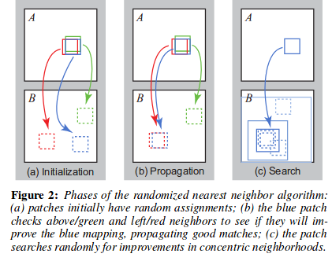
Phases of the Randomised Nearest Neighbour Algorithm

Slide 6
Pseudo Code for ANNF Algorithm
Function [NNF]=PatchMatch(target , source, window)
//Defined in the paper
radius=source_image_size/4 ; alpha=0.5 ; max_no_iters=-log(w)/log(alpha)
//Random Initialization
NNF->random_initialization_of_indices_from_source(leaving_padded_indices)
Calculate L2 dists for each pixel window of source and its corresponding pixel window in target linked by random NNF with and store in offset[ ]
For max_iters:
For each pixel in target image:(i,j)
//Propagation->P
Calculate idx=argmin(index)[offset(i,j),offset(i-1,j),offset(i,j-1)]
if(idx==2)
NNF(i,j,1)=NNF(i,j,1)+1;NNF(i,j,2)=NNF(i,j,2);Update offset of (i,j)
if(idx==3)
NNF(i,j,1)=NNF(i,j,1);NNF(i,j,2)=NNF(i,j,2)+1;Update offset of (i,j)
//Random Search->S
Calculate range of search according to radius and max_no_iters
Define the boundaries of search for each pixel according to the above range
Update NNF and offsets if we find a better L2 distance for a window corresponding to (i,j)
end
end
End

Slide 7
Reconstruction of image:
We move with a stride of window_size/2 and reconstruct the image using the patch_matched from source image of the first pixel in each stride
Halting criteria.
Although different criteria for halting may be used depending on the application, in practice we have found it works well to iterate a fixed number of times. All the results shown here were computed with 4-5 iterations total, after which the NNF has almost always converged.
The practical and theoretical proofs for convergence are provided below:

Slide 8
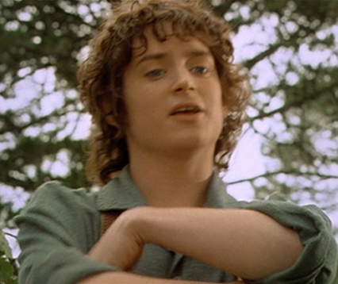
Practical Proof
Source Image

Slide 9
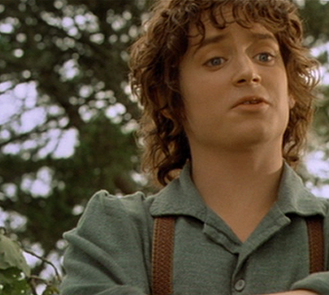
Image that has to be reconstructed from Source Image

Slide 10
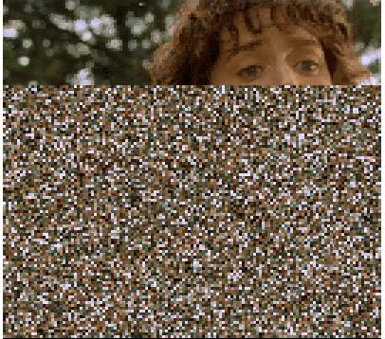
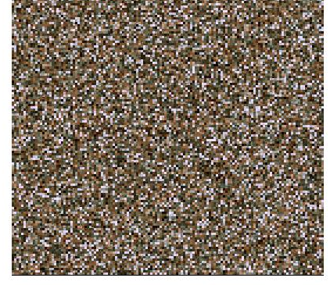
After every iteration
Random Initialised NNF
¼ iteration

Slide 11
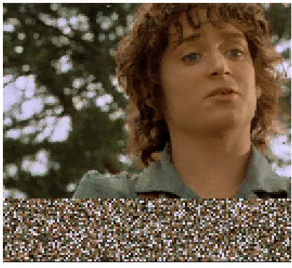
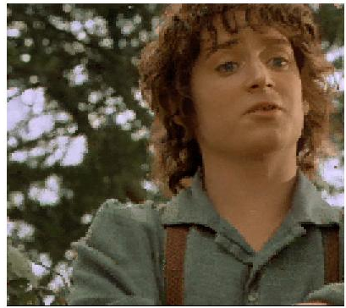
After every iteration
¾ th iteration
1st iteration

Slide 12
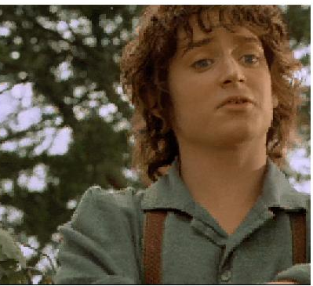

After every iteration
2nd iteration
3rd iteration

Slide 13
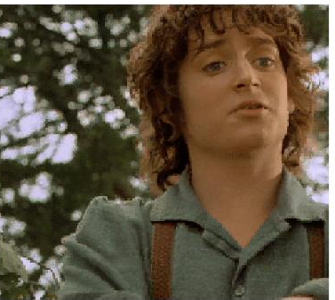
After every iteration
4th iteration

Slide 14
Source Image

Slide 15
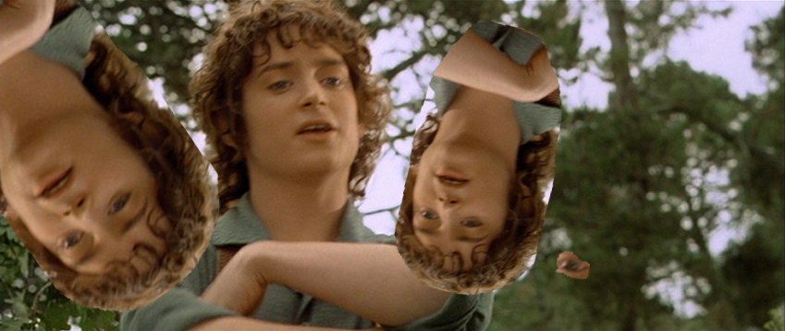
Image that has to be reconstructed from Source Image

Slide 16
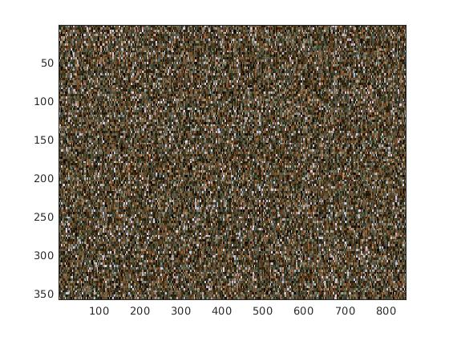
Random initialization

Slide 17
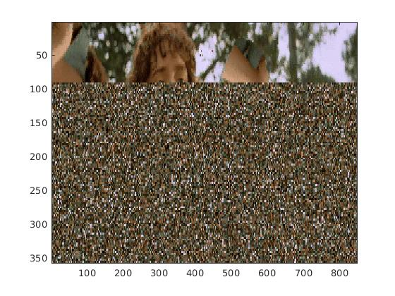
After ¼ iteration

Slide 18
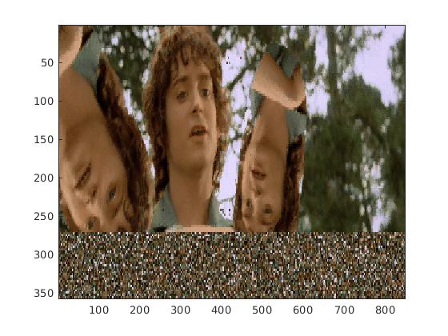
After ¾ iteration

Slide 19
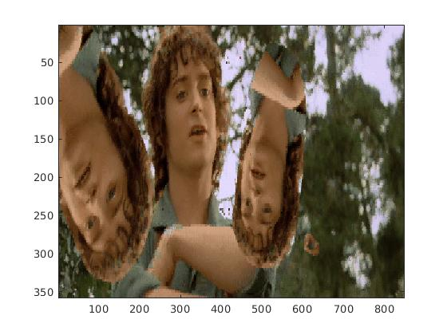
After 1st iteration

Slide 20
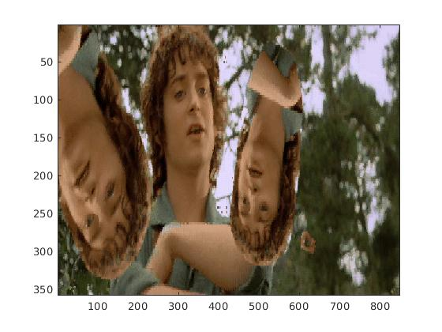
After 2nd iteration

Slide 21
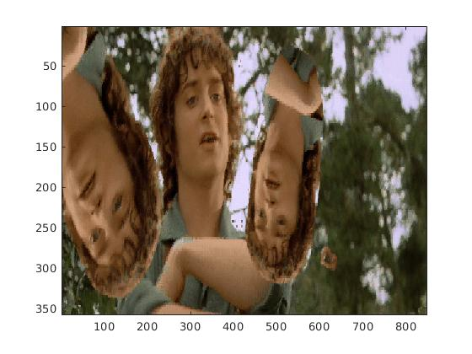
After 3rd iteration

Slide 22

After 4th iteration

Slide 23
Theoretical proof
Step1:
We start by analyzing the convergence to the exact nearest neighbourhood field and then extend the solution to an approximate solution
Assume A and B have equal number of pixels M (same size)
Probability that the random initialization for a pixel is the best offset=1/M
Probability that the random initialization for all the pixels is not the best offset=(1-1/M)^{M}
Probability that at least one pixel has the best offset in the random initialization=1-(1-1/M)^{M}
Lim (p) =1-e⁻¹
(M->infinity)

Slide 24
Convergence Theoretical Proof
Step2:
For an approximate solution, we can also consider a “correct” assignment to be any assignment within a small neighbourhood of size ‘C’ pixels around the offset.
In that case p=1-(1-C/M)^{M}
Lim (p) =1-e^{-M}
(M->infinity)

Slide 25
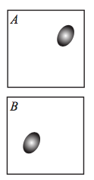
Convergence Theoretical Proof
Step-3:
Consider a synthetic example in which both A and B have M pixels each but we are interesed in matching a region of m pixels in A to a region of m pixels in B
No further information is provided about M-m pixels in A and B

Slide 26

Convergence Theoretical Proof
The probability that any of the m pixels lands within the neighborhood C of the correct offset is given by p=1-(1-C/M)^{m}
The probability that we did not converge on iterations 0, 1, ..., t 1 and converge on iteration t is
p(1-p)^t .
The probabilities thus form a geometric distribution, and the expected time of convergence is
E(t) = 1/p -1
To simplify , let the relative feature size be gamma=m/M
Take the limit as M->infinity
By taylor expansion for small gamma,
<t> is our expected number of iterations to convergence remains a constant for large image resolutions and a small feature size m relative to image resolution

Slide 27
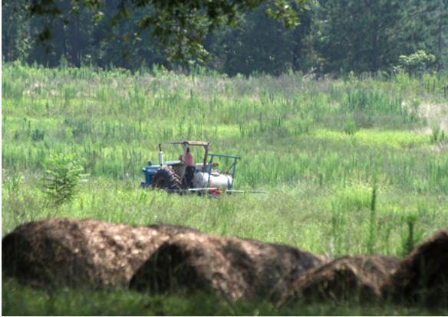
Application: Input

Slide 28
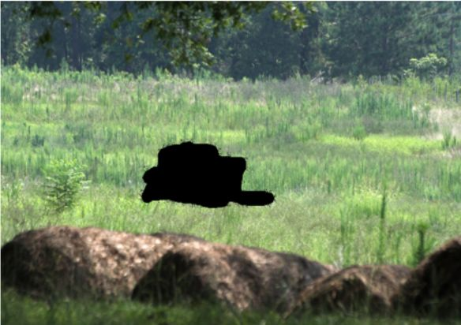
Application: Mask_image

Slide 29
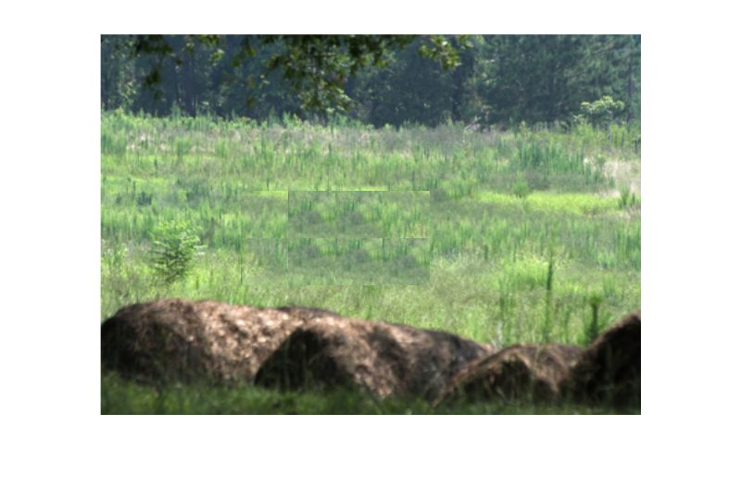
Application: Output image

Slide 30
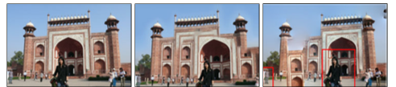
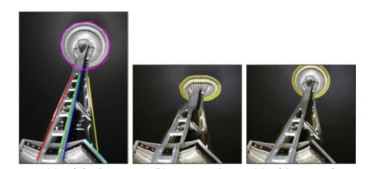
The other editing tools where we can use NNF
Image retargeting Image Reshuffling

Slide 31
Thank You

