Slide 1
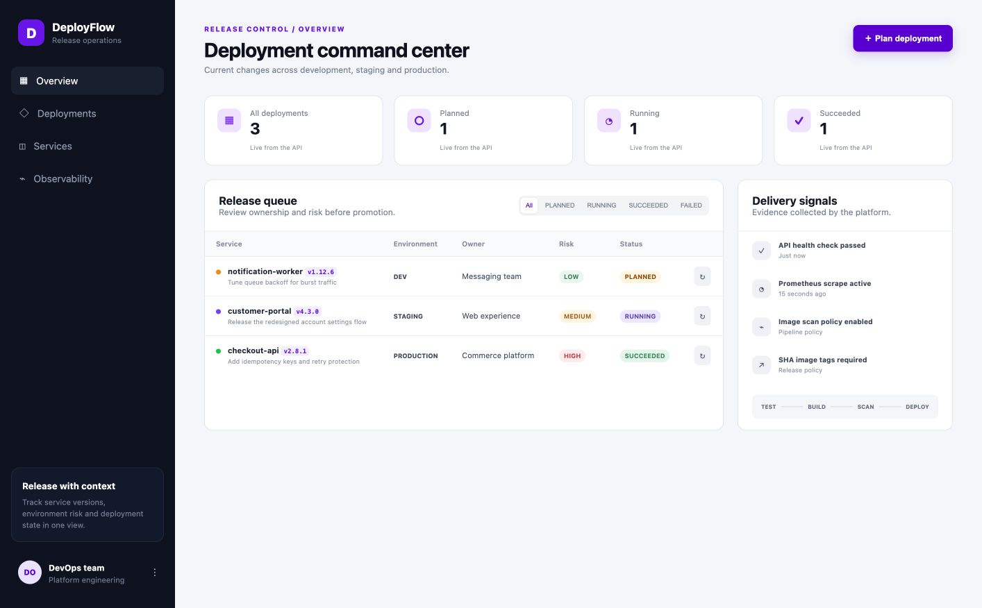
DEVOPS CAPSTONE
DeployFlow
Release operations—from commit to live metrics
FASTAPI
REACT
KUBERNETES
A production-minded delivery system with container security, Infrastructure as Code, Helm deployment, and observable runtime behavior.
Final Project · 2026
Notes:
Open with the product: DeployFlow gives a team one place to plan, promote, and observe service releases.
Explain that every screenshot in this deck was captured from the working local system.

Slide 2
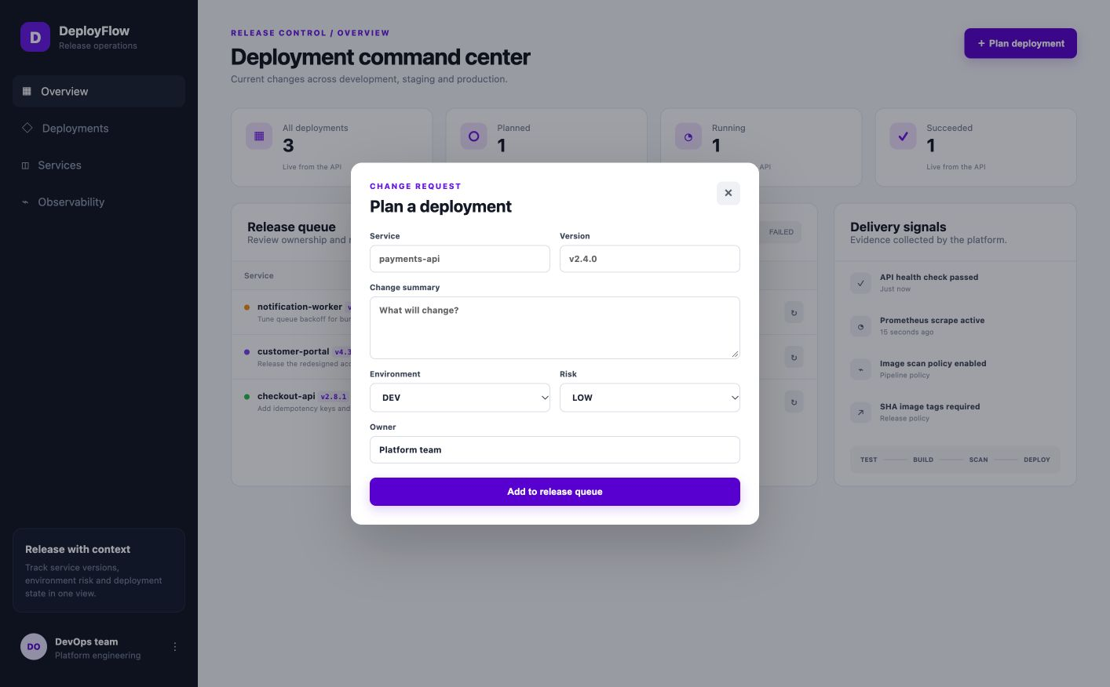
01 · PRODUCT
02
Release decisions need an operational home
DeployFlow turns scattered deployment context into a visible, auditable workflow.
Plan the change
Capture service, version, owner, risk, target environment, and change summary.
Track execution
Move a release through planned, running, succeeded, or failed states.
Read the room
Live status metrics surface risk concentration and release outcomes at a glance.
4
3
RELEASE STATES
ENVIRONMENTS
DEPLOYFLOW · DEVOPS CAPSTONE
Notes:
Demo creating a deployment, then update its status.
The domain and interface were redesigned from the starter material to avoid a copy-only submission.

Slide 3
02 · ARCHITECTURE
03
One delivery path, seven verifiable layers
The same application moves from source checks to containers, Kubernetes, and telemetry.
React
FastAPI
PostgreSQL
Docker
GitHub Actions
Helm + EKS
Prometheus
Operator UI
REST + metrics
Release state
Reproducible images
Test · scan · push
Declarative runtime
Operational feedback
Build once
Operate safely
Close the loop
Immutable images are tagged with the commit SHA, scanned, and promoted through Helm values.
Non-root workloads, health probes, resource limits, ingress routing, and autoscaling are encoded—not remembered.
Prometheus scrapes the API; Grafana turns request behavior into a live operational signal.
DEPLOYFLOW · DEVOPS CAPSTONE
Notes:
Walk left to right: interface, API, database, container build, CI, cluster release, monitoring.
All runtime layers are represented by checked-in configuration.

Slide 4
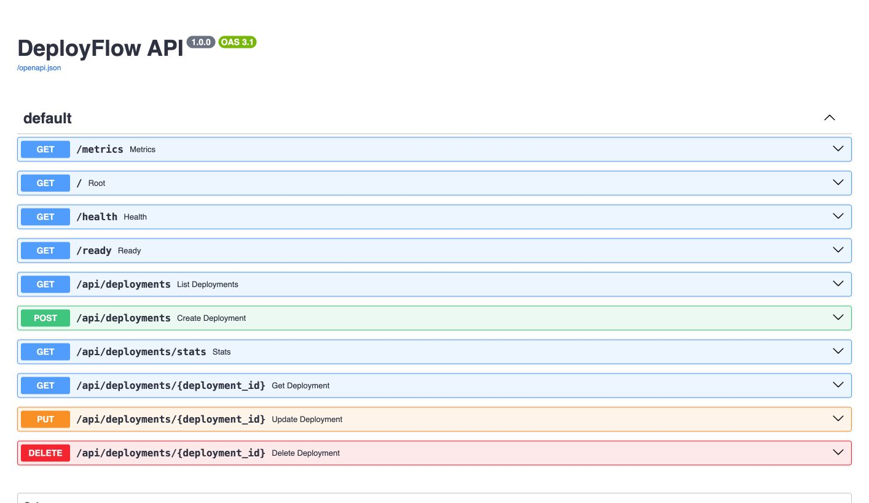
03 · QUALITY
04
The API is observable—and exercised
Release CRUD, aggregate statistics, health, readiness, and Prometheus metrics are built in.
9/9
0
PYTEST CASES PASS
RUFF ERRORS
Behavior, not snapshots
Create, validate, list, fetch, update, delete, stats, health, and readiness paths are covered.
Isolated test state
Each test suite overrides the database dependency with an in-memory SQLite engine.
Machine-readable contract
Swagger documents every endpoint and schema directly from the running application.
DEPLOYFLOW · DEVOPS CAPSTONE
Notes:
Run pytest -v during the live demo if time allows.
Point out the /health, /ready, and /metrics endpoints that support operations.

Slide 5
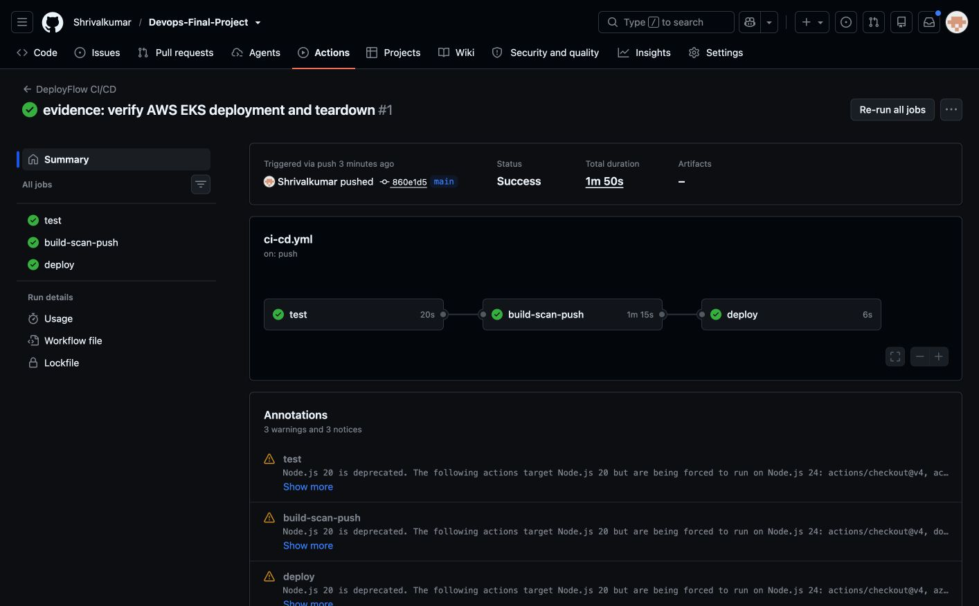
04 · DELIVERY
05
GitHub Actions completed the delivery gate
The completed `main` workflow tested the code, built both images, scanned them, published GHCR tags, and reported deployment configuration.
Test
1
pytest · Ruff · npm build
Build
2
backend + frontend images
Scan
3
Trivy HIGH/CRITICAL gate
Publish
4
GHCR · commit SHA tags
Deploy
5
Helm when kubeconfig exists
DEPLOYFLOW · DEVOPS CAPSTONE
Notes:
This is the actual successful GitHub Actions run for the pushed main branch.
The containers run as non-root users and expose explicit health checks.
The Trivy action is pinned to an immutable action commit and fails on HIGH or CRITICAL findings.

Slide 6
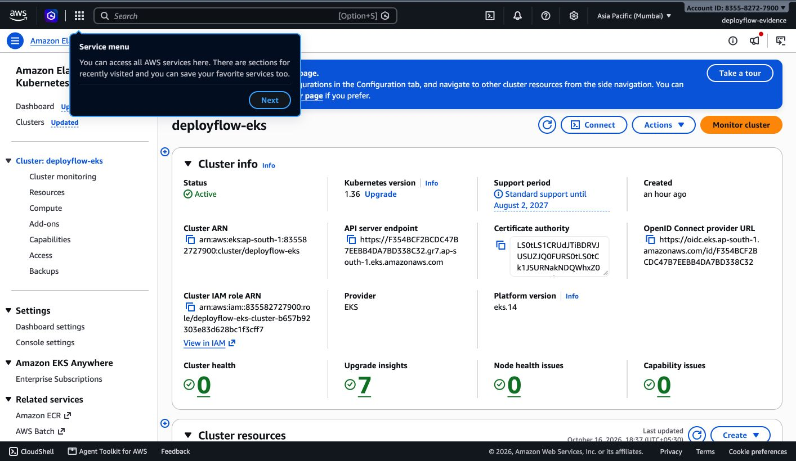
05 · INFRASTRUCTURE AS CODE
06
Real AWS infrastructure—provisioned and verified
Terraform created the two-AZ VPC and EKS platform in Mumbai; the cluster reported Active with zero node-health issues.
ACTIVE
EKS 1.36 · AP-SOUTH-1
Non-empty plan
56 resources planned: VPC, four subnets, NAT, IAM, encryption, logging, EKS, and managed nodes.
Two ready workers
Workloads ran across private subnets in two availability zones behind an AWS load balancer.
Cost-safe teardown
Helm releases and the load balancer were removed before Terraform destroyed the cloud stack.
DEPLOYFLOW · DEVOPS CAPSTONE
Notes:
This is an actual AWS Console screenshot from ap-south-1.
Terraform planned 56 resources and applied the VPC, EKS control plane, and two-node managed group.
The complete destroy was captured after the live demonstration to prevent ongoing costs.

Slide 7
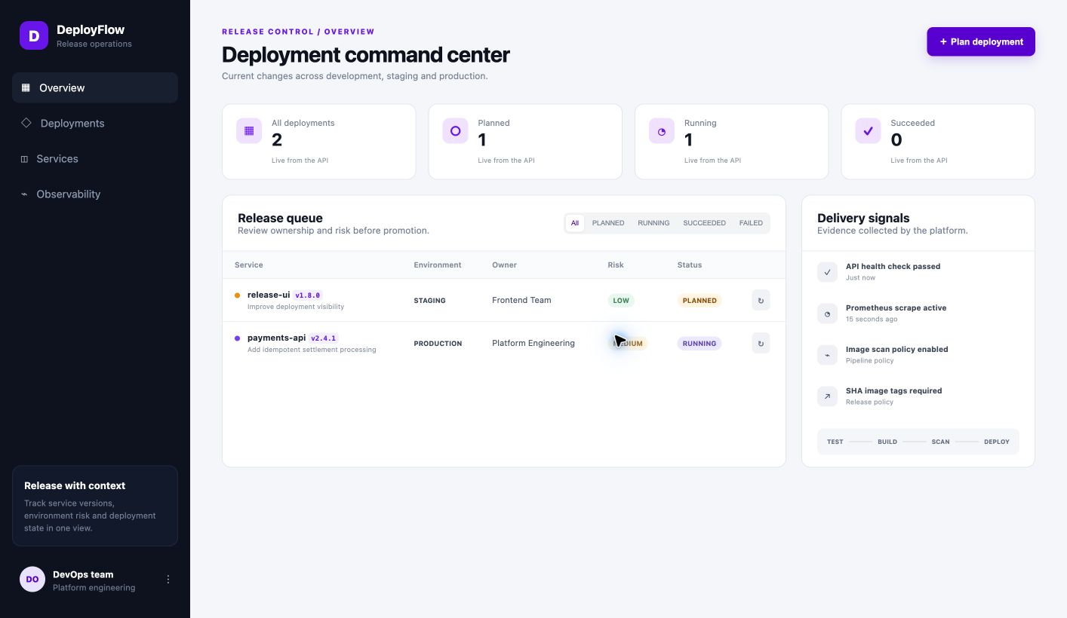
06 · KUBERNETES
07
The Helm release ran on EKS—not hypothetical
The same chart deployed PostgreSQL, two backend replicas, two frontend replicas, and ingress on the live AWS cluster.
2 + 2
BACKEND + FRONTEND PODS
ClusterIP by default
Frontend, backend, and PostgreSQL stay internal; ingress is the controlled entry point.
Environment overlays
Base, development, and production values separate resource and scaling choices.
Operational safeguards
Readiness/liveness probes, resource requests and limits, security contexts, and HPA are templated.
DEPLOYFLOW · DEVOPS CAPSTONE
Notes:
This screenshot is the application running behind the EKS ingress controller.
The terminal evidence shows both frontend and backend replicas distributed across the two workers.
The same chart was also validated locally on kind.

Slide 8
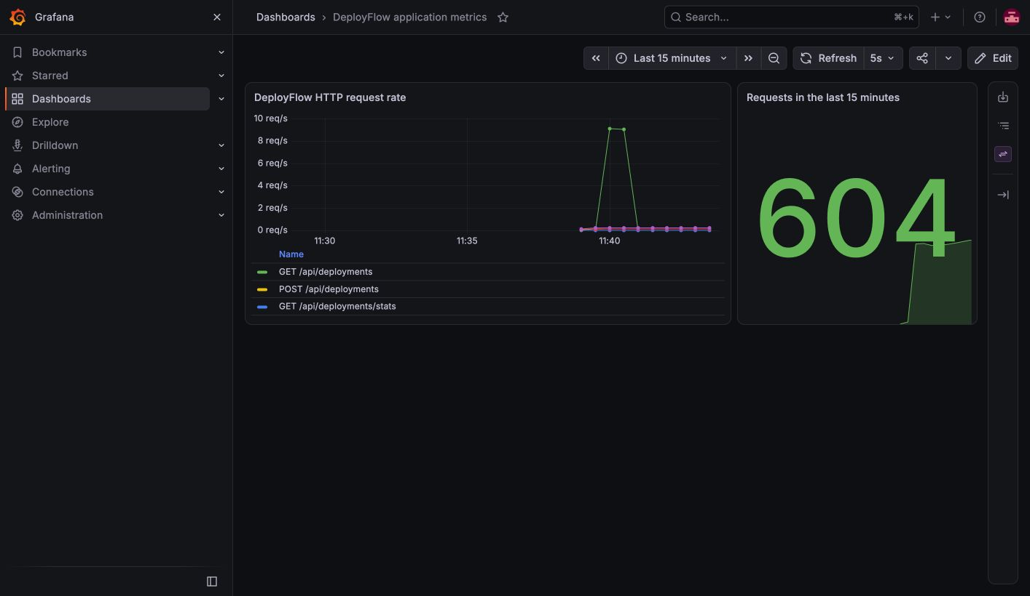
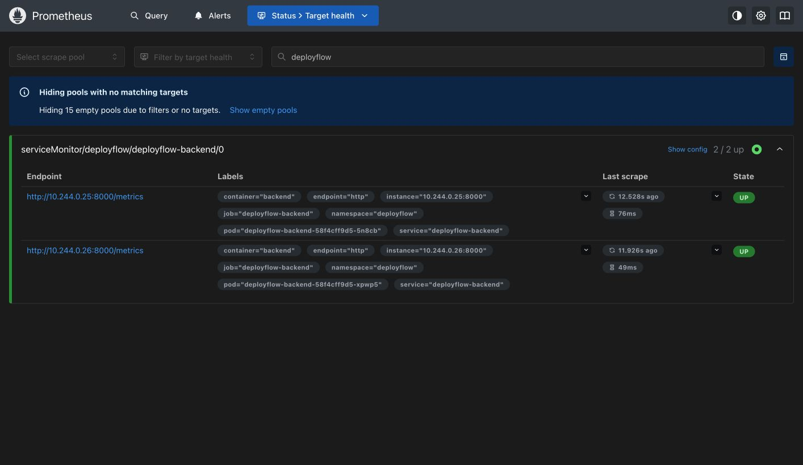
07 · OBSERVABILITY
08
Telemetry closes the delivery loop
ServiceMonitor discovery proves scrape health; a controlled load test produces visible request-rate behavior.
2 / 2 TARGETS UP
Prometheus discovers both API replicas through the chart’s ServiceMonitor.
604 REQUESTS
Grafana captured the generated traffic spike and 15-minute request count.
DEPLOYFLOW · DEVOPS CAPSTONE
Notes:
These are actual screenshots from the running local monitoring stack.
The load generator issues repeat API requests so the graph has a clear, verifiable signal.

Slide 9
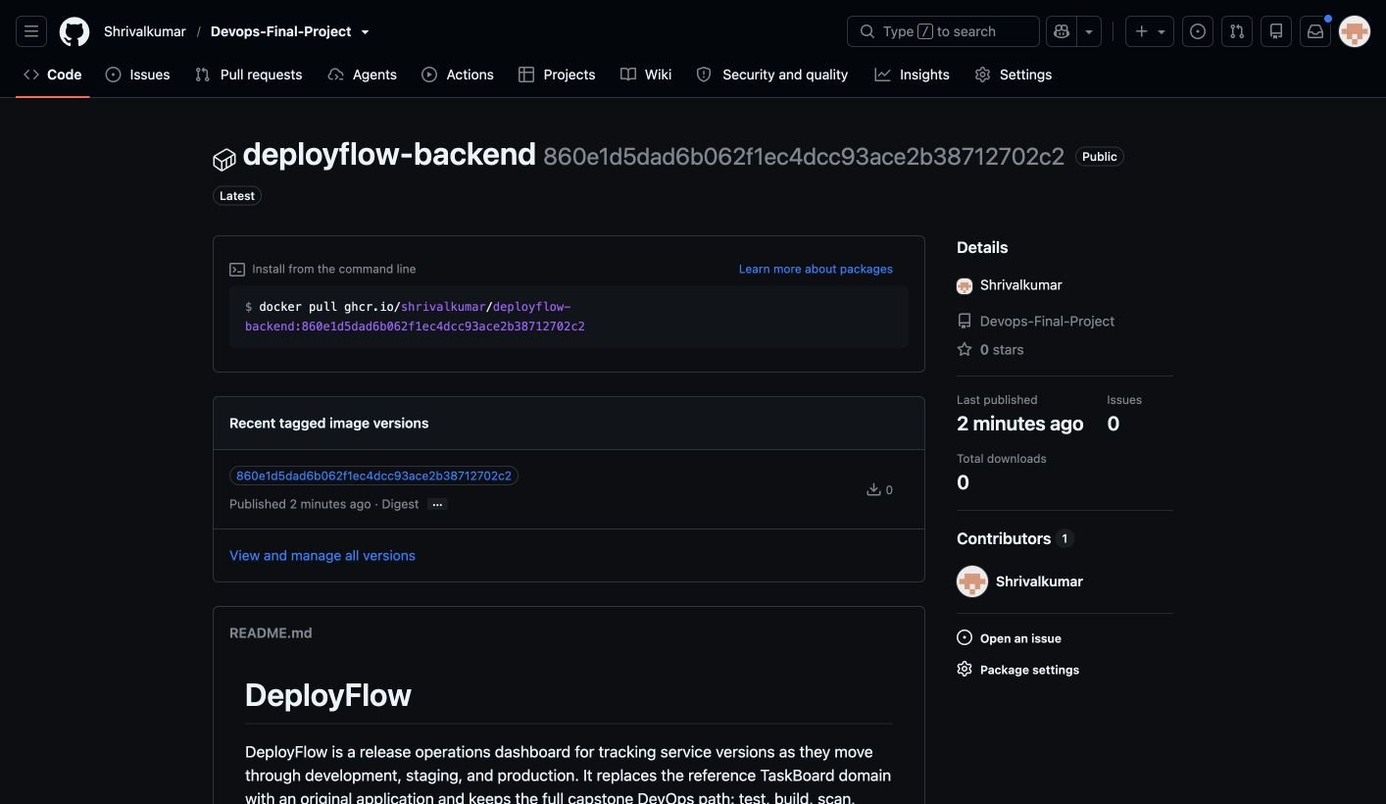
08 · HANDOFF
09
Submission-ready with published container evidence
The repository, GitHub workflow, GHCR image, AWS, Kubernetes, and observability evidence are complete.
Verified now
✓
9 backend tests + Ruff
✓
Frontend build + npm audit
✓
Hardened Docker Compose stack
✓
GitHub Actions: all jobs successful
✓
Public GHCR SHA-tagged image
✓
Helm on kind + live EKS
✓
Prometheus, Grafana, AWS evidence
Recommended demo path
Create release → update status → call API → generate load → watch Grafana
DEPLOYFLOW · AWS VERIFIED · GHCR PUBLISHED
Notes:
Close with the live demo path.
The GHCR backend package shown here is public and tagged with the immutable workflow commit SHA.
AWS plan, apply, EKS runtime, and destroy are also evidenced.

