Slide 1
docker

Slide 2
agenda
Virtualization
Difference between VM and Docker
Docker
Docker Daemon
Docker Client
Docker Images
Docker Hub
Container

Slide 3
Virtualization
Virtualization is the process of creating a software-based, or virtual, representation of something, such as virtual applications, servers, storage and networks.
It is the single most effective way to reduce IT expenses while boosting efficiency and agility for all size businesses.

Slide 4
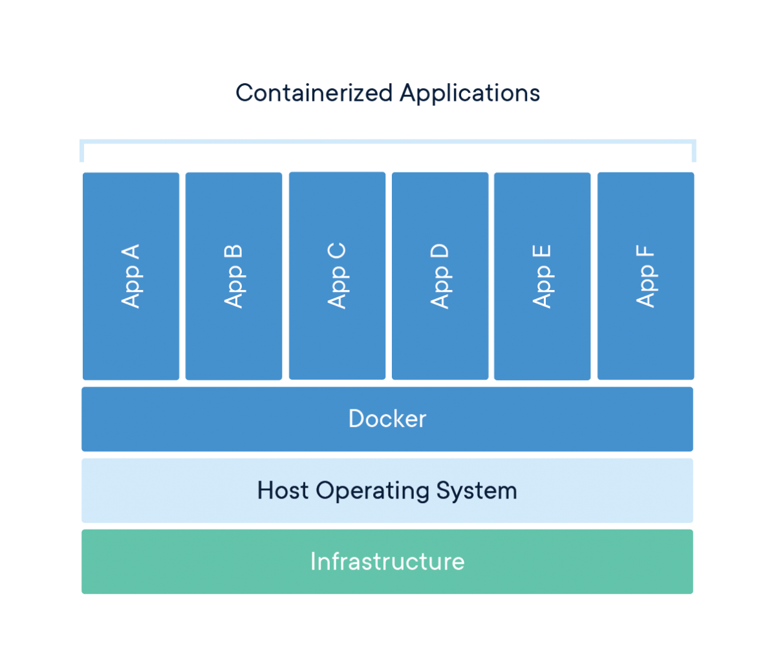
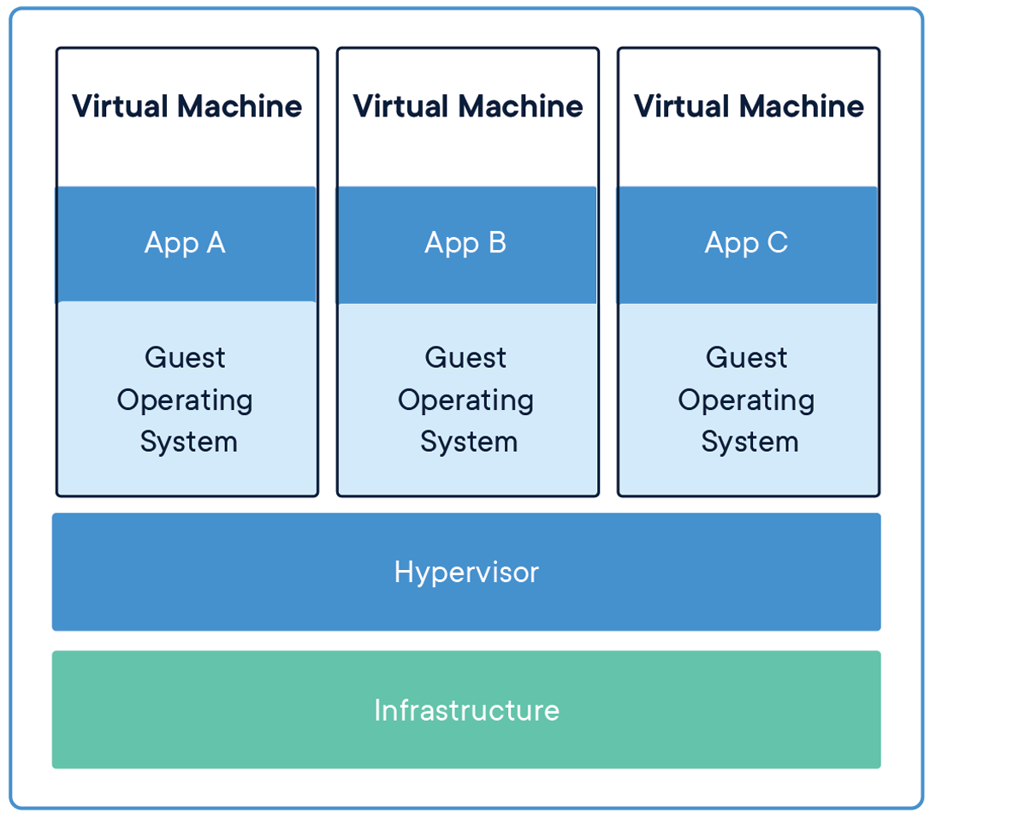
Difference between vm and container

Slide 5
docker
Docker is an open platform for developing, shipping & running distributed applications, whether on laptops, data center VMs or cloud.
Docker provides the ability to package and run an application in a loosely isolated environment called a container.
The Docker Platform consists of multiple product/tools, including the Docker Engine, Images, Containers, and Hub, among others.

Slide 6
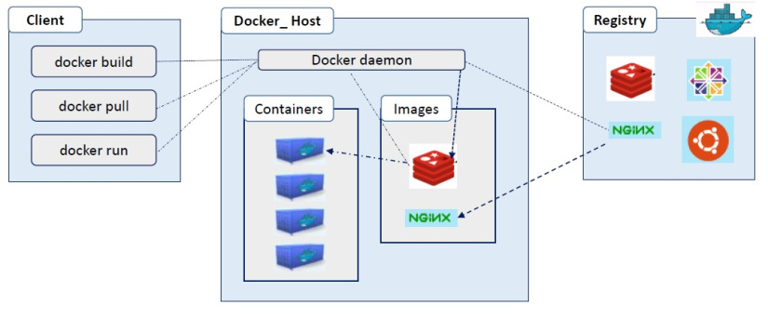
docker

Slide 7
Docker deamon
The background service running on the host that manages building, running and distributing Docker containers.
The daemon is the process that runs in the operating system which clients talk to.

Slide 8
Docker client
The command line tool that allows the user to interact with the daemon.
More generally, there can be other forms of clients too - such as Kitematic which provide a GUI to the users.

Slide 9
Docker images
Base images are images that have no parent image, usually images with an OS like ubuntu, busybox or debian.
Child images are images that build on base images and add additional functionality.

Slide 10
Docker images
Official images are images that are officially maintained and supported by the folks at Docker.
Eg: python, linux, busybox
User images are images created and shared by users like you and me. They build on base images and add additional functionality.
Eg: user/image name

Slide 11
Docker hub
A registry of Docker images.
You can think of the registry as a directory of all available Docker images.
If required, one can host their own Docker registries and can use them for pulling images.

Slide 12
Container
A container is a standard unit of software that packages up code and all its dependencies so the application runs quickly and reliably from one computing environment to another.
A Docker container image is a lightweight, standalone, executable package of software that includes everything needed to run an application: code, runtime, system tools, system libraries and settings.

Slide 13
Container
Container images become containers at runtime and in the case of Docker containers - images become containers when they run on Docker Engine.
Available for both Linux and Windows-based applications, containerized software will always run the same, regardless of the infrastructure.
Containers isolate software from its environment and ensure that it works uniformly despite differences for instance between development and staging.

Slide 14
container
Docker containers that run on Docker Engine:
Standard: Docker created the industry standard for containers, so they could be portable anywhere
Lightweight: Containers share the machine’s OS system kernel and therefore do not require an OS per application, driving higher server efficiencies and reducing server and licensing costs
Secure: Applications are safer in containers and Docker provides the strongest default isolation capabilities in the industry

Slide 15
Docker compose
Compose is a tool for defining and running multi-container Docker applications.
With Compose, you use a YAML file to configure your application’s services.
Then, with a single command, you create and start all the services from your configuration.
Using Compose, it is 3 step process:
Define the app’s environment with Dockerfile so that it can be reproduced anywhere.
Define the services that make up the app in the docker-compose.yml file. So they can be run together in an isolated environment.
Run docker-compose up and compose starts and runs your entire app.

Slide 16
Docker-compose.yml
version: "3.8"
services:
web:
build: .
ports:
- "5000:5000"
volumes:
- .:/code
- logvolume01:/var/log
links:
- redis
redis:
image: redis
volumes:
logvolume01: {}

