Slide 1
OPUS : Helping Students Find Work
Final Review
CIS 550 - Project
Abhinav Atrishi (abhinav1@seas.upenn.edu)
Bushra Kidwai (bkidwai@seas.upenn.edu)
Samuel Kamien (skamien@seas.upenn.edu)
Shrivats Agrawal (shriv9@seas.upenn.edu)

Slide 2
Basic Problems and Goals
As undergrad or grad students, we are in throes of finding a summer internship or a post-college job search.
The process can be exhausting and time taking considering the research that goes behind finding the perfect role and more importantly the right company.
Hence our application is aimed at making the ‘research’ simpler for people looking for jobs.

Slide 3
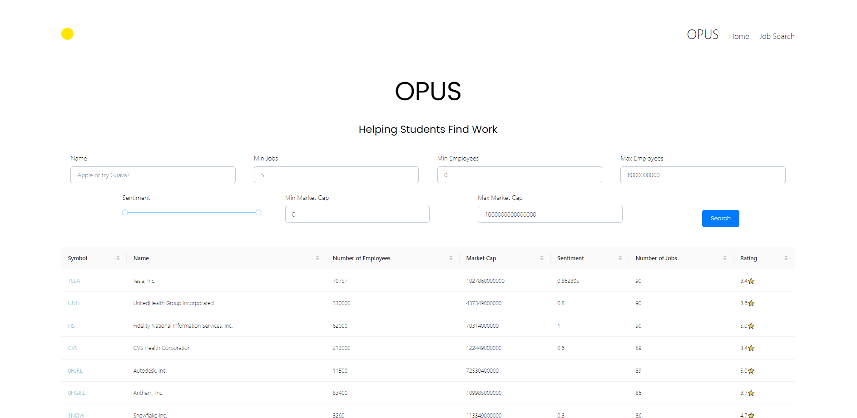
Preview

Slide 4
Datasets
We develop a web app enabling users to readily interpret information combined from two discrete data sources stored in five relations.
Dataset 1- Indeed (Scrapping the data)
Dataset 2- Financial Modelling Prep (FMP)

Slide 5
Indeed (Scrapping the data)
Indeed.com is one of the top websites job seekers prefer for finding work opportunities.
Due to the availability of up-to-date information displayed in an organized and structured fashion, Indeed will serve as a befitting source of job/internships data for our project.
Indeed came out as the top choice amongst Linkedin and Glassdoor due to a well defined html structure and free availability of information without a paywall or requirements for login.

Slide 6
Preprocessing
Indeed:
Jobs fetched for incorrect companies – fetched company names from Indeed to transform this bug into a tool for expanding our scope.
Duplicate jobs postings – dropped duplicates job url link
Conversion of Ratings to float from string
Filled null values with empty strings for Salary

Slide 7
Financial Modelling Prep (FMP)
Provides one of the most comprehensive financial data API. With each update being audited and standardized in real time to ensure consistency in the data.
We choose to work with FMP API as it is freely and easily available, while also it is guaranteed to be consistent and accurate. In addition to the raw financial data the FMP API also provides access to a host of other interesting data about companies like what are a company's stock peers (essentially mapping how companies are related to each other) and what are the social sentiment of a company (with data from a host of social media sites like twitter, reddit, etc.).

Slide 8
Preprocessing
FMP:
Dropped lots of irrelevant columns (for our application) related to stock price statistics to make the tables compact.
Handled and filtered unexpected characters in company symbols and descriptions, keeping only the ones with proper UTF-8 symbols and names.
Converted strings fetched from the API to integers or floats as required for specific data columns.
Expanded over multi-value attributes to ensure atomicity (1 NF).

Slide 9
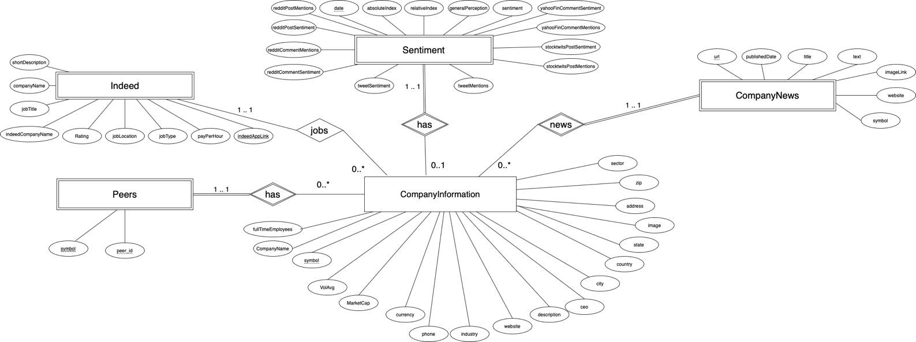
ER Diagram

Slide 10
Normalization
1NF- every attribute in each relation in the dataset is a singled valued attribute. Our Peers table had multi-valued attributes which we normalized to single valued attributes.
2NF- we removed subsets of data that applied to multiple rows and created separate tables and formed relationships using Foreign Key constraints. Each non-key attribute is functionally dependent on the primary key in each table.
3NF, BCNF- The relations have no transitive functional dependency and are in BCNF.

Slide 11
Application Stack
MYSQL ( AWS RDS for SQL)
Node.js
React
Python(Requests, Selenium, BeautifulSoup)

Slide 12
SQL Queries (Complex)
Home Page Query: Returns the companies which match the user entered parameters like number of employees, number of jobs, market capitalization, sentiment and company Name. This query is utilized by the Home-Page.
WITH cmp_info AS (SELECT symbol, companyName, fullTimeEmployees, mktCap FROM CompanyInformation WHERE companyName LIKE '%${cmpName}%' and fullTimeEmployees BETWEEN ${numEmployeesLow} AND ${numEmployeesHigh} AND mktCap BETWEEN ${mktcapLow} AND ${mktcapHigh}), sentiment AS (SELECT symbol as symbol, sentiment FROM CompanySentiments s WHERE sentiment BETWEEN ${sentiLow} AND ${sentiHigh}) ,jobs AS (SELECT companySymbol as symbol ,COUNT(jobLink) as JobCount, max(companyRating) as companyRating FROM IndeedJobs GROUP BY companySymbol HAVING COUNT(jobLink)>= ${jobNum}) SELECT C.symbol as companySymbol, companyName, fullTimeEmployees, mktCap, sentiment, JobCount, companyRating FROM cmp_info C LEFT JOIN sentiment S ON C.symbol=S.symbol LEFT JOIN jobs J ON C.symbol=J.symbol ORDER BY JobCount DESC LIMIT ${pagesize} OFFSET ${offset};

Slide 13
SQL Queries (Complex)
Sentiment Query: Returns sentiment and popularity values for a given company, as well as peers and the average of peers. This query is used on the Company Sentiment Page
WITH T1 AS (SELECT DISTINCT peerID asID FROM Peers WHERE symbol = '${company}' or peerID = '${company}'), T2 AS (SELECT C.companyName, C.symbol, T1.ID, 2 as ord FROM CompanyInformation C JOIN T1 ON C.symbol = T1.ID WHERE symbol != '${company}'), T3 AS (SELECT C.companyName, C.symbol, T1.ID, 0 as ord FROM CompanyInformation C JOIN T1 ON C.symbol = T1.ID WHERE symbol = '${company}'), T23 AS (SELECT * FROM T2 UNION ALL SELECT * FROM T3), T4 AS (SELECT S.sentiment, S.relativeIndex, T1.ID FROM CompanySentiments S JOIN T1 ON S.symbol = T1.ID), T5 AS (SELECT 'Average of peers' AS companyName, 'AVG' AS symbol, AVG(S.sentiment) as sentiment, AVG(S.absoluteIndex) as relativeIndex, 1 as ord FROM CompanySentiments S JOIN T1 ON S.symbol = T1.ID WHERE T1.ID != '${company}') SELECT * FROM T5 UNION ALL SELECT T23.companyName, T23.symbol, T4.sentiment, T4.relativeIndex, T23.ord FROM T23 JOIN T4 ON T23.ID = T4.ID ORDER BY ord;

Slide 14
SQL Queries
Company Jobs: Returns the jobs which match the user entered parameters like industry, sector, company name, normal vs. internship, job rating, number of employees and job title. This query is utilized by the main job search page
WITH TT as ( SELECT * FROM CompanyInformation CI JOIN IndeedJobs I ON I.companySymbol = CI.symbol WHERE CI.industry LIKE '%${industry}%' AND CI.sector LIKE '%${sector}%' AND CI.companyName LIKE '%${cmpName}%' AND I.jobType LIKE '%${jobType}%' AND (I.companyRating BETWEEN ${ratingLow} AND ${ratingHigh}) AND (CI.fullTimeEmployees BETWEEN ${numEmployeesLow} AND ${numEmployeesHigh}) AND I.jobTitle LIKE '%${jobTitle}%' ORDER BY CI.companyName ) SELECT * FROM TT LIMIT 50;

Slide 15
Optimization
SNo | Type of Optimization | Unoptimized Query | Optimized Query | Implication
1 | SELECT | All fields (SELECT *) are being retrieved in both the CTE expression and the final SELECT call. The fields are being filtered on frontend via JavaScript NodeJS. | Only fields needed by subsequent queries are retrieved in CTEs and fields to be displayed on the Front End are projected in the main SELECT call. | Projection on Specific Fields.
2 | WHERE | No selection condition to filter the number of rows in the final result. | Selection condition in WHERE clause to filter out rows with erroneous News Title. | Selection on specific rows.
3 | INNER JOIN vs CARTESIAN CROSS PRODUCT | Cross product with Where clause to filter out relevant rows after the execution of Join. Results in more comparisons to join tables. | Inner Join with the Join condition specified on Primary Key – Foreign Key. Results in filtering of tables on join condition before the execution of join and thereby significantly lesser number of comparisons to be made. | Creating inner joins instead of cross products with selection condition.

Slide 16
Optimization (cont.)
4 | LIMIT | All the results in the final table are retrieved by the server and pagination done on FrontEnd. | LIMIT implemented to enforce pagination at database level. As a result only the data required to be displayed at the front end is queried from the database. Consequently a smaller size of the data is sent to the server. | Using limit to sample query results with dynamic queries.
5 | INDEX | NO INDEX | INDEX on peerID of table Peers. | As joins are made on Primary Key – Foreign Keys the attributes are already indexed. In addition an index is created on PeerID to speedup joins using Indexed Block Nested Loop Joins.
6 | Wildcard Optimization ‘%’ | Use of wildcard while matching symbol resulted in many more results than required. | Wildcards removed to promote exact match and thereby reduce the number of results returned by the database. | Use of ‘%’ wildcard character with LIKE matches all strings when sometimes only specific matches are needed.
 | Execution Time | 9s 106ms | 859 ms
 | Speed Up– 10.6x

Slide 17
Optimizations
Query | Original time | Optimized Time
Home Page | 1s 736ms | 893ms
Job Search | 4s 213ms | 467ms
News Page | 9s 106ms | 859ms
Company Information | 1s 253ms | 302ms
Sentiment | 3s 543ms | 582ms
Job Page Query | 3s 211ms | 754ms

Slide 18
Technical Challenges
Indeed Scraper :
Non uniform html structure and organization of the components on the web page.
Incorrect search results returned for some companies
High request rate - leading to captcha
Database:
High upload time for tables leading to a bottleneck in processing new data and updates
General:
Coordination of code changes with team -> branches and version control
Understanding the components based architecture of React

Slide 19
Extra Credit Features
Web Scrapping of Indeed
Used streaming data for FMP
Recommendation of similar jobs

Slide 20

DEMO

