Slide 1
Opus: Helping Students find Work they Like

Slide 2
Basic Problems and Goals
As undergrad or grad students, we are in throes of finding a summer internship or a post-college job search.
The process can be exhausting and time taking considering the research that goes behind finding the perfect role and more importantly the right company.
Hence our application is aimed at making the ‘research’ simpler for people looking for jobs.

Slide 3
Preview

Slide 4
Datasets
Dataset 1- Financial Modelling Prep (FMP) | Dataset 2- Indeed (Scrapping the data)
We develop a web app enabling users to readily interpret information combined from two discrete data sources stored in five relations.

Slide 5
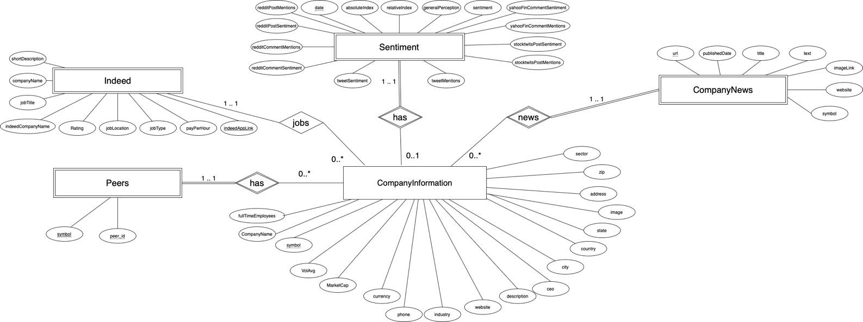

Slide 6

DEMO

Slide 7
APPLICATION STACK
MYSQL ( AWS RDS for SQL)
React
Node.js

Slide 8
Example: Complex Query
WITH tmp1 AS (SELECT symbol, companyName, fullTimeEmployees, mktCap FROM CompanyInformation WHERE companyName LIKE '%${cmpName}%' and fullTimeEmployees BETWEEN ${numEmployeesLow} AND ${numEmployeesHigh} AND mktCap BETWEEN ${mktcapLow} AND ${mktcapHigh}), tmp2 AS (SELECT s.symbol, tmp1.companyName, tmp1.fullTimeEmployees, tmp1.mktCap, s.sentiment FROM CompanySentiments s JOIN tmp1 ON tmp1.symbol= s.symbol WHERE sentiment BETWEEN ${sentiLow} AND ${sentiHigh}) SELECT *, COUNT(jobLink) as JobCount FROM IndeedJobs i JOIN tmp2 ON tmp2.symbol=i.companySymbol GROUP BY i.companySymbol HAVING COUNT(jobLink)> ${jobNum} LIMIT ${pagesize} OFFSET ${offset};

Slide 9
Optimisation

Slide 10
Technical Challenges

