Slide 1
Evaluating Machine Learning Fairness Algorithms: LM, LPS, & FFS (A6, A7)
Group 11
Contributors: Christie Du, Shriya Nallamaddi, Kexin Tang, Xile Zhang, Haozhong Zheng

Slide 2
Features, Model, & Metrics
Data: Using only data with race African-American & Caucasians
Features (6): age, charge degree, sex, length of stay, has juvenile record, has prior record
Protected Feature: race
Model: Gradient Boosting Decision Tree Classifier
Metrics:
Accuracy
Calibration of the two race groups
False Positive Rate of the two race groups (this showed the bias the most)
Notes:
~ 45s
00:15-01:00
COMPAS
Recommit
Filter

Slide 3
Motivation for Correcting Bias
Problem: FPR is 2x larger for African-Americans than Caucasians
Metric | Including Race | Excluding Race
Accuracy | 66.76% | 65.54%
Calibration | 0.44% | 1.8%
FPR (African-American) | 39.60% | 36.58%
FPR (Caucasian) | 18.51% | 24.03%
FPR (Difference) | 21.09% | 12.55%
Can we do better?
Notes:
~20s
01:00-01:30
Interpretation of FPR:
Percentage of people who are not going to recommit is predicted as recommitment.

Slide 4
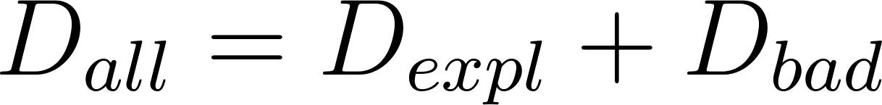
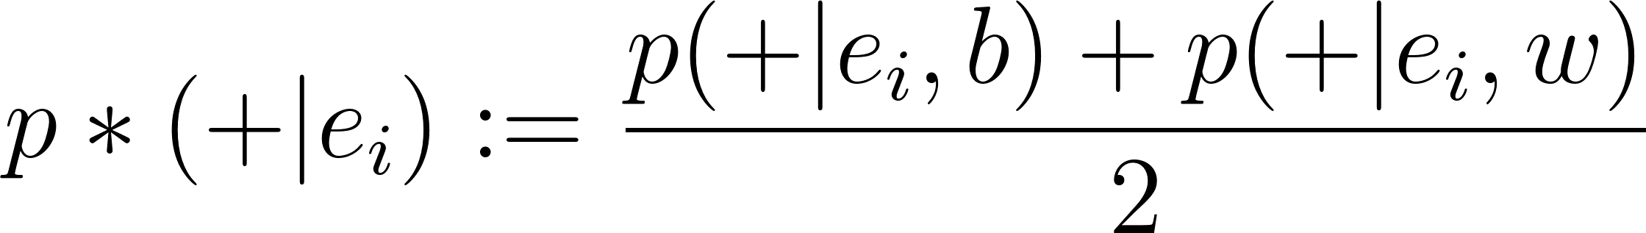
Intro to LM (Local Massaging) & LPS (Local Preferential Sampling)
Algorithm Type: Pre-processing of train data
Same rate of recidivism for different races
Has prior | Race | Recidivate rate | Expectation
FALSE | African- American | 34% | 29%
FALSE | Caucasian | 25% | 29%
Notes:
~15s
01:30-01:45
Change of labels
Half of DELTA

Slide 5
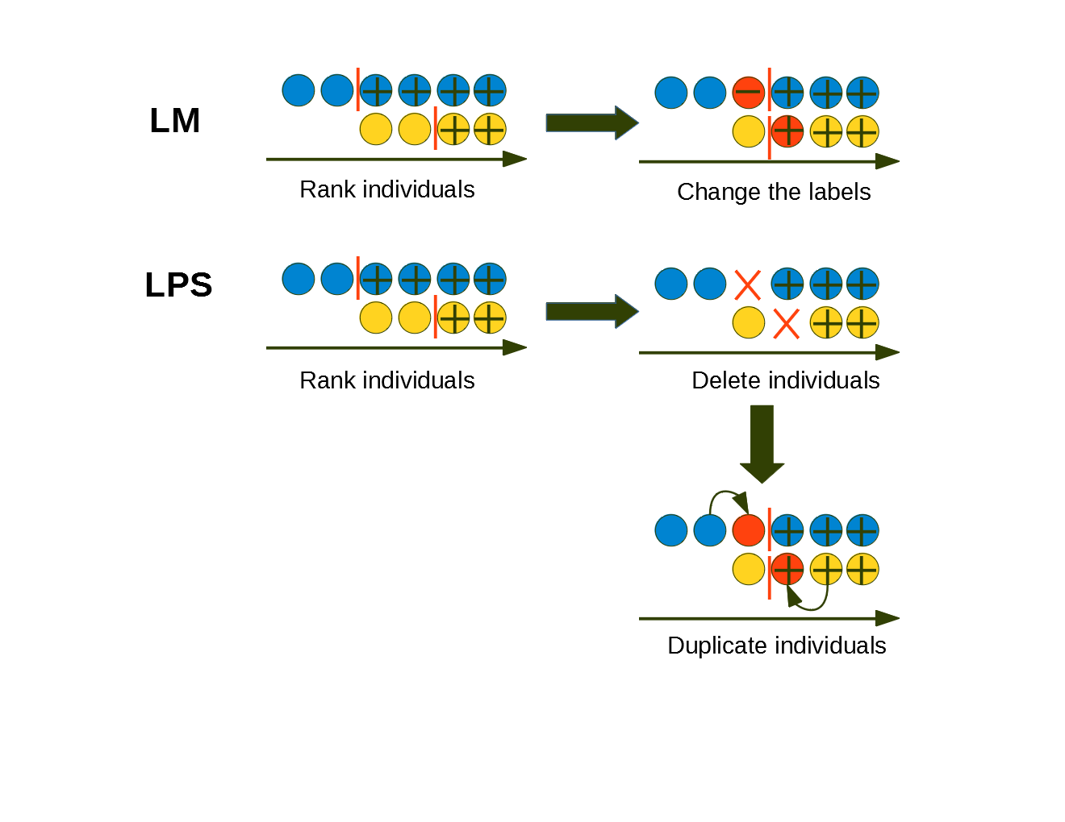
Authors:
instead of
Notes:
~30s
01:45-02:15
Data closest to the decision boundary

Slide 6
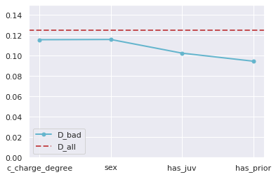
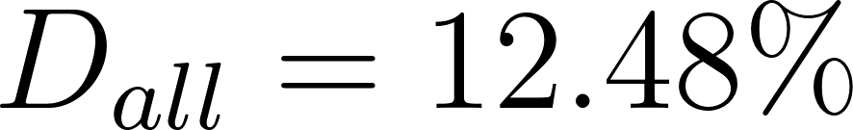
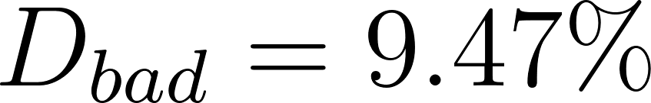
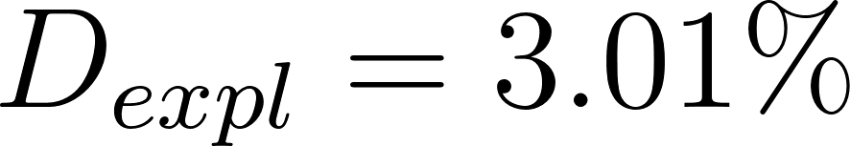
Evaluation: LM, LPS
Choosing ‘has_prior’ as explanatory attribute since it has highest explanatory discriminaiton
Notes:
~15s
02:15-02:30
Note

Slide 7
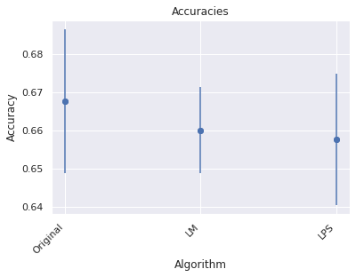
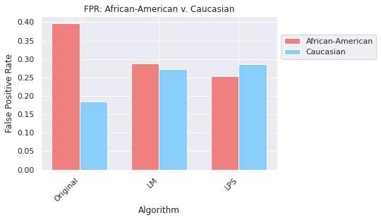
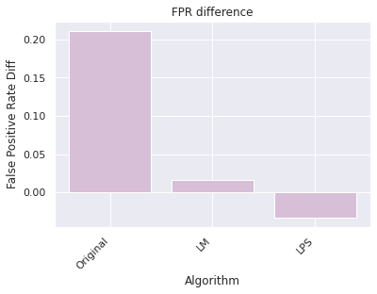
Accuracy
False Positive Rate
False Positive Rate Diff
LM & LPS works well since the difference between the FPR of AA and C is relatively small.
Notes:
~15s
02:30-02:45
LPS overcorrect almost

Slide 8
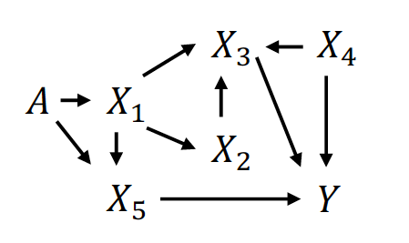
Intro to FFS (Fairness-aware Feature Selection)
Algorithm Type: Feature Selection
Compute an accuracy + discrimination score for each feature
Ideally, remove feature with low accuracy and high discrimination score
Low discrimination score
Protected feature (ex: race)
Likely to have high discrimination scores
Predicted variable
Notes:
~15s
02:45-03:00
2 scores
Higher correlation may lead to higher discrimination scores

Slide 9
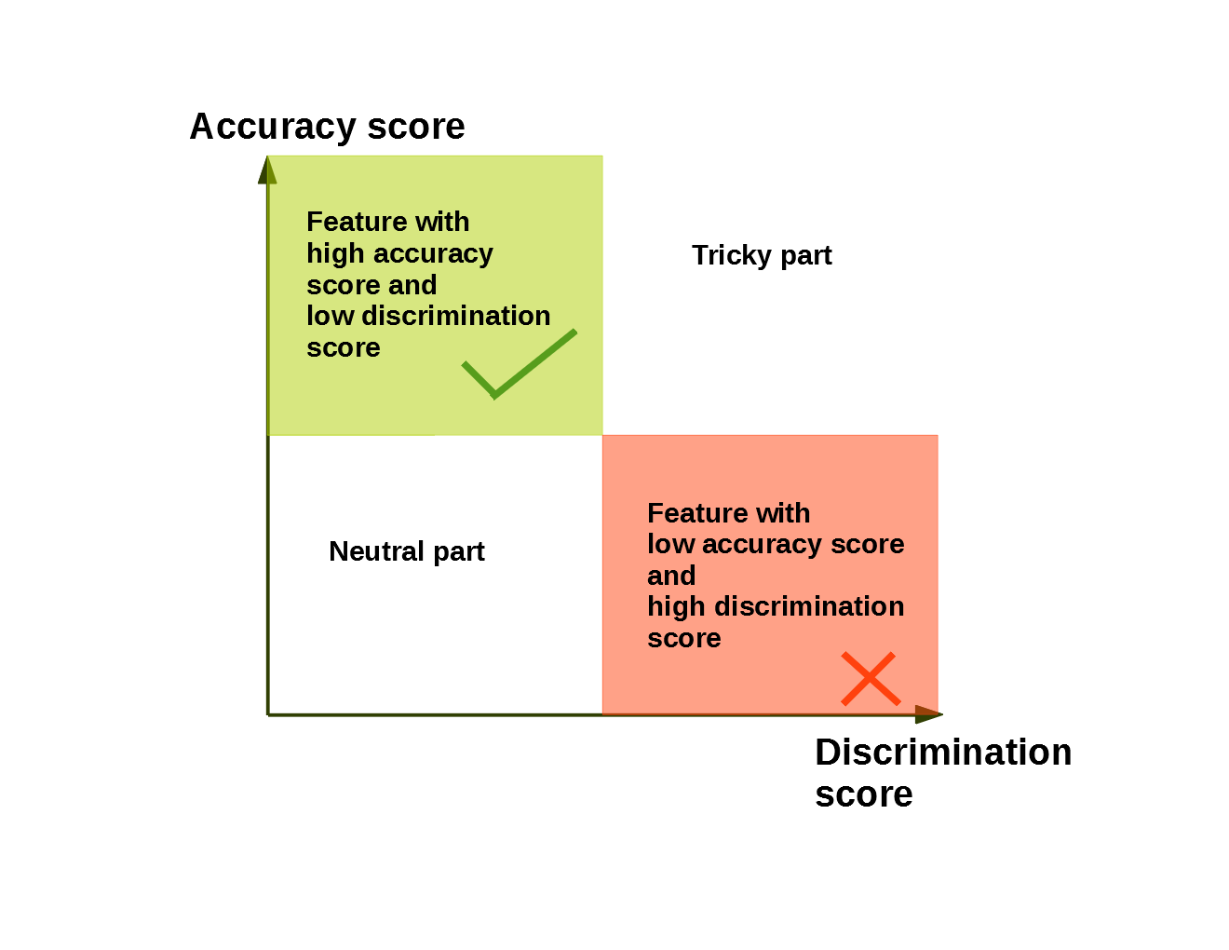
Notes:
~15s
03:00-03:15

Slide 10
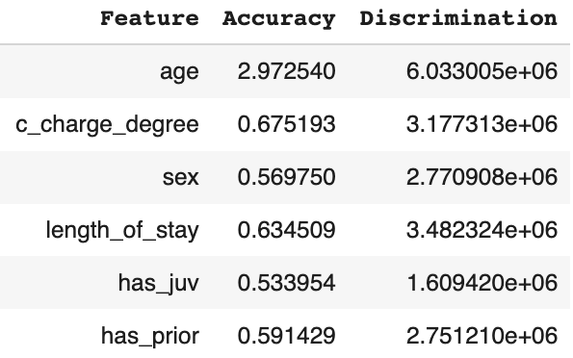
Evaluation: FFS accuracy + discrimination scores
Age
Juv, prior, sex
Len of stay,
charge degree
Notes:
~30s
03:15-03:45

Slide 11
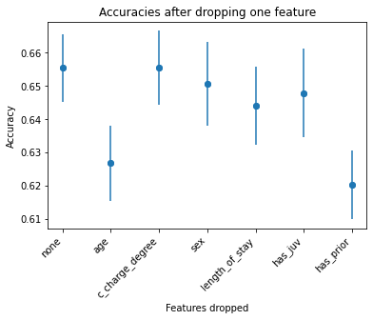
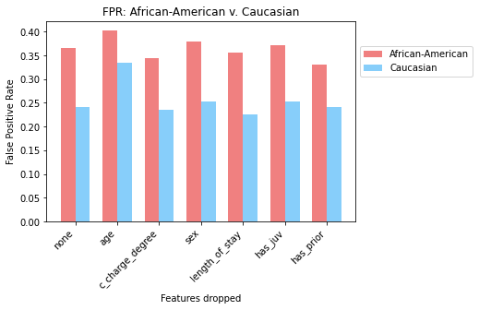
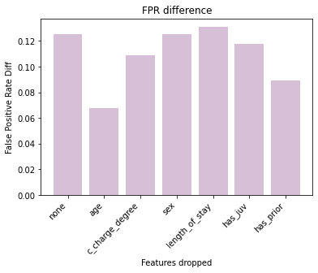
Accuracy
False Positive Rate
False Positive Rate Diff
`has_prior` should’ve had a larger acc and disc score. There is no feature to drop that fixes bias and maintains accuracy.
Notes:
~30s
03:45-04:15

Slide 12
Conclusion
Method | Accuracy (%) | FPR (B) (%) | FPR (W) (%) | FPR (diff) (%)
None | 66.76 | 39.60 | 18.51 | 21.09
Naive (/race) | 65.54 | 36.58 | 24.03 | 12.55
LM | 66.00 | 28.88 | 27.23 | 1.65
LPS | 65.78 | 25.41 | 28.69 | -3.28
FFS (/charge degree) | 64.40 | 34.38 | 23.50 | 10.88
FFS disadvantages:
runtime grows exponentially with # of features (powerset)
feature selection not clear in COMPAS dataset
LM > LPS > FFS
Notes:
~45s
04:15-05:00

Slide 13
Questions?

Slide 14
Appendix

Slide 15
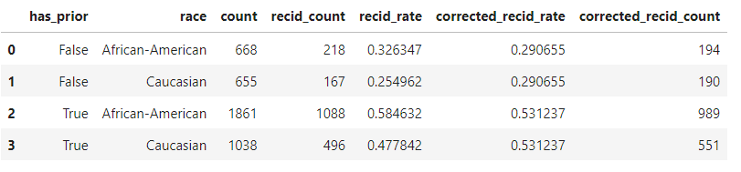
Bad discrimination
No bad discrimination
Measure of Discrimination

Slide 16
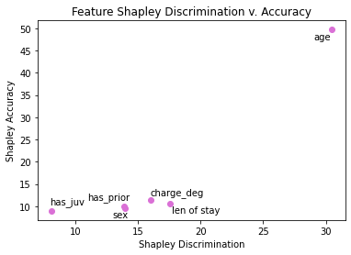
Normalized Shapley Accuracy + Discrimination Plot

Slide 17
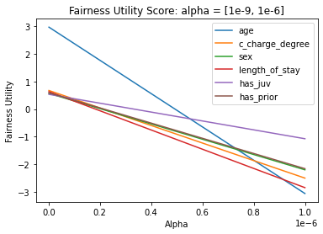
Overall, seems like length of stay and charge degree may be the best candidates to drop
Fairness Utility: Varying alpha

Slide 18
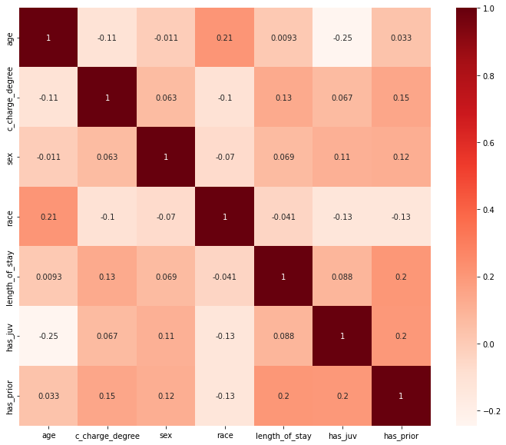
Feature Correlation

Slide 19
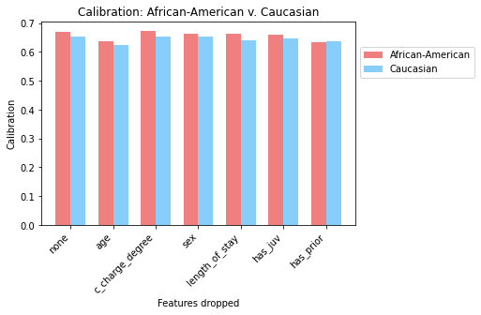
Accuracy: African-American v. Caucasian
Accuracy
FFS: Calibration Experiments

Slide 20
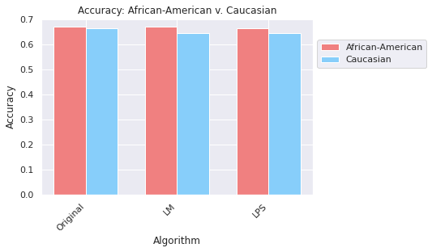
LM+LPS: Calibration Experiments

