Slide 1
Everything Matrices
All the other tricks without all the hassles.

Slide 2
Yet More Vocabulary
Determinant: This number is a scalar based on the information in a square matrix. It is used to determine which matrices are invertible and to determine the volume of a parallelepiped represented by the matrix.
Augmented matrix: When two matrices are sort of “crammed” into one matrix it is called an augmented matrix. They are used to solve systems of equations, solve for variable matrices, and to find inverse matrices.

Slide 3
And even more vocabulary
Reduced Row Echelon Form: Abbreviated RREF, this form is found by performing elementary operations on the rows of matrices. The first entry in each row must be 1, and the rest of the column must be zeroes.
Raising to a power: Any square matrix can be raised to a power. This involves repeated matrix multiplication on itself.

Slide 4
Limitations
Only Square matrices have a determinant.
Only matrices whose determinant is not zero are invertible.
All matrices whose determinant is not zero are invertible. (Biconditional)
Systems of equations can be represented with an augmented matrix.

Slide 5
Using the Calculator
The matrix button will allow you to enter matrices into the calculator.
You can add, subtract, and multiply matrices after entering them into the calculator.
The command Det( will find the determinant of a matrix.
The command RREF will put a matrix into row reduce echelon form.

Slide 6
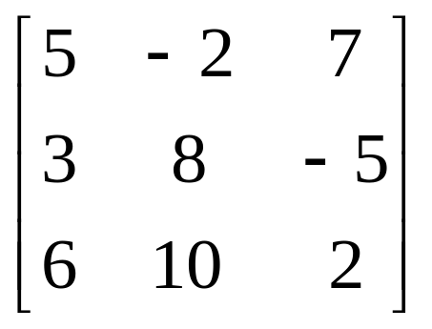
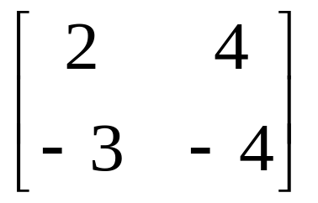
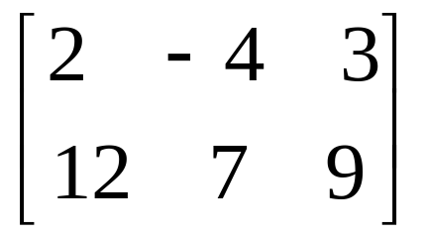
Examples
C
A
B
Find the Inverse of Matrix A, Matrix B, and Matrix C
Find the determinant of Matrix A, Matrix B, and Matrix C
Write Matrix A, Matrix B, and Matrix C in Reduced Row Echelon Form
Find A³, B³, and C³
Find (AB)C, and find A(BC)

Slide 7
Systems of Equations
To solve a system of equations using matrices, you must first write each equation in the same order. Usually you would do: Ax + By + Cz = D, where ABCD are all coefficients.
Then set each equation into an augmented matrix. Each row is a different equation, each column represents a different variable. The last column is the right side of the equals.
RREF

Slide 8
Examples
3x + 5y = 7
4x – 6y = 12
2x – 3y = 8
4x – 6y = 16
-3x + 5y = 18
6x – 10y = 28
4x – 3y + 2z = 4
6x + 3y – 5z = 10
3x + 2y = -7

