Slide 1
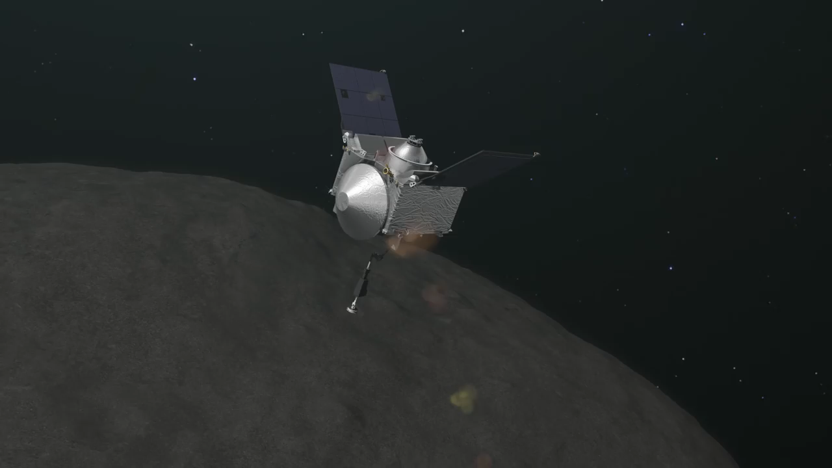
Autonomous Guidance for Asteroid Descent using Successive Convex Optimisation
Dual Quaternion Approach
S. Hazra
Dr. ir. E. Mooij | TU Delft, Astrodynamics and Space Missions
Dr. ir. M. Sagliano | Deutsches Zentrum fur Luft-und Raumfahrt e.V.

Slide 2
How can a spacecraft autonomously descend for a touch-and-go sampling process to a chosen landmark robustly and optimally, while being accurate and safe?
Research Question
Introduction
Mission Overview
Methodology
Results
Conclusions
Recommendations

Slide 3
Asteroids
Research Question
Introduction
Mission Overview
Methodology
Results
Conclusions
Recommendations

Slide 4
Mission Overview
Research Question
Introduction
Mission Overview
Methodology
Results
Conclusions
Recommendations

Slide 5
Methodology
Research Question
Introduction
Mission Overview
Methodology
Results
Conclusions
Recommendations

Slide 6
Results
Research Question
Introduction
Mission Overview
Methodology
Results
Conclusions
Recommendations

Slide 7
Conclusions
Research Question
Introduction
Mission Overview
Methodology
Results
Conclusions
Recommendations

Slide 8
Recommendations
Research Question
Introduction
Mission Overview
Methodology
Results
Conclusions
Recommendations

Slide 35
Thank You!

