Slide 1
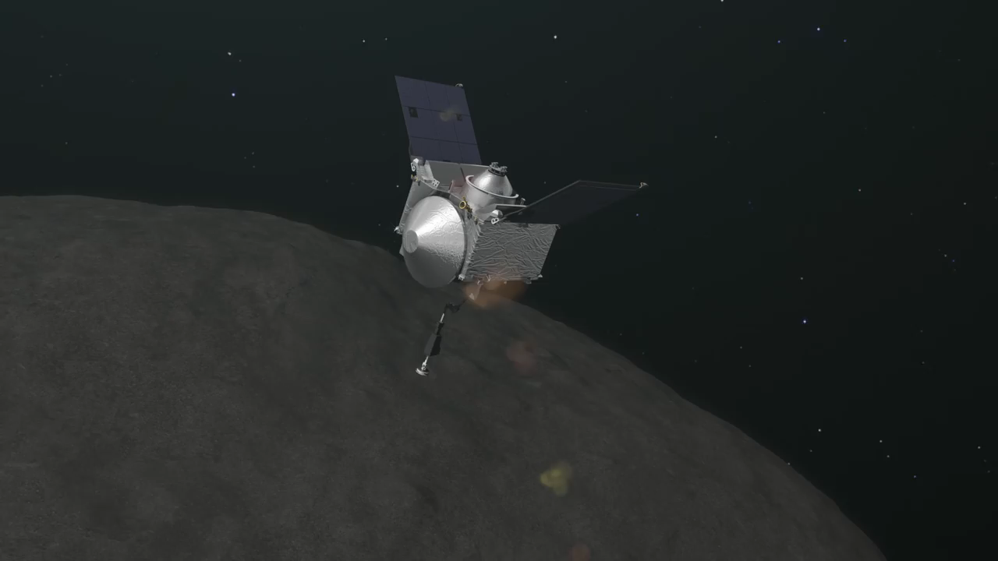

Autonomous Guidance for Asteroid Descent using Successive Convex Optimisation
Dual Quaternion Approach
S. Hazra
Dr. ir. E. Mooij | TU Delft, Astrodynamics and Space Missions
Dr. ir. M. Sagliano | Deutsches Zentrum fur Luft-und Raumfahrt e.V.

Slide 2
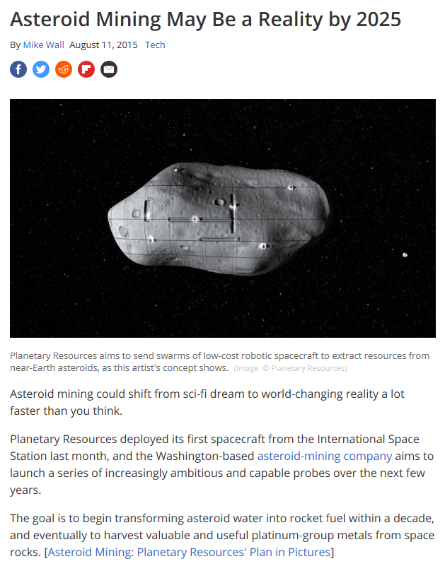
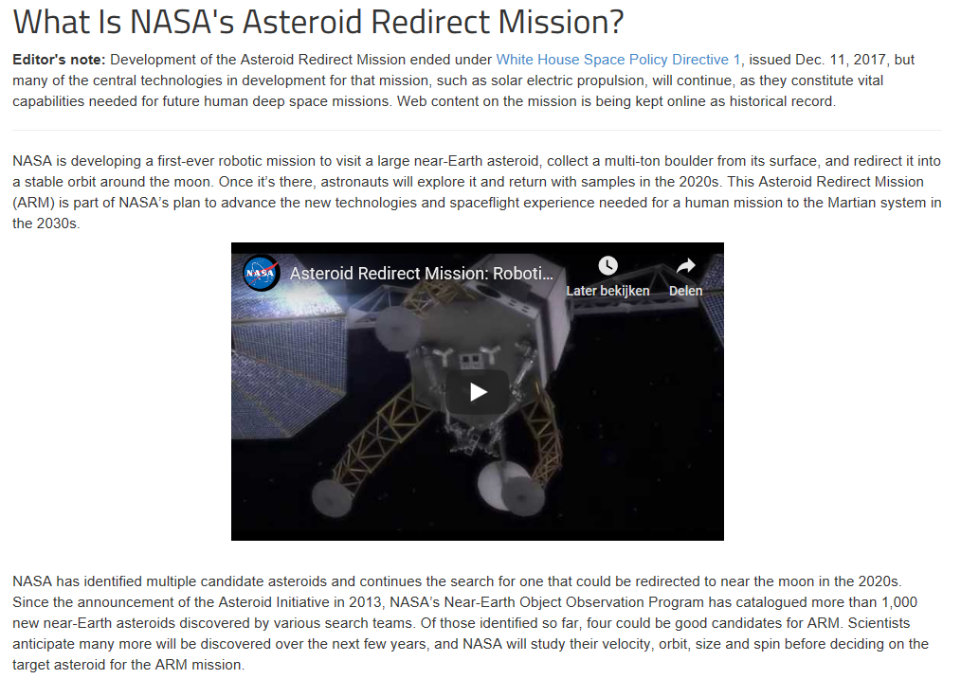
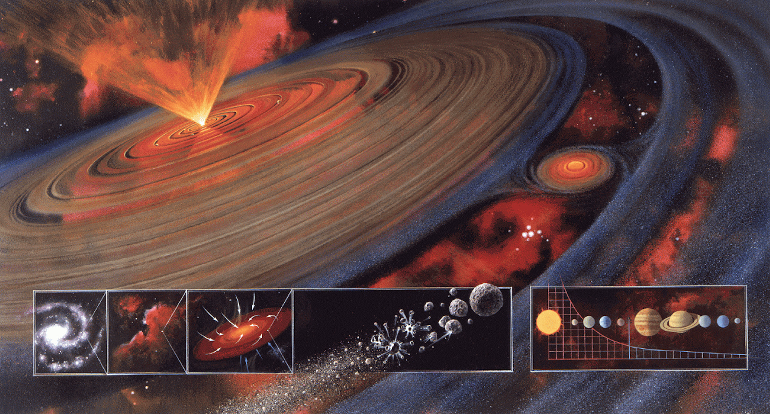

Why Asteroids?
Introduction
Research Question
Mission Overview
Methodology
Simulator Verification
Results
Conclusions
Recommendations
Notes:
Asteroids are pristine remnants from the planetary formation. The study of their composition can help understand the process better. They are plentiful in resources and stand as an option for mining.
Chelyabinsk impact, 20 m dia asteroid, shockwave across six cities. The threat of impact with Earth, requires missions like asteroid redirect mission. They are therefore a hot topic at present.

Slide 3
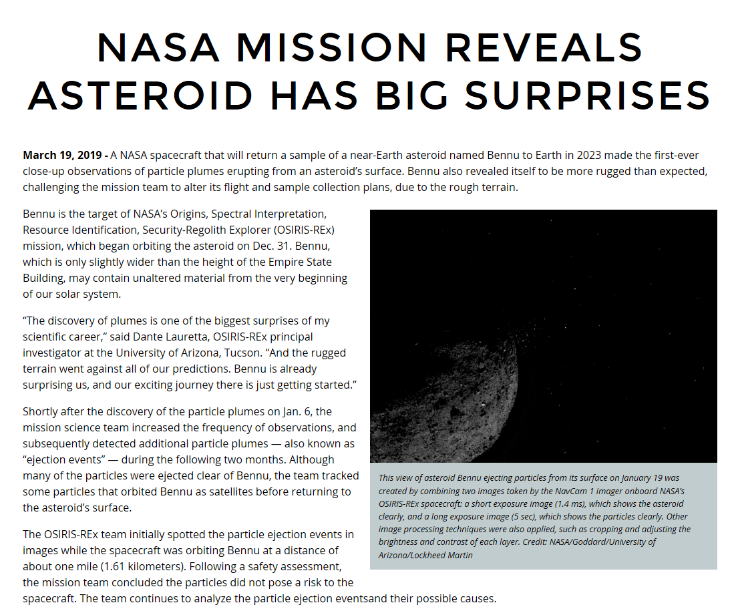
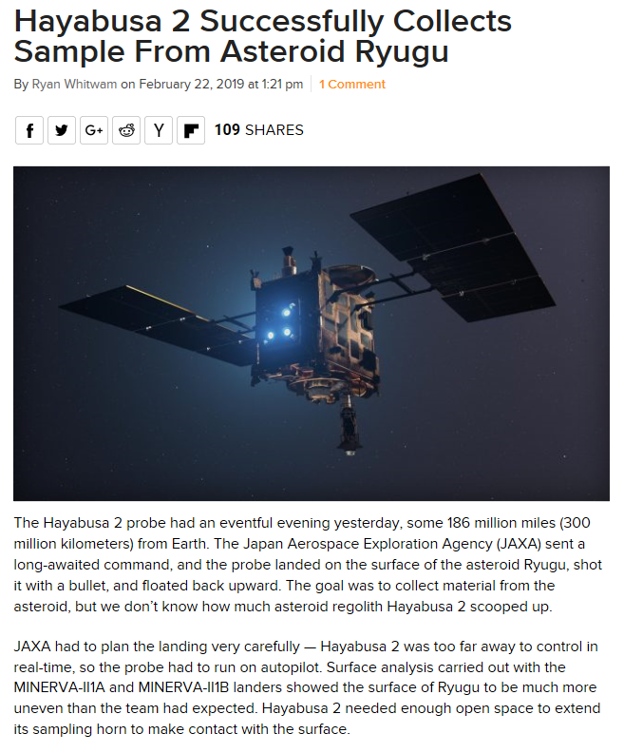
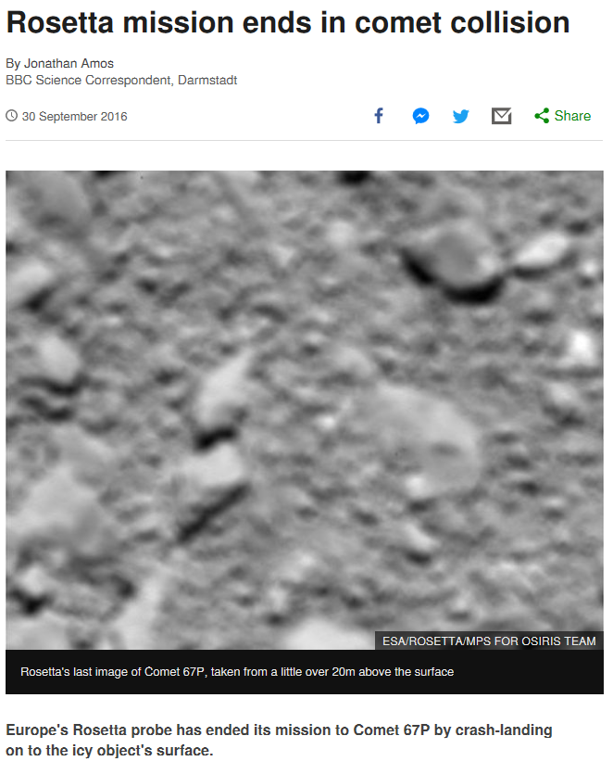
Recent Missions
Introduction
Research Question
Mission Overview
Methodology
Hayabusa 2
Rosetta
Simulator Verification
OSIRIS-REx
Results
Conclusions
Recommendations
Notes:
The most current missions to asteroids that have either conducted sampling missions or close proximity operations to small bodies are: . The current phases of these missions are as follows.
For this thesis we take inspiration from Osiris Rex and Rosetta, since we would like to present a solution for a sampling mission for MAB asteroids. (These are between Mars and Jupiter and also less weathered due to their further positioning from the sun as compared NEAs).

Slide 4
Why Dual Quaternions?
Introduction
General 6DOF representation
Position: Cartesian coordinates
Attitude: Quaternion
Dual Quaternion 6DOF representation
Position: Quaternion
Attitude: Quaternion
Research Question
Advantages of dual quaternions
One transformation for both rotation and translation
Compact representation of 6DOF kinematics and dynamics
Similar properties as quaternions
Mission Overview
Methodology
Simulator Verification
Results
Conclusions
Recommendations
Notes:
Others available for attitude: Euler rotation, MRPs
Dual quaternions: 8 tuple representation, one transformation for both rotation and translation

Slide 5
Why Autonomous Guidance?
Introduction
Research Question
A priori information about asteroids is limited
Perturbed and variable environment
Shapes, rotation rates and densities might be irregular or variable
Distance from Earth around 1.1-2 au
Mission Overview
Methodology
Simulator Verification
Results
Conclusions
Recommendations
Notes:
1. shape, size, rotation rates, densities etc
2. Highly perturbed, Non central gravity field – SRP – 3BP– stable orbits can turn to crashing or escape orbits (seen in mission also Philae)
3. fast rotation – dynamics unpredictable
4. MAB – 2.1 to 3 au, communication ~17 to 33 mins, remote operation costly, delay in comm in unforeseen circumstances (The further we go from the sun, the sampled material becomes more and more primitive. )
5. Restrictions on SC design for fuel requirements

Slide 6
What are the Available Guidance Technologies?
Introduction
Research Question
A priori information about asteroids is limited
Perturbed and variable environment
Shapes, rotation rates and densities might be irregular or variable
Distance from Earth around 1.1-2 au
Mission Overview
Methodology
Simulator Verification
Results
Conclusions
Recommendations
Selected Autonomous Guidance Technologies
Successive Convex Optimisation
Sampling Based Model Predictive Optimisation
Notes:
1. shape, size, rotation rates, densities etc
2. Highly perturbed, Non central gravity field – SRP – 3BP– stable orbits can turn to crashing or escape orbits (seen in mission also Philae)
3. fast rotation – dynamics unpredictable
4. MAB – 2.1 to 3 au, communication ~17 to 33 mins, remote operation costly, delay in comm in unforeseen circumstances (The further we go from the sun, the sampled material becomes more and more primitive. )
5. Restrictions on SC design for fuel requirements

Slide 7
How can a spacecraft autonomously descend for a touch-and-go sampling process to a chosen landmark robustly and optimally, while being accurate and safe?
Introduction
Research Question
Mission Overview
How can the SC attitude and orbital dynamics be represented by dual quaternions?
What are the cost functions that need to be optimised, the constraints they are subject to and how can they be formulated with dual quaternions?
How can the method of successive convex optimisation (SCvx) be implemented to optimise the derived cost functions?
What methods can be used to verify and validate the subsystems and guidance algorithm to qualify the system to be accurate, safe and robust?
How useful is this representation and can it be used in real time autonomous applications?
How can the method of sampling based model predictive optimisation (SBMPO) be used to map a small Solar System body autonomously to provide the SC with a safe landmark for descent?
Methodology
Simulator Verification
Results
Conclusions
Recommendations

Slide 8
Mission
Introduction
Research Question
Mission Overview
Methodology
Simulator Verification
Results
Conclusions
Recommendations

Slide 9
Convex Optimisation
Introduction
Research Question
Mission Overview
Methodology
Simulator Verification
Results
Conclusions
Recommendations

Slide 10
Successive Convex Optimisation
Introduction
Research Question
Mission Overview
Methodology
Simulator Verification
Results
Conclusions
Recommendations

Slide 11
Dynamic Successive Convex Optimisation
Introduction
Research Question
Mission Overview
Methodology
Simulator Verification
Results
Conclusions
Recommendations

Slide 12
Simulator
Introduction
Research Question
Mission Overview
Methodology
Simulator Verification
Results
Conclusions
Recommendations

Slide 13
Simulator
Introduction
Research Question
Mission Overview
Methodology
Simulator Verification
Results
Conclusions
Recommendations

Slide 14
Simulator
Introduction
Research Question
Mission Overview
Methodology
Simulator Verification
Results
Conclusions
Recommendations

Slide 15
Verification: Dynamic Successive Convex Optimisation
Introduction
Research Question
Mission Overview
Methodology
Simulator Verification
Results
Conclusions
Recommendations

Slide 16
Verification: Dynamic Successive Convex Optimisation
Introduction
Research Question
Mission Overview
Methodology
Simulator Verification
Results
Conclusions
Recommendations

Slide 17
Verification: Dynamic Successive Convex Optimisation
Introduction
Research Question
Mission Overview
Methodology
Simulator Verification
Results
Conclusions
Recommendations

Slide 18
Verification: Dynamic Successive Convex Optimisation
Introduction
Research Question
Mission Overview
Methodology
Simulator Verification
Results
Conclusions
Recommendations

Slide 19
Asteroid Descent Scenario
Introduction
Research Question
Mission Overview
Methodology
Simulator Verification
Results
Conclusions
Recommendations

Slide 20
Asteroid Descent Scenario
Introduction
Research Question
Mission Overview
Methodology
Simulator Verification
Results
Conclusions
Recommendations

Slide 21
Asteroid Descent Scenario
Introduction
Research Question
Mission Overview
Methodology
Simulator Verification
Results
Conclusions
Recommendations

Slide 22
Sampling Based Model Predictive Optimisation
Introduction
Research Question
Mission Overview
Methodology
Simulator Verification
Results
Conclusions
Recommendations

Slide 23
Sampling Based Model Predictive Optimisation
Introduction
Research Question
Mission Overview
Methodology
Simulator Verification
Results
Conclusions
Recommendations

Slide 24
Simulator
Introduction
Research Question
Mission Overview
Methodology
Simulator Verification
Results
Conclusions
Recommendations

Slide 25
Simulator
Introduction
Research Question
Mission Overview
Methodology
Simulator Verification
Results
Conclusions
Recommendations

Slide 26
Asteroid Mapping Initialisation
Introduction
Research Question
Mission Overview
Methodology
Simulator Verification
Results
Conclusions
Recommendations

Slide 27
Asteroid Mapping Initialisation
Introduction
Research Question
Mission Overview
Methodology
Simulator Verification
Results
Conclusions
Recommendations

Slide 28
Introduction
Research Question
Mission Overview
Methodology
Simulator Verification
Results
Conclusions
Recommendations

Slide 29
Introduction
Research Question
Mission Overview
Methodology
Simulator Verification
Results
Conclusions
Recommendations

Slide 30
References
https://www.space.com/30213-asteroid-mining-planetary-resources-2025.html
https://www.nasa.gov/content/what-is-nasa-s-asteroid-redirect-mission
https://www.asteroidmission.org/?latest-news=nasa-mission-reveals-asteroid-big-surprises
https://www.extremetech.com/extreme/286238-hayabusa-2-successfully-collects-sample-from-asteroid-ryugu

Slide 31
Questions?
Thank You!

