Slide 1


National Education Society ®
JNN College of Engineering
Sawalanga Road, Navule, Shivamogga -277204
(Accredited by NBA, NAAC 'B' & Certified by UGC 2f & 12B)
Department of Electronics & Telecommunication Engineering
Major project phase 2: Review 1 seminar
“Goushala - A Livestock Management Using AWS IoT”
Presented by:
Anjan D S 4JN19ET004
Harsha J Nazre 4JN19ET014
R R Shriya 4JN19ET026
Smriti K Vantkar 4JN19ET028
Guide:
Prof. Benak Patel M P
Assistant Professor
Dept. of ETE, JNNCE,
Shimoga

Slide 2
Contents
Aim of the Project
Introduction
Block Diagram
Objectives
Design
Hardware implementation
Software implementation
Results obtained and analysis
Future scope
Advantages
Limitations
Applications
Conclusion
References

Slide 3
Aim of the Project
The aim of this project is to provide a comprehensive solution for managing and monitoring the livestock using AWS IoT.
This project involves integrating various sensors and devices to collect data about the livestock’s position inside the perimeter.

Slide 4
Introduction
Animal husbandry involves a significant task which is livestock care.
There are many examples of animals going missing and then being found dead. This is largely a result of the cattle being poorly controlled by the handlers.
We have created a technique by utilizing the Raspberry Pi, BLE Beacons, and AWS IoT to overcome this issue.
Without having to manage the infrastructure, we can connect any device, at any scale. And also move and process our IoT data in real-time anywhere.
It may be utilised on a pay-as-you-go basis. A BLE beacon allows us to track the cattle, while the Raspberry Pi acts as the system's brain.

Slide 5
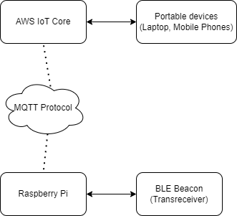
Block Diagram

Slide 6
Objectives
The Objectives and key points of this solution for livestock tracking are:
It uses BLE beacon technology and the RSSI technique to accurately estimate the location of the cattle.
It combines and analyzes the most accurate and relevant techniques to improve the accuracy of the location estimates.
It uses the MQTT protocol for remote control of the livestock tracking system, allowing for easy management of large herds.
It utilizes EMQX for an easy, reliable and scalable connection management.
It provides secure device connections and data with mutual authentication and end-to-end encryption.

Slide 7
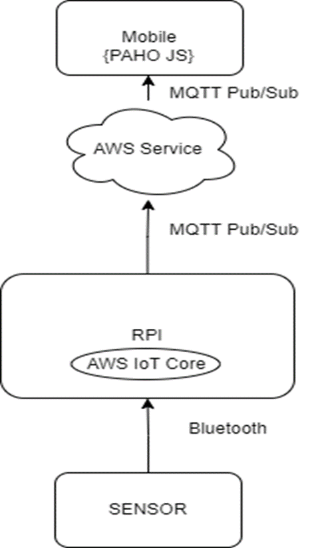
Design

Slide 8
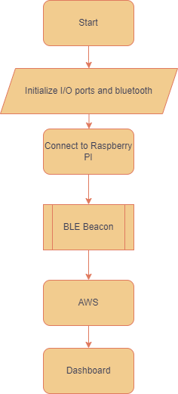
Flowchart
Fig:System Flowchart

Slide 9
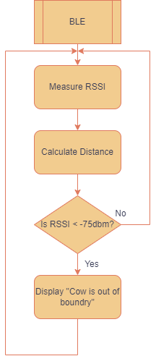
.
Fig: BLE Beacon working flowchart

Slide 10
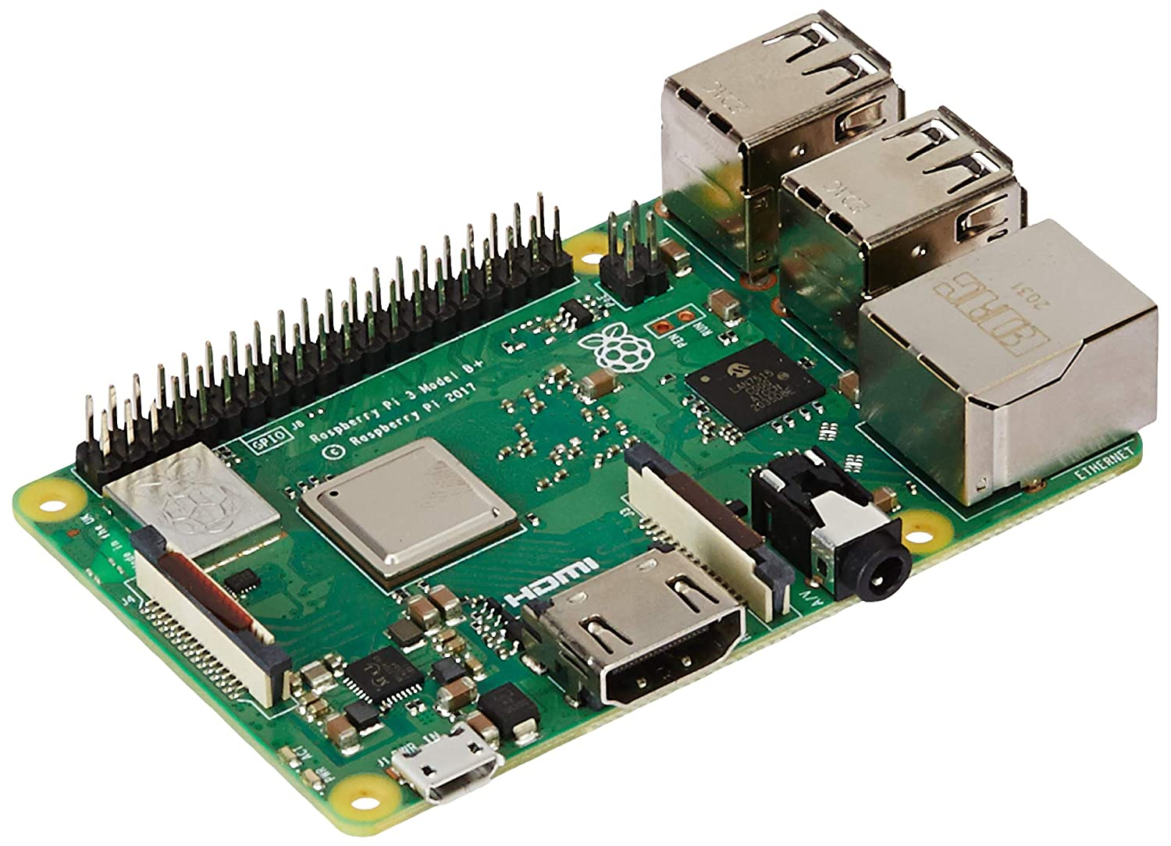
Hardware
Raspberry Pi 3 Model B+
Fig: Raspberry Pi 3 Model B+

Slide 11
The Raspberry Pi 3 Model B+ can be used in the Livestock Management Using EMQX provided by AWS IoT as a low-cost and efficient computing platform for collecting, processing, and transmitting data from various sensors and devices.
The Raspberry Pi may be used to gather information about the temperature and humidity from sensors placed in the livestock's surroundings, as well as information on the location and movement of the animals through bluetooth devices. The health and behavior of the cattle may then be inferred in real-time using EMQX.

Slide 12
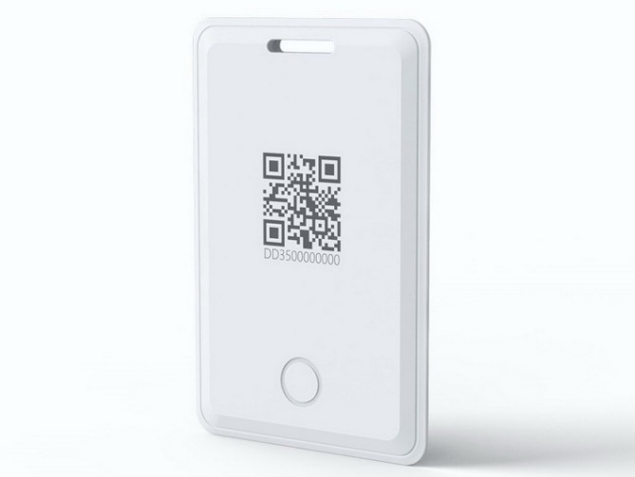
2. BLE Beacon
Fig: BLE Beacon
Bluetooth beacons are hardware transceivers, a class of Bluetooth Low Energy (BLE) devices that broadcasts a radio signal that is made up of a combination of letters and numbers transmitted on short, regular intervals to a Bluetooth-equipped device like a smartphone, a gateway, or an access point can “see” a beacon once its in range. Beacons are very small, simple devices with a CPU, radio, and batteries. Beacons often use small lithium chip batteries which is more powerful than AA batteries.

Slide 13
3. Portable Devices
Portable electronic gadgets are those that can be carried and utilized while on the go. These devices are often lightweight, tiny, and portable, making them perfect for usage in a range of situations such as travelling, commuting, or working remotely.
Smartphones, tablets, laptops, e-readers, portable gaming consoles, portable media players, and smartwatches are examples of portable gadgets. These gadgets often have a rechargeable battery that allows for longer operation without the need for a power source.

Slide 14
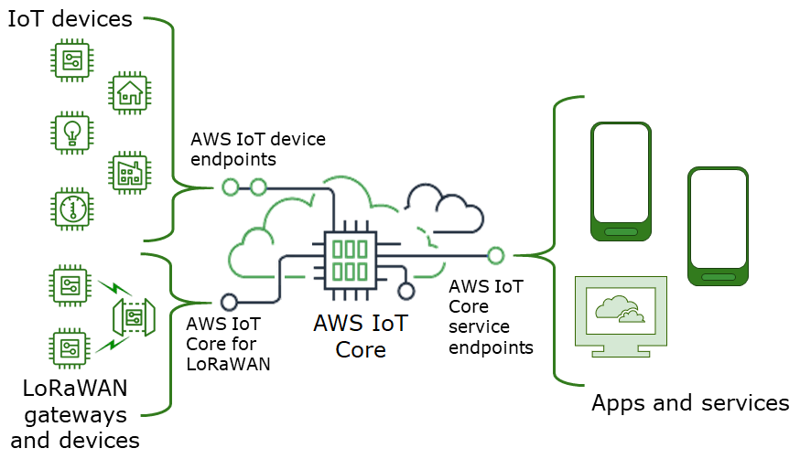
Software
AWS IoT Core: A cloud-based platform supplied by Amazon Web Services (AWS) that enables the safe and scalable connectivity and control of IoT devices. It enables devices to connect to and communicate with cloud apps and other devices in a safe manner.

Slide 15
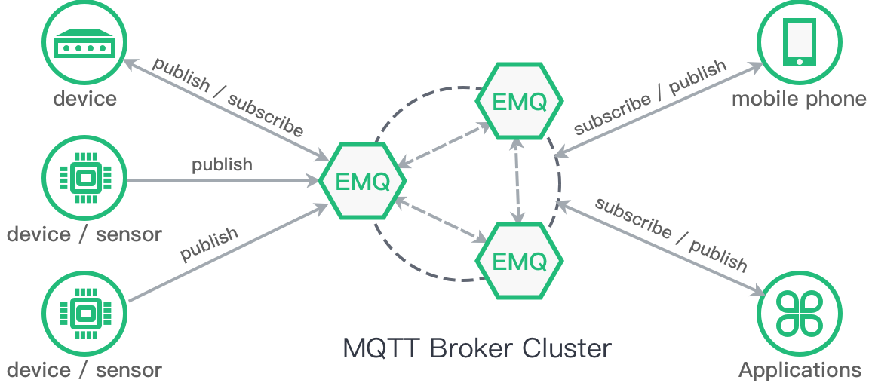
2. EMQX: EMQX provides a web-based dashboard for managing and monitoring the broker. It provides real-time metrics, such as message throughput, connection counts, and broker performance. It also provides detailed logs and error messages for troubleshooting and debugging.

Slide 16
,
3. MQTT protocol: MQTT is a critical protocol in EMQX, a managed cloud service that allows devices to securely connect to and interact with its services and other devices.

Slide 17
Working of MQTT Protocol

Slide 18

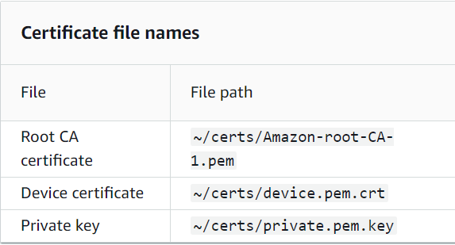
Source Code
1. Install python 3
2. To install the device certificate files for the sample app

Slide 19
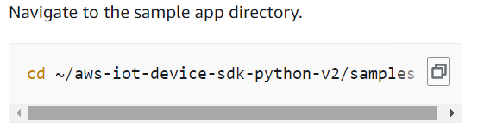
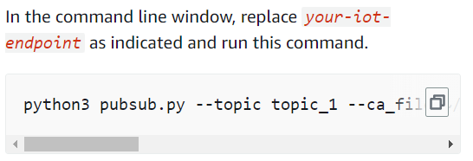
3.
4.

Slide 20

5. Install the MQTT client library

Slide 21
Source Code connecting EMQX to Raspberry Pi
import paho.mqtt.client as mqtt # Define the EMQX broker address and port number broker_address = "k35c56ca.emqx.cloud" broker_port = 1883 # Define the client ID and credentials (if any) client_id = "raspberry-pi-client" username = "rpi" password = "raspberry" # Define the topics to subscribe to or publish to subscribe_topic = "hello" publish_topic = "hey_there"

Slide 22
# Create the client application client = mqtt.Client(client_id=client_id) # Set the credentials (if any) client.username_pw_set(username=username, password=password) # Define the callback functions for the client events def on_connect(client, userdata, flags, rc): print("Connected to EMQX with result code "+str(rc)) client.subscribe(subscribe_topic) def on_message(client, userdata, msg): print("Received message on topic "+msg.topic+": "+str(msg.payload)) # Set the callback functions for the client events client.on_connect = on_connect client.on_message = on_message

Slide 23
# Connect to the EMQX broker client.connect(broker_address, port=broker_port) # Start the MQTT client loop to listen for messages client.loop_start() # Publish a message to the EMQX broker client.publish(publish_topic, "Hello, EMQX!") # Wait for messages while True: pass

Slide 24
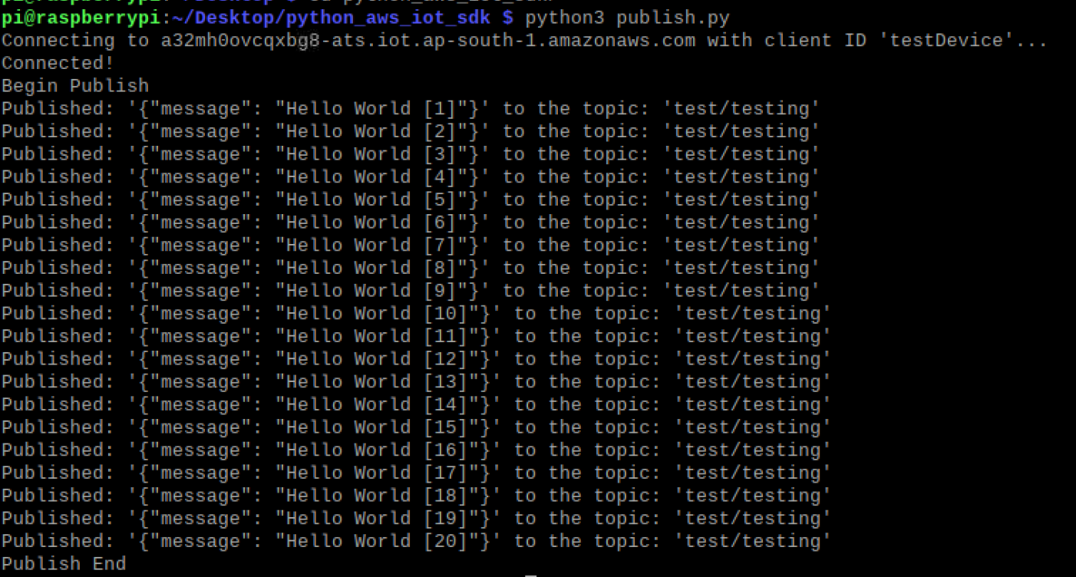
Results Obtained and Analysis
Fig: Message published on Raspberry Pi

Slide 25
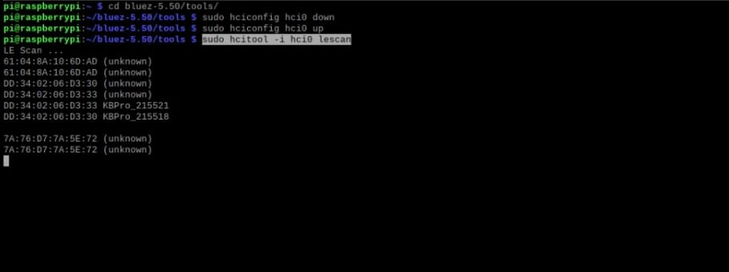
Fig: BLE Beacon connected to Raspberry Pi

Slide 26
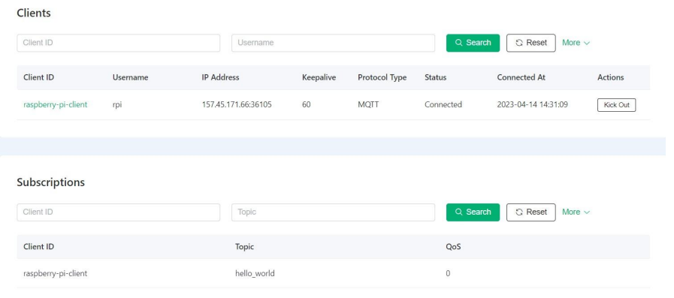
Fig: EMQX MQTT Broker-Client message Pub/Sub

Slide 27
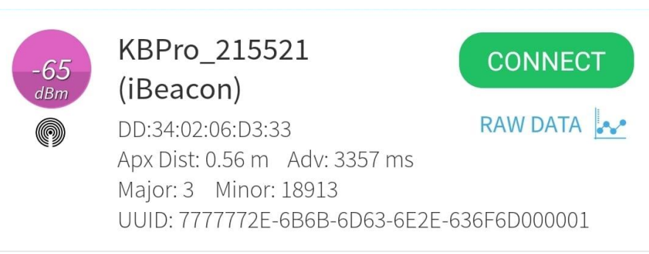
Fig: BLE Beacon Distance Measuring

Slide 28
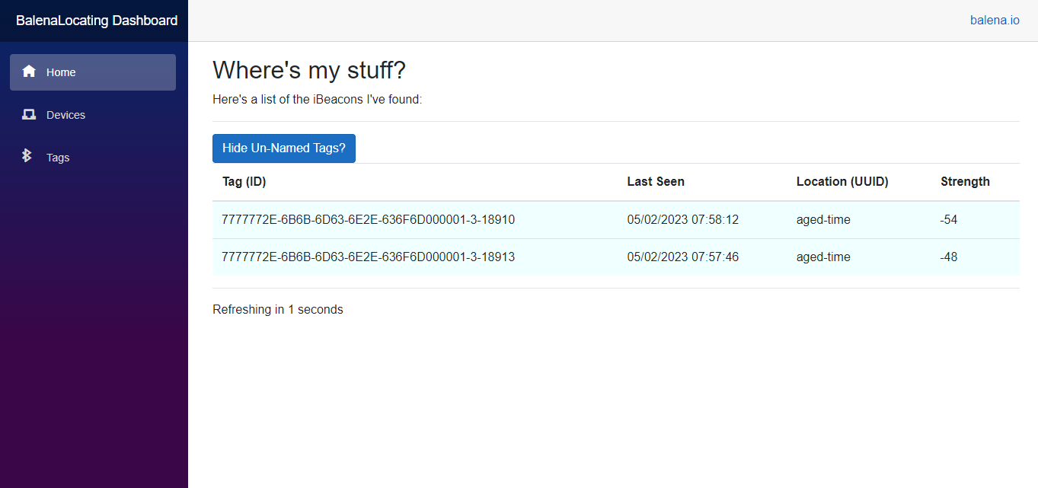
Fig: Dashboard

Slide 29
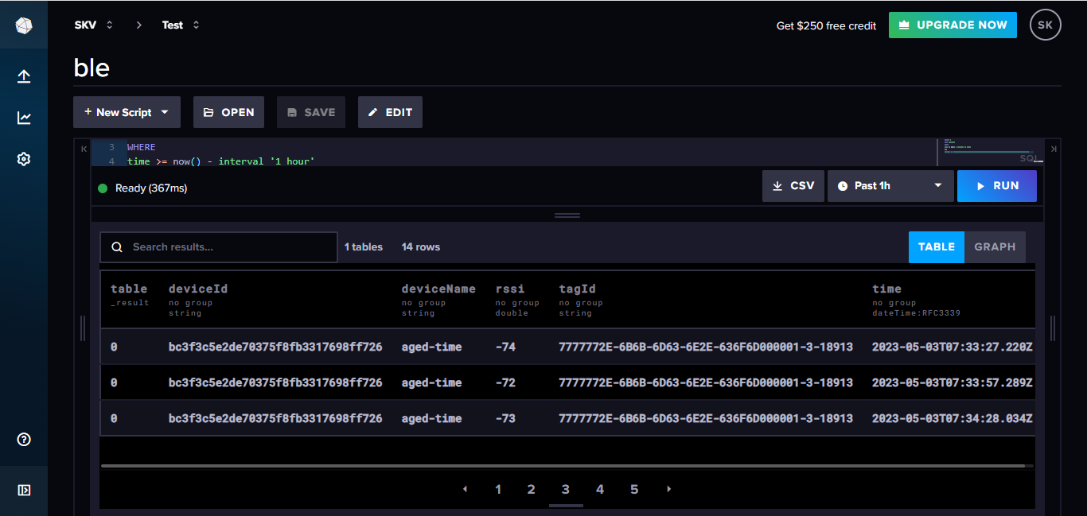
Fig: Influx Database

Slide 30
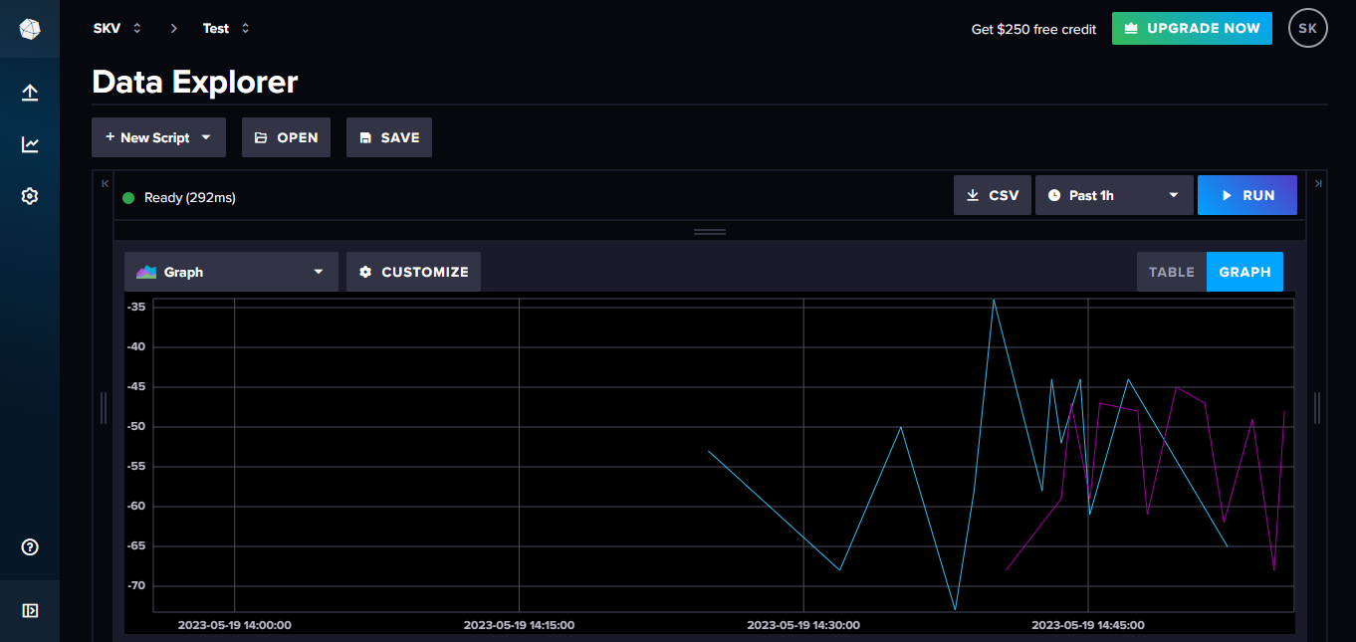
.
Fig: Graph representing distance of object

Slide 31
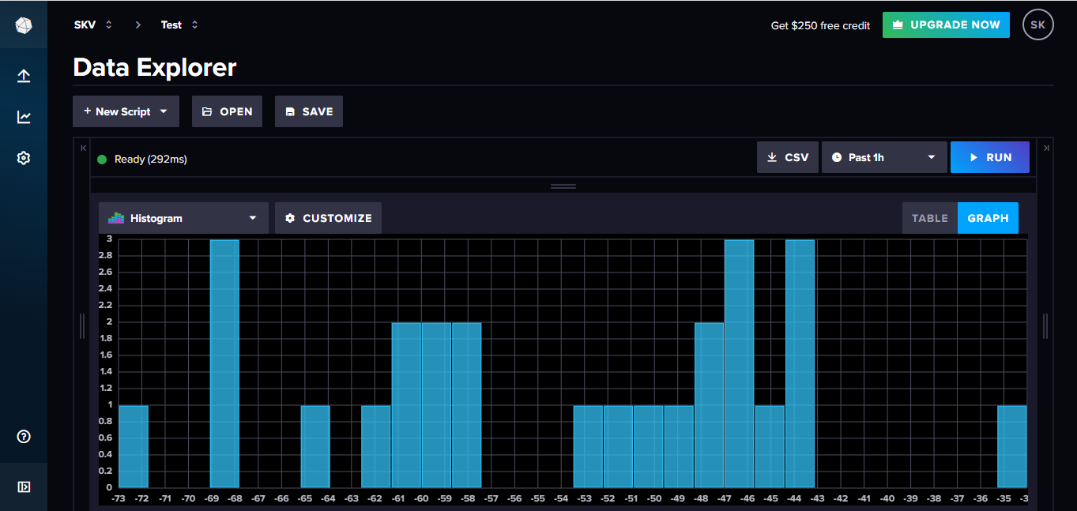
.
Fig: Histogram Representing RSSI values

Slide 32
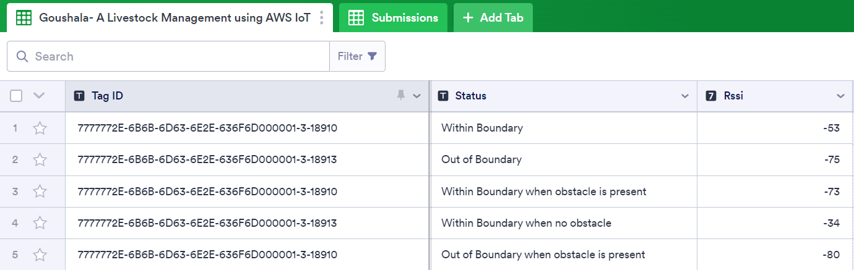
.
Fig: BLE Interface

Slide 33
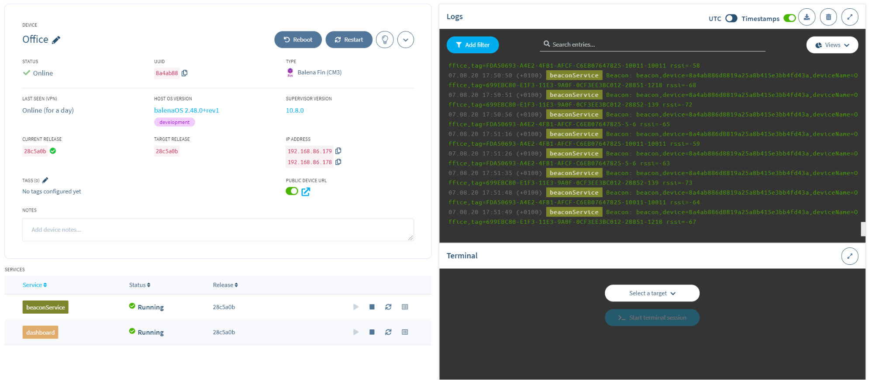
Fig: Raspberry Pi interface with Balena IoT Dashboard

Slide 34
Future Scope
AWS IoT can be used to collect data on livestock behavior, health, and performance. This information may be used to create prediction models that can assist farmers in managing and identifying health concerns before they become critical, as well as maximising the use of feed, water, and medications.
Real-time monitoring of livestock is possible with AWS IoT, allowing farmers to track their position, activity, and vital indicators.
AWS IoT may be combined with other technologies such as drones and autonomous vehicles. Drones, for example, may be used to collect data on livestock position and behaviour, while self-driving cars can provide feed and water.

Slide 35
Advantages
Real-time data monitoring: Amazon IoT enables farmers to track animal health and position using real-time data monitoring of sensor such as BLE Beacon.
Remote monitoring and management: With AWS IoT, farmers can remotely monitor and manage their livestock from anywhere using a mobile device or computer. This saves time and resources by eliminating the need for physical checks on the animals and allows farmers to manage their livestock even if they are off-site.
Predictive analytics: Amazon IoT can examine information from a variety of sources, like as sensors such as BLE Beacons, to offer perceptions and projections about the health and behaviour of animals. With better animal health and production, producers may be able to make more educated choices regarding breeding cycles, feeding regimens, and other management strategies.

Slide 36
.
4. Automation and optimization:Automation and resource optimisation are possible with Amazon IoT, which may automate repetitive chores like ploughing and grazing. In the long run, this may save a lot of money by lowering labour expenses and increasing overall efficiency.
5. Improved traceability: Amazon IoT can offer a digital record of a livestock animal's complete history, including data about its body temperature.

Slide 37
Limitations
Livestock may be in distant places with minimal or no internet access, making data transmission from sensors to the cloud challenging.
When collecting and storing sensitive information about livestock, there may be concerns about data privacy and security.
The cost of implementing IoT technology may be an impediment for some farmers.

Slide 38
Applications
Animal health and behaviour may be monitored using AWS IoT, which provides real-time data on vital signs and mobility. This information may be used to detect early symptoms of disease or damage, allowing farmers to intervene before the situation worsens.
AWS offers various storage options, such as Amazon S3 (Simple Storage Service) for object storage, Amazon EBS (Elastic Block Store) for block-level storage, and Amazon RDS (Relational Database Service) for managed databases. These services provide durability, scalability, and ease of data management.
AWS IoT services provide a platform for securely connecting and managing IoT devices. AWS IoT Core allows devices to communicate with the cloud, while services like AWS IoT Analytics and AWS IoT Events enable data analysis and automation based on IoT device data.

Slide 39
Conclusion
The use of AWS IoT for livestock management has the potential to completely transform the way farmers manage their herds.Farmers can gather and analyse data on individual animals and herd behaviour in real-time by using the power of the cloud, sensors, allowing them to make better informed decisions and optimise their operations.
AWS IoT offers a wide range of applications that may help farms enhance animal welfare, decrease expenses, and boost efficiency, from health and environmental monitoring to feed and water management, location tracking, and reproductive management.
Despite some constraints, such as cost and connectivity, the future of livestock management using AWS IoT is bright, and the benefits it can provide to the agricultural industry are substantial.

Slide 40
References
Karan Juj, Charith Perera, “Exploring the Suitability of BLE Beacons to Track Poacher Vehicles in Harsh Jungle Terrains”, Cardiff University, United Kingdom, IEEE-2020.
J. M. R. de S. Neto, J. J. C. Silva, T. C. M. Cavalcanti, D. P. Rodrigues and J. S. da Rocha Neto, Ian A. Glover, “Propagation Measurements and Modeling for Monitoring and Tracking in Animal Husbandry Applications”, Department of Electronic & Electrical Engineering University of Strathclyde, Scotland, UK and CAPES Visiting Professor, Universidade Federal de Campina Grande, Campina Grande - PB, Brazil,IEE-2010.
Brad Kennedy, Graham W. Taylor, Petros Spachos,”BLE Beacon Based Patient Tracking in Smart Care Facilities”,School of Engineering, University of Guelph, Guelph, ON, N1G 2W1, Canada, Demonstration on Pervasive Computing and Communications 2018.
Kais Mekki, Eddy Bajic, Fernand Meyer, “Indoor Positioning System for IoT Device based on BLE Technology and MQTT Protocol”, Research Centre for Automatic Control of Nancy, Campus Sciences, BP 70239, Vandoeuvre, 54506, France, IEEE 5th World Forum on Internet of Things (WF-IoT), 2019.
Nadia Imtiaz Jaya,Md. Farhad Hossain, “A Prototype Air Flow Control System for Home Automation using MQTT over Websocket in AWS IoT Core”, Department of Electrical and Electronic Engineering Bangladesh University of Engineering and Technology Dhaka-1205, Bangladesh, International Conference on Cyber-Enabled Distributed Computing and Knowledge Discovery-2018.

Slide 41
THANK YOU

