Slide 1
UE18CS204 – WEB TECHNOLOGIES I
HOOP
A SPORTS FORUM
Team Name: Ballers #1 PES1201800027 Shriya Shankar
#6 PES1201800150 Adithi Satish

Slide 2
INTRODUCTION
Problem Statement: To create an easily-accessible and transparent platform for colleges to host, invite, or join tournaments of different sports.
Hoop is a web-application, which aims to crowdsource data on all upcoming tournaments in the city making it easy for the host college, as well as all the participating colleges to procure information. It reduces the hassle of sending invites via emails and since it is a common interface for all colleges, keeping track of registrations becomes much simpler for the host colleges. Our main aim is to establish a common platform for effective communication between the sports departments (and hence, respective sportsmen/women) of different colleges.

Slide 3
FRONT-END
For the frontend, we’ve used HTML, CSS, JS along with Bootstrap and jQuery to enhance the pages and make our website more dynamic and responsive. Our frontend consists of the following web pages (each having one of two consistent themes):
Login
Signup
Homepage
About page/Contact Us
FAQs
Host Tournament
Edit Tournament
Update Score
Upload rulebook
Join Tournament
Registration Form
MyProfile

Slide 4
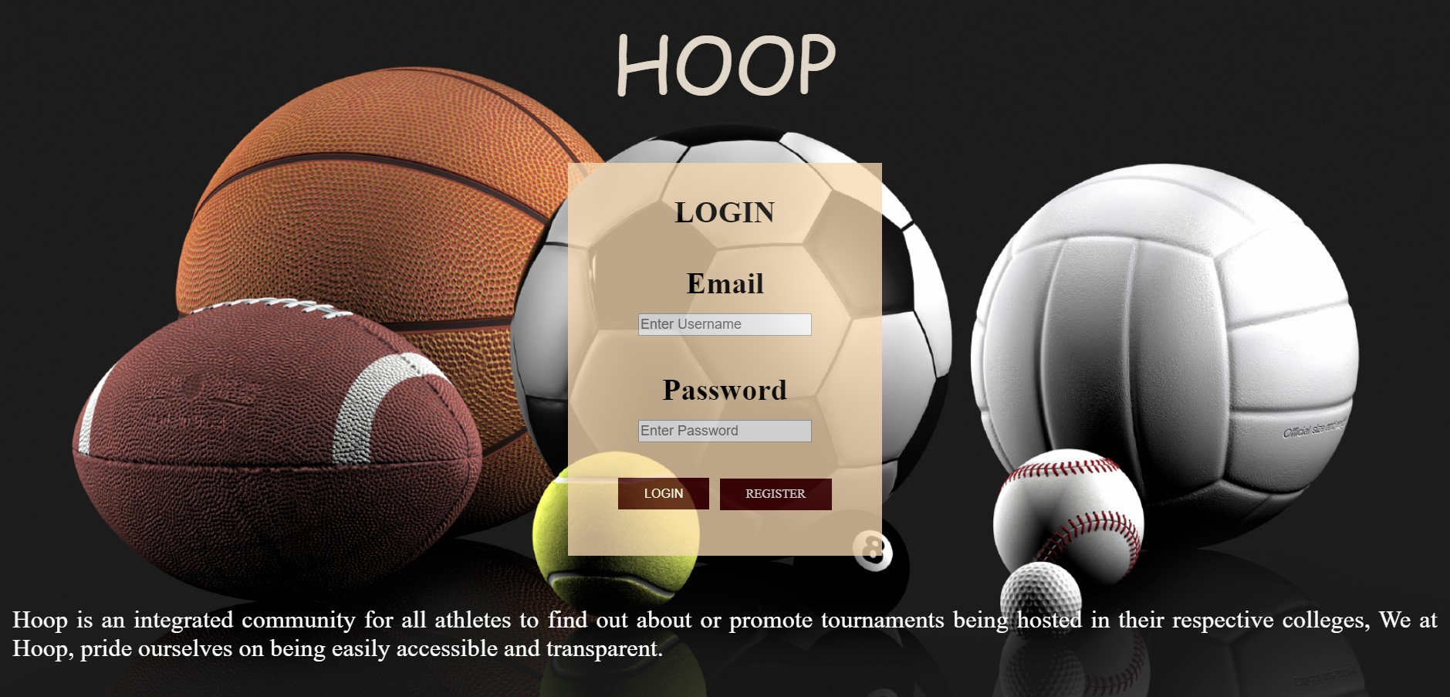
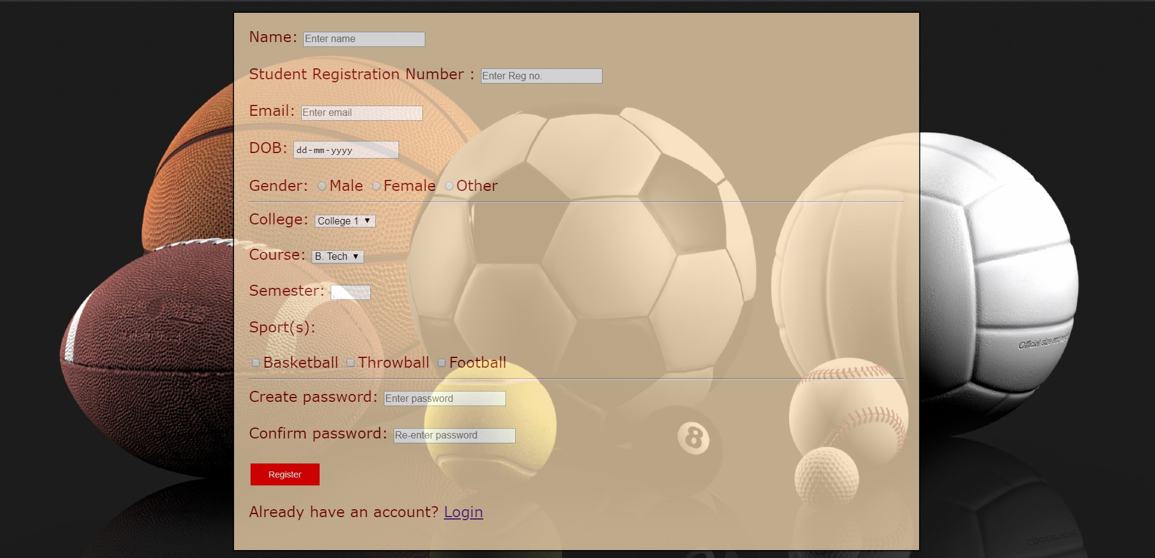
Login (Login and Signup pages use the same theme)

Slide 5
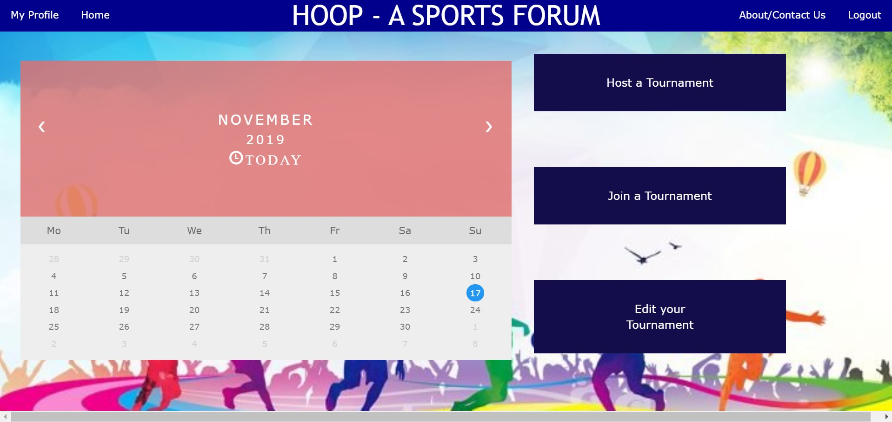
HOME PAGE The homepage uses a different theme than the one used for Login/Signup. The rest of the webpages also follow this theme, all having a common navigation bar made using CSS and Bootstrap

Slide 6
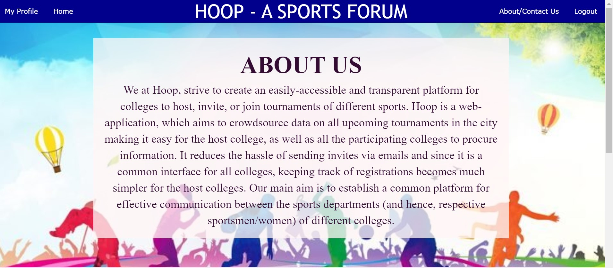
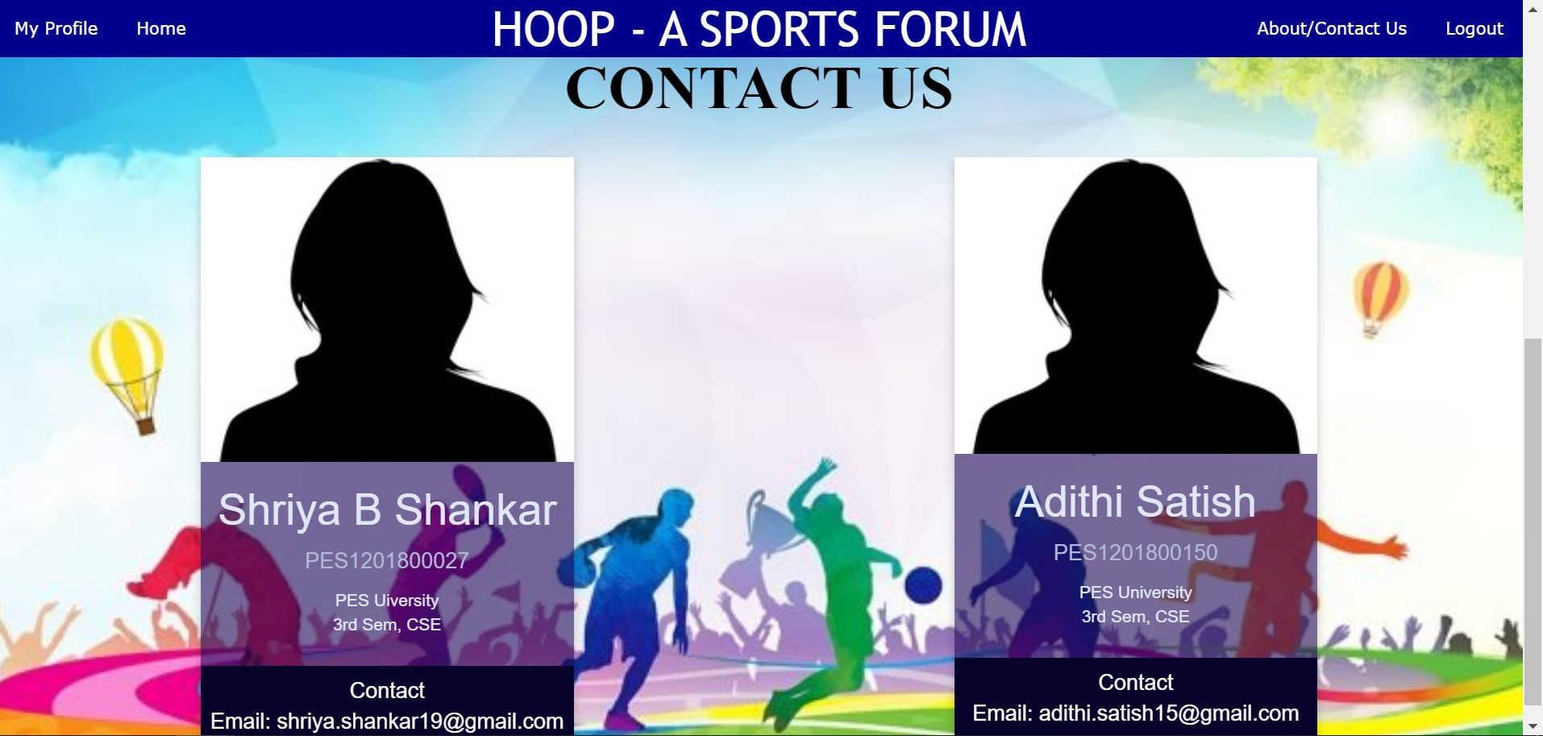
ABOUT/CONTACT US PAGE This page provides a brief description of the website and also has details of the makers(i.e team members) as profile cards

Slide 7
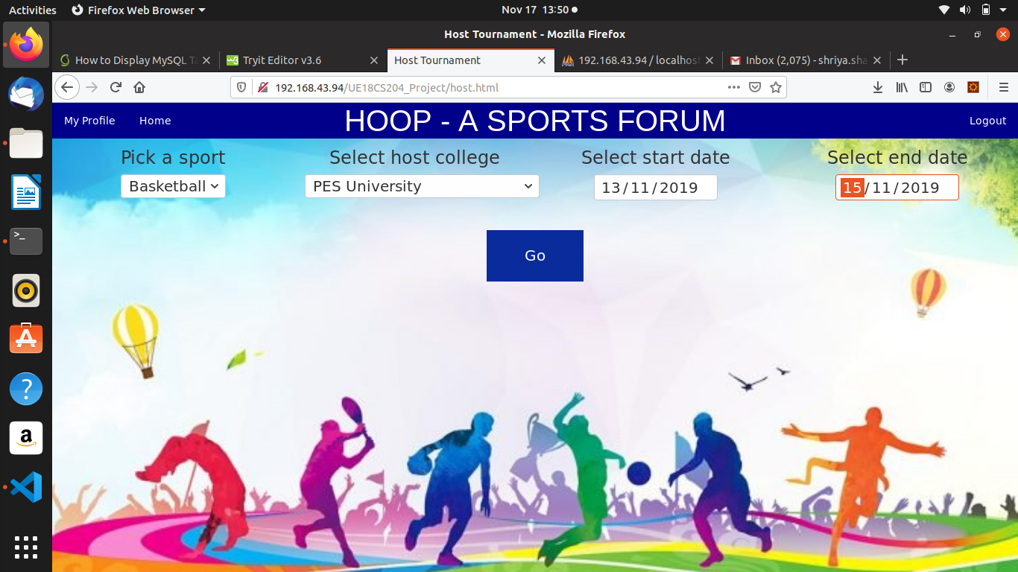
HOST/EDIT/JOIN TOURNAMENTS All these pages follow the same theme allowing the user to Host a tournament, Join a pre-existing tournament or update scores/rulebook using the Edit feature.
Host Tournament
When the user enters all details and clicks on “GO”, a new record is created in our database which stores the details of the tournament. This is then reflected in the calendar displayed on the Home Page.

Slide 8
BACK-END
The backend has been made predominantly using PHP. The database used to store data, whether it is user data or the tournaments is SQL. We’ve also used Apache to set up the server.
A significant amount of JavaScript has also been used for the backend.
To enable the ‘Edit Tournament’ feature, we’re making use of HTML5 LocalStorage to store the updated scores.

