Slide 1
UE18CS204 – WEB TECHNOLOGIES I
HOOP
A SPORTS FORUM
Team Name: Ballers #1 PES1201800027 Shriya Shankar
#6 PES1201800150 Adithi Satish

Slide 2
INTRODUCTION
Problem Statement: To create an easily-accessible and transparent platform for colleges to host, invite, or join tournaments of different sports.
Hoop is a web-application, which aims to crowdsource data on all upcoming tournaments in the city making it easy for the host college, as well as all the participating colleges to procure information. It reduces the hassle of sending invites via emails and since it is a common interface for all colleges, keeping track of registrations becomes much simpler for the host colleges. Our main aim is to establish a common platform for effective communication between the sports departments (and hence, respective sportsmen/women) of different colleges.

Slide 3
FRONT-END
For the frontend, we’ve used HTML, CSS, JS along with Bootstrap and jQuery to enhance the pages and make our website more dynamic and responsive. Our frontend consists of the following web pages (each having one of two consistent themes):
Login
Signup
Homepage
About page/Contact Us
FAQs
Host Tournament
Edit Tournament
Update Score
Upload rulebook
Join Tournament
Registration Form
MyProfile

Slide 4
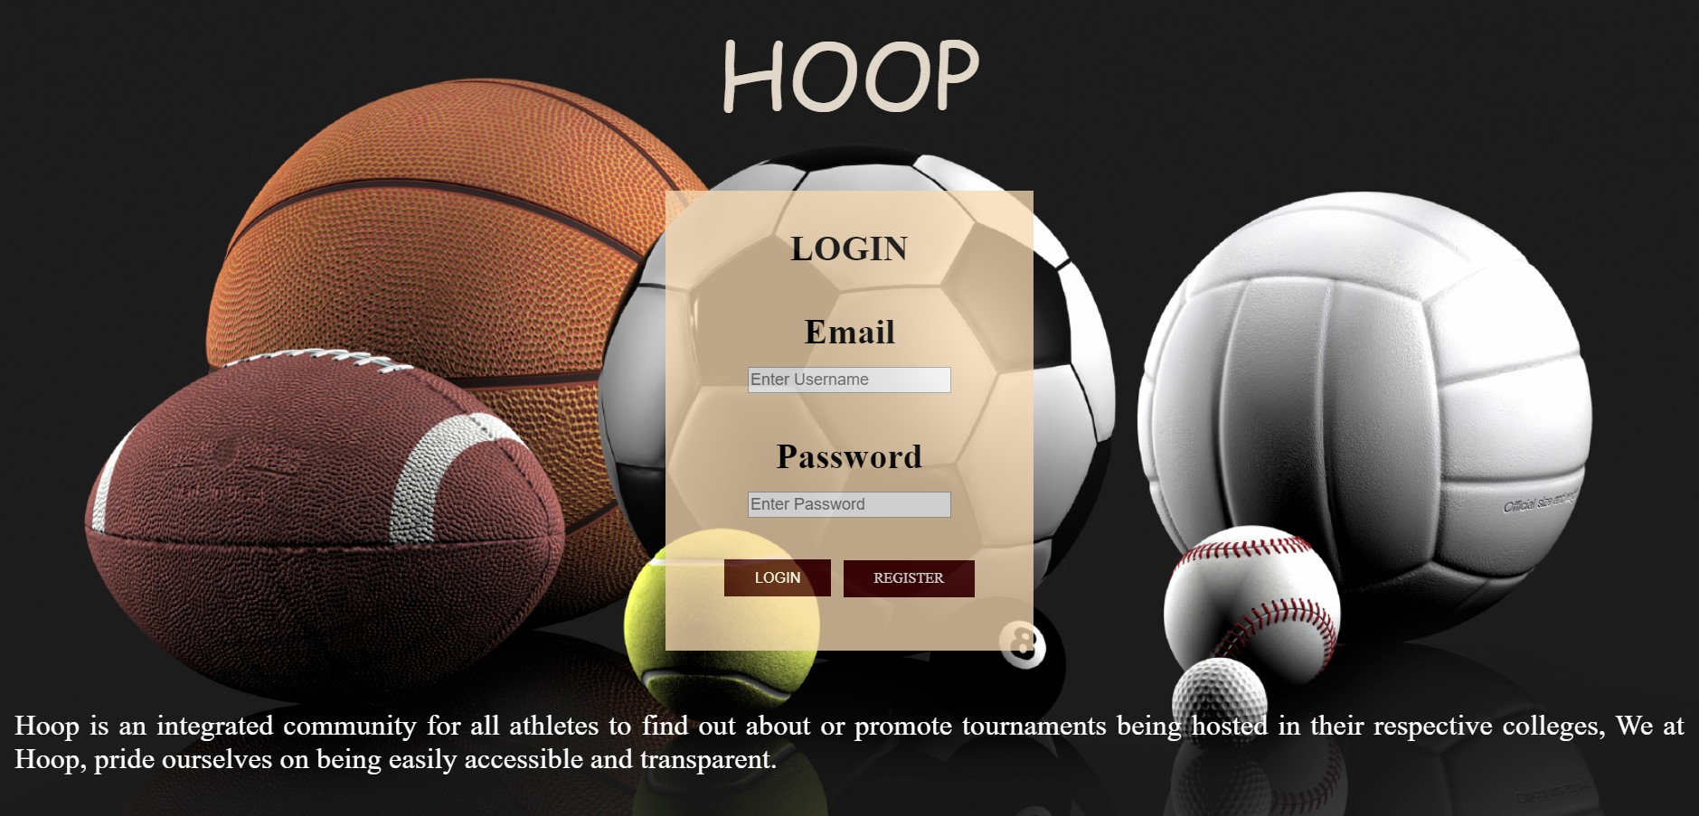
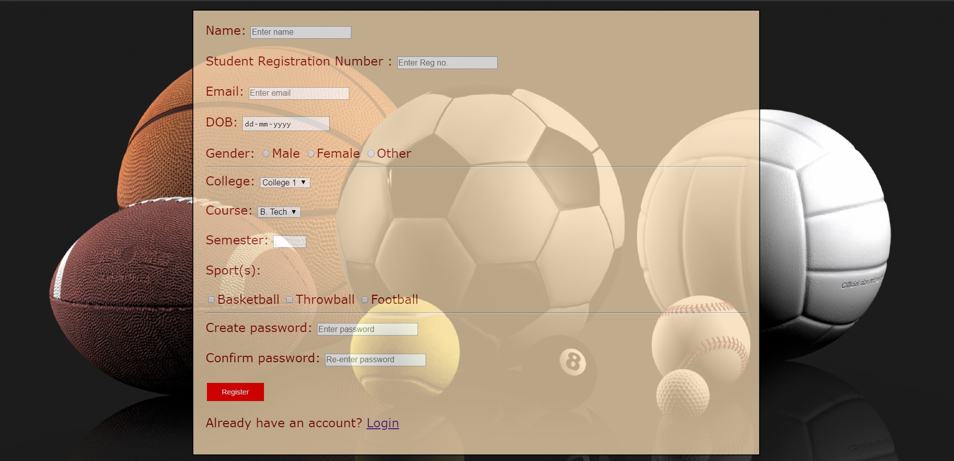
Login (Login and Signup pages use the same theme)

Slide 5
HOME PAGE The homepage uses a different theme than the one used for Login/Signup. The rest of the webpages also follow this theme.

