Slide 1
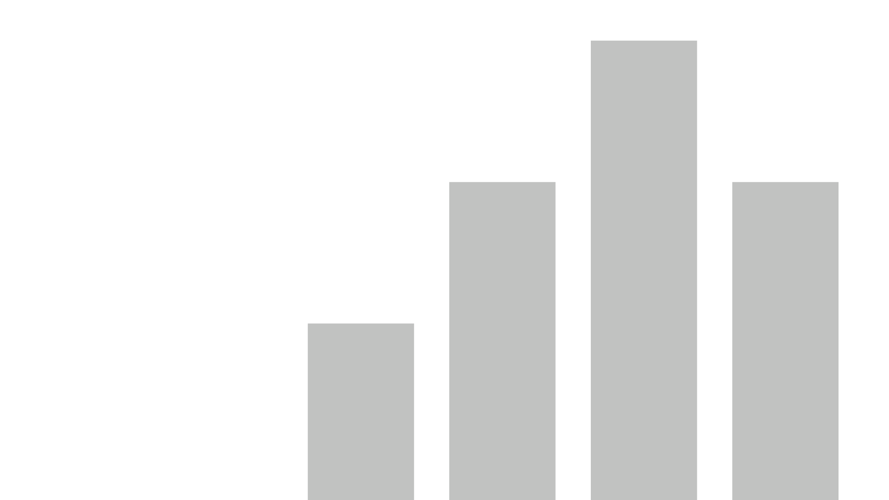


dashboardd
View in Power BI
Last data refresh:
6/15/2025 4:39:46 AM UTC
Downloaded at:
6/15/2025 4:44:10 AM UTC

Slide 2
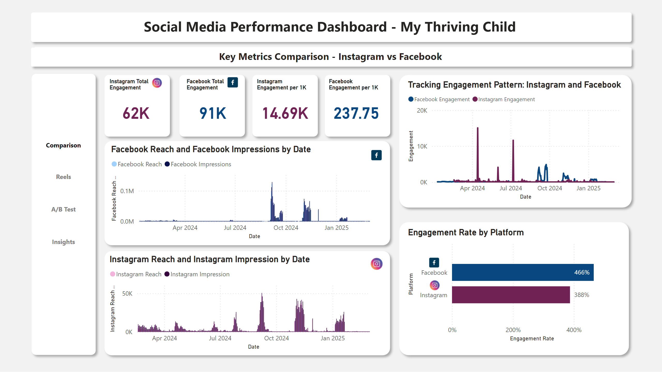
dashboard1
Notes:
shape
No alt text provided
shape
No alt text provided
shape
No alt text provided
textbox
No alt text provided
textbox
No alt text provided
shape
No alt text provided
shape
No alt text provided
shape
No alt text provided
shape
No alt text provided
shape
No alt text provided
shape
No alt text provided
Instagram Total Engagement
No alt text provided
Facebook Total Engagement
No alt text provided
Tracking Engagement Pattern: Instagram and Facebook
No alt text provided
clusteredColumnChart
No alt text provided
shape
No alt text provided
shape
No alt text provided
clusteredColumnChart
No alt text provided
barChart
No alt text provided
Facebook Engagement per 1K
No alt text provided
Instagram Engagement per 1K
No alt text provided
image
No alt text provided
image
No alt text provided
image
No alt text provided
image
No alt text provided
image
No alt text provided
image
No alt text provided
actionButton
No alt text provided
actionButton
No alt text provided
actionButton
No alt text provided
actionButton
No alt text provided

Slide 3
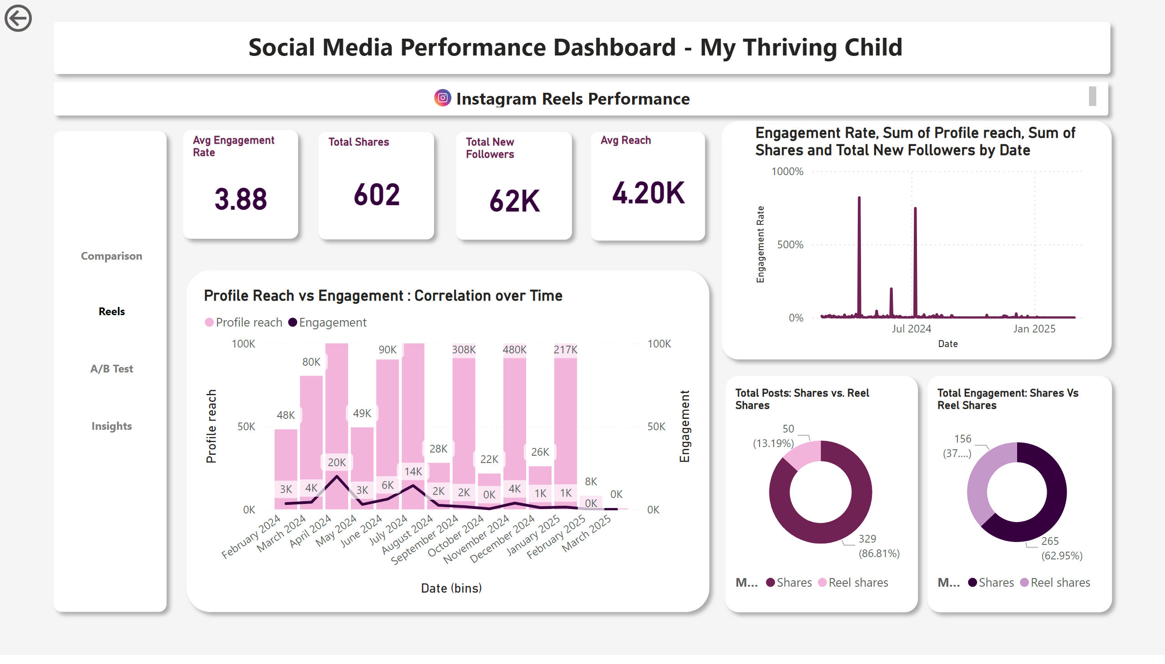
dashboard2
Notes:
shape
No alt text provided
shape
No alt text provided
textbox
No alt text provided
shape
No alt text provided
shape
No alt text provided
textbox
No alt text provided
actionButton
No alt text provided
shape
No alt text provided
shape
No alt text provided
shape
No alt text provided
shape
No alt text provided
Avg Engagement Rate
No alt text provided
Total Shares
No alt text provided
Total New Followers
No alt text provided
Avg Reach
No alt text provided
lineChart
No alt text provided
image
No alt text provided
shape
No alt text provided
shape
No alt text provided
shape
No alt text provided
Profile Reach vs Engagement : Correlation over Time
No alt text provided
Total Posts: Shares vs. Reel Shares
No alt text provided
Total Engagement: Shares Vs Reel Shares
No alt text provided
actionButton
No alt text provided
actionButton
No alt text provided
actionButton
No alt text provided
actionButton
No alt text provided

Slide 4
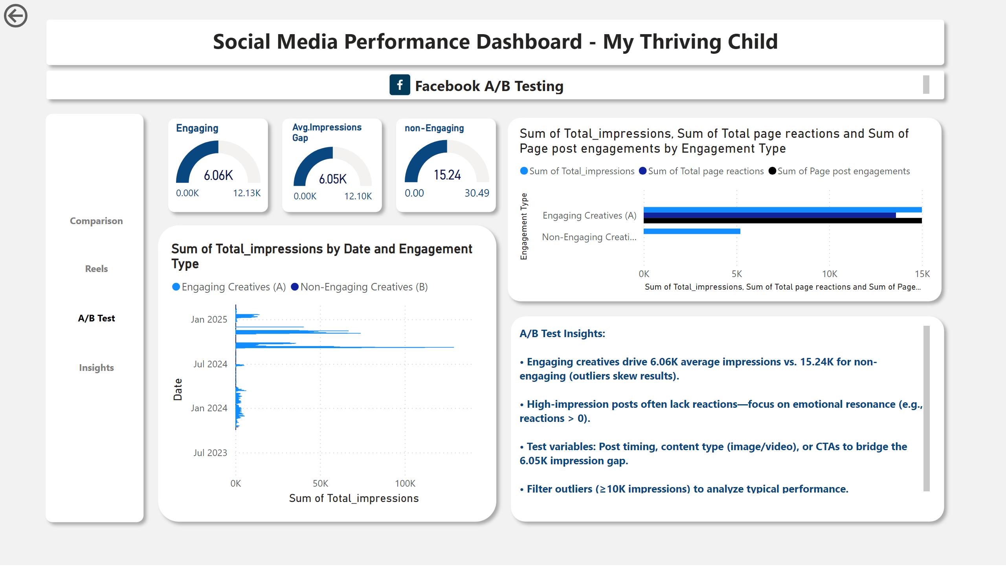
dashboard3
Notes:
shape
No alt text provided
shape
No alt text provided
shape
No alt text provided
shape
No alt text provided
shape
No alt text provided
textbox
No alt text provided
textbox
No alt text provided
image
No alt text provided
clusteredBarChart
No alt text provided
shape
No alt text provided
shape
No alt text provided
shape
No alt text provided
shape
No alt text provided
Engaging
No alt text provided
Avg.Impressions Gap
No alt text provided
non-Engaging
No alt text provided
clusteredBarChart
No alt text provided
actionButton
No alt text provided
textbox
No alt text provided
actionButton
No alt text provided
actionButton
No alt text provided
actionButton
No alt text provided
actionButton
No alt text provided

Slide 5
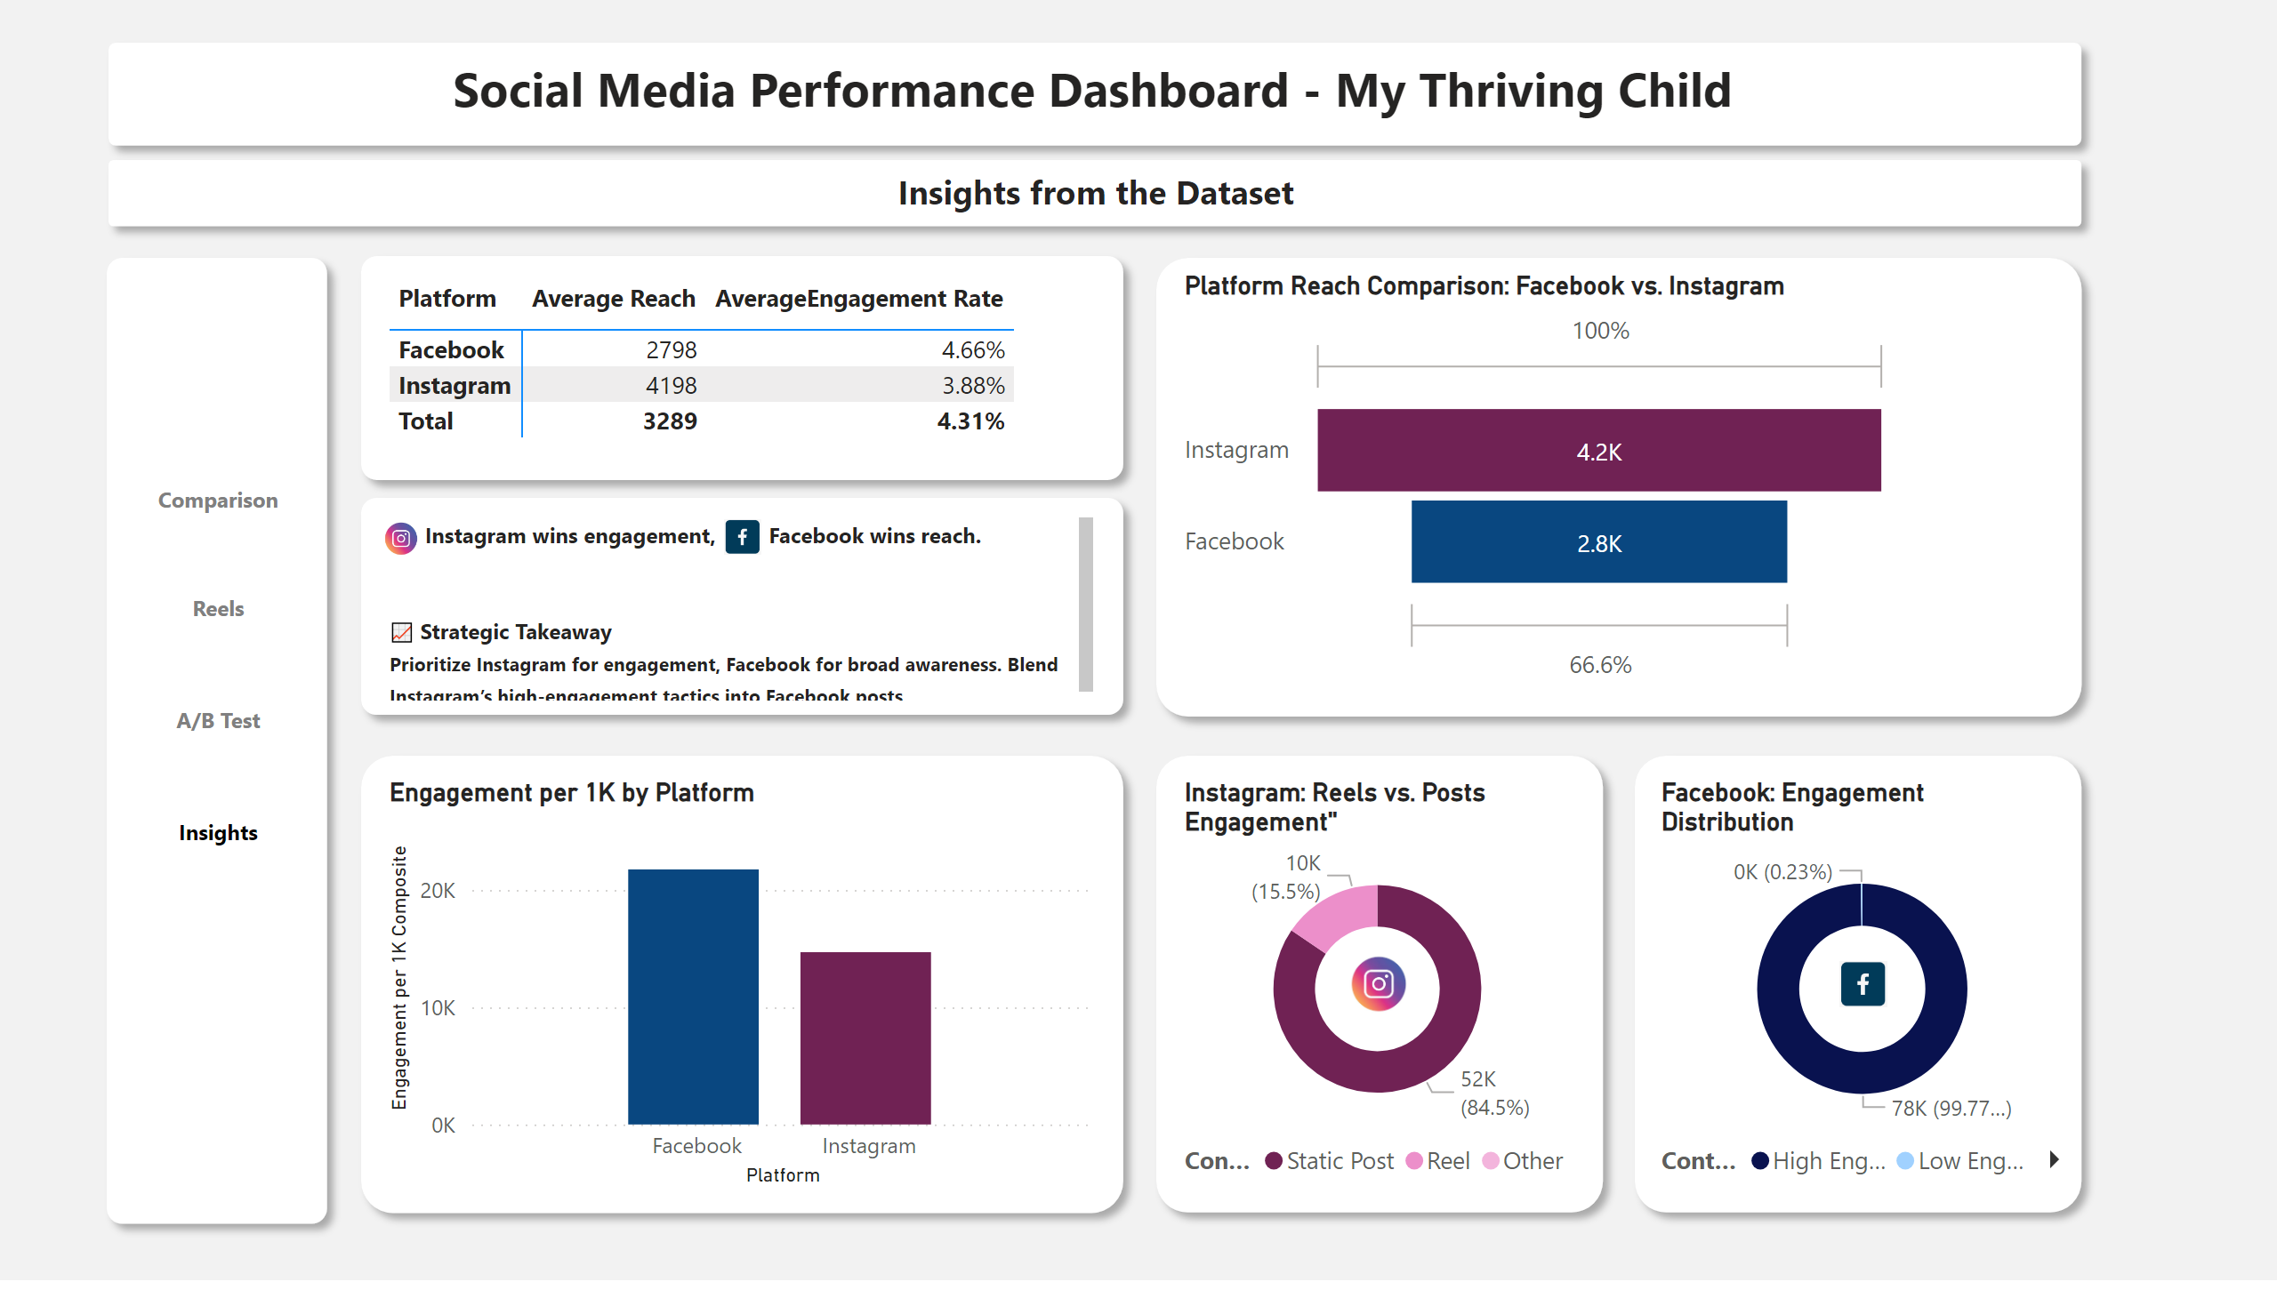
dashboard4
Notes:
shape
No alt text provided
shape
No alt text provided
textbox
No alt text provided
textbox
No alt text provided
shape
No alt text provided
shape
No alt text provided
shape
No alt text provided
shape
No alt text provided
shape
No alt text provided
pivotTable
No alt text provided
shape
No alt text provided
textbox
No alt text provided
image
No alt text provided
image
No alt text provided
Platform Reach Comparison: Facebook vs. Instagram
No alt text provided
Engagement per 1K by Platform
No alt text provided
Instagram: Reels vs. Posts Engagement"
No alt text provided
shape
No alt text provided
Facebook: Engagement Distribution
No alt text provided
image
No alt text provided
image
No alt text provided
actionButton
No alt text provided
actionButton
No alt text provided
actionButton
No alt text provided
actionButton
No alt text provided

