Slide 1
MovieLens: Data exploration and visualization
Shriyak Sridhar

Slide 2
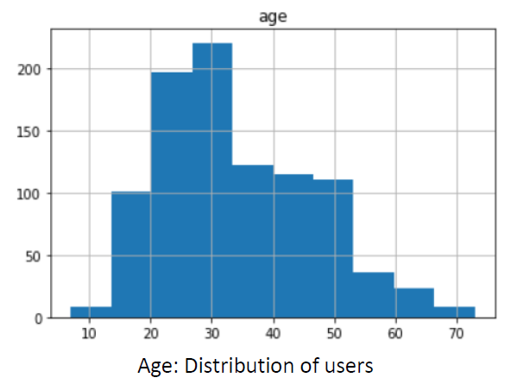
Data Exploration: age

Slide 3
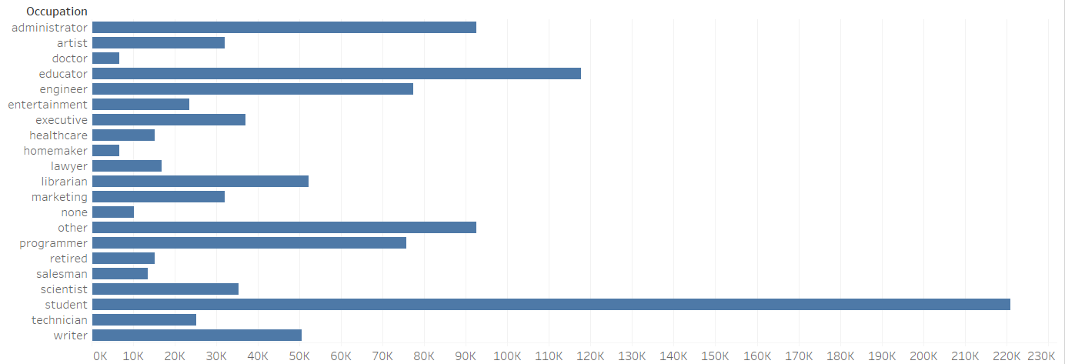
Data Exploration: occupation

Slide 4
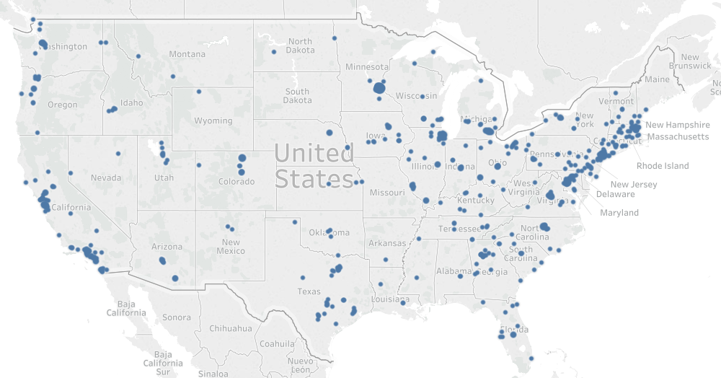
Data Exploration: zip code

Slide 5
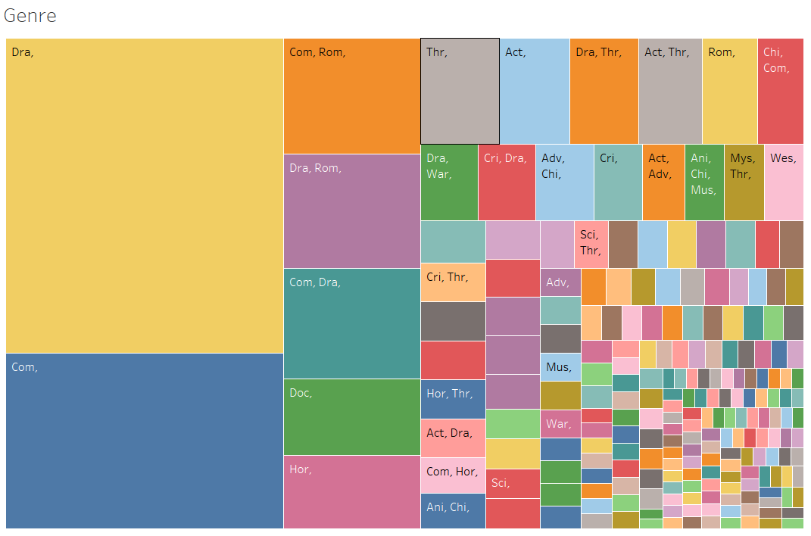
Data Exploration: genre

Slide 6
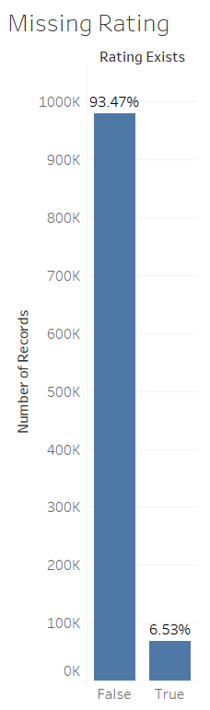
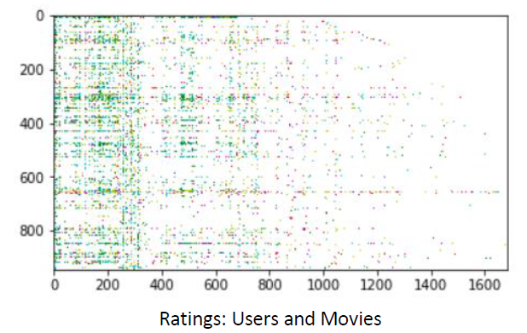
Missing Data: pattern

Slide 7
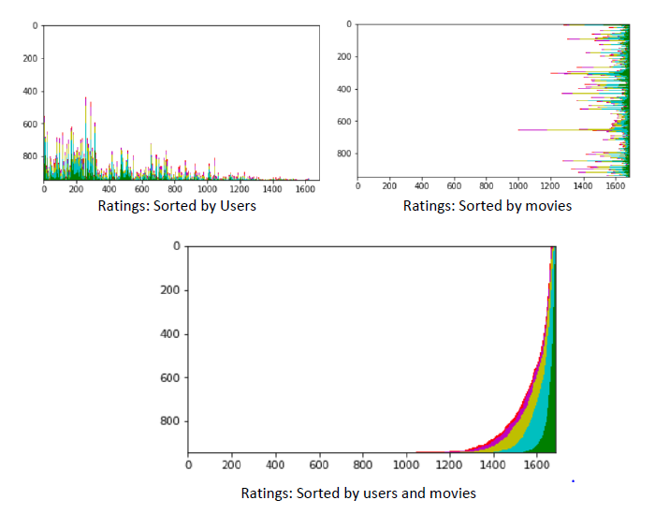
Missing Data: sorting

Slide 8
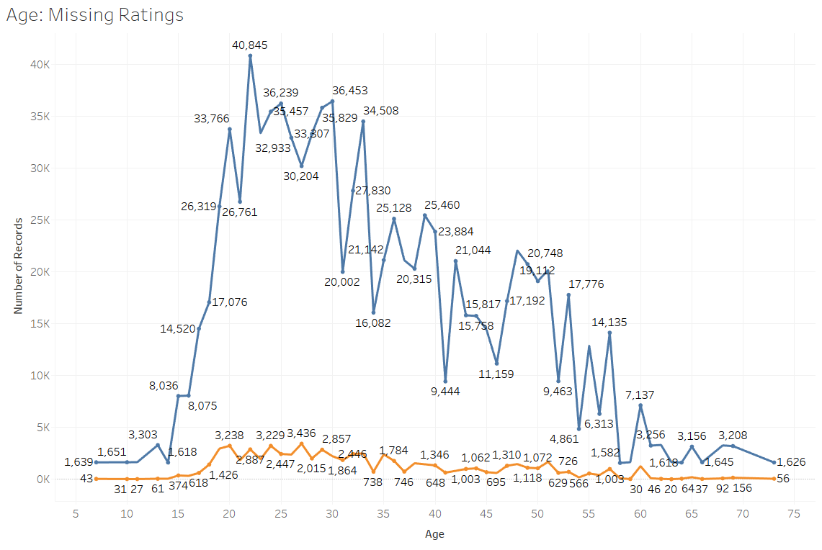
Missing Data: age

Slide 9
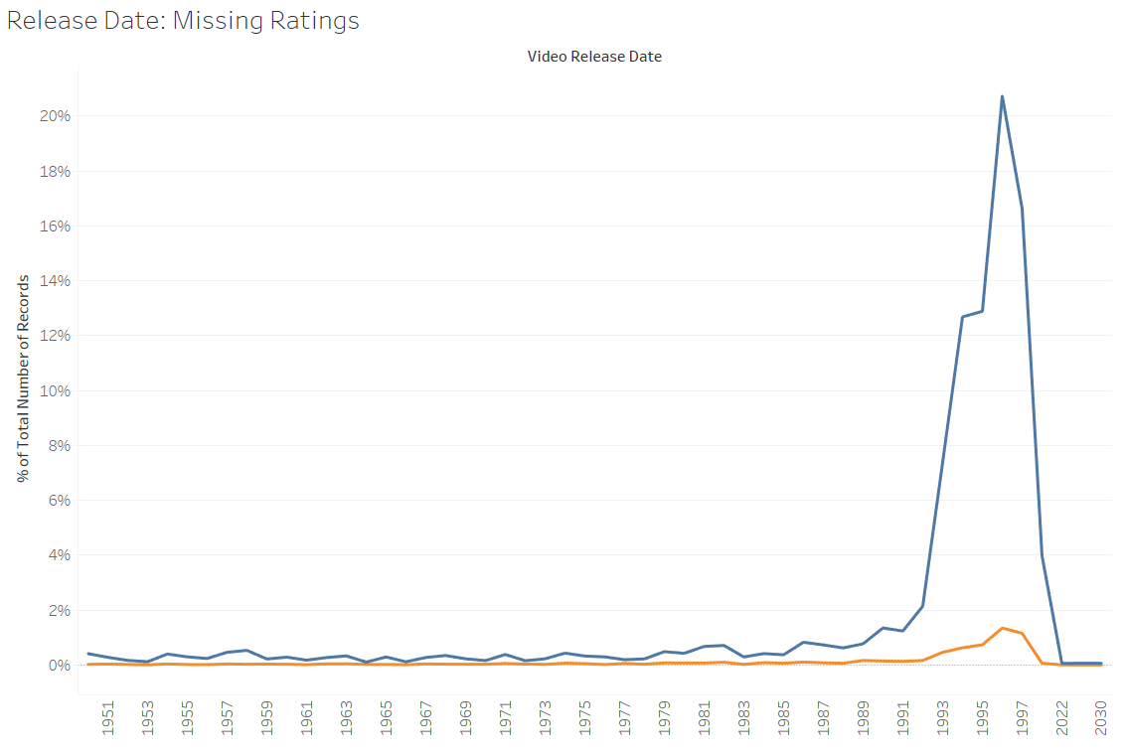
Missing Data: release date

Slide 10
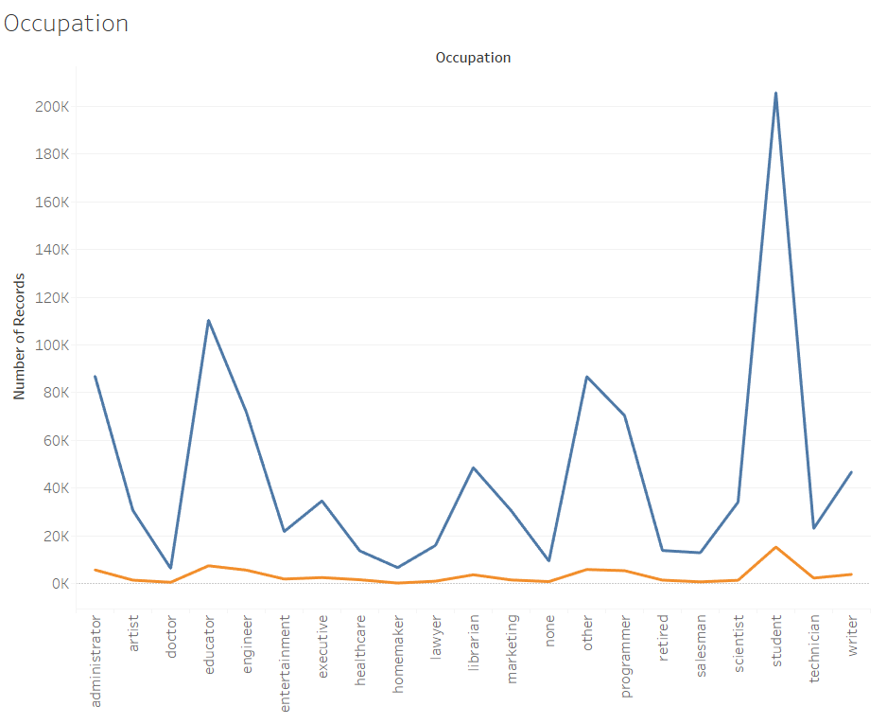
Missing Data: occupation

Slide 11
Conclusion
Explored data across different axis
Pattern isn’t random if pattern is not uniform
Modelling:
Linear Regression (easy but poor performance)
Ridge Regression (better, gives imp. Features)
Decision Tree (good performance, gives imp. features)
If some features are more important than others to predict missing values, data was not random.
Imputation performed using important features.

