Slide 1
Cascading Style Sheets (CSS)

Slide 2
Separating Presentation Details
Separating content and its presentation details is important
Content is consumed using various media
  Computer monitor
  Braille terminal
  Text to speech system
  Automated systems
Focus on content during development
Easily improve/change the presentation later
Saves a lot of effort

Slide 3
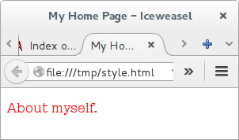
In-line CSS (Bad)
You Write:
You See:
<!DOCTYPE html>
<html>
<head>
<title> My Home Page
</title>
</head>
<body style="color: red;">
<p>About myself.</p>
</body>
</html>

Slide 4
Internal CSS (Better)
You Write:
You See:
<head>
<title> My Home </title>
<style>
body {
color: red;
}
</style>
</head>

Slide 5
External CSS (Good)
In HTML You Write:
You See:
<head>
<title> My Home </title>
<link
rel="stylesheet"
href="style.css">
</head>
In style.css You Write:
body {
color: red;
}

Slide 6
CSS Syntax
Selector
Property
Value
body {
color: red;
font-weight: bold;
}
h1 {
font-size: 20px;
}
Rule

Slide 7
CSS Comments
/* This is a comment */
body {
color: red;
font-weight: bold;
}
h1 {
font-size: 20px;
}

Slide 8
CSS Selectors – Tag Name
Select all elements in a page matching a HTML tag name
<body>
<h1>Section 1</h1>
<p>About myself.</p>
<h2>Sub section 1.1</h2>
<p>My interests are...</p>
</body>
p {
color: red;
}

Slide 9
CSS Selectors – Class Name
Select all elements in a page have a “class” attribute
An element can have multiple classes
<body>
<h1 class=”heading”>
Section 1</h1>
<p>About myself.</p>
<h2 class=”heading”>
Sub section 1.1</h2>
<p>My interests are...</p>
</body>
.heading {
color: red;
}

Slide 10
CSS Selectors – ID
Select all elements in a page a ID attribute
ID must be unique in the entire document
<body>
<h1>Section 1</h1>
<p id=”first-p”>
About myself.</p>
<h2>Sub section 1.1</h2>
<p>My interests are...</p>
</body>
#first-p {
color: red;
}

Slide 11
Grouping Selectors
h1 { color: red; }
h2 { color: red; }
is same as:
h1, h2 { color: red; }

Slide 12
Grouping Selectors
p { color: red; }
p { background: black; }
is same as:
p { color: red; background: black; }

Slide 13
Combining Selectors
p.even { color: red; }
means all elements with “p” tag and “even” class, and similarly
p#first { color: red; }
means all elements with “p” tag and “first” as ID attribute

Slide 14
Other Selectors
X Y
  Select descendant Y under ancestor X
X > Y
  Select child Y under parent X
X + Y
  Select sibling Y immediately after X
X ~ Y
  Select sibling Y of X

Slide 15
Other Selectors
[P]
  Select elements containing attribute P
[P=Q]
  Select elements containing attribute P and value Q
:hover :link :visited
  Select elements with a particular state
:before :after
  Select pseudo elements before/after an element
And more...

Slide 16
Cascading
Priority among various selectors
  Tag (low)
  Class
  ID
  Style attribute (high)
See specificity algorithm for full details

Slide 17
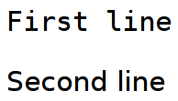
Font Family
You Write:
You See:
#first {
font-family: monospace;
}
#second {
font-family: sans-serif;
}

Slide 18
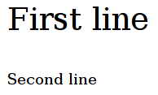
Font Size
You Write:
You See:
#first {
font-size: 32px;
}
#second {
font-size: 16px;
}

Slide 19

Font Style
You Write:
You See:
#first {
font-style: italic;
}
#second {
font-style: normal;
}

Slide 20
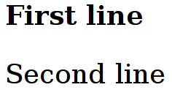
Font Weight
You Write:
You See:
#first {
font-weight: bold;
}
#second {
font-weight: normal;
}

Slide 21
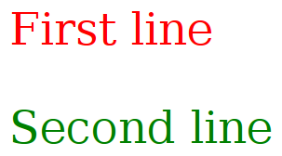
Text Color
You Write:
You See:
#first {
color: red;
}
#second {
color: green;
}

Slide 22
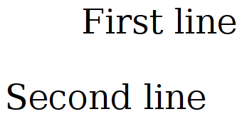
Text Color
You Write:
You See:
#first {
text-align: right;
}
#second {
text-align: left;
}

Slide 23
Box Model
Margin
Border
Padding
Content
Width x Height

Slide 24
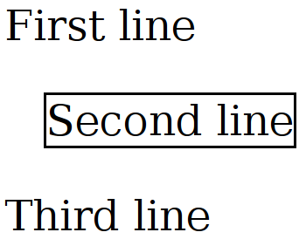
Margin
You Write:
You See:
#second {
border: black solid 1px;
margin-left: 15px;
}

Slide 25
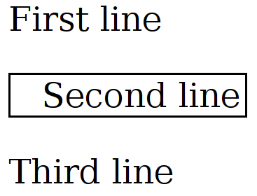
Padding
You Write:
You See:
#second {
border: black solid 1px;
padding-left: 15px;
}

Slide 26
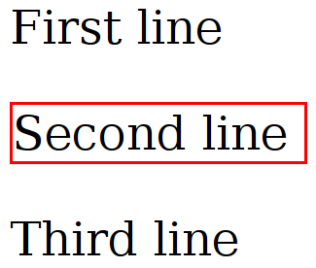
Border Color
You Write:
You See:
#second {
border-color: red;
border-style: solid;
border-width: 1px;
}

Slide 27
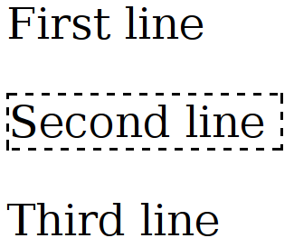
Border Style
You Write:
You See:
#second {
border-color: black;
border-style: dashed;
border-width: 1px;
}

Slide 28
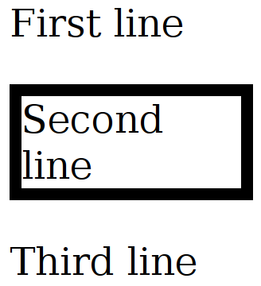
Border Width
You Write:
You See:
#second {
border-color: black;
border-style: solid;
border-width: 5px;
}

Slide 29
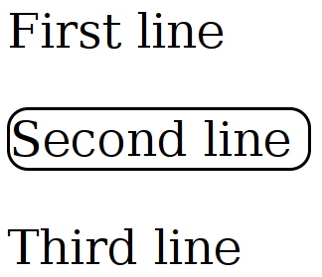
Border Width
You Write:
You See:
#second {
border-color: black;
border-style: solid;
border-width: 1px;
border-radius: 7px;
}

Slide 30
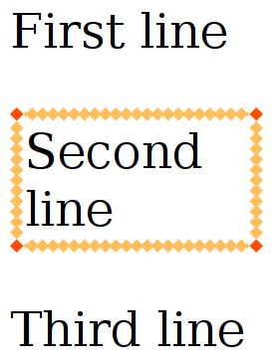
Border Image
You Write:
You See:
#second {
border-color: black;
border-style: solid;
border-width: 1px;
border-image:
url(border.png)
30 30 repeat repeat;
}

Slide 31
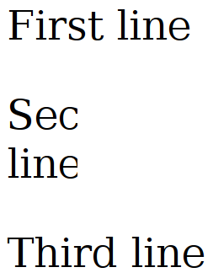
Width
You Write:
You See:
#second {
overflow: hidden;
width: 30px;
}

Slide 32
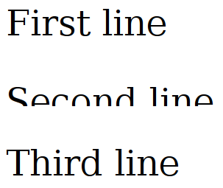
Height
You Write:
You See:
#second {
overflow: hidden;
height: 12px;
}

Slide 33
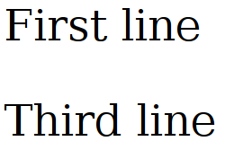
Display: None
You Write:
You See:
#second {
display: none;
}

Slide 34
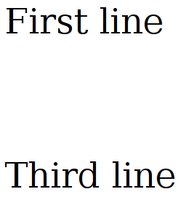
Visibility: Hidden
You Write:
You See:
#second {
visibility: hidden;
}

Slide 35
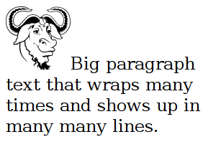
Float: None
You Write:
You See:
#pic {
float: none;
}

Slide 36
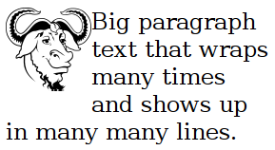
Float: Left
You Write:
You See:
#pic {
float: left;
}

Slide 37
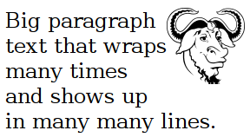
Float: Right
You Write:
You See:
#pic {
float: right;
}

Slide 38
More CSS

Slide 39
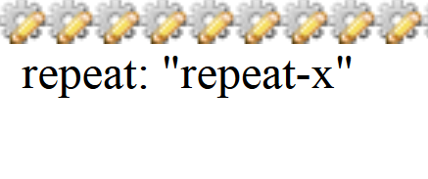
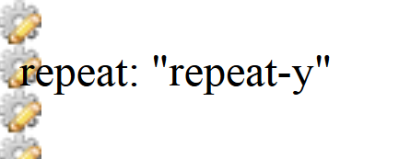
Background Repeat

Slide 40
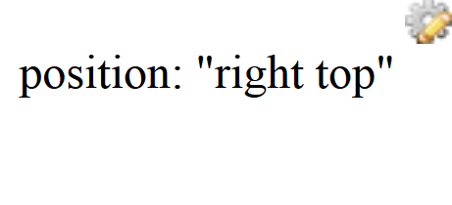
Background Positioning

Slide 41
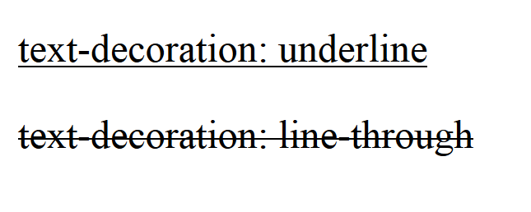
Text decoration

Slide 42
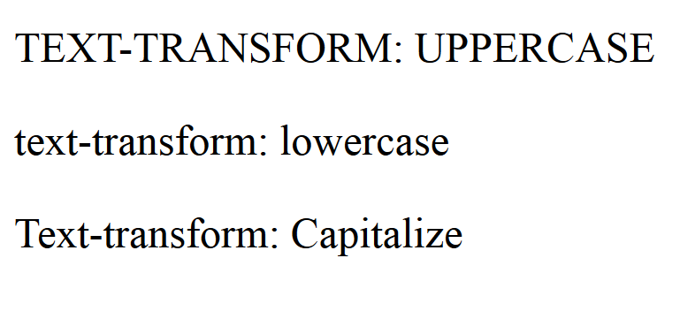
Text transformation

Slide 43
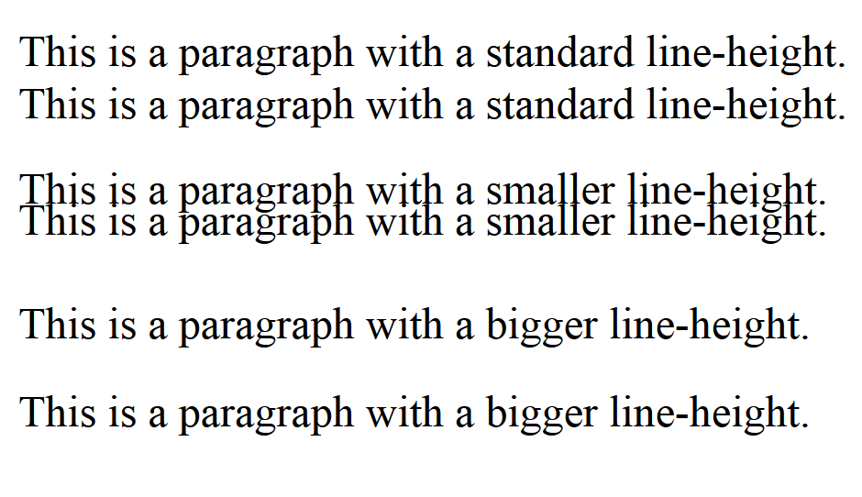
Line height

Slide 44
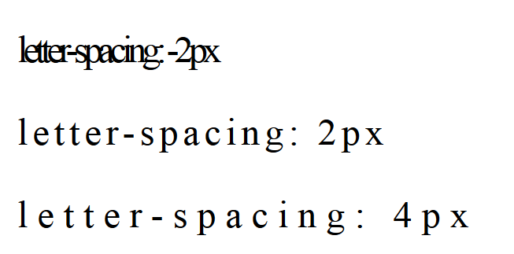
Letter spacing

Slide 45
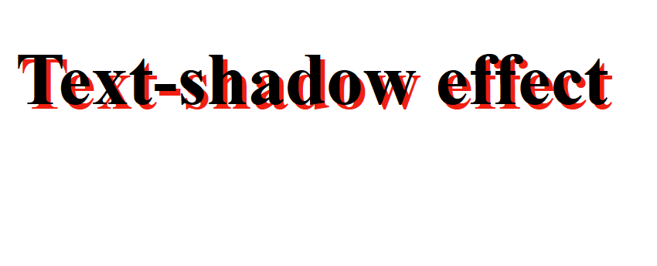
Text shadow

Slide 46
Some Interesting Topics
Loading font files
Link pseudo states
List style (type, position, image)
Table border collapse
Margin collapse
Border style
Outlines
Negative margins
Min and Max dimensions

Slide 47
Some Interesting Topics
Positioning (fixed, absolute, relative, static)
  Z-index
Clearing floats
Center align using auto margin
More CSS selectors
  First child, even, odd, last child, nth child, first letter
Pseudo elements
Transparency
Media types

Slide 48
Some Interesting Topics
Box shadow
Border image
Background size, Multiple background images
Gradients – Linear, radial
Text shadow
Transformations – 2D and 3D
Transitions
Animations
Responsive design

Slide 49
References
W3Schools CSS Tutorial: http://www.w3schools.com/css/
W3C CSS Standard: http://www.w3.org/Style/CSS/Overview.en.html
W3C CSS Validator: http://jigsaw.w3.org/css-validator/

