Slide 1
Course Portal & Discussion Forum
April 10,2017
Submitted By:
Athresh G
Sunny Ahlawat
Dishant Chauhan
Shriyansh Agarwal

Slide 2
Problem Statement
The Problem | Communication between students, faculty and ta was difficult
Affects | Student, Instructor, TA, University Administration
The impact of which is | Handling had to be done manually which would require lot of man hours.
A successful solution would be | Online course forum system which meets stakeholder requirements

Slide 3
Requirements elicitation, gathering, specifications
Item 1
Item 2
Challenges
Requirements
Create Courses
Managing Student Grades
Assignment Submissions
Forum
Feedback
Gathering right requirements
Covering Clean code principles
Integrating modules.

Slide 4
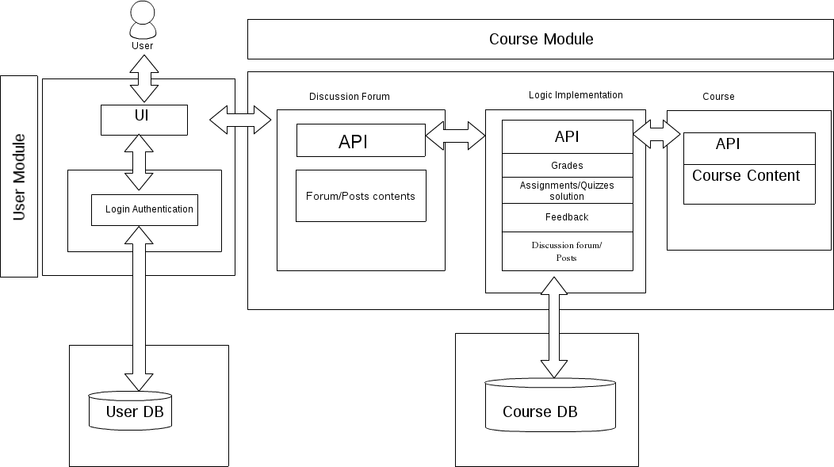
Design And Architecture

Slide 5
Implementation And Testing
Developed using Web2py framework
Performed Unit Testing on tables, controller functions using web2py testing tools provided by gluon.

Slide 6
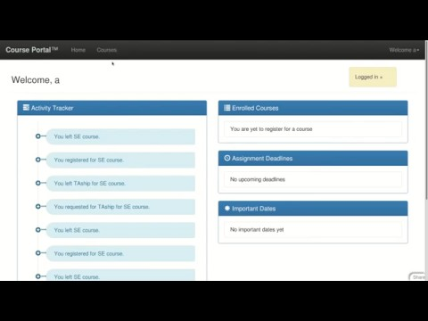
Demo Video

Slide 7
Conclusion
Course portal and discussion forum with feedback provides a central platform that solves all communication issues.
Students can interact, discuss queries and post assignments , grades evaluated on a single system.

