Slide 1

Presented by -
Shriya Sahu

Slide 2

About me
Shriya Sahu
Core tools
Recent B.Tech graduate • Electronics & Telecommunication Engineering
MySQL • Python • Excel
Data Analysis
• Graduated from IIIT Bhubaneswar with an ETC background.
• Building practical skills in Python, SQL, Excel, Data Analysis and Machine Learning.
• Interested in using data to understand business problems and convert raw data into useful insights.
• This project demonstrates my work with relational databases, SQL joins, aggregation, business questions and insight generation.
Linkedin: https://www.linkedin.com/in/shriya-sahu-7586681b4/
GitHub: https://github.com/Shriyasahu2804
Project role
Data Analyst perspective
Business question → SQL → insight
Hotel Reservation Analytics • MySQL Business Analytics Project

Slide 3
Table of contents
• Project Overview
• Business Scenario & Objectives
• Data Sets & Database Overview
• ER Structure & Analytical Flow
• Booking demand Analysis
• Guest booking behaviour
• Stay performance
• Staff & room performance
• Booking & stay problems
• Key Insights & Findings
• Challenges Faced in the Project
• Conclusion and Recommendations
Hotel Reservation Analytics • MySQL Business Analytics Project

Slide 4

Project overview
Project Purpose
Analyze hotel reservation data using SQL.
Convert raw database records into meaningful business insights.
Understand patterns in bookings, guests, stays and hotel operations.
Use data to identify areas for better operational monitoring and planning.
Database Coverage
Guests – customer information and loyalty details
Hotels – hotel and location information
Rooms – room types, capacity and pricing
Bookings – reservations, channels, nights and booking amount
Stays – stay outcomes, duration and service requests
Staff – employees handling hotel stays
Hotel Reservation Analytics • MySQL Business Analytics Project

Slide 5
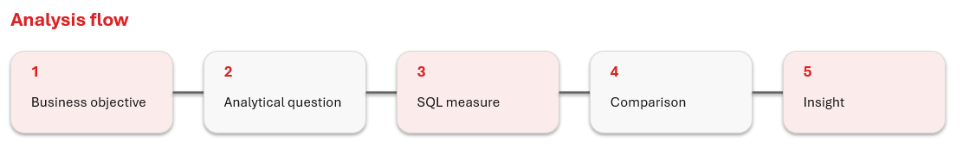
Business Scenario & Objectives
Business Scenario
StayPoint Hospitality operates multiple hotels and manages guests, rooms, bookings, stays and staff. The business has reservation data that can be analyzed to understand customer demand and operational performance.
The analysis helps answer:
Where is booking demand highest?
Which channels contribute the most?
How do guests use the reservation service?
What happens after a booking?
Where do cancellations and no-shows occur?
Business Objectives
Analyze Booking Demand
Understand Guest Behaviour
Evaluate Stay Performance
Analyze Staff & Room Performance
Identify Booking & Stay Problems
Hotel Reservation Analytics • MySQL Business Analytics Project

Slide 6
Data sets & database overview
Table | Rows | Key purpose
guests | 350 | Guest profile, type, loyalty
hotels | 25 | Property, city, rating, rooms
rooms | 600 | Room type, capacity, price
bookings | 2,800 | Reservation, channel, nights, amount
stays | 3,200 | Outcome, duration, requests, staff
staff | 70 | Staff profile, rating, department
Database
Total booking amount: ₹45,823,178.73
Average nights booked: 3.32
Coverage
5 booking channels
4 room types
4 stay statuses
Data model
Bookings connect guests + hotels.
Stays connect bookings + rooms + staff.
Hotel Reservation Analytics • MySQL Business Analytics Project

Slide 7
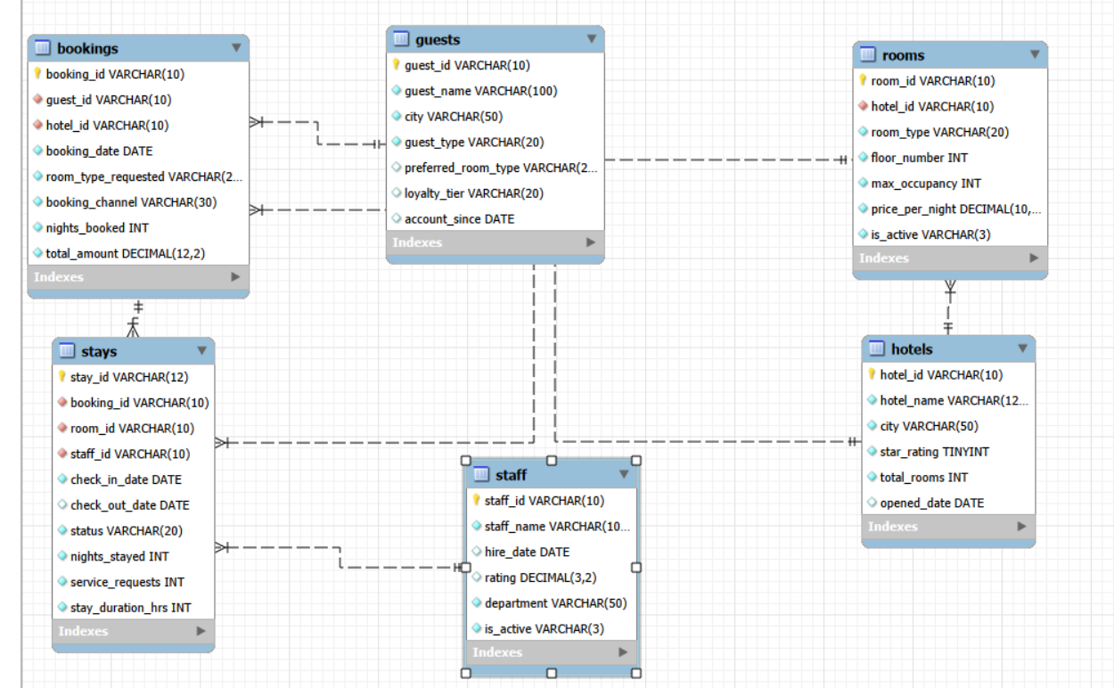
ER structure & analytical flow
Hotel Reservation Analytics • MySQL Business Analytics Project

Slide 8
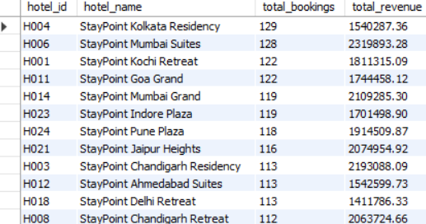
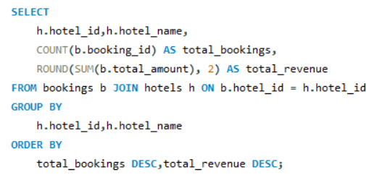
Booking demand Analysis
Q. Which hotels receive the highest number of bookings?
Key insights
• StayPoint Kolkata Residency leads booking volume with 129 bookings.
• Website is the largest revenue channel at ₹15,298,855.
• Standard is the most requested room type with 1259 requests.
Hotel Reservation Analytics • MySQL Business Analytics Project

Slide 9
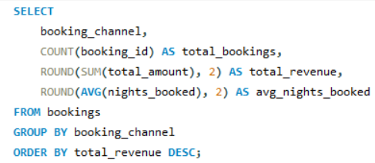
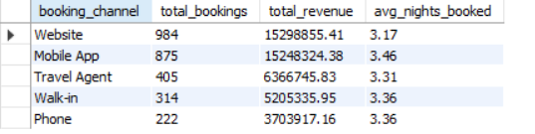
Booking demand Analysis
Q. Which booking channels contribute the most business and longer stay duration?
Key insights
• Website contributes the highest booking amount: ₹15,298,855.
• Website has 984 bookings.
• Average nights shows whether a channel is associated with shorter or longer reservations
Hotel Reservation Analytics • MySQL Business Analytics Project

Slide 10
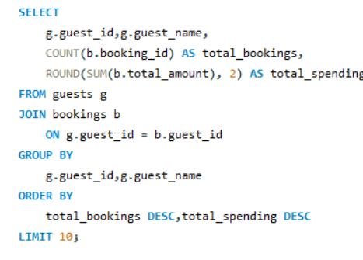
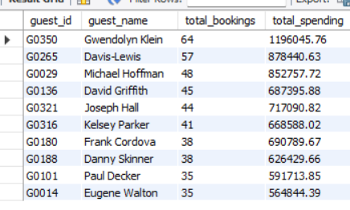
Guest booking behaviour
Q. Which guests have the highest booking frequency and total spending?
Key insights
• Gwendolyn Klein has the highest booking frequency with 64 bookings and total spending of ₹11.96 lakh.
Davis-Lewis and Michael Hoffman follow with 57 and 48 bookings, spending approximately ₹8.78 lakh and ₹8.53 lakh respectively.
The results highlight a group of high-frequency and high-spending guests, indicating strong repeat-customer activity.
Hotel Reservation Analytics • MySQL Business Analytics Project

Slide 11
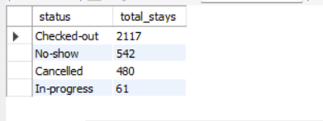
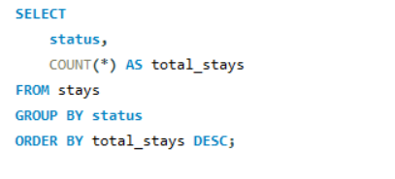
Stay performance
Q. What are the different stay outcomes and how frequently does each occur?
Key insights
• Checked-out is the largest outcome category with 2117 stays.
• No-show records (542) exceed cancellations (480).
• The highest monthly stay volume occurs in 2026-07 with 153 stays
Hotel Reservation Analytics • MySQL Business Analytics Project

Slide 12
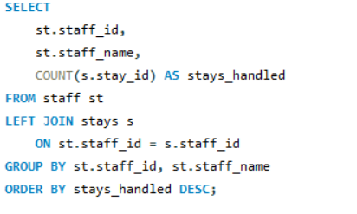
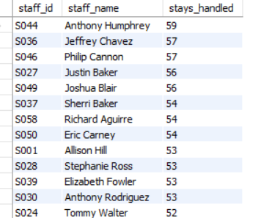
Staff & room performance
Q. How many stays were handled by each staff member?
Key insights
• Anthony Humphrey handles the highest number of stays: 59.
• Jeffrey Chavez and Philip Cannon follow with 57 stays each.
• The top staff members handled 52–59 stays, showing a relatively close workload range among the highest-performing staff group
Hotel Reservation Analytics • MySQL Business Analytics Project

Slide 13
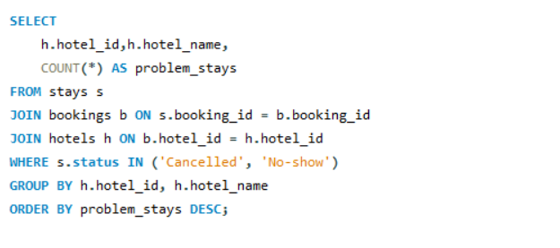
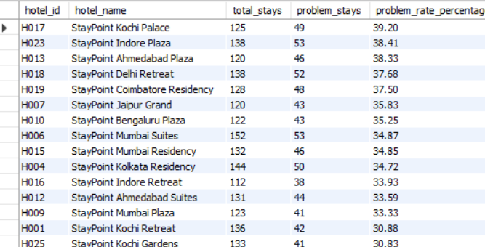
Booking & stay problems
Q. Which hotels have the most cancellation and no-show problems?
Key insights
StayPoint Kochi Palace has the highest problem-stay rate at 39.2%.
• The highest-rate hotel has 49 problem stays out of 125 stays.
• Using a rate makes hotels with different stay volumes more comparable than raw counts alone.
Hotel Reservation Analytics • MySQL Business Analytics Project

Slide 14
Key Insights & Findings
StayPoint Kolkata Residency recorded the highest booking volume among the analyzed hotels.
Website contributed the highest booking revenue among the analyzed booking channels.
Gwendolyn Klein was the most active guest with 64 bookings and approximately ₹11.96 lakh in total spending.
Anthony Humphrey handled the highest number of stays with 59 stays.
Stay outcome analysis showed that Checked-out was the most common stay status.
Hotel-level analysis helped identify properties with higher cancellation and no-show rates.
The highest hotel problem rate is 39.2%, showing why rate—not only raw counts—matters.
Hotel Reservation Analytics • MySQL Business Analytics Project

Slide 15
Challenges Faced in the Project
Data preparation: Handling different date formats and ensuring the CSV data was imported correctly.
Database relationships: Understanding and correctly joining the six tables using their primary and foreign keys.
Query formulation: Converting business objectives into meaningful and measurable SQL questions.
SQL complexity: Using JOIN, COUNT(), SUM(), AVG(), GROUP BY, ORDER BY and CASE WHEN correctly.
Result interpretation: Converting SQL outputs into clear business insights rather than only presenting numbers.
Comparative analysis: Using both raw counts and percentages to make meaningful comparisons between hotels, guests, channels and staff.
Hotel Reservation Analytics • MySQL Business Analytics Project

Slide 16
Conclusion
SQL analysis transformed the hotel reservation data into actionable business insights.
The analysis identified important patterns in booking demand, guest behaviour, staff workload and stay outcomes.
Combining multiple database tables provided a more complete view of hotel operations and customer activity.
Business recommendations
Use hotel, room-type and channel booking counts to prepare capacity for high-demand segments.
Website and Mobile App together represent the largest booking/revenue contribution; monitor conversion and average stay metrics.
Balance staff workload by comparing stays handled and average stay duration.
Focus on repeat and high-value guests through customer retention and loyalty activities.
Hotel Reservation Analytics • MySQL Business Analytics Project

Slide 17

THANK
YOU

