Slide 2


Banking System
October 19, 2022
By-
Shriyash Kerimane

Slide 3
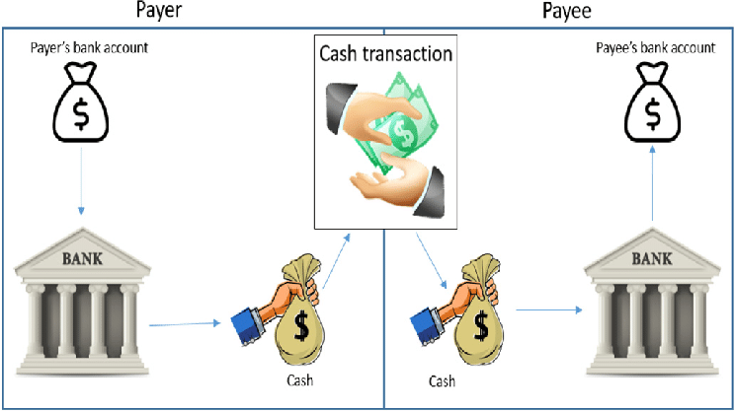
October 19, 2022
Brief on project expectation
Banking System is application which will allow employees and customers to perform day to day financial task and not requiring to visit bank.
This application will allow user to operate and monitor their financial status.

Slide 4

Requrirements of the project
Java SDK 11
Spring boot, spring data JPA
Spring cloud
Thymeleaf
Mariadb

Slide 5
Functionality :
Customer :
Register to access bank functionality
Login functionality
Open accounts
Transaction - deposit, withdraw, transfer
Check balance
Fetch transaction statement
Employee:
Get customer details
Open accounts for customers
Activate or Deactivate accounts
List customers

Slide 6
Architecture
AccountDB
Customer-microservice
customer
Account
Transaction
API
GATEWAY
Employee-microservice
Client
+
Login-Service
User
CredentialDB
Discovery service
(Eureka)

Slide 7
Project requirements
Code quality check in sonarqube
Integration of Prometheus/graphana
Creation of UI using thymeleaf
Docker Image from Jenkins
Dockerize all the microservices
Deploy on Amazon EC2

Slide 8
Microservices
October 19, 2022
Login:
Validates credentials and redirects to employee page or customer page based to credential.
Customer:
Performs functionality based on customer needs.
Employee
Performs functionality based on employee needs.
By-
Shriyash Kerimane

