Slide 1
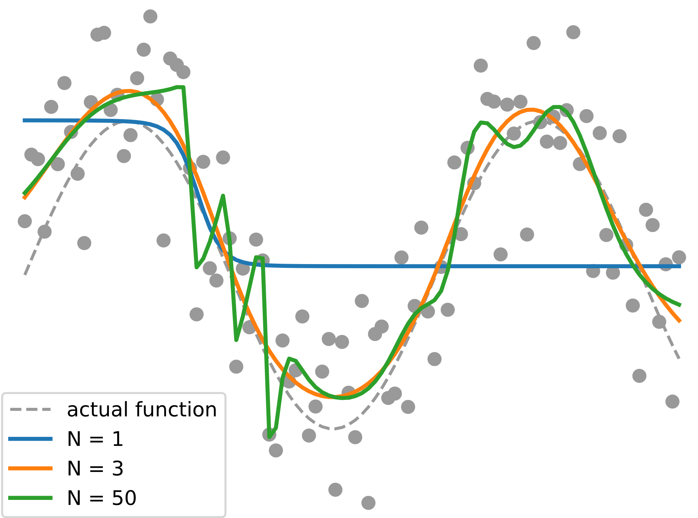
data with noise
overfit
50 hidden neurons
balanced
3 hidden neurons
actual function
underfit
1 hidden neuron

