Slide 1


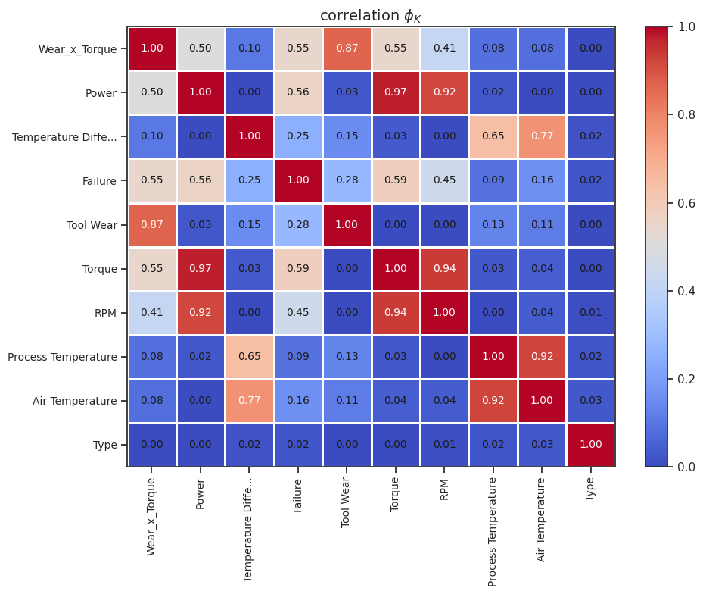
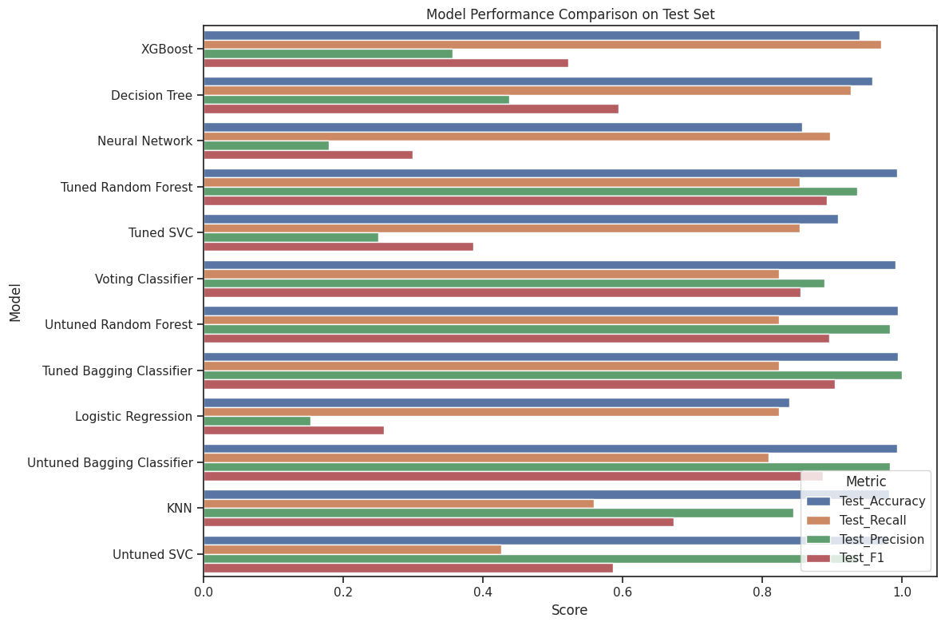
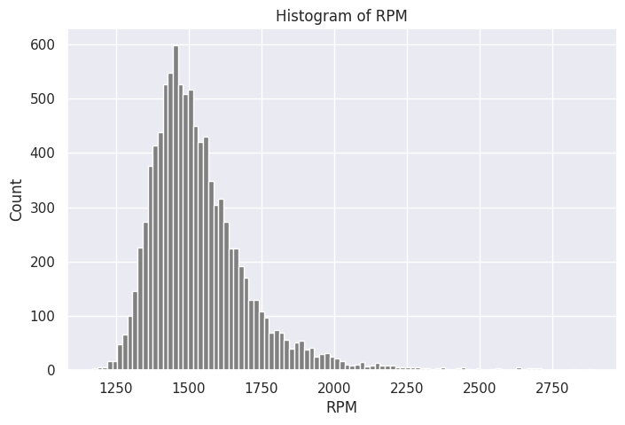
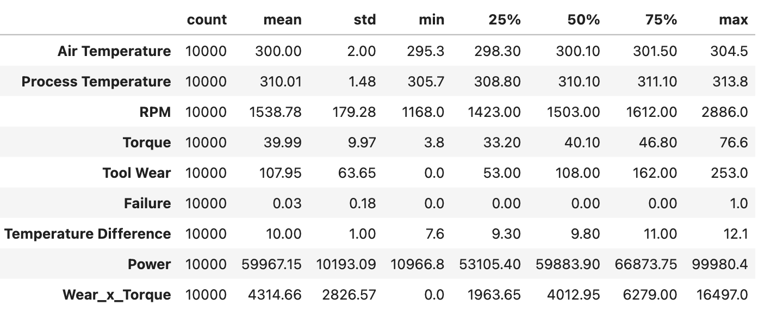
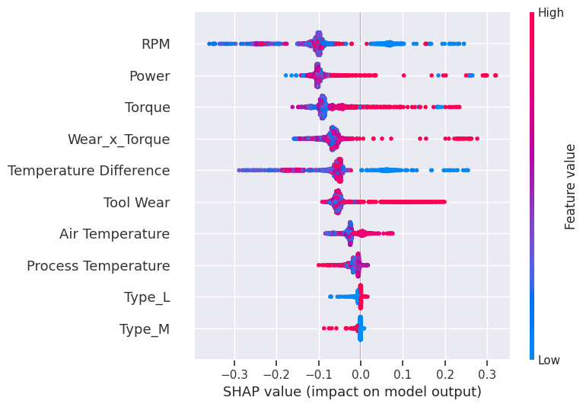
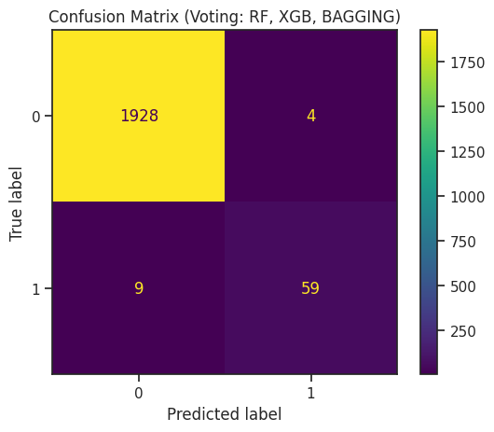
Forecasting Equipment Failure using Machine Learning
Stanford Pre-Collegiate Summer Institutes
Zayd Krunz
Introduction
In manufacturing, unexpected machine failure causes costly downtime and repairs. Predictive maintenance forecasts these failures early, enabling proactive repairs. This project develops and evaluates various machine learning models to predict failure, focusing on maximizing recall to minimize missed failures.
Data Analysis & Results
The dataset (AI4I 2020 Predictive Maintenance Dataset) is heavily imbalanced. Only 339 of the 10,000 instances (3.4%) represent a "Machine Failure." This makes accuracy misleading, so recall was prioritized to ensure models optimized finding rare (but critical) failure events. Correlation heatmaps show that Torque and Tool Wear had the strongest positive correlations with Failure. More interestingly, Air Temperature and Process Temperature were highly correlated with each other (r ≈ 0.87), indicating multicollinearity, and so the Temperature Difference feature was engineered to capture their net impact more effectively.
Methods
Data was cleaned by removing irrelevant columns. The categorical 'Type' feature was one-hot encoded, and all numerical features were scaled using StandardScaler to better predict the binary output of ‘Failure’.
Feature Engineering
New features were created to capture interactions between variables, including 'Power' (from RPM and Torque) and 'Wear_x_Torque' (from Tool Wear and Torque).
Model Tuning & Evaluation
GridSearchCV was used to systematically tune hyperparameters for each model, optimizing for recall score to prioritize the detection of true failures. The dataset was split into 80% training and 20% testing sets for robust evaluation.
Conclusion & Insights
This research successfully demonstrated that tuned machine learning models can successfully forecast machine failure, with model performance being highly dependent on optimizing for recall to minimize costly misses, especially when the cost of a false positive is significantly lower than that of a false negative.
Voting Classifier: By letting top models “Vote”, the classifier can average out unique weaknesses of each algorithm, leading to a more reliable final decision.
Limitations: By implementing binary failure prediction, it is impossible to differentiate between different types of failure (e.g, tool wear vs. power failure).
Machine Learning Results
Analysis showed that the model tuning strategy is the most important factor in developing a useful predictive maintenance model. A model optimized specifically for high Recall is far superior for the business goal than a model optimized for a balanced F1-Score.
A false positive leads to a fast checkup by a technician; a false negative may lead to thousand-dollar repairs.
The best-performing model was the Voting Classifier, trained using the predicted probabilities averaged from Random Forest, XGBoost, and the Bagging classifier.
References
"AI4I 2020 Predictive Maintenance Dataset," UCI Machine Learning Repository, 2020. [Online]. Available: https://doi.org/10.24432/C5HS5C.
F. Pedregosa et al., "Scikit-learn: Machine Learning in Python," J. Mach. Learn. Res., vol. 12, pp. 2825–2830, 2011.
T. Chen and C. Guestrin, "XGBoost: A Scalable Tree Boosting System," in Proc. 22nd ACM SIGKDD Int. Conf. Knowl. Discovery Data Mining, 2016, pp. 785–794.
M. Abadi et al., "TensorFlow: Large-Scale Machine Learning on Heterogeneous Systems," 2015. [Online]. Available: https://www.tensorflow.org
Pearson's Correlation (r)
 |  | Air Temperature | Process Temperature
 | Air Temperature | 1 | 0.876107
 | Process Temperature | 0.876107 | 1

