Slide 1


Car Price Market Analysis
SIC – AI07
Notes:
Note:
1

Slide 2
Agenda
Team Members
Motivation & Problem
Targeted audience
Our Approach
Data Collection and Preparation
Visualization
Conclusion
Business Recommendations
Limitations of the analysis
Samsung Innovation Campus

Slide 3

Team Members
Mariam Hany
Shrouk Sayed
Lojayn Khaled
Samsung Innovation Campus

Slide 4
Problem Definition
Samsung Innovation Campus
Notes:
Note:
2

Slide 5
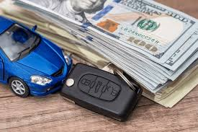
Problem Definition
This project analyzes a dataset of cars to identify the key factors that influence car pricing.
The goal is to provide clear, actionable insights into what drives car valuations.
Samsung Innovation Campus

Slide 6
Targeted audience
Samsung Innovation Campus
Notes:
Note:
2

Slide 7

Targeted audience
Car buyers
Car Manufactures
Car Dealers
Samsung Innovation Campus

Slide 8
Practical Impact of our System
Car Manufacturers
Understand what features to focus on when manufacturing cars.
Car Buyers
Understand the features that influence car’s price the most.
Car Dealers
Understand the features based on which they should price the car.
Samsung Innovation Campus
Notes:
Note:
4

Slide 9

What is the purpose of our application
Our aim is to explore a dataset of cars to identify the features that have the greatest impact on price. By analysing these features and their relationships, we can better understand what makes some cars more expensive than others.
Samsung Innovation Campus
Notes:
Note:
4

Slide 10
Our Approach
Samsung Innovation Campus
Notes:
Note:
2

Slide 11
Our Approach
Data Collection & Preparation
Visualization
Conclusion
Samsung Innovation Campus
Notes:
Note:
4

Slide 12
Date Collection and Preparation
Samsung Innovation Campus
Notes:
Note:
2

Slide 13
Data Source & Description
Data Source
Kaggle dataset
Key Columns
Make, model, year, fuel type , number of doors , market category, …
Initial Size
Rows: 11914
Columns: 18
Samsung Innovation Campus

Slide 14



Date Collection and Preparation
Data Ingestion
Loaded raw data into a Pandas Data Frame for processing
Column name Standardization
Inconsistencies were present in the column names.
We standardized them by converting all names to a consistent format using spaces for readability.
Deleting duplicated rows
Loaded raw data into a Pandas Data Frame for processing
Samsung Innovation Campus

Slide 15

Date Collection and Preparation
Handling missing values
Fuel Type & Doors → Imputed using same Make & Model
Engine HP & Cylinders → Filled with column median
Market Category → Filled nulls with mode
Transformed into binary features (Luxury,
Performance, Hatchback, etc.)
Samsung Innovation Campus

Slide 16



Date Collection and Preparation
Correcting Data types
Converted Number of Doors and Engine Cylinders Columns from float to integer data type
Feature Engineering
Created a new feature: Fuel efficiency, which is the average of city mpg and highway mpg
Dropping unnecessary columns
Reduced the number of features
Identified and removed all duplicate rows from the dataset to ensure the integrity and accuracy of the analysis.
Samsung Innovation Campus

Slide 17
Visualization
Samsung Innovation Campus
Notes:
Note:
2

Slide 18
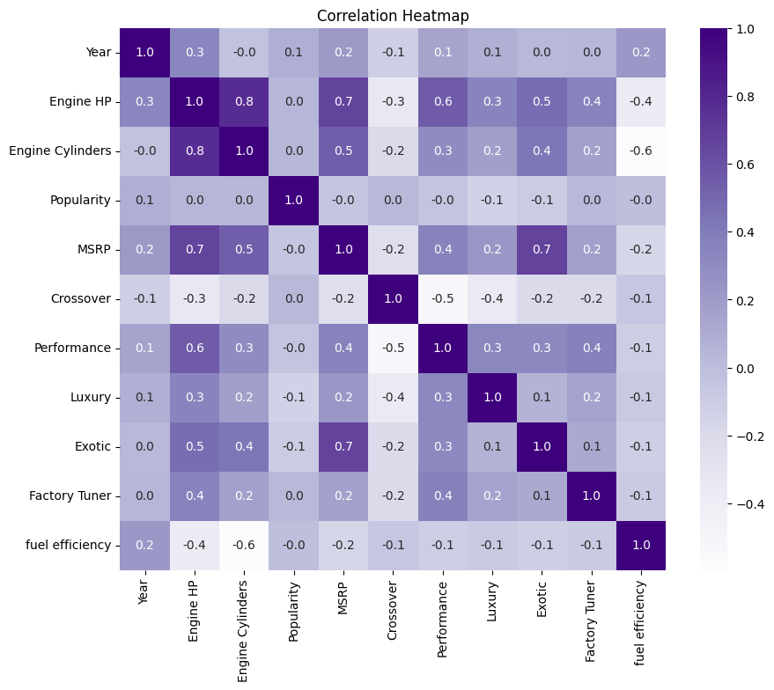
Technical Data Visualization
Heat Map
This visualization explores the correlations between the MSRP and other features in the dataset.
Samsung Innovation Campus

Slide 19
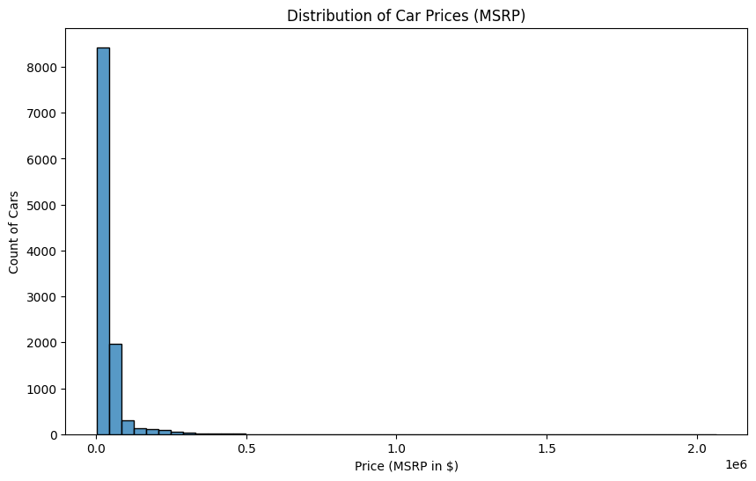
Technical Data Visualization
Histogram
The histogram reveals a right-skewed price distribution, indicating that most cars are priced in the lower range. The long tail represents a few high-end models that elevate the average price
Samsung Innovation Campus

Slide 20
Power BI Visualization
Samsung Innovation Campus
Notes:
Note:
2

Slide 21
Price Drivers & Feature Analysis Dashboard
Average of MSRP Compared with:
Engine Cylinders
Average of MSRP increases significantly as the number of engine cylinders increases
Vehicle Size
Large cars have the highest MSRP.
Transmission
Automated manual and direct drive lead in price. Automatic & manual are lower. Unknown transmission type lowest.
Midsize follow
Compact lowest.
Samsung Innovation Campus

Slide 22

Price Drivers & Feature Analysis Dashboard
Car prices are strongly influenced by number of engine cylinders, vehicle size, and transmission type. High number of cylinders and advanced transmission types create sharp price jumps, while most standard models remain far more affordable.
Samsung Innovation Campus

Slide 23
Luxury & Performance Segmentation Dashboard
Average MSRP vs Performance:
High Performance cars: around $76K
Average MSRP vs Exotic:
Exotic cars: around $233K
Low performance cars: around $28k
Non-exotic cars: around $33k
Exotic cars have the largest price gap,
followed by performance cars.
Samsung Innovation Campus

Slide 24
Overview & Market Positioning Dashboard
Average MSRP vs Make:
Bugatti is the highest priced make. Other makes' prices are far below it.
Average MSRP vs Model:
Veyron 16.4, Reventon and Landaulet are the top 3 priced models. Other models' prices are far below it.
Samsung Innovation Campus

Slide 25
Overview & Market Positioning Dashboard
Max of MSRP
Median of MSRP
Price Range
Min of MSRP
2M
31K
2K
2M
Samsung Innovation Campus

Slide 26
Overview & Market Positioning Dashboard
The market shows a significant gap in car prices. Brands like Bugatti command extremely high prices compared to others. Likewise, models such as the Veyron, Reventon, and Landaulet create sharp price jumps relative to other models.
Samsung Innovation Campus

Slide 27
Popularity Overview Dashboard
Most famous car brands:
Ford
Most Famous Card Models:
F-150
Chevrolet
Toyota
Nissan
Volkswagen
Tundra
Silverado 1500
Frontier
Sierra 1500
Samsung Innovation Campus

Slide 28
Engine HP Analysis Dashboard
Average of Engine HP Compared with:
Engine Cylinders
The average engine HP increases significantly as the number of engine cylinders rises. The highest average HP is for cars with 15 or more cylinders, reaching over 1000 HP.
Exotic
Exotic Cars: Cars classified as exotic have a much higher average engine HP than non-exotic cars.
Performance
Performance Cars: Performance cars also have a higher average engine HP compared to non-performance cars. However, the difference appears to be less dramatic than with exotic cars.
Samsung Innovation Campus

Slide 29
Engine HP Analysis Dashboard
Max of Engine HP
Average of Engine HP
Min of Engine HP
1001
253.3
55
Samsung Innovation Campus

Slide 30
Conclusion
Samsung Innovation Campus
Notes:
Note:
2

Slide 31
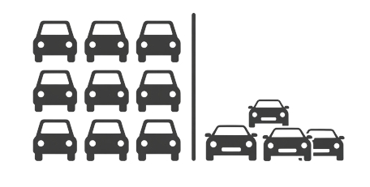
Conclusions
The Market is Bimodal: there are two distinct markets:
1- High-volume, affordable mainstream market (median around $30k) dominated by brands like Toyota and Chevrolet,
2- Low-volume, high-margin luxury performance market defined by exotic brands.
Samsung Innovation Campus

Slide 32

Conclusions
Price is Driven by Performance and Exclusivity:
The strongest predictors of a high MSRP are not basic features but metrics of performance (Engine HP, Cylinders) and market positioning (Exotic or Performance category).
Samsung Innovation Campus

Slide 33

Conclusion
The Data is Heavily Skewed:
Car prices follow a power-law distribution. Using the mean price ($41,930) is misleading; the median price ($30,680) is a more accurate representation of what a typical car costs. This skew is caused by extreme outliers in the luxury segment.
Samsung Innovation Campus

Slide 34

Conclusion
Feature Hierarchy Matters:
When predicting price, 'Exotic' status and engine specs are paramount. Other features like vehicle size and transmission type are secondary indicators.
Samsung Innovation Campus

Slide 35
Business Recommendations
Samsung Innovation Campus
Notes:
Note:
2

Slide 36

Business Recommendations
For Marketing and Sales Team:
Segment Your Audience: Develop distinct marketing campaigns for performance/luxury buyers (focused on horsepower, exclusivity, engineering) vs. mainstream buyers (focused on reliability, value, utility).
Value-Based Pricing: For luxury models, pricing can be aggressive and based on positioning against competitors like Ferrari or McLaren. For mainstream models, pricing must be competitive within a tight range.
Test and Evaluation
Samsung Innovation Campus
Notes:
Note:
9

Slide 37

Business Recommendations
For Product Strategy and Manufacturing:
Focus on HP and Performance Trims: Since engine power is a key purchase driver, investing in performance variants of existing models can create higher-margin products.
Understand the Luxury Premium: The analysis quantifies the "exotic premium." This value can justify investments in bespoke materials, limited production runs, and advanced engineering for high-end marques.
Test and Evaluation
Samsung Innovation Campus
Notes:
Note:
9

Slide 38

Business Recommendations
For Data analysis team:
Build Segmented models → Do not build a single model to predict price for a Ferrari and a Ford. Split the data by vehicle category (e.g., standard, performance, exotic) before building predictive or analytical models to ensure accuracy.
Robust metrics → Always report median alongside mean for financial metrics like price to avoid the skewing effect of ultra-luxury vehicles.
Test and Evaluation
Samsung Innovation Campus
Notes:
Note:
9

Slide 39
Limitations of the Analysis
Samsung Innovation Campus
Notes:
Note:
2

Slide 40
Limitations of the Analysis
Dated Dataset:
The most significant limitation is that the analysis is based on car model years from 1990 to 2017. The market has evolved substantially since then, with the rise of electric vehicles, new luxury brands, and shifts in consumer preference towards SUVs. The conclusions may not fully reflect the current market dynamics.
Samsung Innovation Campus

Slide 41
Limitations of the Analysis
Causality vs. Correlation:
The analysis identifies correlations (e.g., more cylinders = higher price) but cannot prove causation. The high price of exotic cars is also driven by brand prestige, craftsmanship, and marketing, which are not fully captured in the data.
Data Scope: The dataset may not include all possible price-influencing factors, such as maintenance costs, brand perception scores, or specific technology packages, which could improve the model's accuracy.
Samsung Innovation Campus

Slide 42

ⓒ2020 SAMSUNG. All rights reserved.
Samsung Electronics Corporate Citizenship Office holds the copyright of book.
This book is a literary property protected by copyright law so reprint and reproduction without permission are prohibited.
To use this book other than the curriculum of Samsung innovation Campus or to use the entire or part of this book, you must receive written consent from copyright holder.
Notes:
14

