Slide 1
Book Box
Mobile Application

Slide 2
BOOK BOX APP
Now most people prefer to reed books on their smartphones and prefer to share their reviews about what they reed ,their thoughts and their favorite quotes and see other user posts .
Book box provides a community which can help the users to explore more interesting books, useful reading habbits, and enjoy to share their thoughts.

Slide 3
Problem
Users prefer to see reviews before reed books and prefer to share their opinion and their favorite quotes ,and encourage the others to reed more useful books.

Slide 4
Solution approach
Simple and user friendly app which users can read books, post their reviews and see other’s reviews.

Slide 5
Tools
Android studio
Java programming language
SQLite database

Slide 6
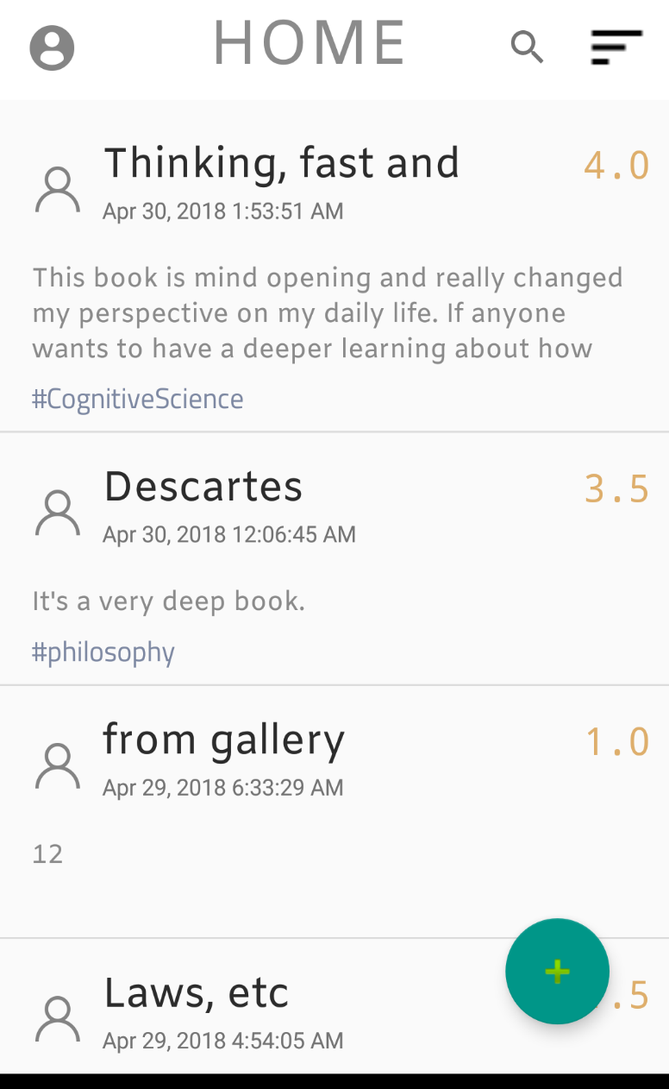
Snap shots

Slide 7
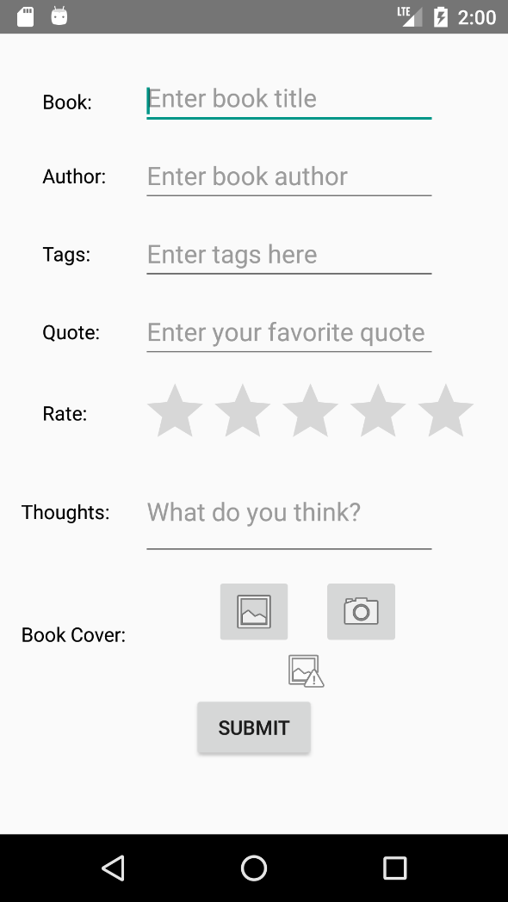
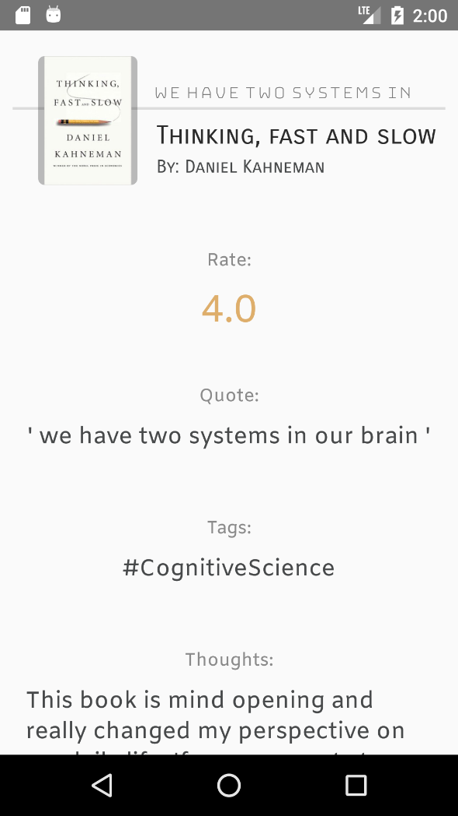
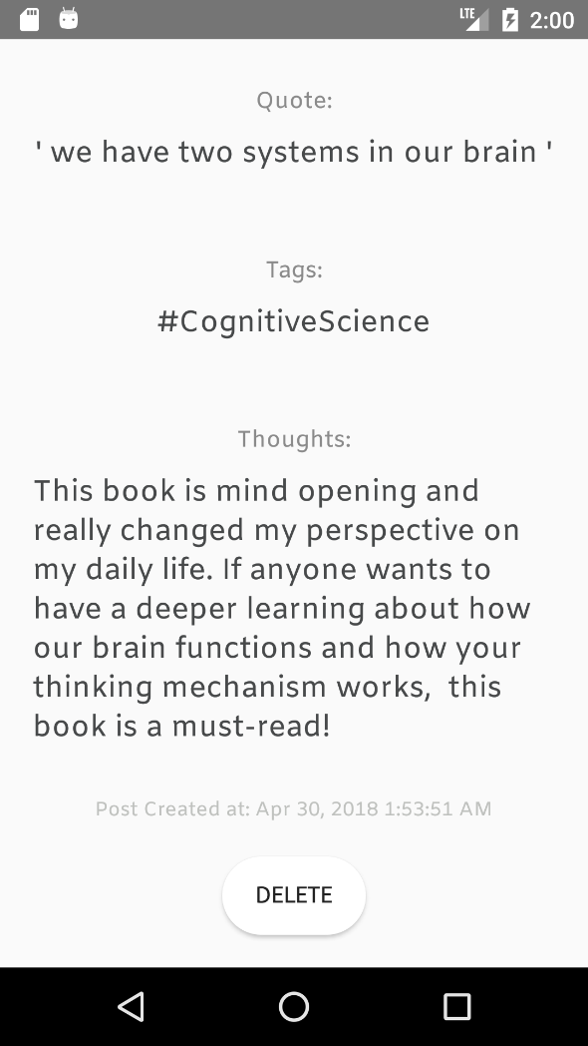

Slide 8
Provided by:
Shrouk Mohamed Abdelhakim Ali
Nada Ahmed Mohamed Farouk

