Slide 1
In-order BST Traversal
JAVA Project
Submitted to: Reema Patel
Submitted by:
Shreya Patel (18BCP136)
Vaidehi Shah (18BCP121)
Uditi Parekh (18BCP119)
Team Leader: Vaidehi Shah

Slide 2
Index
Prerequisites
About the Project
Technicalities
GUI Display with Code Snippets
Working Model of GUI
Classes and Interfaces
Insight to Methods used
Exception Handling
Exception Handling Code Snippets
Applications
References

Slide 3
Prerequisites
What is BST?
A binary tree is a tree where the parent node has at max two children.
A Binary Search Tree (or a BST) is a binary tree with a special property.
All the elements that are less in value than parent node are placed to the left of the parent node and all those with value greater than the parent node are placed to the right of it.
What is tree traversal?
The way you move across the nodes of a tree so that all the nodes are covered exactly once is known as tree traversal. These traversals are classified on the basis of the order of node visiting.
Ex. In-order, pre-order, post-order.
What is in-order traversal?
It is a type of tree traversal where the graph is traversed as follows:
The left sub-tree is recursively called.
The root node data is taken up.
The right sub-tree is recursively called.

Slide 4
About the project
This is a mini project wherein we have tried to create a GUI for In-order Binary Search Tree Traversal.
The GUI we made will display a frame with a text field, a button, a few text labels and a text area.
You will have to enter the numbers in the text field.
When you press the "ADD" button on the bottom left corner of the screen, you will see that the element is added in the BST.
The in-order tree traversal will be printed below the "ADD" button and will keep on updating as you add elements in the tree.
*This project is only for viewing in-order traversal!

Slide 5
Technicalities of the project
We have mainly used mxGraph, AWT and Swing for creating this GUI.
AWT (Abstract Window Toolkit) is an API to develop GUI or window-based applications in JAVA. It has Components and Container. The container (like a frame) contains buttons, labels, text fields, etc. for the user to interact with the GUI through simple means.
Swing is a more sophisticated version of AWT. It has advanced components such as scroll panels and trees.
mxGraph is an extension of mxEventSource so as to implement graph models.
*Click on the links to know more

Slide 6
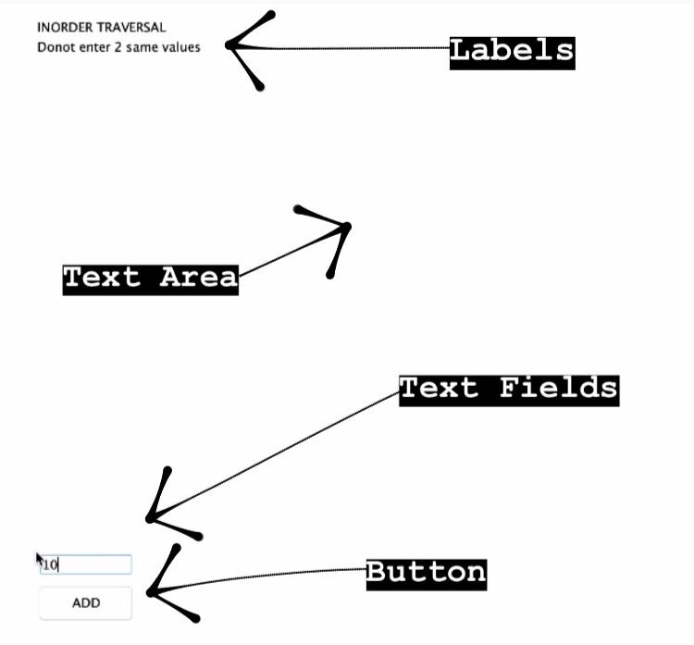
GUI Display with code snippets
JButton: We have used "JButton(String text)" which creates a button with the text.
JLabel: We have used "JLabel(String text)" which creates a JLabel instance with the specified text.
JTextField: We have used "JTextField()" which constructs a new TextField.
JTextArea: We have used "JTextArea()" which constructs a new TextArea.
*Click on the links to know more

Slide 7
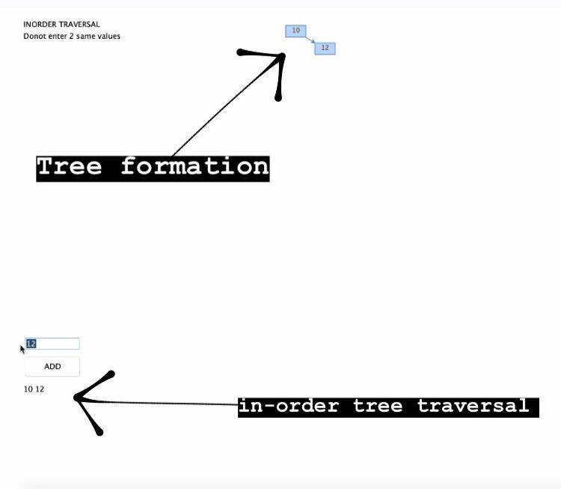
GUI Display with code snippets
//in-order printing code snippet
public void inorder()
{
inorderRec(root);
}
public void clear()
{
s="";
}
public void inorderRec(Node root)
{
if(root!=null)
{
inorderRec(root.left);
s=s+(Integer.toString(root.data)+" ");
inorderRec(root.right);
}
}
//Tree Formation code snippet
public Node insertRec(Node root, int data)
{
if(root==null)
{
root=new Node(data);
return root;
}
if(data<root.data)
{
root.left=insertRec(root.left,data);
}
else if(data>root.data)
{
root.right=insertRec(root.right,data);
}
return root;
}

Slide 8
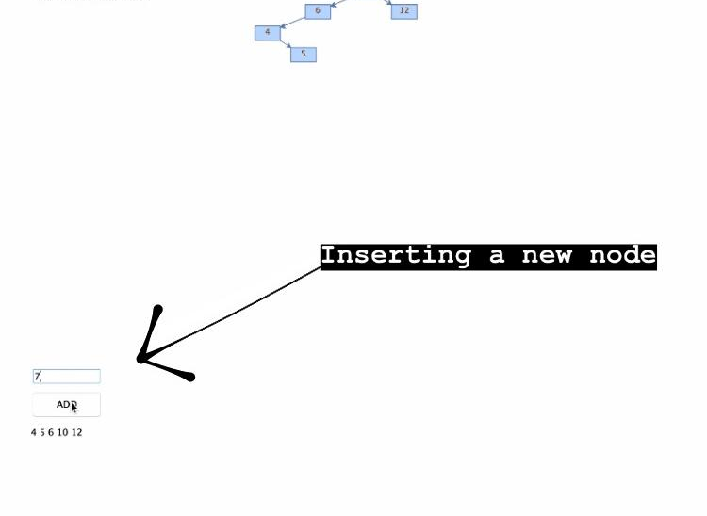
GUI Display with code snippets
//New node formation code snippet
class Node
{
int data;
Node left, right;
public Node(int item)
{
data=item;
left=right=null;
}
}

Slide 9
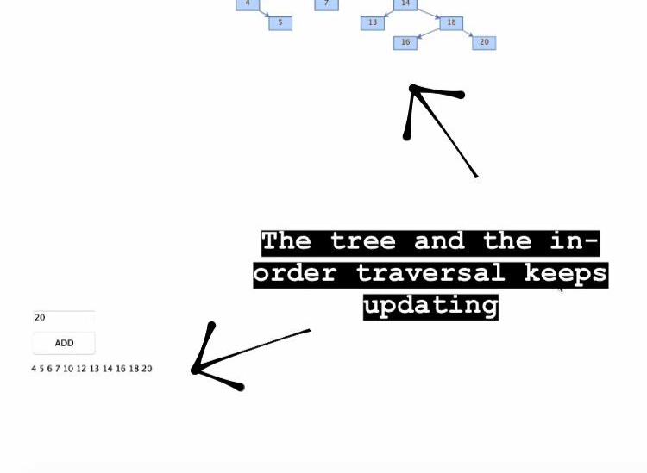
GUI display with code snippets
//Tree and in-order traversal updation code snippet
void upd_graph(Node root, Object par, int x, int y)
{
if(root.left!=null && root.right!=null)
{
Object v1=bst.insertVertex(parent,null,Integer.toString(root.left.data),x-70,y+30,35,20);
bst.insertEdge(par,null,"",par,v1);
upd_graph(root.left,v1,x-70,y+30);
Object v2=bst.insertVertex(parent,null,Integer.toString(root.right.data),x+50,y+30,35,20);
bst.insertEdge(par,null,"",par,v2);
upd_graph(root.right,v2,x+50,y+30);
}
else if(root.left!=null)
{
Object v1=bst.insertVertex(parent,null,Integer.toString(root.left.data),x-70,y+30,35,20);
bst.insertEdge(par,null,"",par, v1);
upd_graph(root.left,v1,x-70,y+30);
}
else if(root.right!=null)
{
Object v2=bst.insertVertex(parent,null,Integer.toString(root.right.data),x+50,y+30,35,20);
bst.insertEdge(par,null,"",par,v2);
upd_graph(root.right,v2,x+70,y+30);
}
}

Slide 10
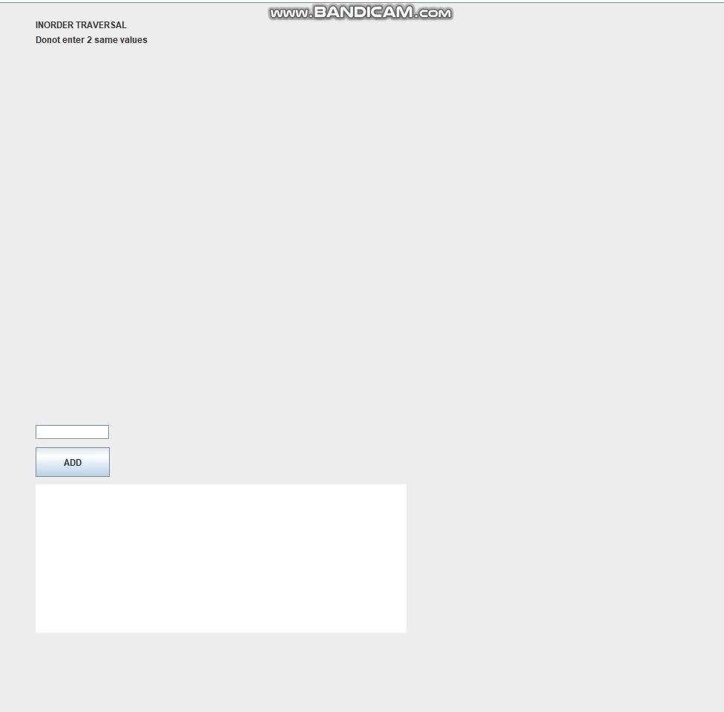
Working model of our gui

Slide 11
Classes and interfaces
Functions
BinarySearchTree()
insert()
insertRec()
inorder()
inorderRec()
clear()
Interfaces
Action Listener
JFrame
Classes
Main Class: BST_Traversal
Class Node
Class BST

Slide 12
Insight to some methods used
mxGraph.addVertex() adds a new vertex to the specified parent cell.
mxGraphModel.beginUpdate() starts a new transaction or a sub-transaction.
mxGraphModel.endUpdate() completes a transaction or a sub-transaction.
The methods that alter the graph model and should be placed, directly or indirectly, with the scope of an update
setValue(cell, value)
setVisible(cell, visible)
mxGraph.insertVertex(parent, id, value, x, y, width, height, style) creates and inserts a new vertex into the model, within a begin/end update call.
mxGraph.insertEdge(parent, id, value, source, target, style) creates and inserts a new edge into the model, within a begin/end update call.
ActionListner() is notified whenever you click on the button or menu item. It is notified against ActionEvent.
*x and y are position of the top left corner of the vertex and its width and height.

Slide 13
Exception handling
There are three exceptions that we have looked into in our project:
The input by user should be an integer.
The input should not contain any special characters or letters.
If the user inputs 2 same numbers, our code will not take any input.

Slide 14
Exception handling code snippets
try {
if(root==null)
{
root=new Node(data);
return root;
}
if(data<root.data)
{
root.left=insertRec(root.left,data);
}
else if(data>root.data)
{
root.right=insertRec(root.right,data);
}
else
throw new InputMismatchException();
}
catch (InputMismatchException e) {
System.out.println("Must not be the same");
}
try {
if(tf.getText().equals(""))
{
return;
}
String s=tf.getText();
int val=Integer.valueOf(s);
l3.setBounds(0, 0, 0, 0);
tree.insert(val);
setSize(1000,1000);
parent=bst.getDefaultParent();
bst.getModel().beginUpdate();
if(tree.root!=null)
{
Object n1=bst.insertVertex(parent,null,Integer.toString(tree.root.data),500,30,35,20);
upd_graph(tree.root,n1,500,30);
}
bst.getModel().endUpdate();
tree.clear();
tree.inorderRec(tree.root);
ta.setText(tree.s);
}
catch (NumberFormatException me) {
System.out.println("--- Error!! Input must be an integer ---");
System.out.println("Please enter the value again ---> ");
l3.setBounds(50, 525, 200, 20);
}

Slide 15
Applications
In-order traversal is very commonly used on binary search trees because it returns values from the underlying set in order, according to the comparator that set up the binary search tree.
The odes of the graph represent task and an edge from A to B indicates that A has to be performed before B. A topological sort will arrange these tasks in a sequence such that all the dependencies of the task appear earlier than the task itself.
Any build system like UNIX has to implement this algorithm.

Slide 16
References
https://jgraph.github.io/mxgraph/docs/manual.html
https://www.javatpoint.com/java-swing
https://www.geeksforgeeks.org/java-swing-jpanel-examples/
https://www.javatpoint.com/java-actionlistener

Slide 17
Thank you!

