Slide 1
Blackjack
By Ben Ruelas and Shruti Sharma

Slide 2
Basic Rules
The goal of blackjack is to beat the dealer’s hand without going over 21.
Face cards are worth 10. Aces are worth 11.
Player starts with two cards, one of the dealer's cards is hidden until the end.
To 'Hit' is to ask for another card. To 'Stand' is to hold your total and end your turn.
If you go over 21 you bust, and the system wins regardless of the dealer's hand.
If you are dealt 21 from the start (Ace & 10), you got a blackjack.
Dealer will hit until his/her cards total 17 or higher.

Slide 3

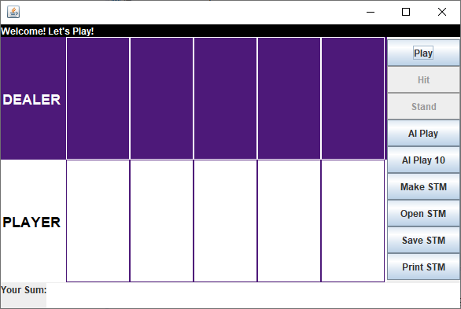
CLS Model for our Game

Slide 4
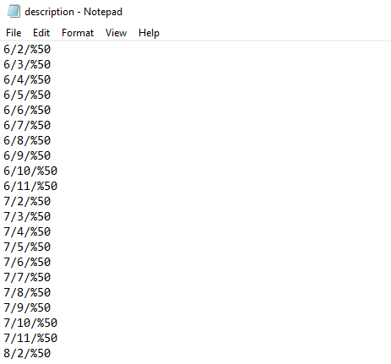
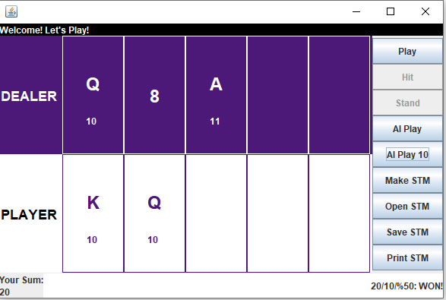

Initial Descriptive STM
Initially all the game have equal probabilities which shows an equal chance of hit or stand irrespective
of the dealer and player sum and its deviation from the number 21.

Slide 5
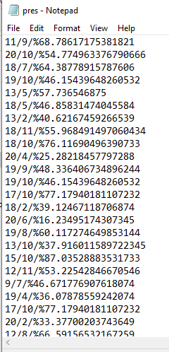
Final (or not) Prescriptive STM
We go ahead and start playing, and eventually after about 5000 games, our STM seems to learn and take a more progressive shape.
However, it’s rate of progress is slow and this Prescriptive data is not final as the more it plays, the more it learns!
The difference in can be seen from the collected STM data

Slide 6
Final Observable Results: Strategy to Play and Win (Today is you lucky day! $$)!!
First Card: Having a small high-number, i.e. from 8-11 calls for a hit irrespective of the opponent’s card. However, a big high-number from 12-16 calls for a hit only when the dealer has his show card lower than or equal to 7.
Second Card: Having a numbers smaller than 7 with an ace usually call for a hit, depending on the card shown by the dealer. If the dealer has a high card, the probabilities of calling a hit increase.
There are rare and special cases, even within the observed matrix, and so are some deviations.

