Slide 1
Blackjack
By Ben Ruelas and Shruti Sharma

Slide 2
Quick Recap: Basic Rules
The goal of blackjack is to beat the dealer’s hand without going over 21.
Face cards are worth 10. Aces are worth 11.
Player starts with two cards, one of the dealer's cards is hidden until the end.
To 'Hit' is to ask for another card. To 'Stand' is to hold your total and end your turn.
If you go over 21 you bust, and the system wins regardless of the dealer's hand.
If you are dealt 21 from the start (Ace & 10), you got a blackjack.
Dealer will hit until his/her cards total 17 or higher.

Slide 3

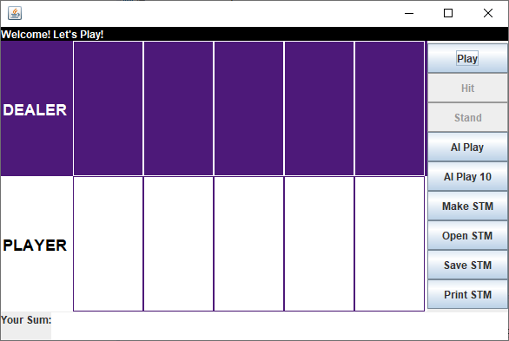
Neural Network Model for our Game

Slide 4
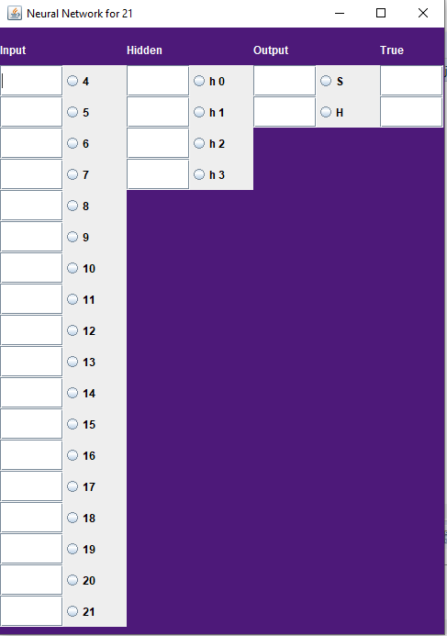
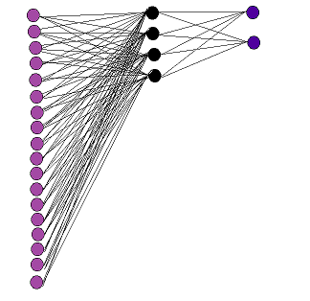
Basic NN Structure
Input Layers = 18
(All possible Initial Player Sums)
Hidden Layers = 4
(Decision Factor: No. of neurons = About double of the output layer)
Output Layers = 2
( Always only two options: either Hit or Stand)

Slide 5
NN Visual Representation

Slide 6
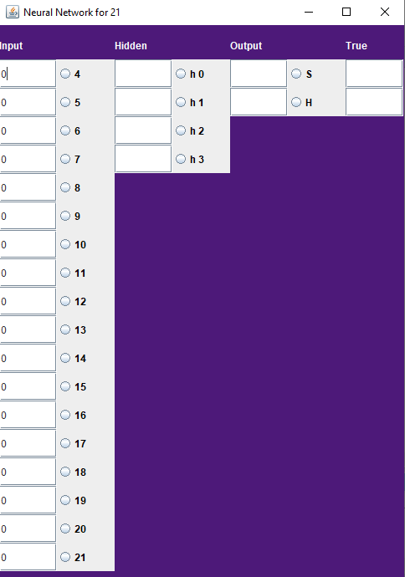
Initial NN Data
The image on the left shows the initial NN with no input yet. So, we have all input values as 0. But, as soon as we hit play…
We get a sum equal to 13 and that is fed into the input neuron value.
We randomize the hidden neuron values.
Our alpha is 0.6.
Our true value is set to S but we hit get a sum of 22 and lose. This is later backpropagated to the neural network. (See next Slide)

Slide 7

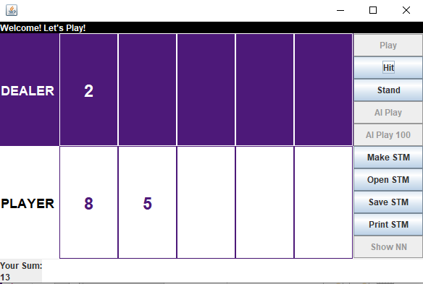

Slide 8

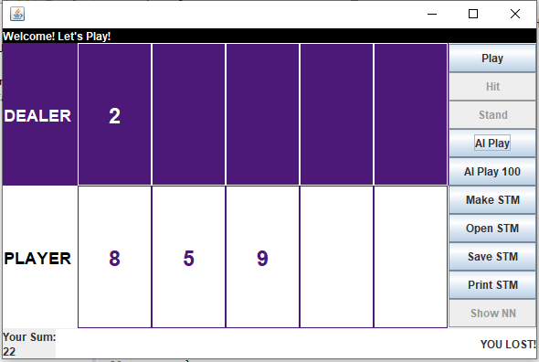

Slide 9
Learning after 10,000 Games
After 10K games there is no clear improvement in playing.

Slide 10
Final Observable Results: Strategy to Play and Win (Today is you lucky day! $$)!!
First Card: Having a small high-number, i.e. from 8-11 calls for a hit irrespective of the opponent’s card. However, a big high-number from 12-16 calls for a hit only when the dealer has his show card lower than or equal to 7.
Second Card: Having a numbers smaller than 7 with an ace usually call for a hit, depending on the card shown by the dealer. If the dealer has a high card, the probabilities of calling a hit increase.
There are rare and special cases, even within the observed matrix, and so are some deviations.

