Slide 1

“Plant Leaf ’s Image Disease Detector”
Project Presentation
MITU22BTCS0370 :- Kartik Devkar
MITU22BTCS0802 :- Shruti Thorat
MITU22BTCS0503 :-Om Talekar
MITU22BTCS0867:-Sujal Hande
Guided by
Prof.Rashmi Tundalwar
Prof. Dr. Ganesh Pathak (HOD, Computer Science & Engineering)
Prof. Dr. Sunil Dingare(HOD, Aerospace Engineering)
Department of Computer Science & Engineering, MITSoC, Loni Kalbhor

Slide 2
Outline
Introduction
Problem Statement
Objectives
Concepts & Methods
Literature Review
Scope And Feasibility
Implementation
Reference
Q&A
Department of Computer Science & Engineering, MITSoE, Loni Kalbhor

Slide 3
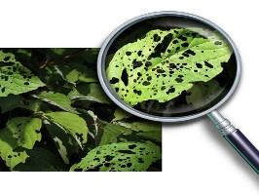
Introduction
A Plant Leaf Image Disease Detector leverages image processing and machine learning techniques to identify, classify, and analyze plant leaf based on visual data. This technology is particularly useful in fields such as agriculture, botany, forestry, and environmental science, where accurate plant identification is critical for tasks like crop monitoring, biodiversity assessment, and disease detection.
Department of Computer Science & Engineering, MITSoE, Loni Kalbhor

Slide 4
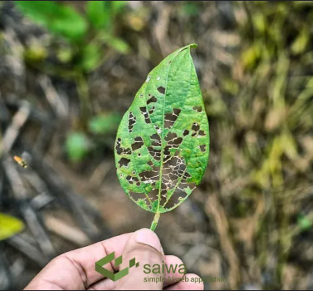
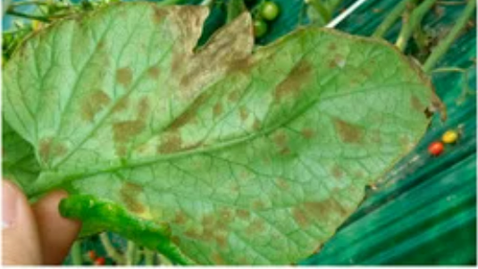
Problem Statement
The agricultural sector faces significant challenges due to plant diseases, which lead to reduced crop yields, quality, and economic loss. Traditional methods of disease detection rely on manual observation and expertise, making them labor-intensive, time-consuming, and often prone to errors. For large-scale farms, early detection of diseases is challenging, yet it is essential to prevent the spread and impact of infections.
Department of Computer Science & Engineering, MITSoE, Loni Kalbhor

Slide 5
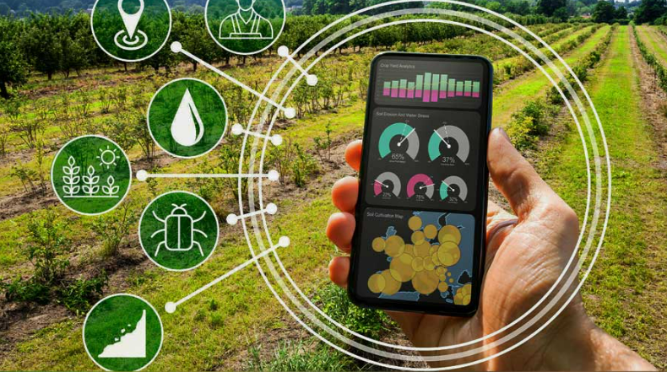
Objectives
To develop an AI-based system for plant leaf disease detection, capable of accurately identifying and diagnosing plant diseases from leaf images, thereby aiding in early disease detection, improving plant care, and promoting sustainable agriculture practices.
Make plant care easy and accessible by letting users identify diseases with just a quick photo.
Use smart AI to give fast and accurate answers, so users can worry less and enjoy plant care more.
Provide simple, helpful tips for treating plants, making it easy to take action right away.
Empower everyone—from hobby gardeners to farmers—to feel confident in caring for their plants.
Support sustainable, healthy plant growth, helping users prevent issues before they spread.
Department of Computer Science & Engineering, MITSoE, Loni Kalbhor

Slide 6
Concepts and Methods
Concept :- The Plant Leaf Disease Detector is like a plant doctor in your pocket. Simply upload a leaf photo, and the app identifies any diseases and suggests treatments, helping you keep your plants healthy with ease.
Methods:-
Capture the Leaf: Snap a clear picture of your plant’s leaf using your phone or camera.
Image Enhancement: The app automatically adjusts the image for better clarity, removing any background distractions to focus on the leaf.
AI Diagnosis: The app uses advanced AI to analyze the leaf, comparing it to a database of healthy and diseased leaves.
Instant Results: You’ll instantly see which disease, if any, is affecting your plant, along with suggestions for treatment and care.
Take Action: Based on the results, you can follow easy tips to treat your plant and prevent further damage.
Department of Computer Science & Engineering, MITSoE, Loni Kalbhor

Slide 7
Literature Survey
Deep Learning Approaches for Plant Disease Detection
Author(s): Mohanty et al. (2016)
Objective: To evaluate the effectiveness of deep learning models, specifically Convolutional Neural Networks (CNNs), in detecting plant diseases.
Methodology: Used the Plant Village dataset with over 50,000 images to train CNN models.
Findings: CNN models achieved high accuracy, demonstrating that deep learning is effective for plant disease recognition.
Limitations: Performance decreases with varied lighting and background noise; models are sensitive to the image quality.
Future Work: Focus on real-world applications and improving model robustness against noise and environmental variations.
Mobile Applications for Real-Time Plant Disease Detection
Author(s): Ramcharan et al. (2019)
Objective: To develop a mobile app that can detect cassava leaf diseases in real time using smartphone images.
Methodology: Developed a mobile-compatible CNN model with transfer learning, optimized for real-time use on mobile devices.
Findings: The mobile app was able to detect diseases with high accuracy in field conditions.
Limitations: Limited to specific plant types (cassava); device processing power affects performance.
Future Work: Expand to other crops and optimize for low-spec devices.
Department of Computer Science & Engineering, MITSoE, Loni Kalbhor

Slide 8
3.Comparative Study of Machine Learning Models for Plant Disease Detection
Author(s): Zhang et al. (2018)
Objective: To compare different machine learning models for the classification of plant diseases.
Methodology: Evaluated models such as SVM, KNN, Decision Trees, and CNNs on a common dataset.
Findings: CNNs outperformed traditional machine learning models in terms of accuracy, especially with complex image patterns.
Limitations: Traditional models require extensive feature engineering, which is time-consuming.
Future Work: Further investigate deep learning to improve detection of diseases in multi-crop systems.
4.Image Processing Techniques for Plant Leaf Disease Detection
Author(s): Ramesh & Vydeki (2020)
Objective: To review various image processing techniques used in plant disease detection.
Methodology: Analyzed techniques like color segmentation, edge detection, and texture analysis for disease spot identification.
Findings: Combining multiple techniques improves disease identification, but requires high-quality images.
Limitations: Processing techniques may fail in complex backgrounds or low-light conditions.
Future Work: Incorporate machine learning to make image processing methods more robust to environmental factors.
Department of Computer Science & Engineering, MITSoE, Loni Kalbhor

Slide 9

Scope :
Automated Detection:-Identifies common plant diseases from leaf images, aiding quick diagnosis.
Improves Crop Health:- Enables early detection, potentially increasing crop yield.
Accessible:- Usable on mobile or web, making it easy for farmers and gardeners.
Supports Smart Farming:- Contributes to real-time crop health monitoring.
Feasibility :
Technical: CNN models and transfer learning make accurate disease detection achievable.
Economic: Cost-effective, with potential for large-scale deployment at low cost.
Practical: Simple, user-friendly, with challenges like real-world conditions manageable through testing.
Department of Computer Science & Engineering, MITSoE, Loni Kalbhor

Slide 10


Implementation Tools and Languages
Implementation:
Data Collection & Preprocessing:- Collect and prepare leaf images with resizing and augmentation.
Model Training:- Use CNNs (e.g., ResNet, VGG) with transfer learning for accurate classification.
Testing & Evaluation:- Measure accuracy and fine-tune based on test results.
Deployment:- Deploy as a web or mobile app for real-time use.
User Interface:- Simple UI for uploading images and viewing disease results.
Tools & Languages:
Languages: Python (model training), JavaScript (React Native for mobile), HTML/CSS (web).
Libraries: TensorFlow/PyTorch (deep learning), OpenCV (image processing).
Platforms: Flask/Django (web backend), React Native/Flutter (mobile)
Department of Computer Science & Engineering, MITSoE, Loni Kalbhor

Slide 11
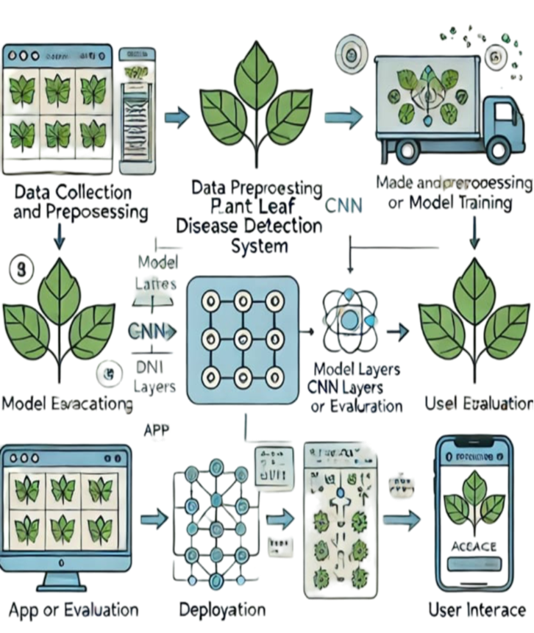
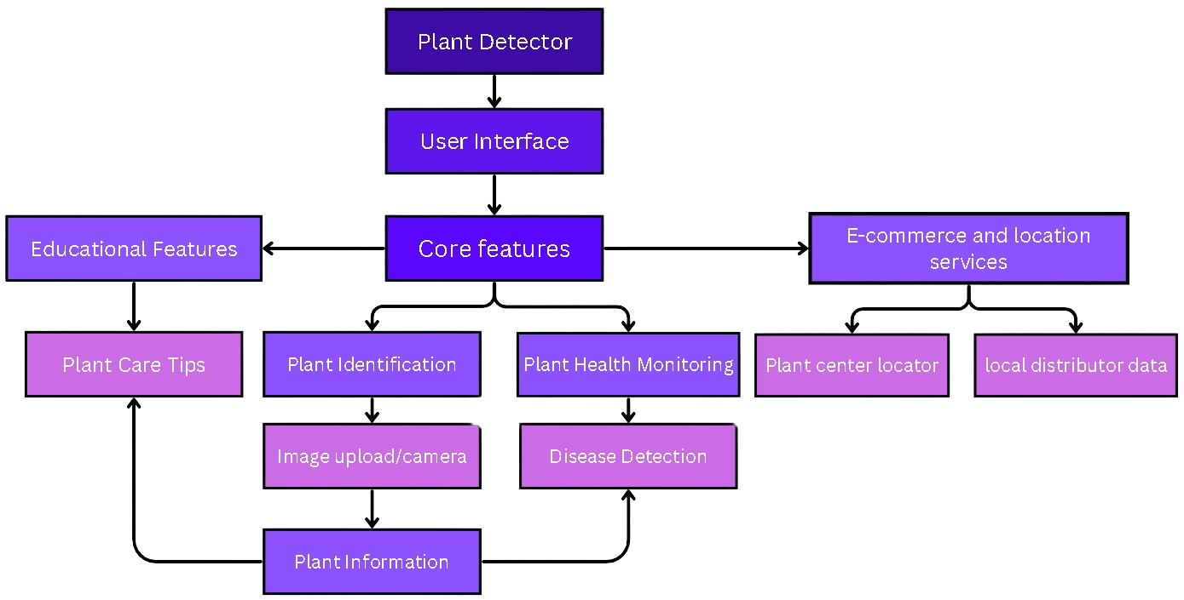
Department of Computer Science & Engineering, MITSoE, Loni Kalbhor

Slide 12
Conclusion
This plant leaf disease detection system uses AI to identify and classify diseases accurately, enabling timely interventions for sustainable agriculture. Scalable and usable on User-friendly online platform, it provides a practical tool for farmers. While effective, it faces challenges like sensitivity to lighting and image quality, with future goals to broaden disease coverage and add treatment advice for improved field applications.
Department of Computer Science & Engineering, MITSoE, Loni Kalbhor

Slide 13
References
https://www.researchgate.net/publication/348199541_A_literature_review_on_detection_of_plant_diseases
https://www.researchgate.net/publication/371755394_A_Systematic_Literature_Review_on_Plant_Disease_Detection_Motivations_Classification_Techniques_Datasets_Challenges_and_Future_Trends
https://www.ijraset.com/research-paper/plant-disease-detection-using-cnn
https://ieeexplore.ieee.org/document/10458943
https://apsjournals.apsnet.org/doi/10.1094/PDIS-03-15-0340-FE#:~:text=Common%20methods%20for%20the%20diagnosis,diagnostic%20techniques%20(Bock%20et%20al.
Ferentinos:- Deep learning models for accurate plant disease detection.
Sladojevic et al. :- CNNs for classifying plant diseases via leaf images.
Mohanty et al. :- Applying deep learning to detect plant diseases from images.
Dhaka et al. :- Survey of CNNs used in plant leaf disease prediction.
Lu et al. :- CNN-based identification of rice diseases, applicable to similar crops.
Hands-On Computer Vision with TensorFlow 2" by Benjamin Planche and Eliot Andres
Python Machine Learning" by Sebastian Raschka and Vahid Mirjalili
Artificial Intelligence in Agriculture" by Fadi Al-Turjman
Agricultural Image Analysis" by Oscar R. F. L. D. Figueiredo and A. Z. M. J. L. D. S. Chagas
Department of Computer Science & Engineering, MITSoE, Loni Kalbhor

Slide 14

Department of Computer Science & Engineering, MITSoE, Loni Kalbhor

Slide 15

Questions
Department of Computer Science & Engineering, MITSoE, Loni Kalbhor

