Slide 1
CAPSTONE PROJECT

Slide 2
BUSINESS OBJECTIVE
The main business objective is to create end to end pipeline and analyse the data.
Designing the tables to hold the data in CSV format and importing CSV’s files into SQL database.
And then importing into HDFS/Hive, Create external tables using Hive/Impala and perform several analysis using certain Data Engineering technologies.
Build ML model using pyspark and creating ML pipeline.

Slide 3
Data Used and Description
Dataset includes six CSV files. Dataset and their description has been mentioned below:
a. Titles (titles.csv):
Ttitle_id – Unique id of type of employee (designation id) – Character – Not Null
Title – Designation – Character – Not Null
b. Employees (employees.csv):
emp_no – Employee Id – Integer – Not Null
emp_titles_id – designation id – Not Null
birth_date – Date of Birth – Date Time – Not Null f
irst_name – First Name – Character – Not Null
last_name – Last Name – Character – Not Null
sex – Gender – Character – Not Null
hire_date – Employee Hire date –Date Time -Not Null
no_of_projects – Number of projects worked on – Integer – Not Null
Last_performance_rating – Last year performance rating – Character – Not Null
left – Employee left the organization – Boolean – Not Null Last_date - Last date of employment (Exit Date) – Date Time

Slide 4
c. Salaries (salaries.csv):
emp_no – Employee id – Integer – Not Null
Salary – Employee’s Salary – Integer – Not Null
d. Departments (departments.csv):
dept_no - Unique id for each department – character – Not Null
dept_name – Department Name – Character – Not Null
e. Department Managers (dept_manager.csv):
dept_no - Unique id for each department – character – Not Null
emp_no – Employee number (head of the department ) – Integer – Not Null
f. Department Employees (dept_emp.csv):
emp_no – Employee id – Integer – Not Null
dept_no - Unique id for each department – character – Not Null

Slide 5
TECHNOLOGY STACK USED
Several Data Engineering technologies has been used to analyse and creating the pipeline, which includes:
MySQL - To create the database
Linux - Several Linux commands
Sqoop – To Transfer the data from MySQL Server to HDFS/Hive
HDFS - To store the data
Hive - To create database
Impala - To perform the Exploratory Data Analysis
SparkSQL - To perform the Exploratory Data Analysis
Spark - To perform model building

Slide 6
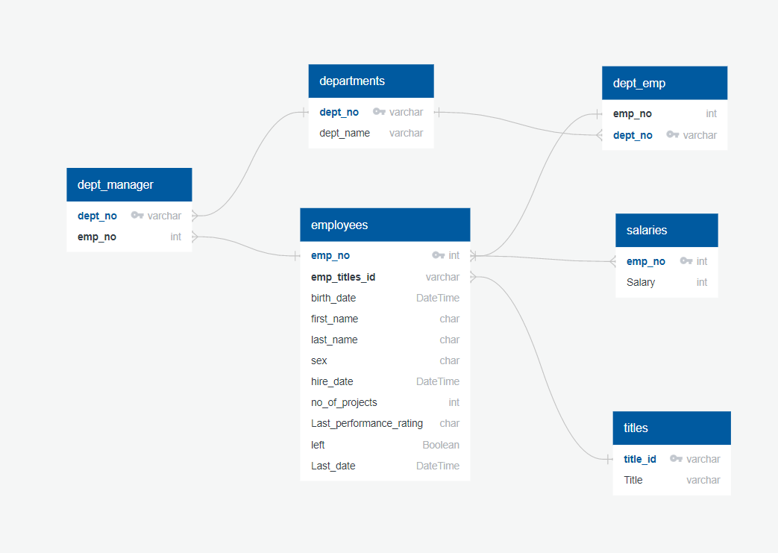
ER Diagram

Slide 7
ARCHITECTURE OF THE PIPELINE
Data Pipeline:
Step 1: Create Database and SQL tables in MySQL and insert the values to the tables.
Step 2: Using Sqoop commands transfer the data from SQL Server to HDFS in Avro file format.
Step 3: Create the file in HDFS location in order to save the data.
Step 4: Move the Avro file schemas to HDFS location which was created before.
Step 5 : Create tables in Hive/Impala
Step 6: Perform exploratory data analysis using Hive/Impala.

Slide 8
SparkML Pipeline Architecture:
Step1: Read CSV files and perform feature engineering.
Step 2: Perform Label encoding . Create indexers for the categorical features.Encode the categorical features
Step 3: Perform Vector Assembler. Create vectors for all features categorical and continuous.
Initialize the linear model
Create the pipeline with sequence of activities
pipeline = Pipeline( stages=indexers + encoders + [assembler, lrModel ])
stages = indexers + encoders + [assembler, lrModel] pipeline = Pipeline(stages=stages)
Split the dataset into training and testing for evaluation.
Build the ML model and save model for future use.

Slide 9
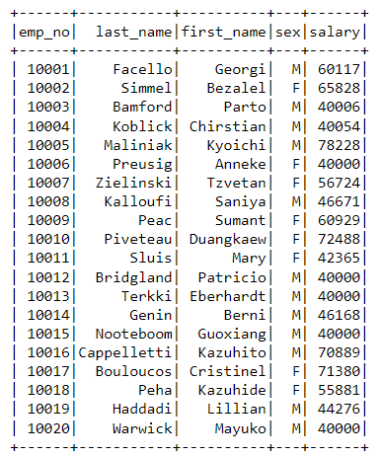
OUTPUTS FOR EDA AND ML
A list showing employee number, last name, first name, sex, and salary for each employee1.

Slide 10
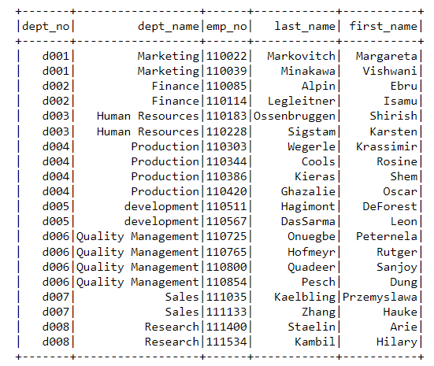
A list showing the manager of each department with the following information: department number, department name, the manager's employee number, last name, first name.

Slide 11
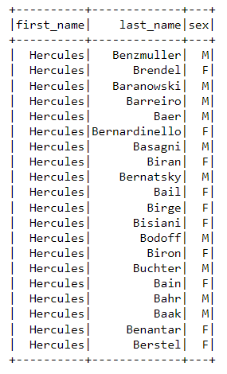
A list showing first name, last name, and sex for employees whose first name is "Hercules" and last names begin with "B".

Slide 12
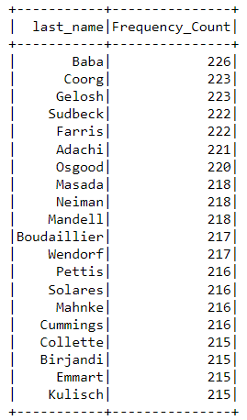
A list showing the frequency count of employee last names, in descending order.( i.e., how many employees share each last name)

Slide 13
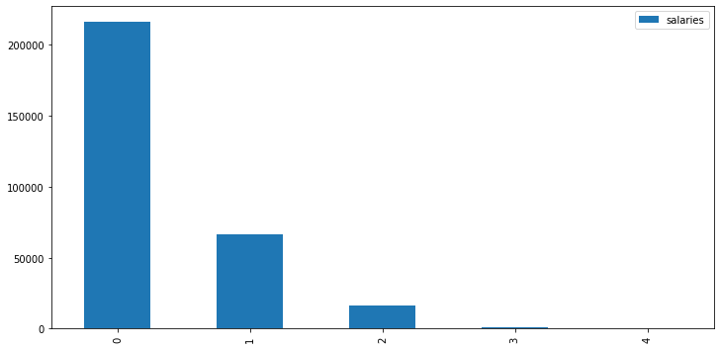
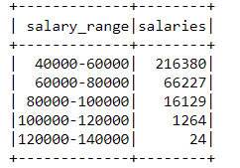
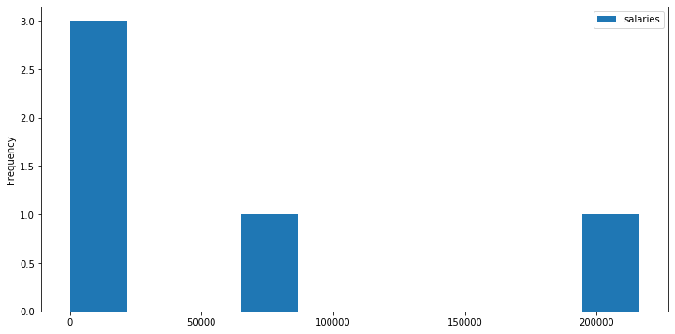
Histogram to show the salary distribution among the employees.

Slide 14
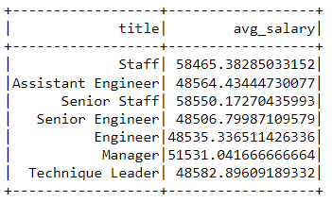
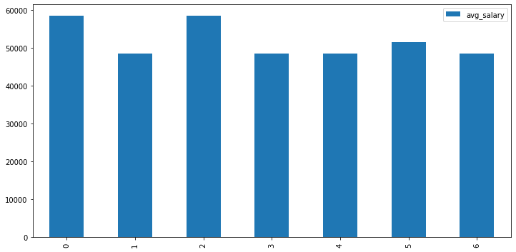
6. Bar graph to show the Average salary per title (designation)

Slide 15
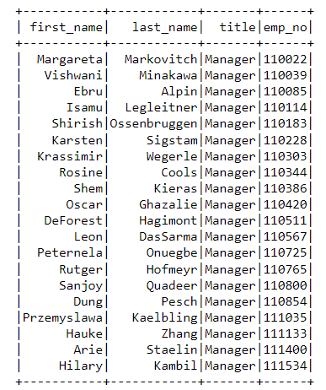
Retrieve the details of employees whose designation is Manager

Slide 16
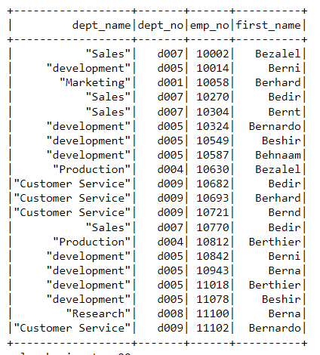
provide employee details and depart details whose employee first name starts with 'Be’

Slide 17
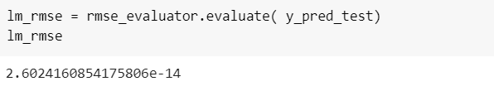
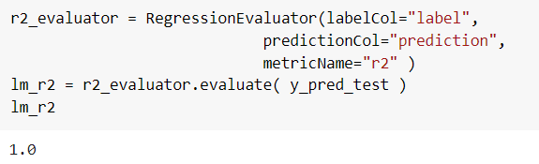
Result of prediction using Linear Regression

Slide 18
CHALLENGES FACED
Challenges faced during creating SQL tables with suitable datatypes, so that it should not create issue during Sqoop import.
Several challenges were faced during importing the data to HDFS using Sqoop commands.
Creating entire data pipeline.
While creating ML pipeline there were errors regarding encoding and model building. This was a major challenge which took more time to resolve.

