Slide 1
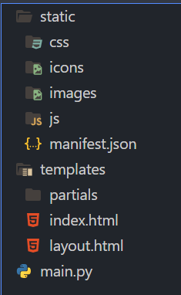
Flask Architecture
File structure
The static folder contents are served publicly
Today, PWA requirements and the Bootstrap frontend framework have already been built into the static folder to facilitate our rapid app development
The templates folder is the repository for dynamic HTML files with the Jinga2 template engine built-in
The main.py is the Flask App python implementation configuring endpoints and their HTTP request methods.
Other Python files (think machine learning, database interface, app services, etc, etc) can be added to the root of the project and called by main.py as you would any other Python abstraction.
Netflix, Uber, Airbnb, Reddit all use Flask
Notes:
Introduce the Flask architecture and folder structures for static and dynamic frontend components and the Python backend implementation.

Slide 2
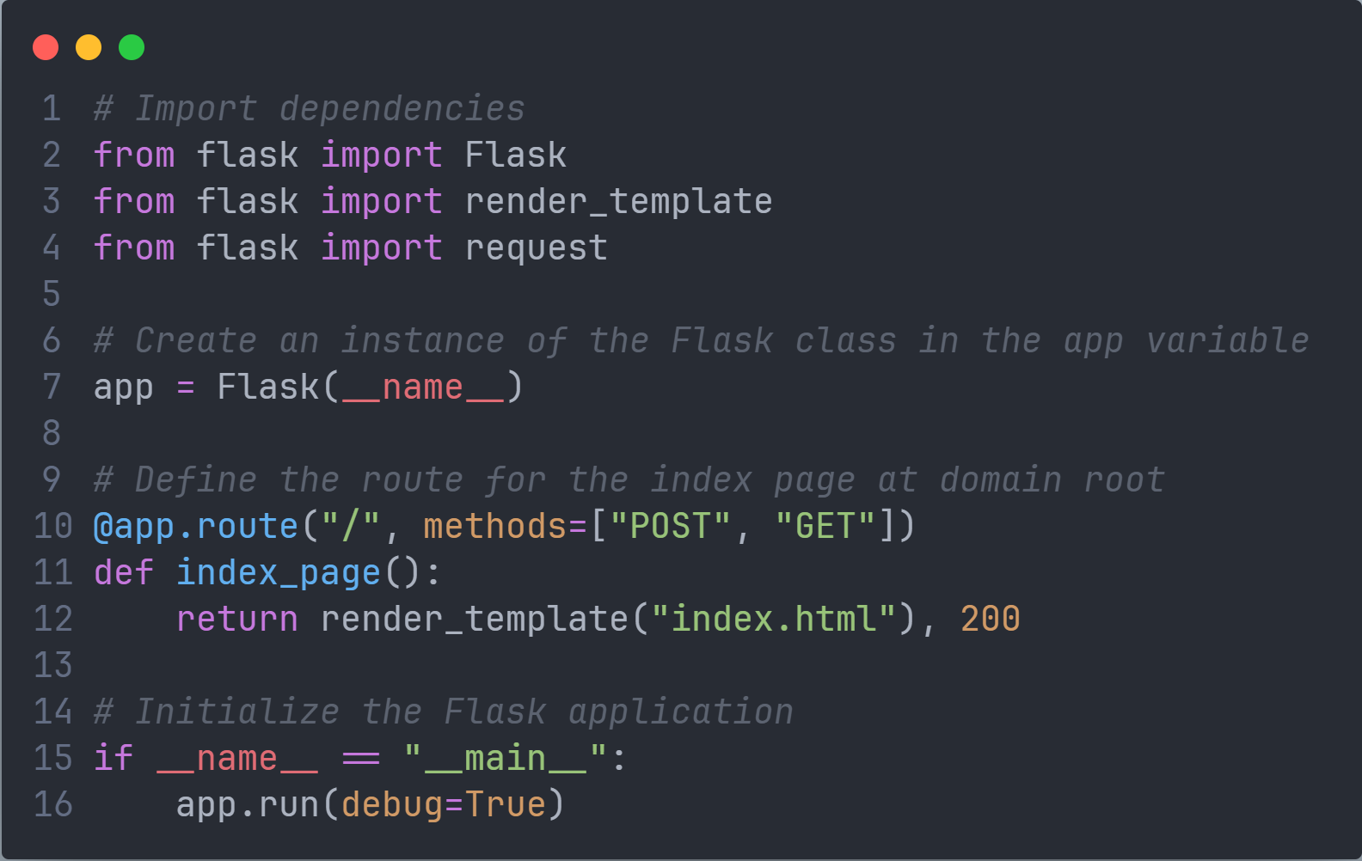
main.py
HTTP return code
Notes:
Setup main.py
Explain the dependencies, instantiation, endpoint configuration and initiation.

Slide 3
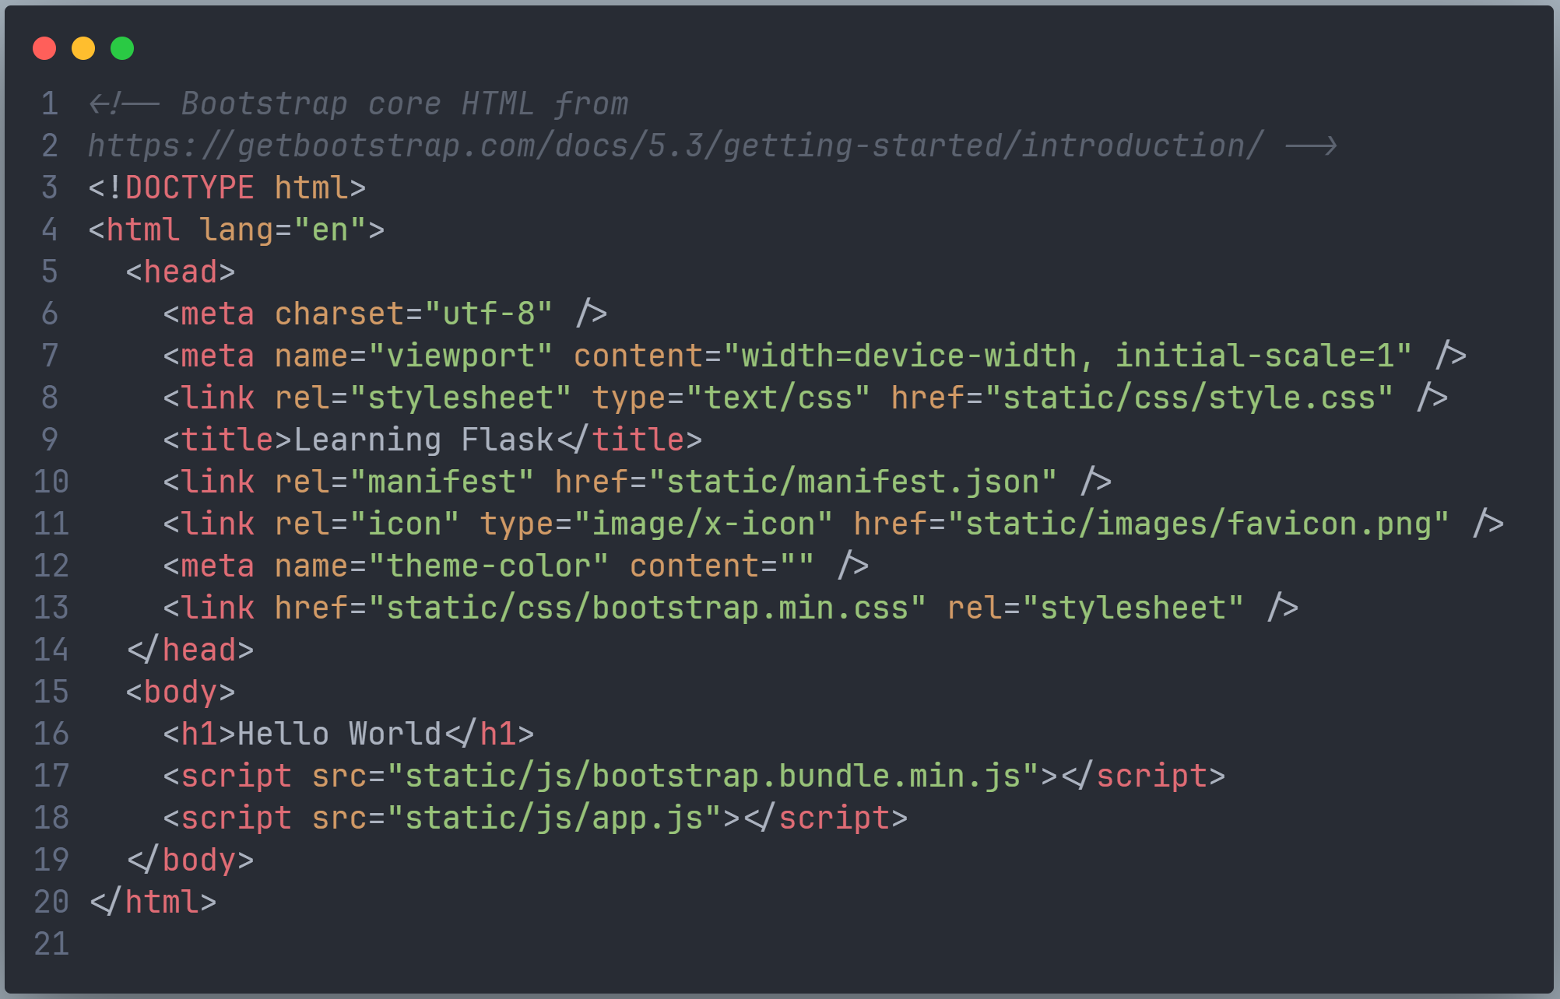
index.html
Notes:
Setup templates/index.html
Explain the render_template library defines the templates folder name

Slide 4
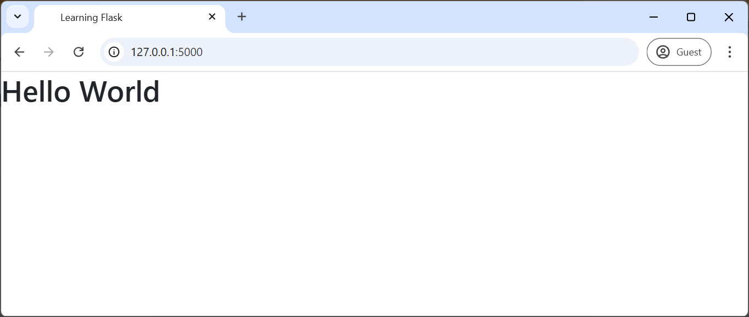
Testing
Test: basic HTML and domain root GET request
Execute the Python
$ python main.py
Navigate to
http://127.0.0.1:5000/
Inspect:
Browser developer tools console
Terminal
Notes:
Test the domain root endpoint.
Demonstrate the developer tools and terminal for debugging a Flask app.

Slide 5
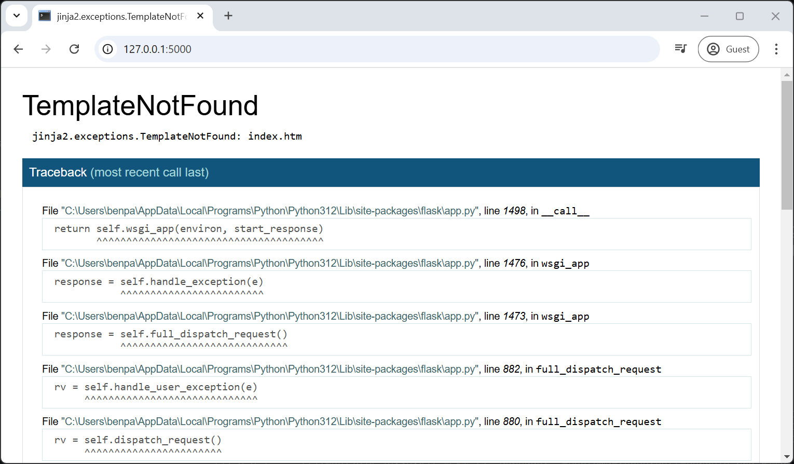
Debugging Flask
Tools
Runtime error
Program starts but crashes unexpectedly, error will appear on the webpage.
The most likely error will be at given at the start.
For example, change the index.html to index.htm in main.py and restart the program to see the error.
$ python main.py
Navigate to http://127.0.0.1:5000/
Compiler error
They will generally cause a terminal error, and Flask will need to be re-initialised from the terminal
$ python main.py
Notes:
Demonstrate the traceback tool for debugging a runtime error
Explain the different debugging tools
Explain the terminal effect of a compiler error

Slide 6
Debugging Flask
Tools
Debugging Tools
Terminal – Webserver and event log
Browser developer tools – Frontend
Traceback - Runtime
VSCode debugging tools – General debugging
Notes:
Demonstrate the traceback tool for debugging a runtime error
Explain the different debugging tools
Explain the terminal effect of a compiler error

Slide 7
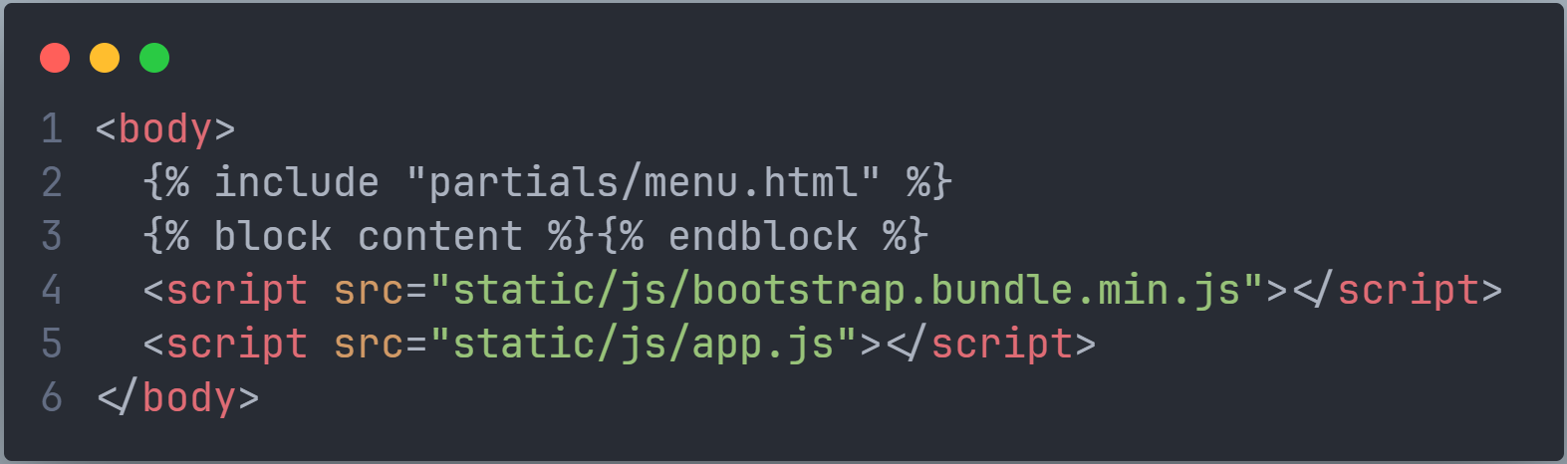
Rename the index.html to layout.html
Change the <body></body> to add the Jinga2 partials and block content
Notes:
Rename the index.html to layout.html
Change the <body></body> to add the Jings2 partials and block content and explain how Junga2 partials and block content work.

Slide 8
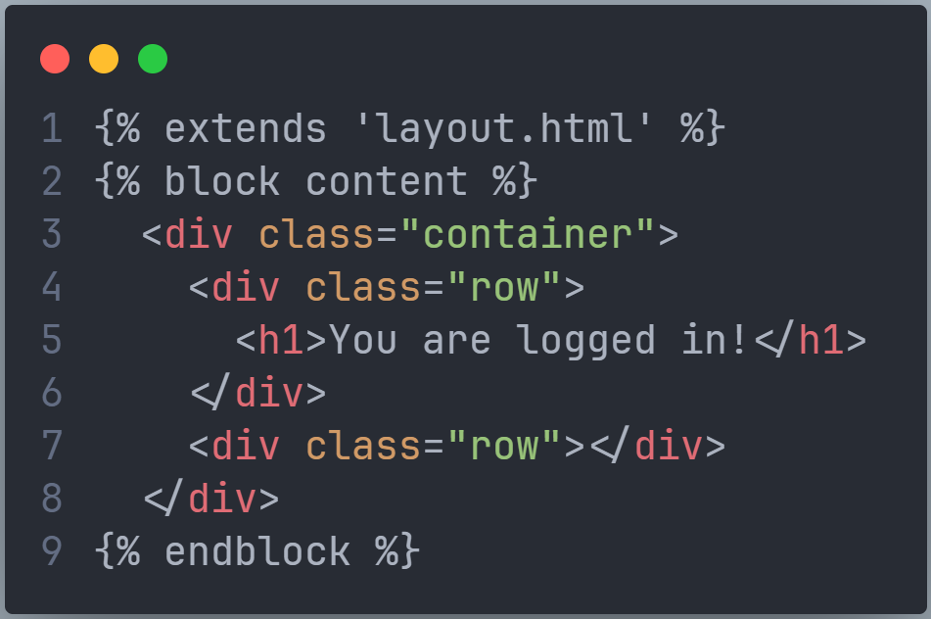
Create a new index.html
Add the following to that file
Notes:
Create a new index.html
Explain the extend and block content Jinga2
Create a partials/menu.html
Copy the basic navbar from https://getbootstrap.com/docs/5.3/components/navbar/

Slide 9
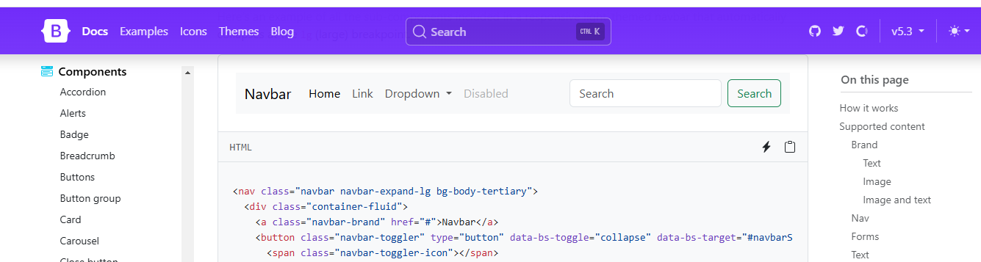
Create a partials/menu.html
Copy and paste into menu.html the basic navbar from https://getbootstrap.com/docs/5.3/components/navbar/
Copy
Notes:
Create a partials/menu.html
Copy the basic navbar from https://getbootstrap.com/docs/5.3/components/navbar/

Slide 10
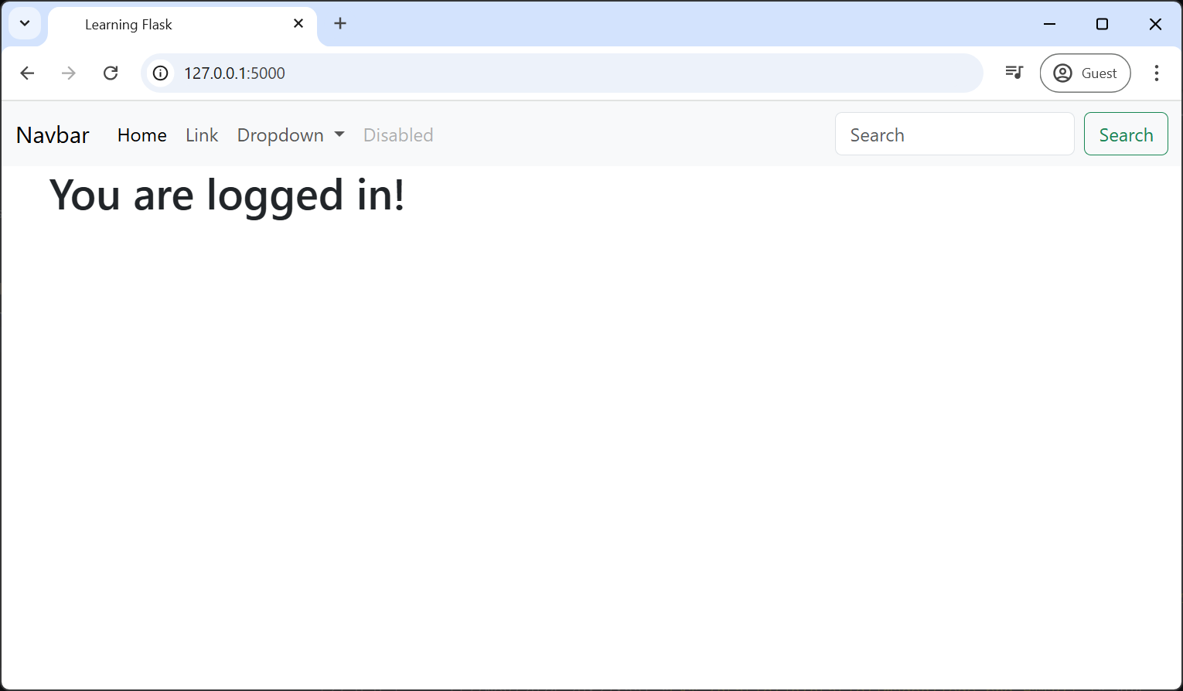
Testing
Test layout template with menu partial and index block
Execute the Python
$ python main.py
Navigate to
http://127.0.0.1:5000/
Inspect:
Developer tools source
Notes:
Test the layout template, index block and menu partial.
Inspect the developer tools source to show how the Jinga2 constructs the page.

Slide 11
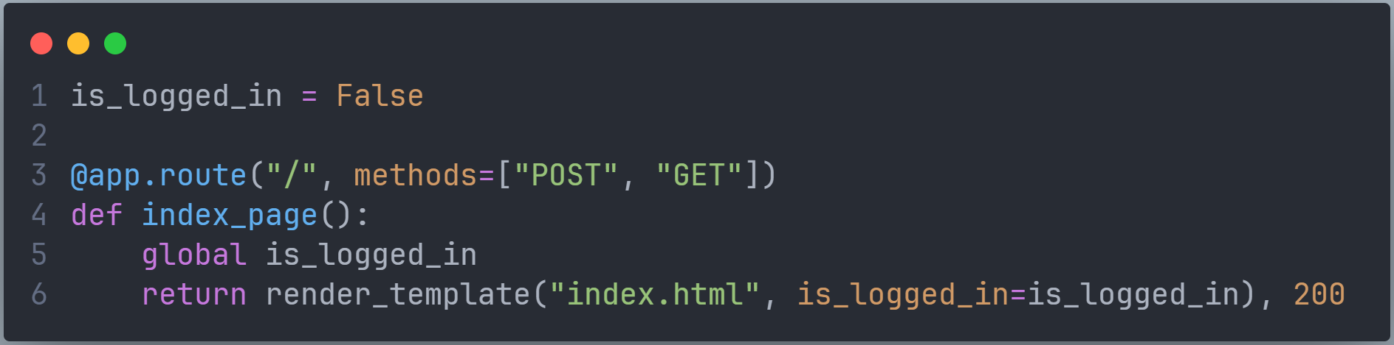
Add a Boolean to manage logged in/out state
Pass the Boolean to the index.html template.
Notes:
Declare POST and GET request methods to the endpoint
Add a Boolean to manage logged in/out state
Pass the Boolean to the index.html template.
Explain that any data can be passed to render template including JSON, dictionaries, tuples, variables, files, API responses, etc

Slide 12
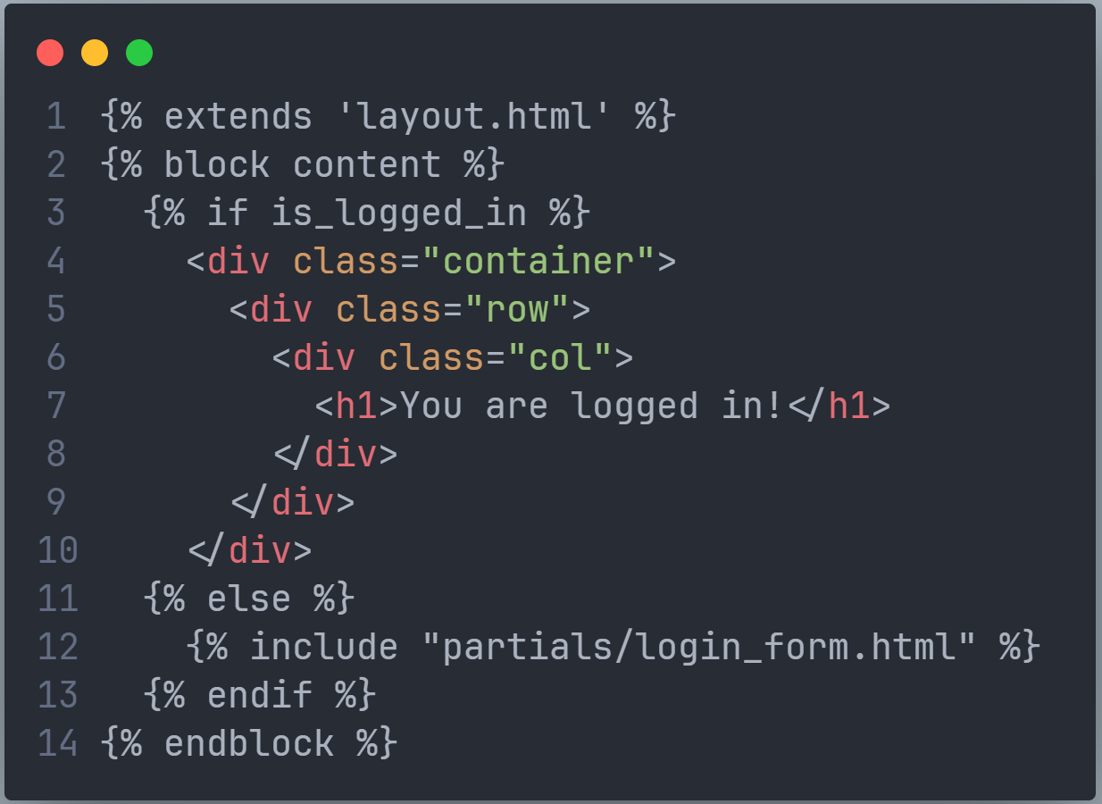
Add some Jinga2 logic to the index.html
Notes:
Add some Jinga2 logic to the index.html
Explain that Jinga2 has the common selection and iteration logic built-in
Add the login form partial
Explain the use of partials to abstract front-end elements for easy maintenance and reuse

Slide 13
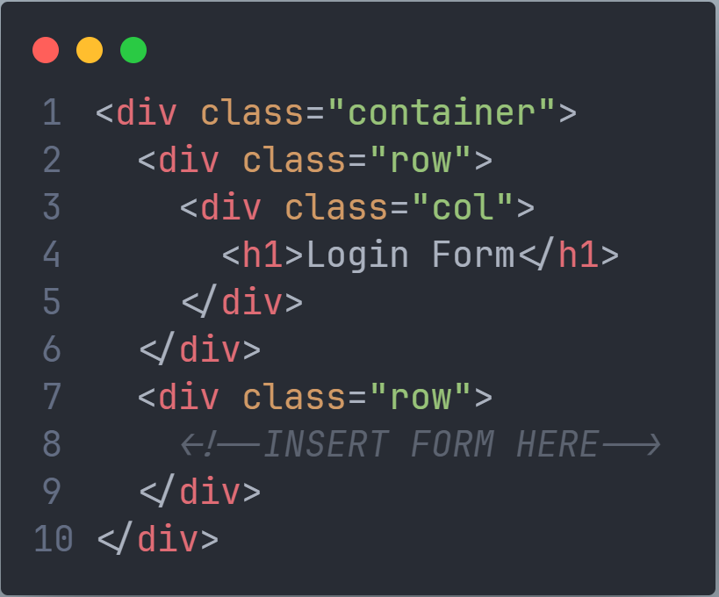
Create a new file partials/login_form.html
Add the following code to the file
Notes:
Build the login form using Bootstrap forms: https://getbootstrap.com/docs/5.3/forms/overview/
Explain the “name” is the attribute used by Python Flask

Slide 14
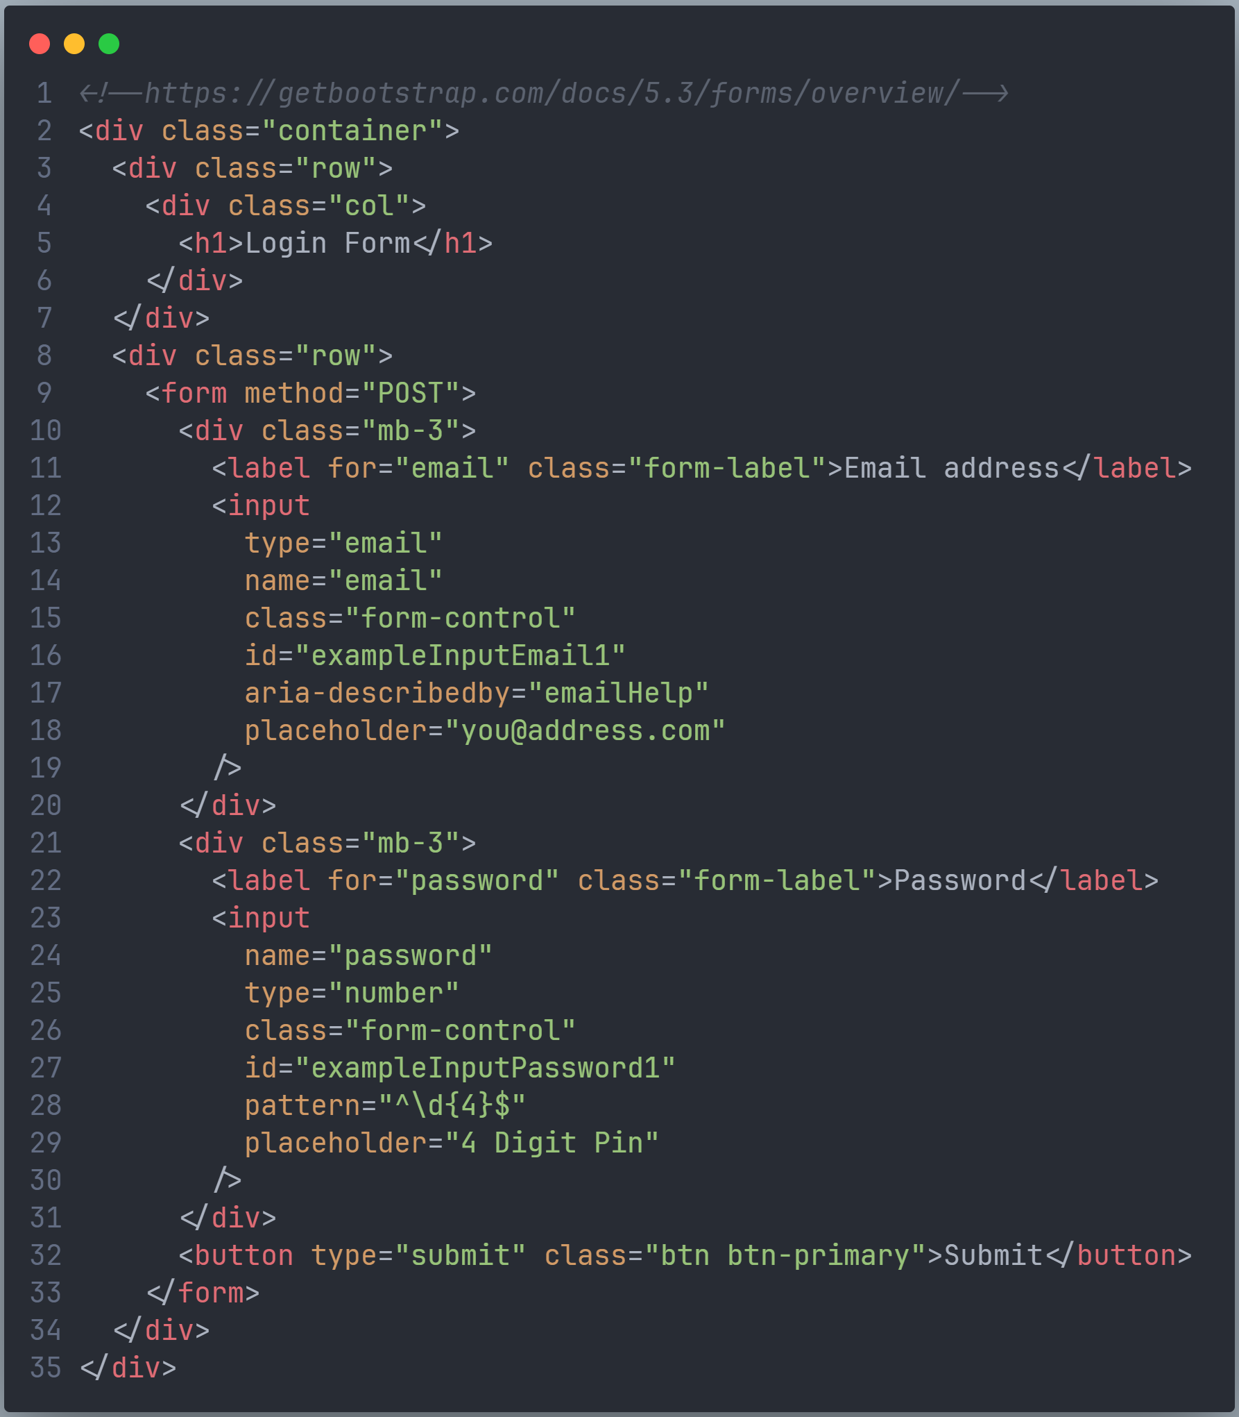
Navigate to https://getbootstrap.com/docs/5.3/forms/overview/
Add to login_form.html the first login script
Notes:
Build the login form using Bootstrap forms: https://getbootstrap.com/docs/5.3/forms/overview/
Explain the “name” is the attribute used by Python Flask

Slide 15
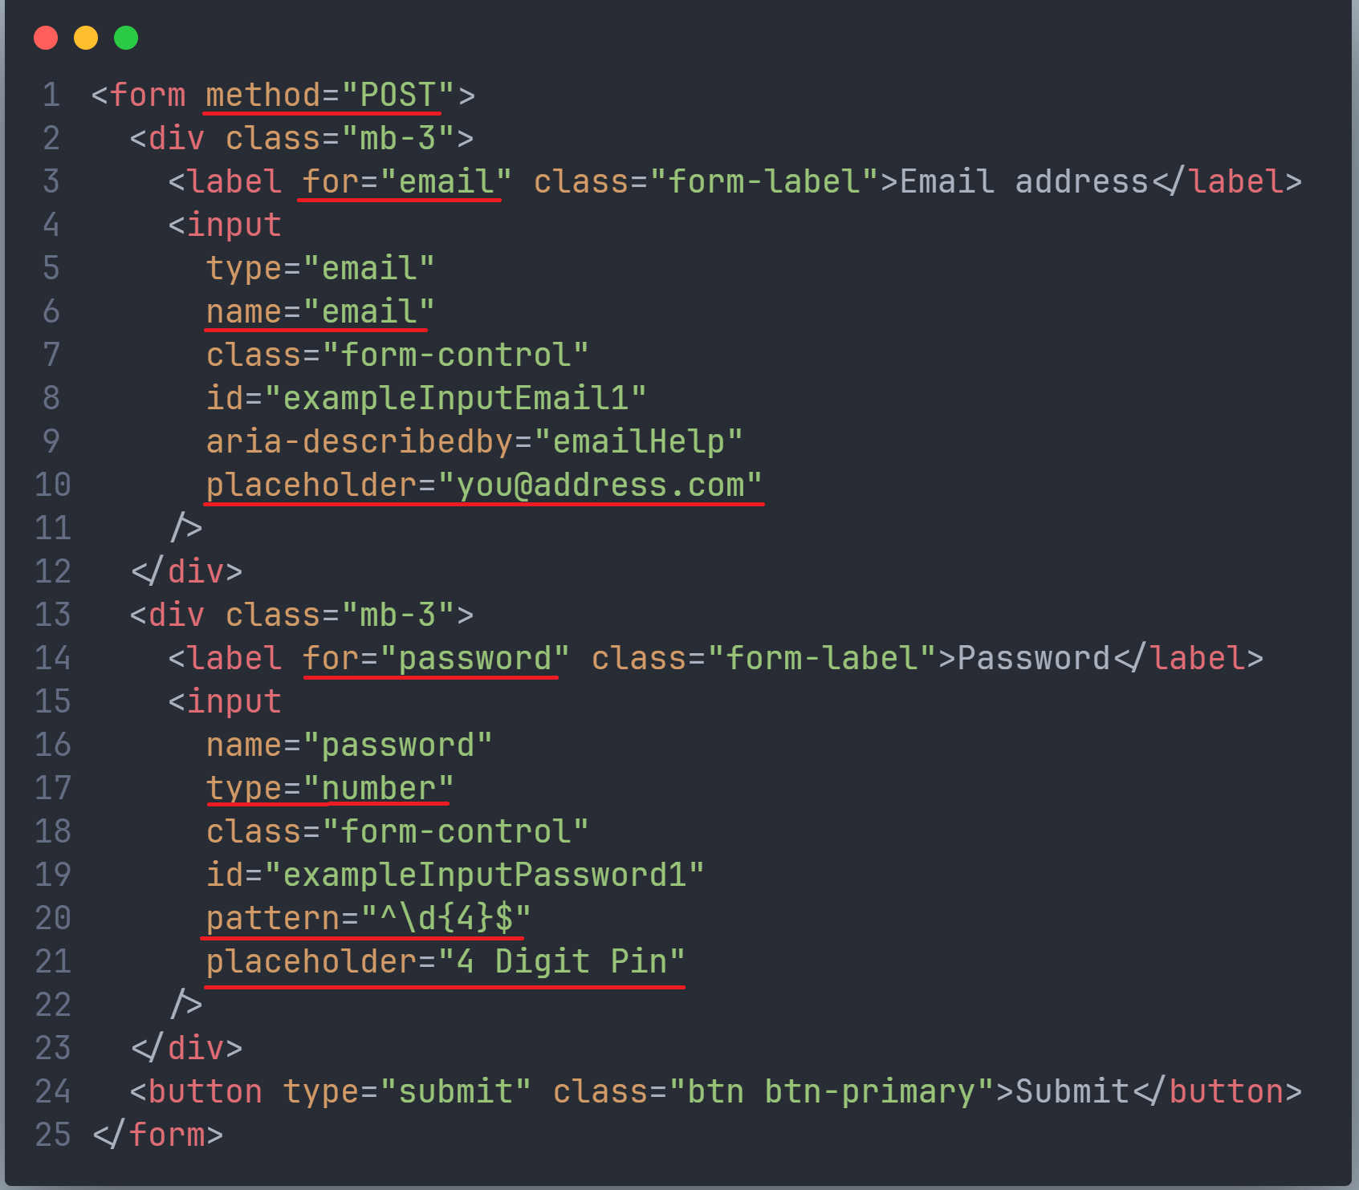
Modify the form so that it matches that given.
Each underlined section will need to be added.
Notes:
Build the login form using Bootstrap forms: https://getbootstrap.com/docs/5.3/forms/overview/
Explain the “name” is the attribute used by Python Flask

Slide 16
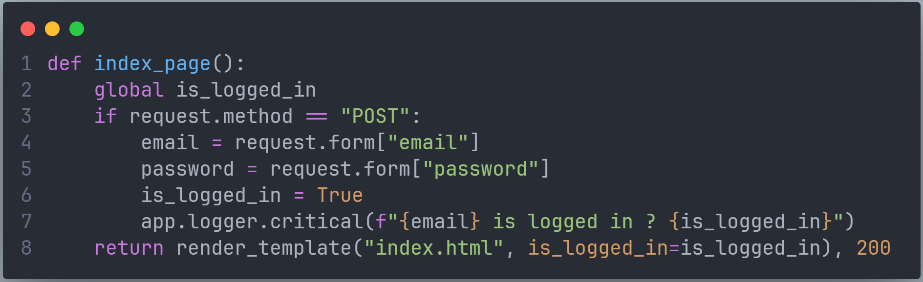
Extend the index_page() method to store the form data as variables. Log them to the terminal for debugging purposes.
main.py
Notes:
Extend the index_page() method to store the form data as variables and log then to the terminal for debugging purposes.

Slide 17
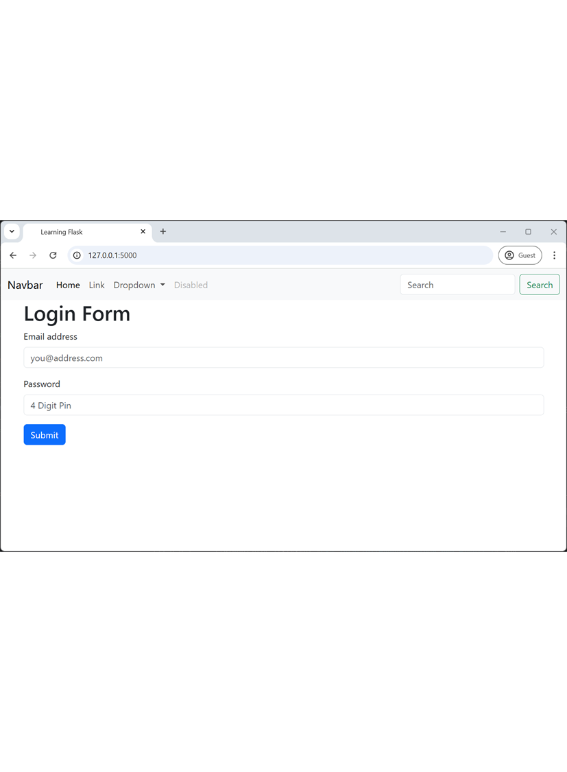
Testing
Test login user experience
Execute the Python
$ python main.py
Navigate to
http://127.0.0.1:5000/
Force value
is_logged_in = True
Navigate to
Navigate to http://127.0.0.1:5000/
Notes:
Test the login user experience by manually changing the value of is_logged_in

Slide 18
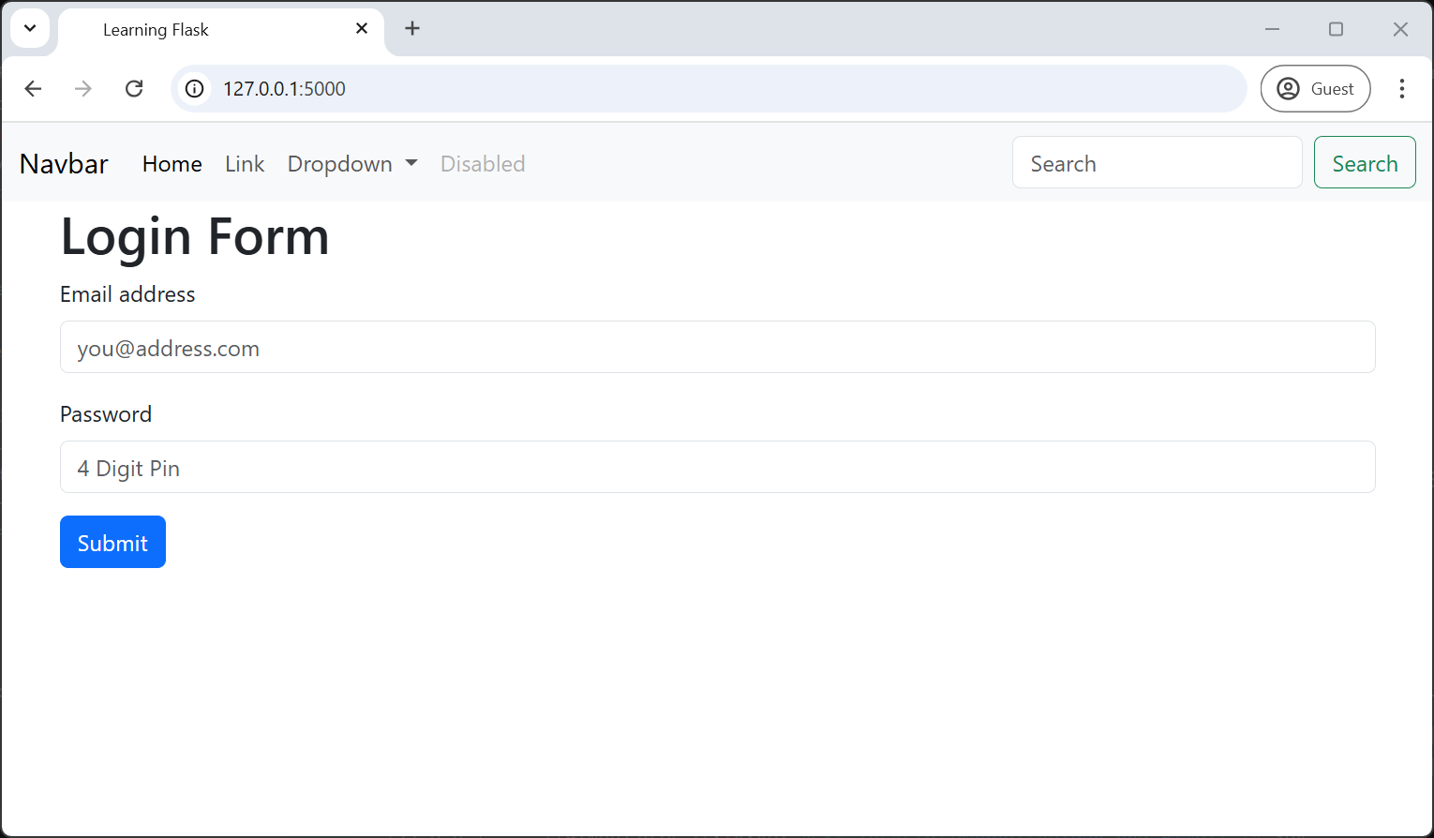
Testing
Test login
Execute the Python
$ python main.py
Navigate to
http://127.0.0.1:5000/
Test script
Enter invalid data and submit to test front-end validation
Enter a valid email and 4-digit password and submit to test authentication
Inspect:
Terminal
Notes:
Test the POST request and confirm the values in the terminal log

Slide 19
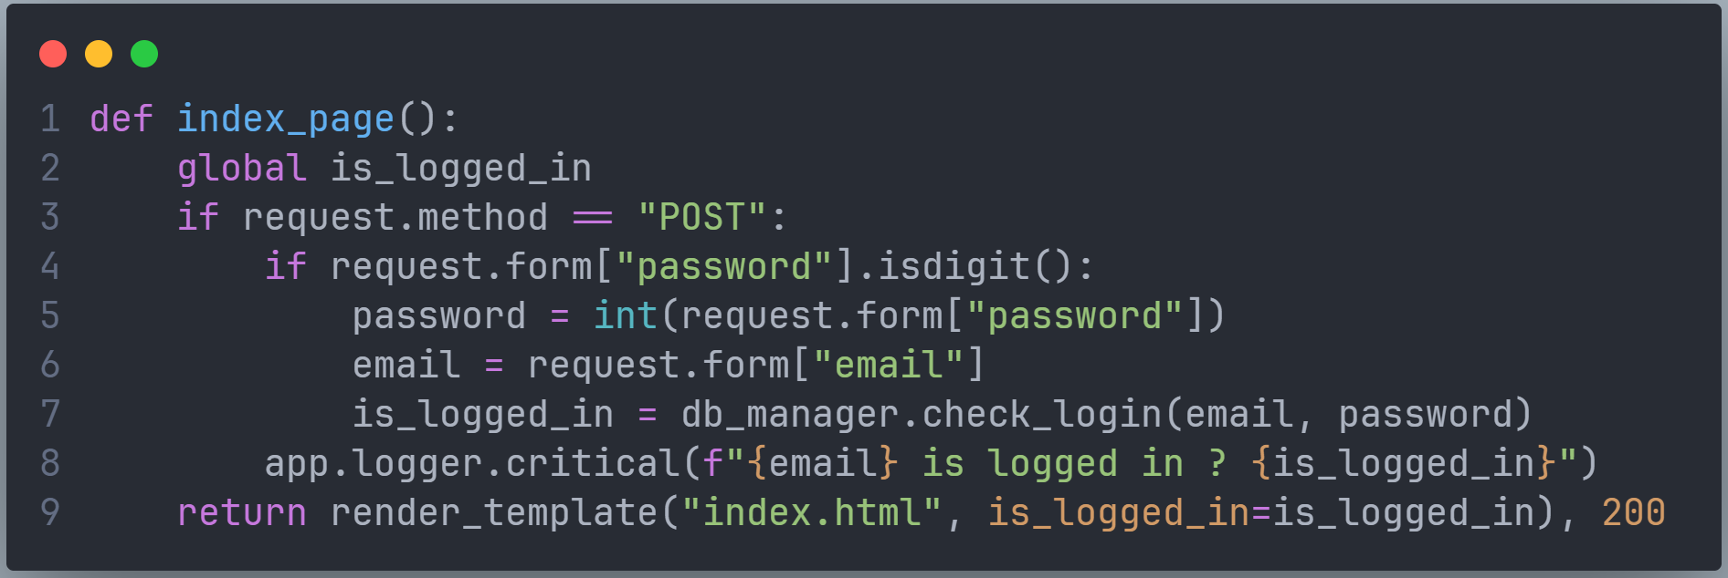
Add import db_interface as db_manager
to the start of main.py.
Extend the index_page() method to pass the email and username to the db_manager for authenticating.
A valid email/password is me@here.com/1234
main.py
Notes:
Extend the index_pag() method to pass the email and username to the db_manger for authenticating

Slide 20
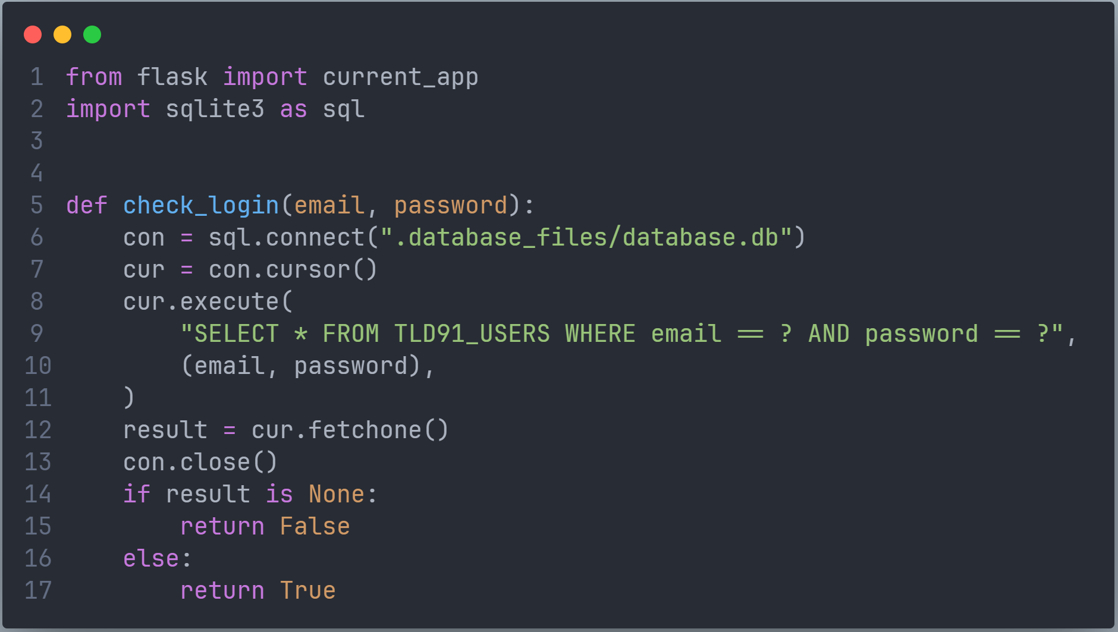
Notes:
Implement a binary comparison of the form values to the user database.
Explain that for further implementation more exception handling and salting and hashing of passwords is required.
Explain the importing of “import current_app” allows debugging values to the terminal.

Slide 21
Testing
Test login
$ python main.py
Navigate to http://127.0.0.1:5000/
Enter a valid email and 4-digit password that is not in the database and submit the form
Enter a valid email and 4-digit password that is in the database and submit the form
Inspect:
Terminal
Notes:
Test the final app.

