Slide 1
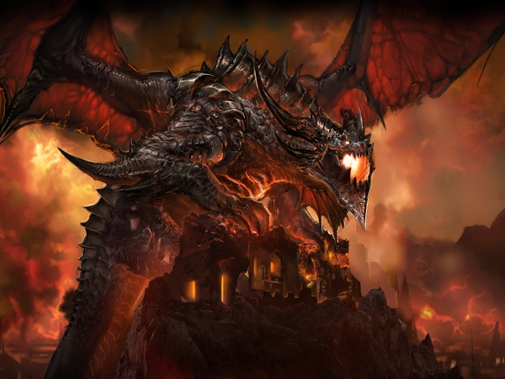
Eragon The untold Story

Slide 2
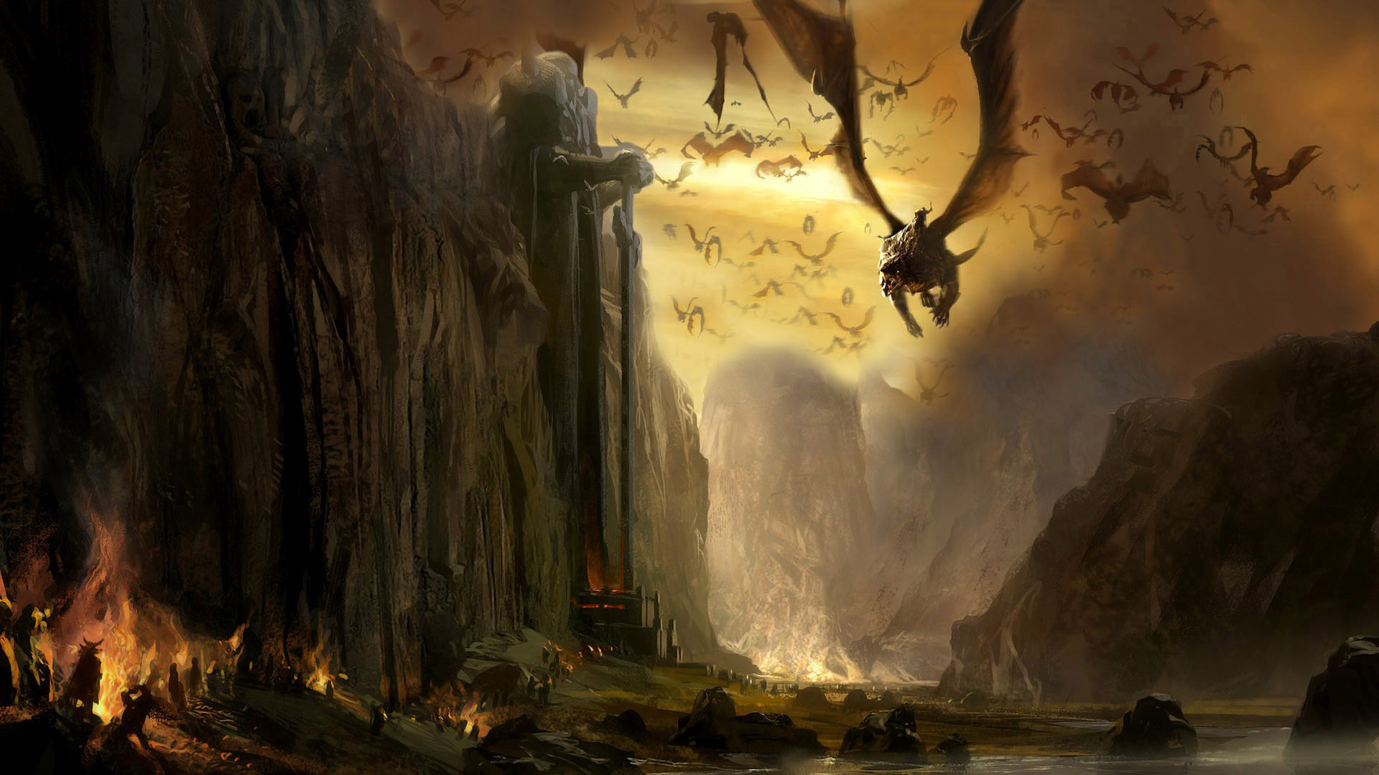
Alegezia
Land of the Dragon riders
Main idea :
Village is tormented by:
Shruikan /the bad dragon/ and
Galbatorix the evil king /Shruikan’s rider/;
Young Eragon goes on a quest to find the heart of Saphire /the good dragon/;
He must kill all of the creeps in order to get find and slayer the king;
The king holds the Saphire’s heart;
With the heart Eragon will wake up Saphire;
With his help Eragon will kill Shruikan and save the village;

Slide 3
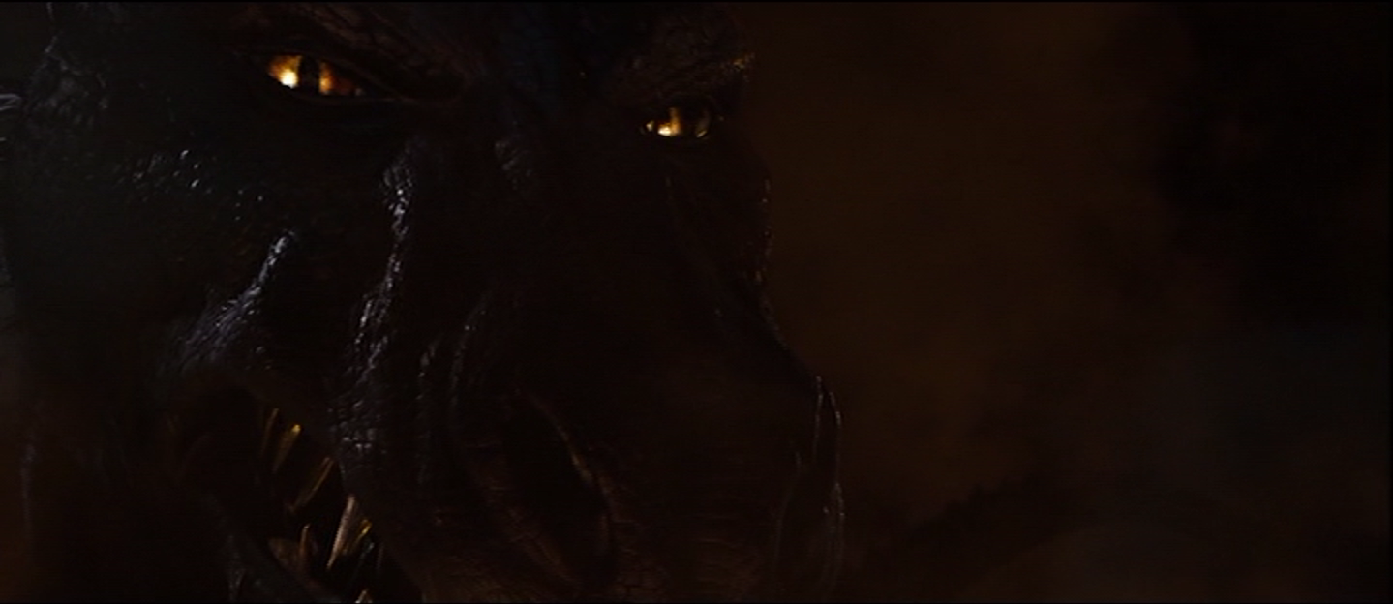
Shruikan
Shruikan is a black dragon of titanic size
Shruikan went insane, and was consumed by hatred due to having been controlled and corrupted by Galbatorix his entire life.
His only desire was to burn and destroy every last being and plant until nothing remained.
http://inheritance.wikia.com/wiki/Shruikan

Slide 4
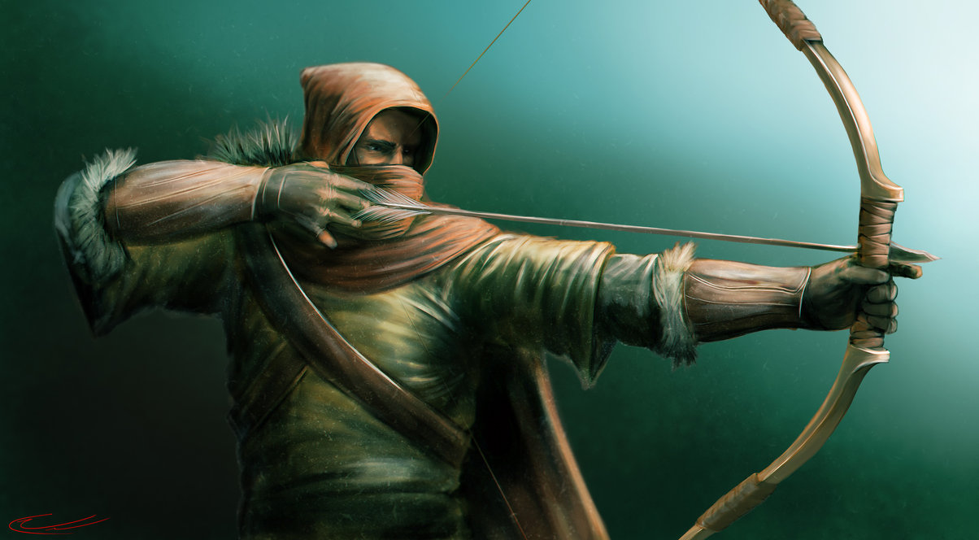
Eragon
"My heart died a while back."
---Eragon
Range attack
Dragon rider
Can cast magic : Brisingr
http://inheritance.wikia.com/wiki/Eragon

Slide 5
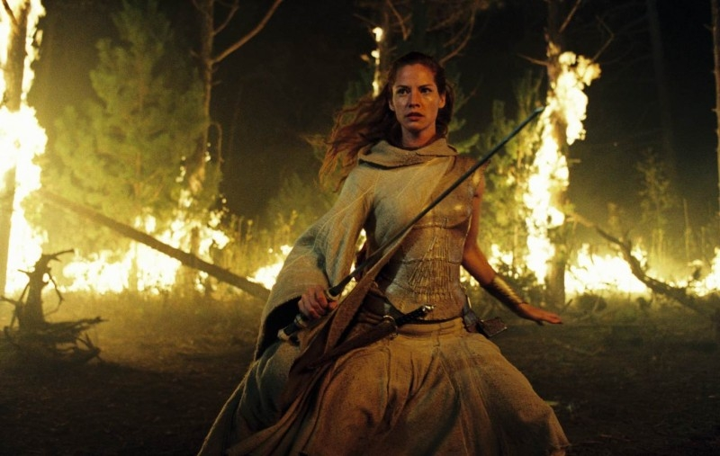
Arya
Magical attack
Elf
Dragon rider
http://inheritance.wikia.com/wiki/Arya

Slide 6
Creature
Attack
Defense
Health
Position
Player
Money
Enemy
Patrol
Trader
Experience
Holds weapons
Trade with money
Range
Mage
Creeps
Boss
…
…
Bonus
DMG
Health
Defence
…
…
…
…
…

Slide 7
Inventory
Attack
Defense
Other (optional)
Saphire’s heart
Range
Magical
Armor
Money
Potions (health & mana)
Bow
…
Defense only
Cross - Bow
…
Orb effect / Passive attack
Item found on the field
…

Slide 8
Land
...
…
…
…
…
…
…
…
…
…
…
…
…
…
…
…
…
…
…
…
…
…
…
…
…
…
…

Slide 9
Harry Birimirski
Creatures
Inventory
Land
Petko
Ventsislav
Yavor
Georgi
Yavor
Tatyana
…
…
…
…
…
…
…
…
…
…
…
…
…
…
…
…
…
…

