Slide 1

Capstone Project
Online Retail Customer Segmentation TEAM DETAILS: SHRUNGA M SNEHA H V

Slide 2
Steps Performed
Defining the problem statement
Data Exploration and Preparation of dataset
Exploratory Data Analysis
Applying the Model
Model Selection and Conclusion

Slide 3
Problem Statement
We have to identify major customer segments on a transnational data set which contains all the transactions occurring between 01/12/2010 and 09/12/2011 for a UK-based and registered non-store online retail. The company mainly sells unique all-occasion gifts. Many customers of the company are wholesalers.

Slide 4
Data Exploration
Our dataset has 541909 rows and 8 columns to begin with. In the preprocessing we have added 4 more columns.
The columns of the dataset are as follows:
InvoiceNo: Invoice number is a 6-digit integral number uniquely assigned to each transaction. If this code starts with letter 'c', it indicates a cancellation.
StockCode: It is a 5-digit integral number uniquely assigned to each distinct product. It can also be called as product code.
Description: This describes the product name.
Quantity: The quantities of each product (item) per transaction.
InvoiceDate: This specifies the day and time when each transaction was generated.
UnitPrice: Price of product per unit.
CustomerID: It is a 5-digit integral number uniquely assigned to each customer.
Country: Specifies the name of the country where the customer resides.

Slide 5
Data Exploration (Contd.)
The calculated columns created during preprocessing are as follows:
TotalAmount - Created by combining unit price and quantity. This gives information of total amount spent during that particular transaction.
month – month value extracted from InvoiceDate column
day – day name value extracted from InvoiceDate column.
hour – hour value extracted from InvoiceDate column.

Slide 6
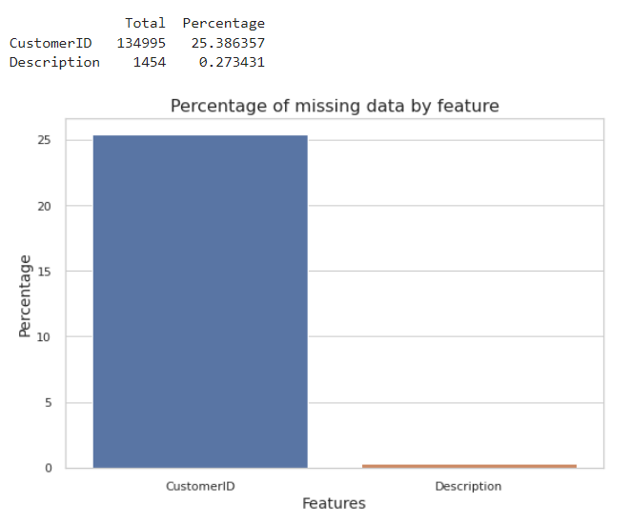
Spread of Missing values
We can observe that 25% of CustomerID values are missing.
This can be handled in multiple ways. One such way is by imputing it with a random number.
It is possible to impute customerID based on unique value of InvoiceNo, but there will be a big inaccuracy in matching cancelled transactions. Because we have observed that the corresponding purchase and cancelled transaction do not have same InvoiceNo.
And this kindof purchase will be likely to be a one-time purchase as customers who shop frequently would probably create an account for ease of purchasing.
So, we have dropped those missing values.

Slide 7
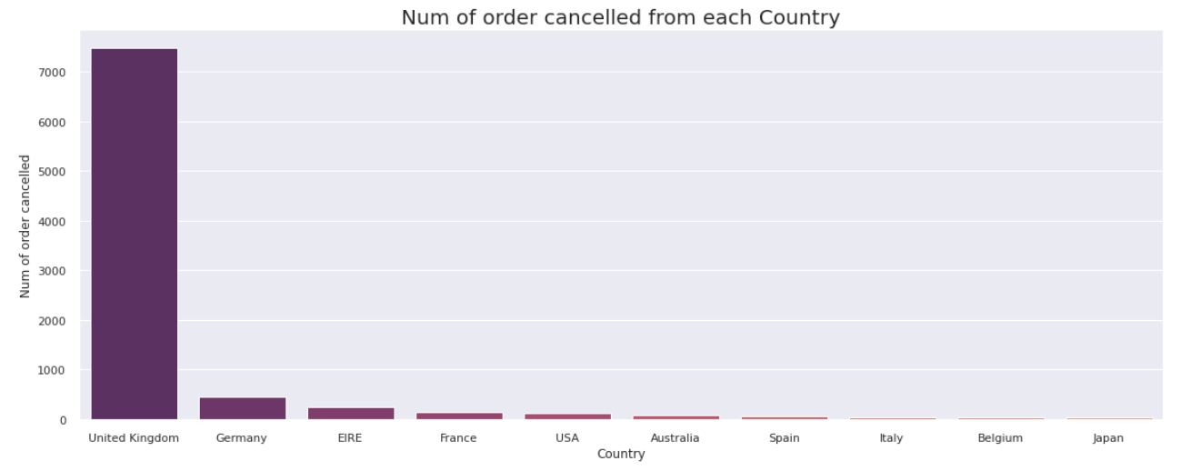
Exploratory Data Analysis
Maximum number of order cancellation done from United Kingdom.

Slide 8
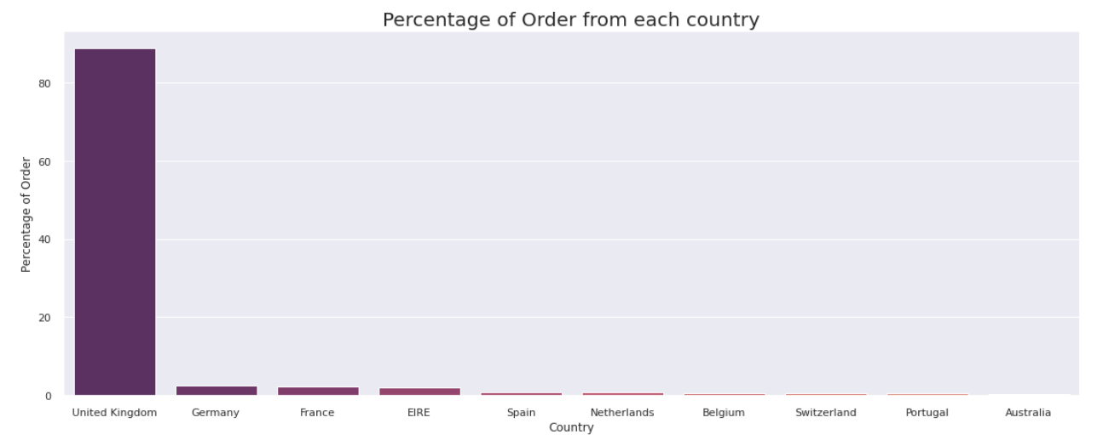
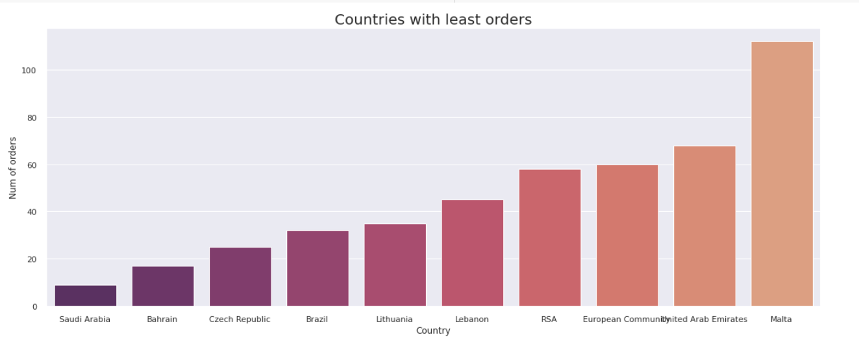
Exploratory Data Analysis (contd.)
About 88.8% of orders are coming from UK, so we can say that most customers and most orders will be from United Kingdom.
We have least number of orders and customers from Saudi Arabia.

Slide 9
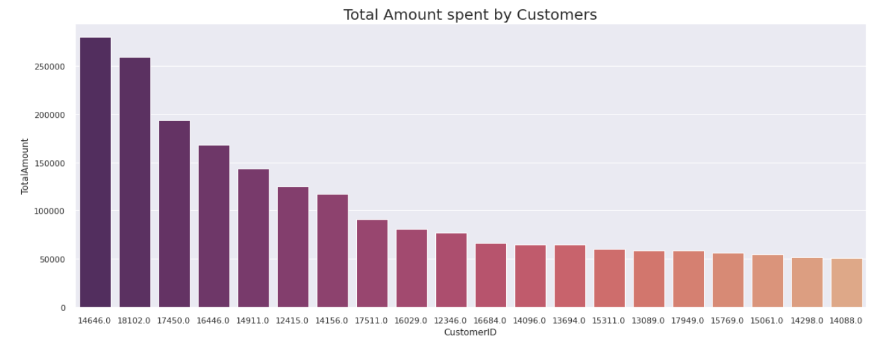
Exploratory Data Analysis (contd.)
CustomerID - 14646, spends more money on shopping.

Slide 10
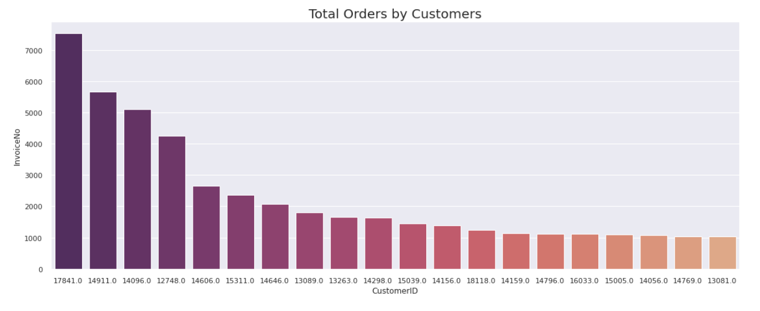
Exploratory Data Analysis (contd.)
CustomerID - 17841 is a shopaholic, who shops/orders more.

Slide 11
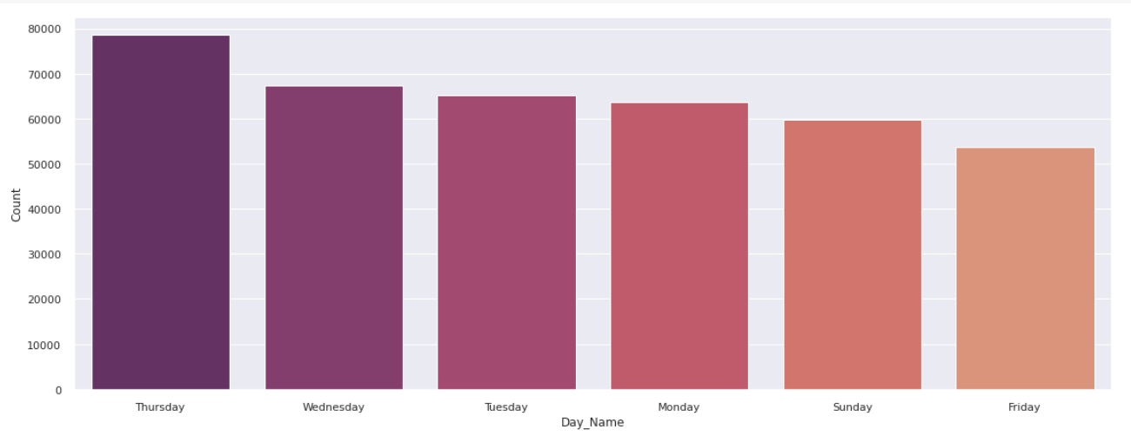
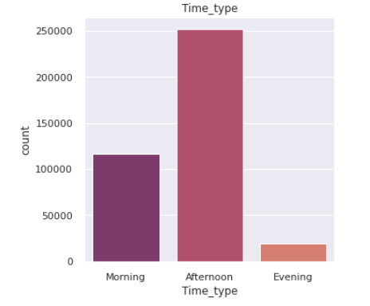
Exploratory Data Analysis (contd.)
Shopping will happen mostly on weekdays and it will be more during afternoon.

Slide 12
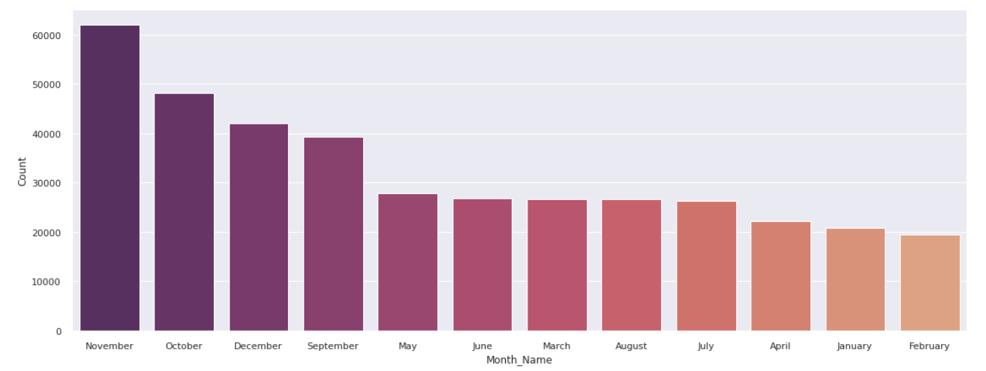
Exploratory Data Analysis (contd.)
Shopping will be more during the festival season.

Slide 13
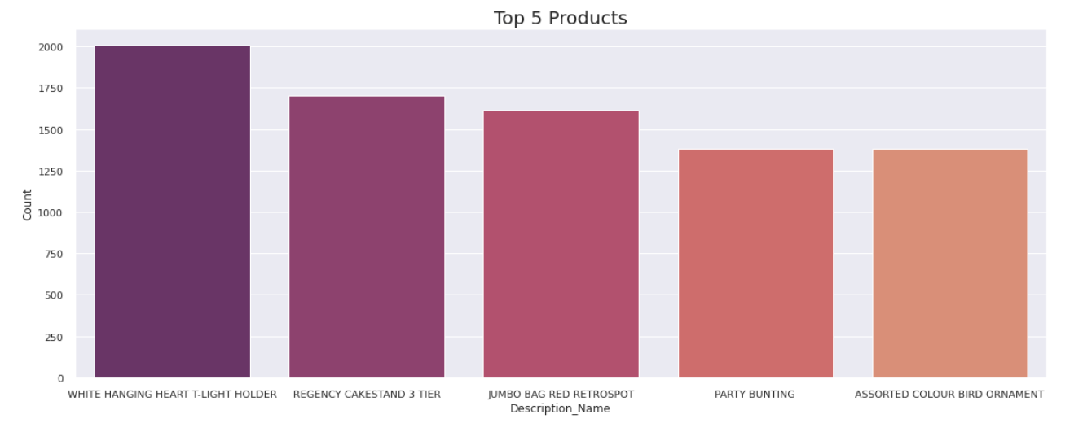
Exploratory Data Analysis (contd.)

Slide 14
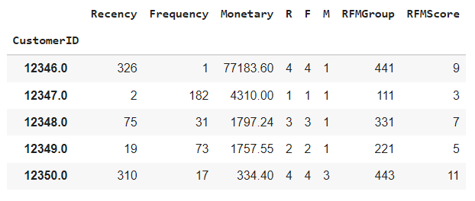
Applying the Model
RFM Model
Best Customers– This group consists of those customers who are found in R-Tier-1, F-Tier-1 and M-Tier-1 i.e.,1-1-1, meaning that they transacted recently, do so often and spend more than other customers.
High-spending New Customers– This group consists of those customers in 1-4-1 and 1-4-2. These are customers who transacted only once, but very recently and they spent a lot.
Lowest-Spending Active Loyal Customers – This group consists of those customers in segments 1-1-3 and 1-1-4 (they transacted recently and do so often, but spend the least).

Slide 15
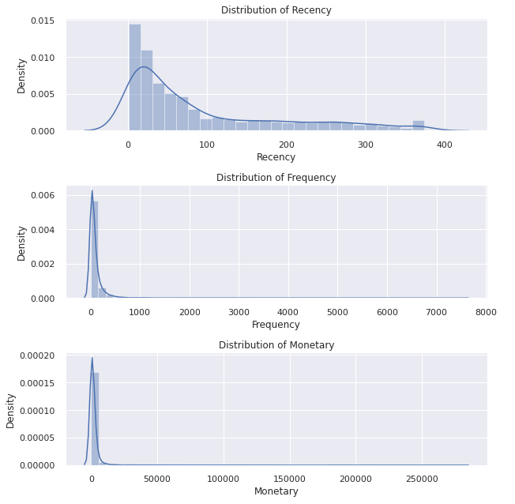
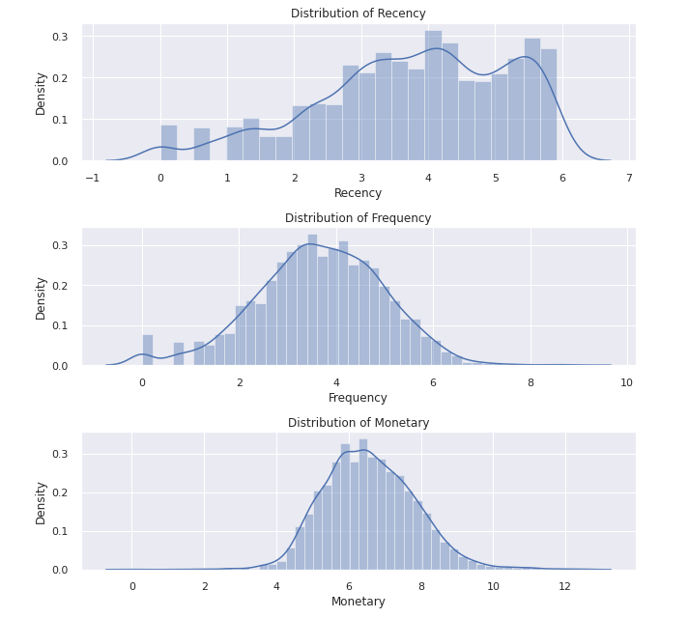
Applying the Model (contd.)
RFM Model
log

Slide 16
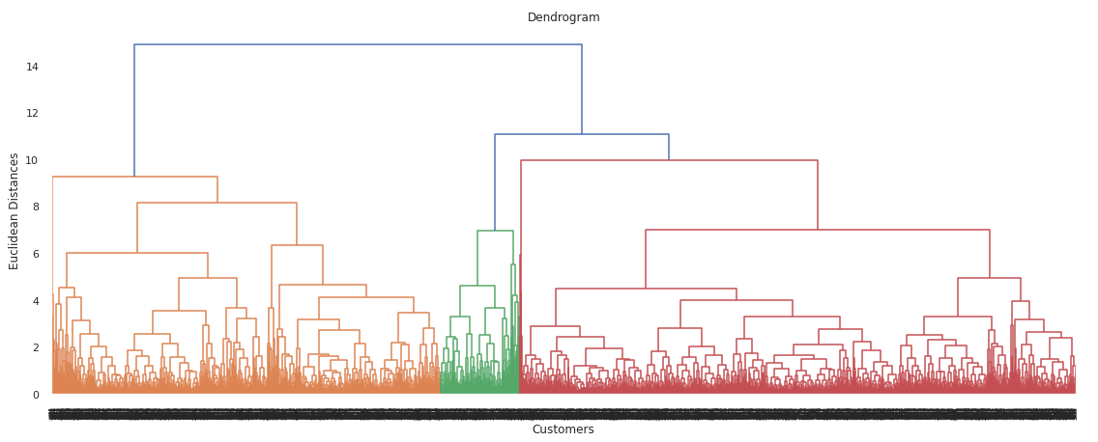
Applying the Model (contd.)
Hierarchical Clustering
Complete Linkage:

Slide 17
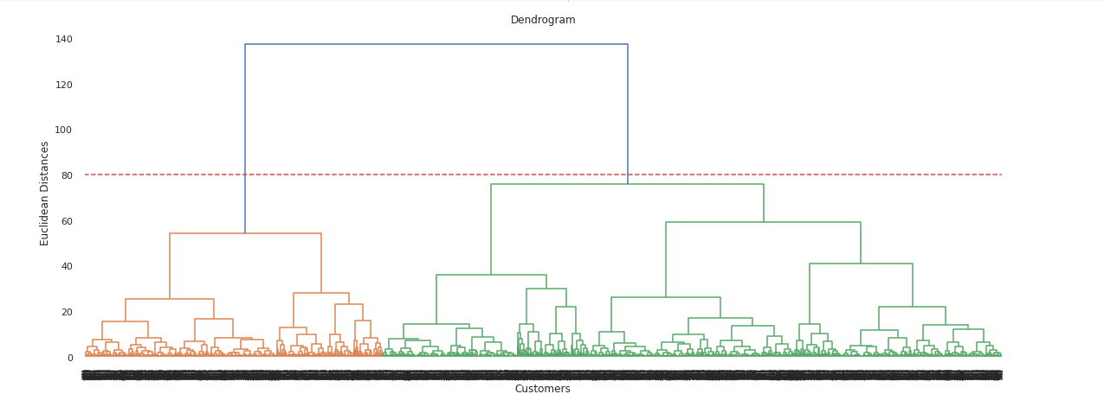
Applying the Model (contd.)
Hierarchical Clustering
Ward’s Linkage:

Slide 18
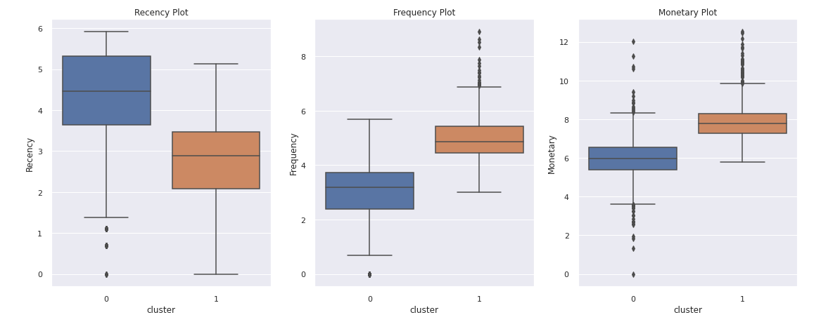
Applying the Model (contd.)
Hierarchical Clustering

Slide 19
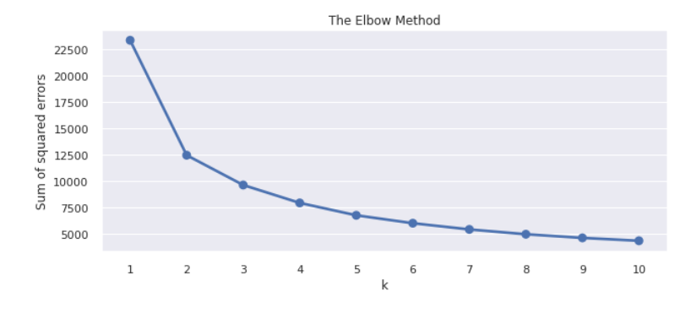
Applying the Model (contd.)
Kmeans Clustering
To identify ‘K’ value, we will be using Silhouette score and Elbow method.

Slide 20
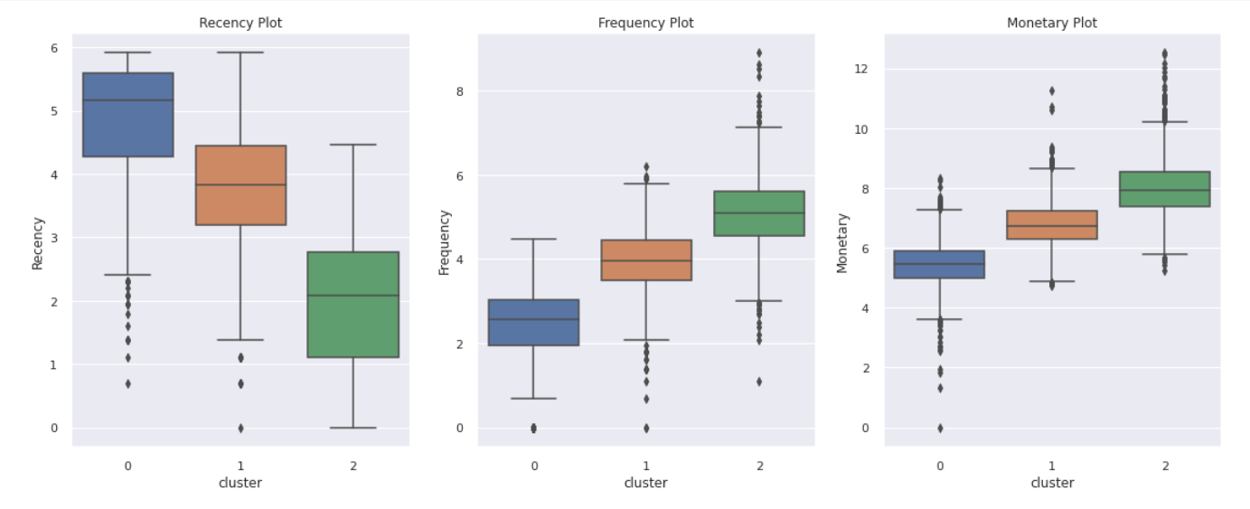
Applying the Model (contd.)
Kmeans Clustering

Slide 21
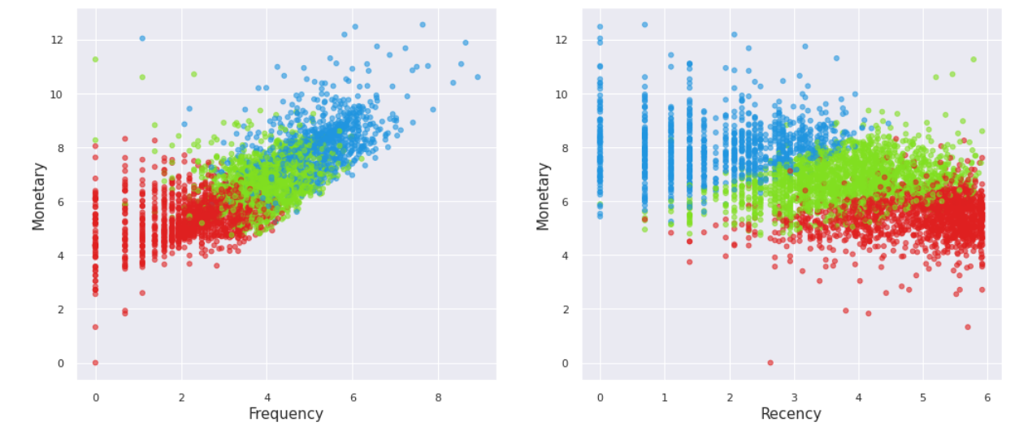
Applying the Model (contd.)
Kmeans Clustering

Slide 22
Conclusion
Segmentation is needed to drive higher profitability through understanding customer needs and delivering on those.
From the above analysis, we have majorly created 3 customer segments. They are as follows-
Low Value Customers 'Cluster 0' customers can be called Low valued customers because they are less frequent, spends less money and they have purchased long time ago.
Average value Customers 'Cluster 1' customers can be called has Average valued customers because they are some what more recent, frequent and spend some what more money compared to Low value customers. These customers could become high risk and we should aggressively market towards them with great deals so we don't lose them forever.

Slide 23
Conclusion (contd.)
High value Customers 'Cluster 2' customers can be grouped has High valued customers because they are very recent (shopped recently), more frequent and spend more money aswell. These are our best or potential customers we should not lose them.Communications with this group make them feel valued and appreciated. These customers likely generate a disproportionately high percentage of overall revenues and thus focusing on keeping them happy should be a top priority. Further analyzing their individual preferences and affinities we can provide additional opportunities for even more personalized messaging.

Slide 24
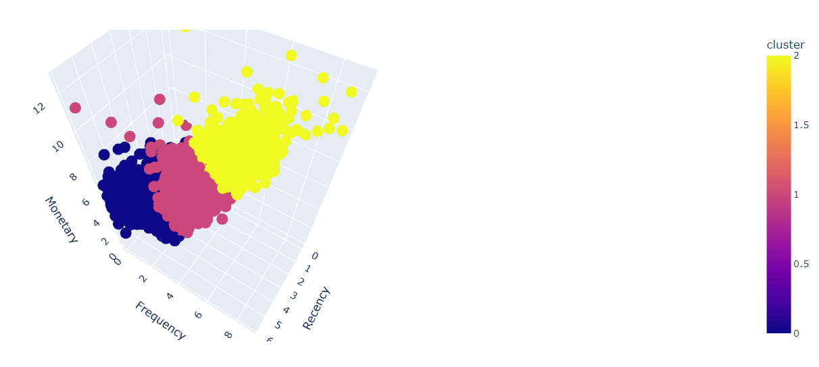
Conclusion (contd.)
3D Representation of customer segments

Slide 25
Thank You

