Slide 1
Shruthika L (2021503557)
Department of Computer Technology
Madras Institute of Technology
Anna University, Zone - IV
Final Project
3/21/2024 Annual Review

Slide 2
PROJECT TITLE
YOUTUBE VIDEO TRANSCRIPT GENERATOE
3/21/2024 Annual Review

Slide 3


AGENDA
Creating a YouTube video transcript generator involves several key agendas to ensure its effectiveness and usefulness. First and foremost, the primary goal is accuracy. The tool must accurately transcribe the spoken words in the video without significant errors. Efficiency is also crucial, as users value quick turnaround times. Providing customization options enhances user experience, allowing users to specify language, formatting preferences, and content inclusion/exclusion.
Accessibility is paramount, ensuring that transcripts are easy to read and comprehend,
catering to users with different needs. Optimizing transcripts for SEO is essential for
improving search engine visibility. Multilingual support broadens the tool's appeal,
while integration with platforms like YouTube streamlines workflows.
Cost-effectiveness is vital for user adoption, and ensuring privacy and security of user
data is a priority. Finally, continuous improvement based on user feedback ensures
that the generator evolves to meet changing user needs and expectations over time.
3/21/2024 Annual Review

Slide 4

PROBLEM STATEMENT
The YouTube Video Transcript Generator automates accurate transcript creation for YouTube videos, using advanced NLP and speech recognition tech. It saves creators time by swiftly transcribing spoken content, especially useful for those with large libraries. Leveraging Python libraries like speech_recognition and nltk, it processes audio tracks and applies NLP algorithms for faithful transcripts. This tool empowers creators, improving accessibility and searchability, enhancing the viewing experience.
3/21/2024 Annual Review

Slide 5

PROJECT OVERVIEW
The YouTube Video Transcript Generator is a project designed to automate the process of creating accurate and detailed transcripts for YouTube videos. By automatically transcribing spoken content into text, the generator enables creators to quickly obtain accurate transcripts for their videos. This feature is especially beneficial for creators with extensive video libraries or those seeking to improve accessibility for viewers. Utilizing Python libraries such as speech_recognition and nltk, the generator is capable of processing audio tracks from YouTube videos and converting speech to text. Additionally, it employs NLP algorithms for improved accuracy and context understanding, ensuring the generated transcripts reflect the spoken content faithfully. The YouTube Video Transcript Generator empowers content creators by providing a reliable and efficient tool for generating high-quality transcripts. With its seamless integration of NLP and speech recognition technologies, the generator aims to enhance the accessibility and searchability of YouTube content, ultimately improving the overall viewing experience for audiences.
3/21/2024 Annual Review

Slide 6

WHO ARE THE END USERS?
1. Content Creators: YouTube creators who want to improve the accessibility of their videos by providing accurate transcripts. They may also use transcripts for repurposing content into other formats like blog posts or ebooks.
Viewers with Hearing Disabilities: Individuals who are deaf or hard of hearing rely on transcripts to access the content of videos. Transcripts provide them with a textual representation of the spoken words and any other audio elements in the video.
Language Learners: People learning a new language may use transcripts to follow along with the spoken dialogue more easily. Transcripts allow them to read along while listening, which can aid comprehension and vocabulary acquisition.
SEO Professionals: Transcripts can be used for search engine optimization (SEO) purposes. By providing accurate transcripts, content creators can improve the discoverability of their videos since search engines can crawl and index the text.
Researchers and Academics: Scholars and researchers may use transcripts for studying content, analyzing language patterns, or conducting research on topics covered in the videos.
These end users span various industries and sectors, highlighting the potential widespread application of the neural style transfer system.
3/21/2024 Annual Review

Slide 7

YOUR SOLUTION AND ITS VALUE PROPOSITION
Solution:
The YouTube Video Transcript Generator automates transcript creation by extracting audio, converting it to text via speech recognition, refining it with NLP techniques, and formatting it for clarity. Rigorous testing ensures accuracy, and integration into a user-friendly tool completes the process. Continuous improvement through feedback ensures it meets evolving user needs.
3/21/2024 Annual Review

Slide 8
YOUR SOLUTION AND ITS VALUE PROPOSITION
Value Proposition:
The YouTube Video Transcript Generator offers creators a streamlined content creation process by automating transcription. It saves time, improves accessibility, and enhances professionalism through accurate, detailed transcripts. This empowers creators to produce engaging, inclusive content efficiently, ultimately boosting engagement and reach on the platform.
3/21/2024 Annual Review

Slide 9

THE WOW IN YOUR SOLUTION
The wow factor in our YouTube Video Transcript Generator solution is its seamless
integration of cutting-edge technology to revolutionize content creation. By automating the
transcription process with precision and speed, it liberates creators from tedious manual work,
unlocking their creative potential. Its ability to produce accurate, detailed transcripts not only
enhances accessibility but also elevates the professionalism of content, setting creators apart
a competitive landscape. With a user-friendly interface and continuous improvement driven by
user feedback, our solution promises to wow creators with its efficiency, effectiveness, and
transformative impact on their YouTube journey.
3/21/2024 Annual Review

Slide 10
MODELLING
The project utilizes several frameworks and libraries for various tasks in deep learning and data preprocessing. Here's a list of frameworks and libraries used:
1. TensorFlow: TensorFlow is a powerful open-source machine learning library developed by Google. It's widely used for building and training deep learning models, including convolutional neural networks (CNNs) for image classification.
2. Keras: Keras is a high-level neural networks API written in Python and compatible with TensorFlow. It provides a user-friendly interface for building and training deep learning models, making it easier to prototype and experiment with different architectures.
3. NumPy: NumPy is a fundamental package for scientific computing with Python. It provides support for multi-dimensional arrays and matrices, along with a collection of mathematical functions to operate on these arrays, making it essential for data manipulation and numerical computations.
3/21/2024 Annual Review

Slide 11
MODELLING
4. Pandas: Pandas is a fast, powerful, and flexible open-source data analysis and manipulation library built on top of NumPy. It provides data structures like DataFrame for handling structured data and tools for data cleaning, reshaping, and analysis.
5. Matplotlib: Matplotlib is a comprehensive library for creating static, animated, and interactive visualizations in Python. It's commonly used for plotting graphs, histograms, scatter plots, etc., to visualize data and model performance.
6. Plotly Express: Plotly Express is a high-level interface for creating expressive and interactive visualizations using Plotly. It provides easy-to-use functions for generating various types of plots, including pie charts, line plots, scatter plots, etc.
7. SciPy: SciPy is a library used for scientific and technical computing in Python. It provides modules for optimization, integration, interpolation, linear algebra, and more, making it useful for various numerical computations and statistical analysis.
These frameworks and libraries collectively provide a robust ecosystem for building, training, and analyzing deep learning models for image classification tasks.

Slide 12
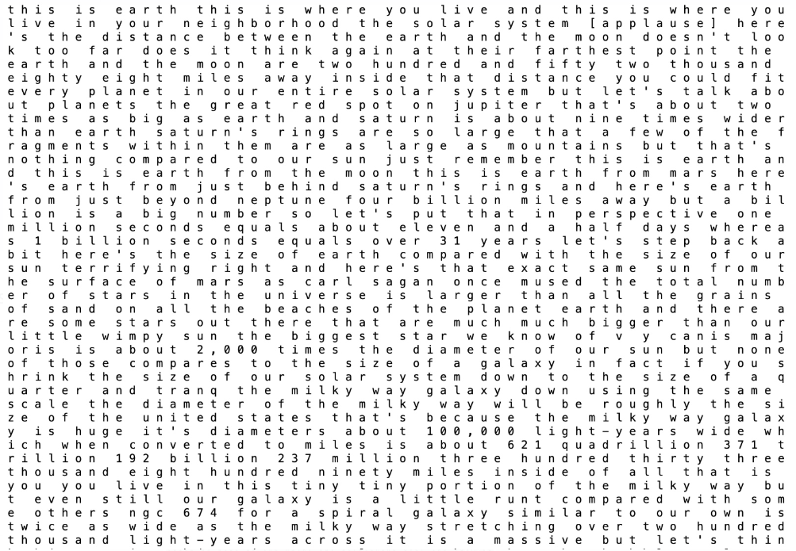
RESULTS
3/21/2024 Annual Review

Slide 13
Thank you!

