Slide 1

WindWatch AI
Capstone Project · Machine Learning · AWS
Wind Turbine Operating-Status Prediction using Machine Learning
MENTOR
DEVELOPED BY
Rithik Raj
Shrushti Malkar
Notes:
Good morning everyone. This is WindWatch AI, our capstone project. It reads the sensor data of a wind turbine and predicts what state the turbine is in, then offers that as a web application hosted on AWS. I am Shrushti Malkar, and this project was guided by my mentor Rithik Raj. In the next minutes I will explain the problem, what has been done before, what we did, and I will show a live demo.

Slide 2



Introduction, problem and motivation
Introduction
Problem statement
Why we built it
Turbines log 81 sensor values every 10 minutes (SCADA)
Every record also has a status code
160,637 records from 2 turbines, 2019–2023
Nobody can check every sensor by hand
The data is messy: a hidden header row turned every number into text
Only 2% of records are the rare “service” status
Predict the status automatically, with a confidence score
Flag abnormal states early to reduce downtime
Let anyone use the model through a web app
Notes:
Introduction: a wind turbine records dozens of sensor values every ten minutes. This is called SCADA data. In our file there are 160,637 records from two turbines.
Problem: operators cannot read every sensor all day, so we want the computer to tell the turbine's state. Also the Excel file was dirty: a header row was repeated in the middle, so every number column was read as text. And the classes are very unbalanced; only about 2 percent of records are the 'service' state.
Motivation: predict automatically, warn early, and make it usable by anyone through a web app.
If asked: SCADA = Supervisory Control and Data Acquisition, the system that logs turbine signals.

Slide 3

Aim and objectives
1
Clean the messy raw Excel data
2
Explore it with 8 charts
AIM
3
Compare 4 machine-learning models
Build and deploy an end-to-end machine-learning system that predicts a wind turbine's operating status from SCADA sensor data, usable by anyone through a web app on AWS.
4
Select the best using macro-F1
5
Build a web app with 3 input modes
6
Deploy on AWS (Beanstalk, EC2, App Runner)
Notes:
Our aim is one sentence: build and deploy an end-to-end ML system that predicts turbine status and make it usable through a web app on AWS.
To reach it we set six objectives: clean the data, explore it with eight charts, compare four models, choose the best one with a suitable metric, build a web app with three ways to enter data, and prepare deployment on AWS. The full report lists eight objectives; these six are the grouped version.

Slide 4



Background: the data and the target
SCADA data
10-minute records, 81 sensor statistics (average, min, max, std). Names are anonymised.
Status codes
0 = normal, 3 = service, 5 = other downtime (standard convention; to be confirmed with the data owner).
Class imbalance
One class dominates, so plain accuracy is misleading. We use class weights and macro-F1.
Notes:
Background. SCADA records are taken every ten minutes with four statistics per signal: average, minimum, maximum and standard deviation, giving 81 sensor columns.
The target is the status code with three values. The doughnut shows the imbalance: 78.8 percent normal, 19.1 percent other downtime, only 2.1 percent service.
Because one class dominates, a model that always says 'normal' would already be about 79 percent accurate and totally useless. That is why we use class weights and macro-F1.
If asked what the codes mean: we used the common SCADA convention, but the file has no data dictionary, so this is an assumption that should be confirmed with the data owner. The model itself does not depend on the names.

Slide 5
Previous work vs. what we do extra
Previous work
What we do extra
Mostly component faults and anomaly detection
Judged by accuracy; imbalance often ignored
Papers and experiments, rarely a usable tool
Clean benchmark data is assumed
Predict the general operating status
Repair a real messy file (hidden header bug)
Choose the model by macro-F1; show per-class results honestly
Web app: single reading, pasted row or upload
Explain each prediction; AWS-ready
VS
Notes:
This slide is the research gap. Previous work is mostly about component faults and anomaly detection, usually judged by accuracy, and mostly stays in papers.
What we add: we predict the general operating status; we documented and repaired a real messy data file; we choose the model by macro-F1 and show per-class results, including where the model fails; we built a web application with three input modes and explanations for each prediction; and the project is ready for deployment on AWS.

Slide 6
Methodology (1): workflow and data cleaning
Load
Clean
Transform
Explore
Model
Evaluate
Deploy
1
2
21
154,132
hidden header row inside the data made every number column read as text
empty rows and 2 constant columns removed
redundant sensors dropped (correlation > 0.98): 61 features left
training rows; 6,505 hold-out rows from the dataset's own split
Notes:
Methodology part one. Seven steps: load, clean, transform, explore, model, evaluate, deploy.
Cleaning was the first surprise. Two turbine files had been joined and the second header row stayed inside the data, so pandas read every numeric column as text. We removed that row, the two empty rows and two constant columns, converted types, and checked for duplicates; none were found. No valid record was lost: 160,637 remain.
Transformation: we added hour and month, dropped 21 sensors that were more than 98 percent correlated with another, leaving 61 features, and used the split that the dataset provides: 154,132 training rows and 6,505 hold-out rows. Imputation and scaling sit inside the model pipeline so no test information leaks into training.

Slide 7
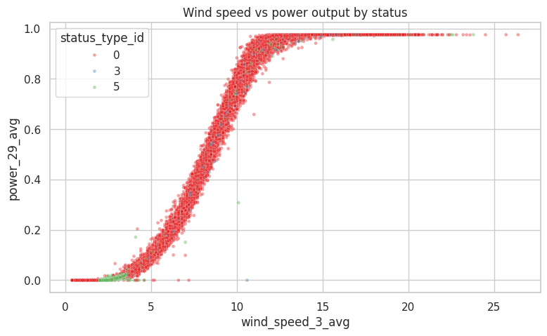
Methodology (2): what the data tells us
50.1%
of readings below 4 m/s are status 5 (only 2.9% at 8 m/s or more)
Status 3 overlaps normal operation, so it is the hardest class
Status 5 follows the night and early-morning wind pattern
8 charts: class balance, time, power curve, box-plots, density, hour, correlations
Wind speed vs. power, coloured by status
Notes:
Exploration. The chart is the classic power curve: power rises with wind speed in an S shape. Status 5 points sit at the bottom left, where the wind is too weak to produce power. Half of all readings below 4 metres per second are status 5, compared with only 2.9 percent at 8 or more.
So we expected status 5 to be easy. Status 3 occurs at ordinary wind speeds and overlaps normal operation in most sensors, so we expected it to be hard. The results confirmed both.
We made eight charts in total: class distribution, status over time, power curve, box-plots, density plots, status by hour, correlation ranking and a heat-map. They are in the report, chapter 10.

Slide 8
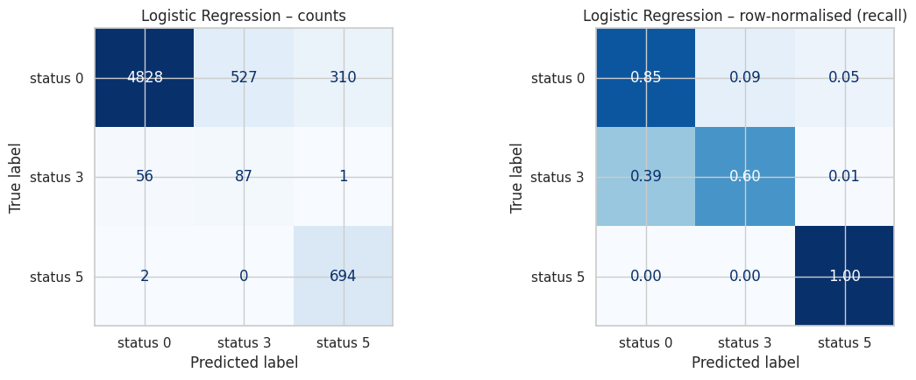
Methodology (3): four models, one fair test
Logistic Regression: confusion matrix
Selected: Logistic Regression
macro-F1 0.654 · recall 0.82 · no overfitting
Trees: 96% accuracy, but found 0–2 of 144 rare status-3 records
Notes:
We compared four models with the same pipeline, same seed and class weighting: Logistic Regression, Decision Tree, Random Forest and Histogram Gradient Boosting, tested on 6,505 hold-out records.
Look at the grey bars: the three tree models have about 96 percent accuracy, Logistic Regression only 86. But the red bars show status 3: Random Forest and Gradient Boosting found none of the 144, the Decision Tree 2. Logistic Regression found 87, which is 60 percent. It also has the best macro-F1 of 0.654 and the best macro-recall of 0.82, and its train and test scores are almost equal, so it does not overfit, while Random Forest scores 0.999 on training and 0.635 on test.
Honest limitation: Logistic Regression raises many false alarms for status 3 (precision 0.14) and misclassifies about 15 percent of normal records. The margin in macro-F1 is small. The choice depends on cost: missing a non-normal state is usually worse than a false alarm.
If asked why not accuracy: 79 percent of rows are status 0, so accuracy rewards ignoring the rare classes.

Slide 9
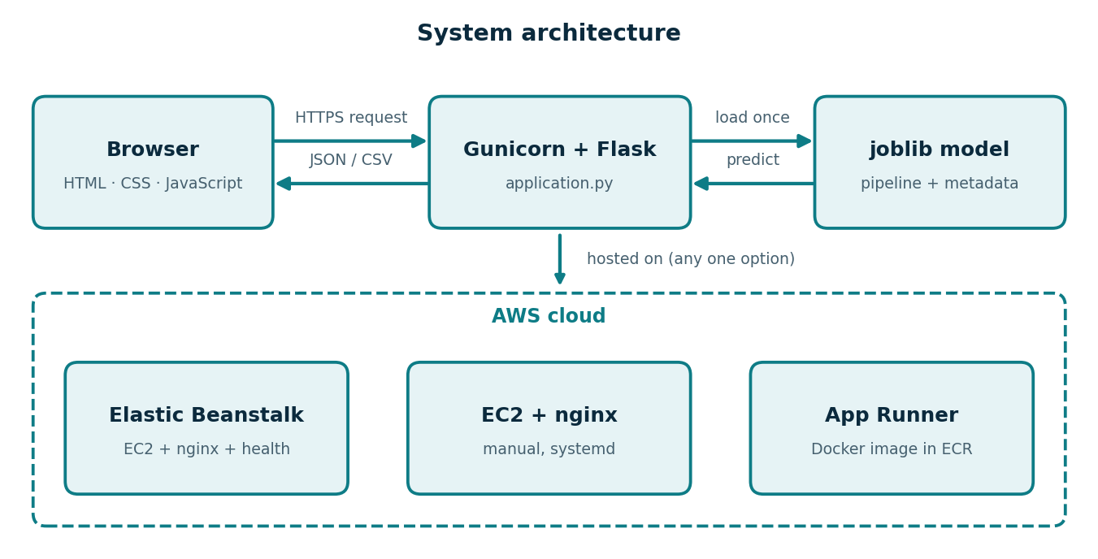



Methodology (4): web app and AWS deployment
Elastic Beanstalk
easiest: upload the folder
EC2 + nginx
full control, systemd service
Docker + App Runner
container with HTTPS URL
joblib file → Flask API → browser; hosted on AWS
Health check: /health · 50 MB uploads
Notes:
Deployment. The trained pipeline, with its imputer and scaler, is saved in one joblib file together with the feature list, typical values, metrics and sample rows. A Flask application loads it once and offers endpoints: one for a single row, one for a file upload and a health check. Gunicorn runs Flask in production.
We prepared three ways to host it on AWS: Elastic Beanstalk, the easiest, where you just upload the folder; EC2 with nginx, which gives full control; and Docker with App Runner, which gives an HTTPS address automatically. We also raised nginx's default 1 MB upload limit to 50 MB because the app accepts datasets.
If asked whether it is already live: the files and the step-by-step guide are ready; the demo today runs from the same code.

Slide 10
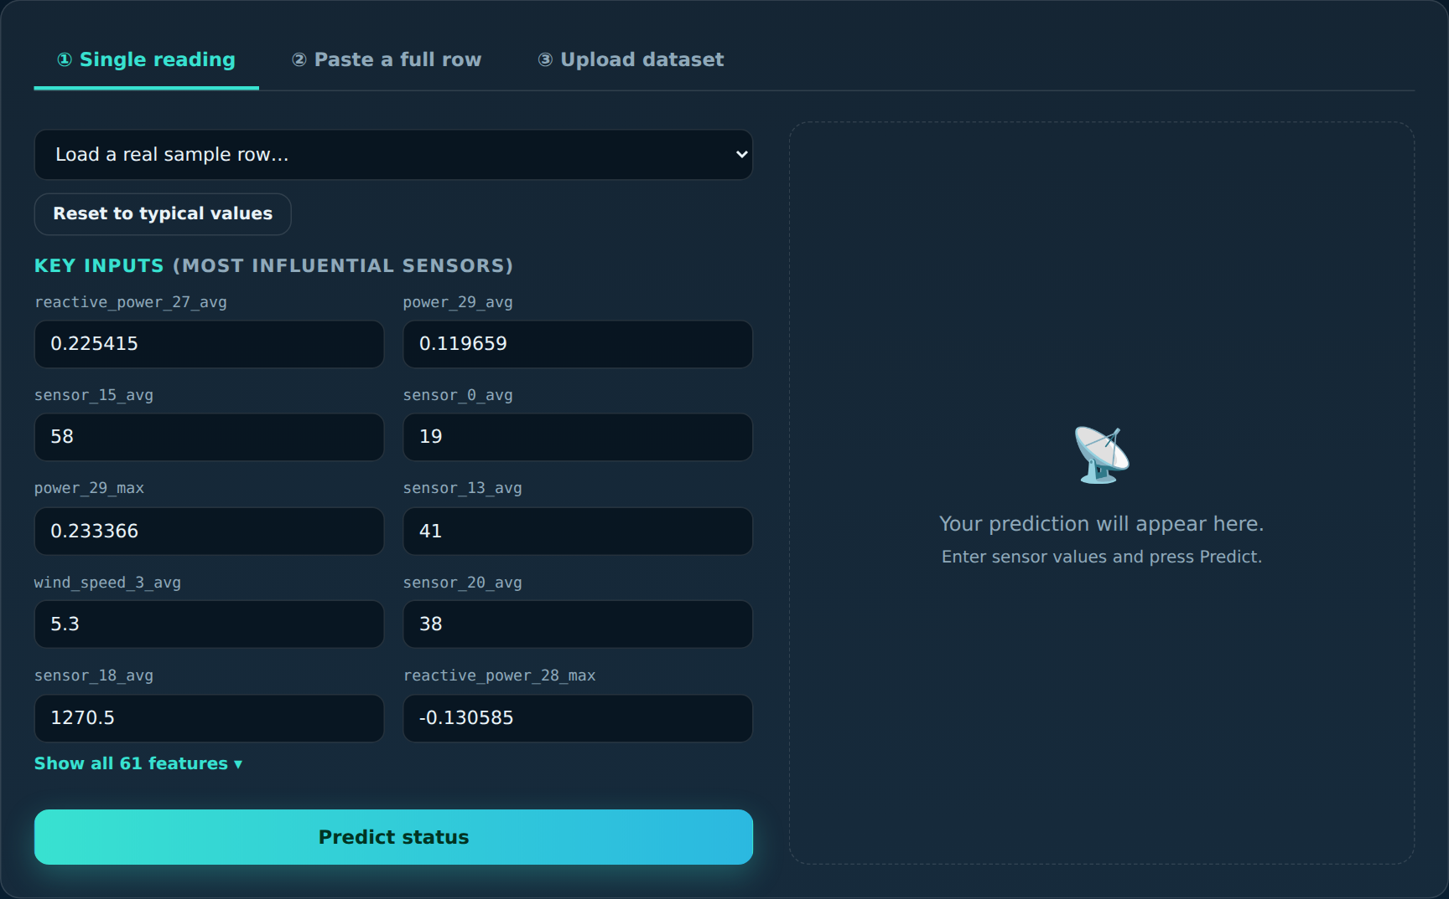
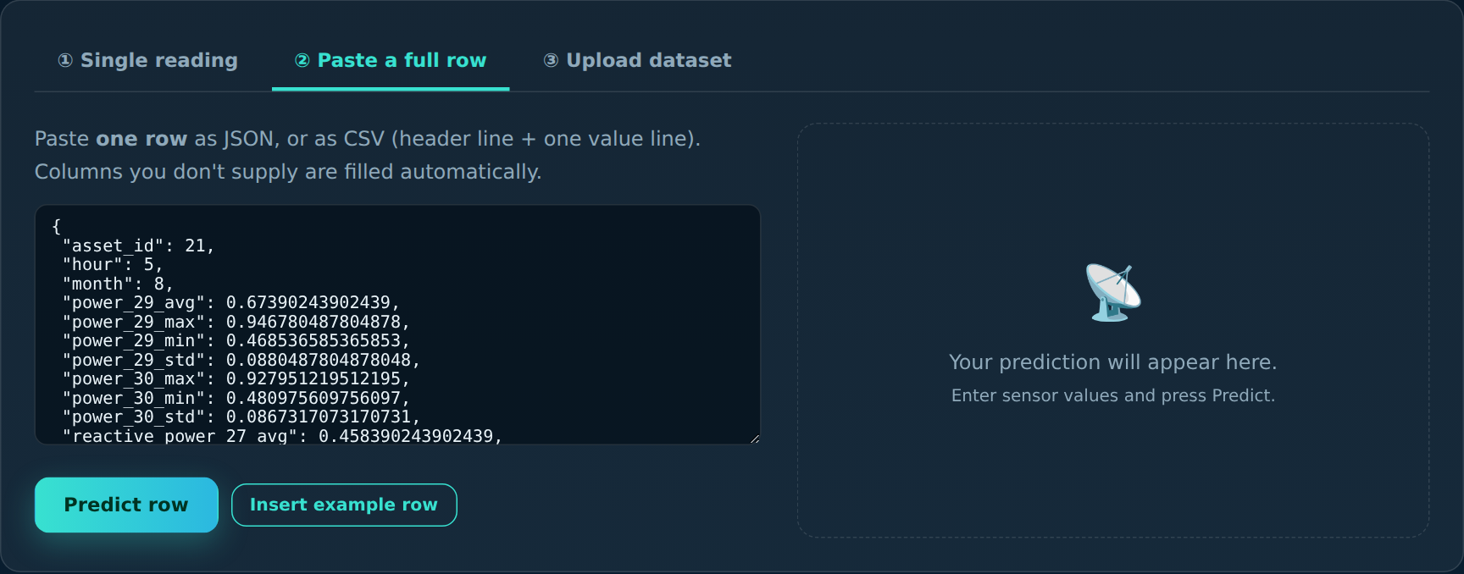
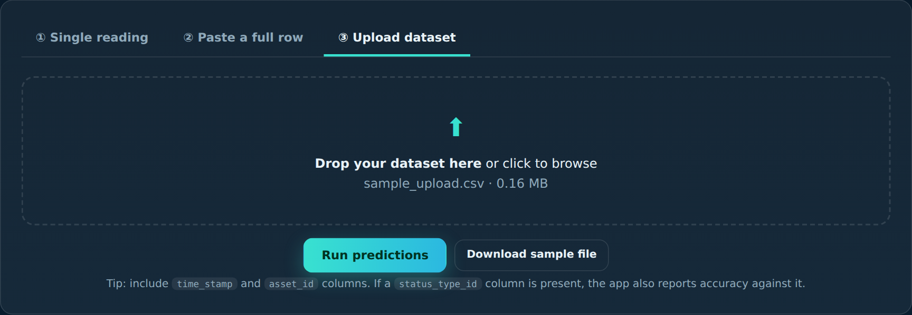
Input: three ways to give data
② Paste a full row JSON or CSV text
① Single reading edit sensors one by one
③ Upload dataset CSV or Excel
Notes:
Live demo cue. The application has three input modes.
One: a single reading. The ten most influential sensors are shown as editable fields with typical values already filled in, and an expandable list for all 61 features. A drop-down loads real rows from the hold-out set.
Two: paste a complete row as JSON or as CSV text. Anything missing is filled automatically.
Three: upload a CSV or Excel dataset. The app cleans it with the same rules as the notebook. If your file contains the real status column, it also reports accuracy.
Demo suggestion: load a 'Service' sample, press Predict, then upload sample_upload.csv.

Slide 11
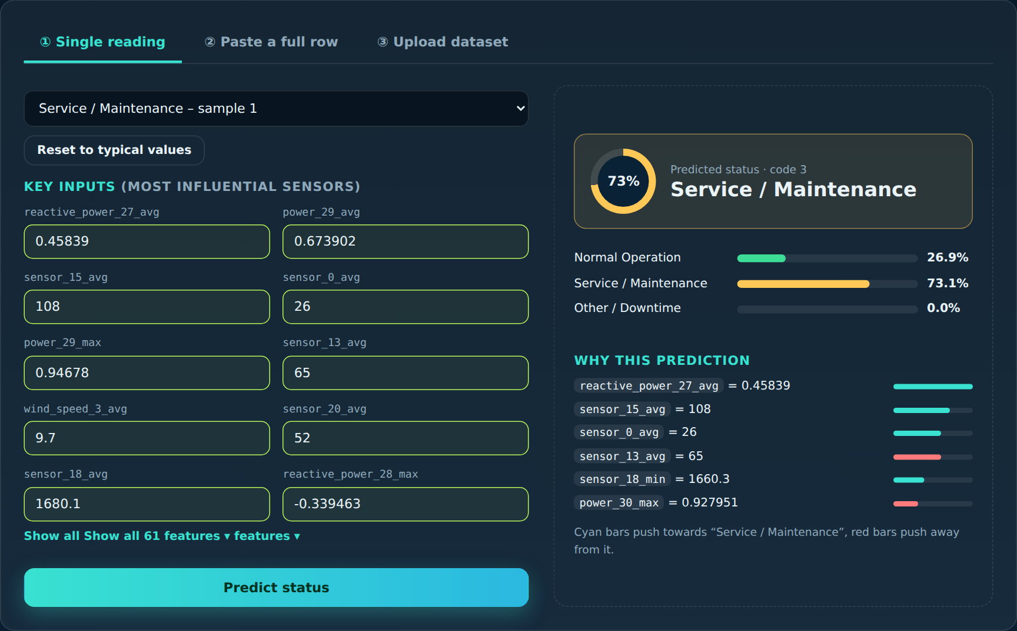
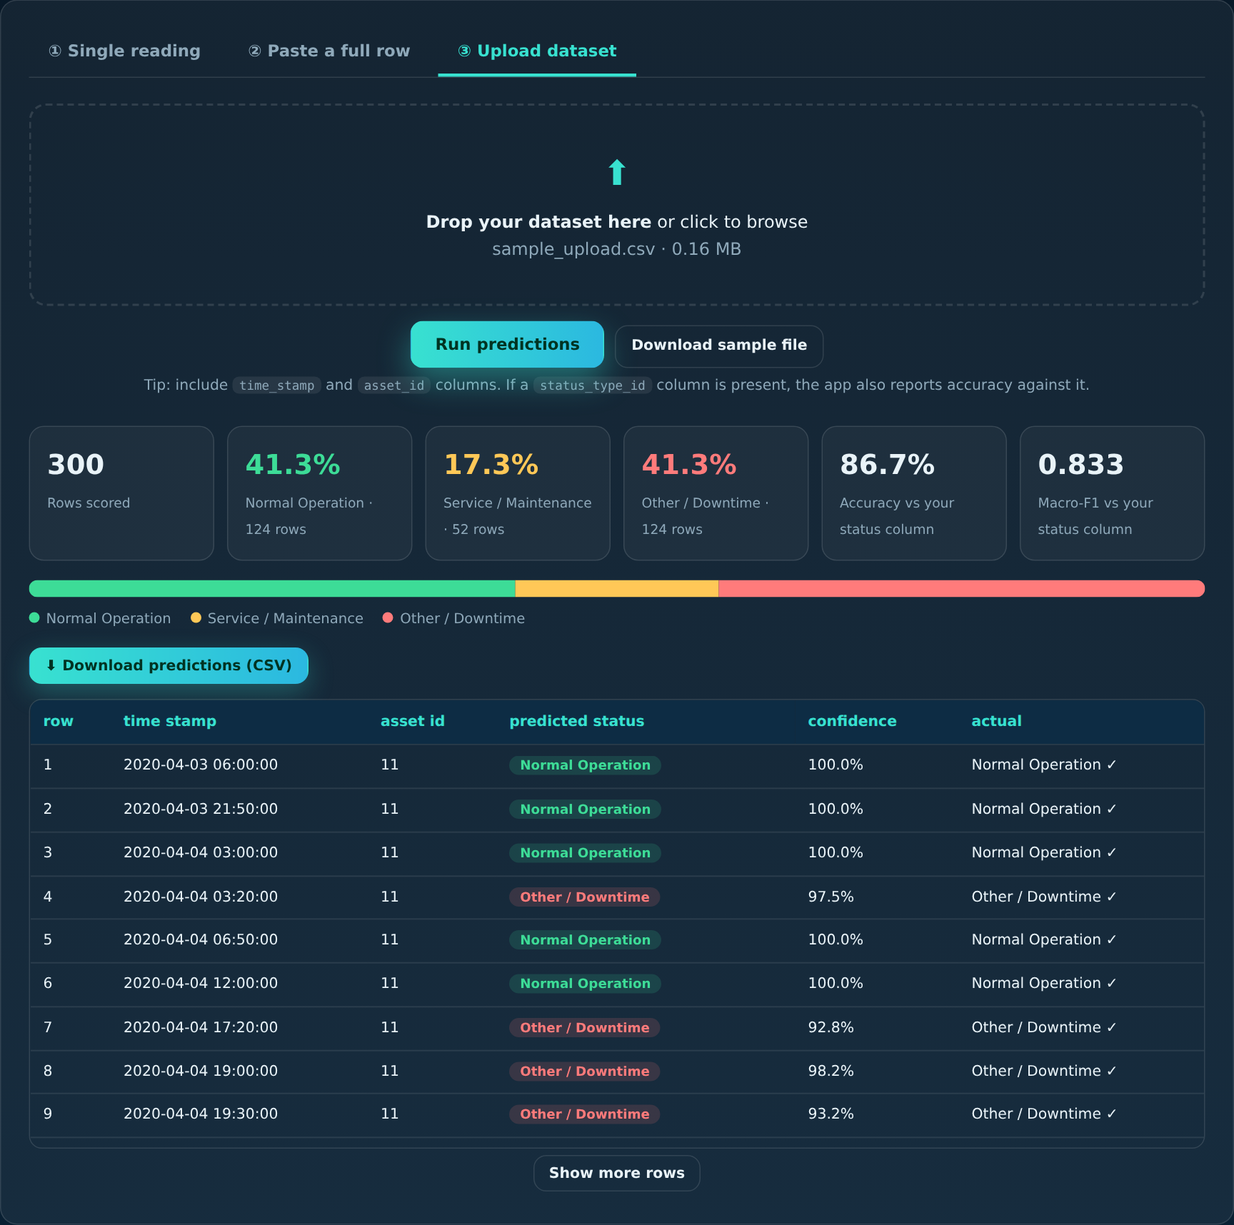
Output: prediction and batch results
Predicted status, confidence ring, class probabilities and the sensors that drove the decision
Upload results: class shares, accuracy 86.7% on the demo file, downloadable CSV
Notes:
Output. On the left, a single prediction: this is a real hold-out record whose true status is 3, and the model predicts service with 73 percent confidence. You see the probability of each class and the six sensors that pushed the decision; cyan bars push towards the predicted class, red bars away from it.
On the right, a dataset upload: it shows the share of each predicted status, the accuracy against the real status column, and a table with a downloadable CSV. The demo file is deliberately balanced, so its 86.7 percent accuracy and 0.833 macro-F1 are higher than the real hold-out macro-F1 of 0.654; do not quote them as the expected performance.

Slide 12
Conclusion and future scope
Conclusion
Future scope
Cleaned 160,637 records and predicted status from 61 sensor features
Logistic Regression won on macro-F1 (0.654) and found 60% of the rare status 3
Accuracy alone would have hidden the failure of the 96%-accurate tree models
Delivered as a Flask web app with explanations, ready for AWS
SMOTE and threshold tuning to improve status 3
Rolling-window and lag features for time patterns
SHAP explanations for stronger models
Early fault detection, monitoring and login on AWS
Notes:
Conclusion: we built the full path from a messy spreadsheet to a deployed web service. The main lesson is technical: a 96 percent accurate model can still completely miss the rare state, so metrics must match the problem. Logistic Regression was chosen because it detects the rare state, generalises and is transparent, with the limitations stated openly.
Future scope: oversampling and threshold tuning for status 3, time-window features, SHAP explanations, public benchmark data and early fault detection, plus authentication and monitoring for production.
Thank you. I am happy to take questions.

Slide 13
Thank you!

